Slide 1
FIVE THINGS TO KNOW ABOUT EMAIL MESSAGES
Property of Indiana University of Pennsylvania, all rights reserved.
Created by: Krista Sarraf July 2018
Notes:
Hello and welcome to this writing center tutorial, five things to know about email messages. We think we know how and when to use email, but do we really? This tutorial will introduce you to the 5 fundamentals of email messages so that you can email with ease.

Slide 2
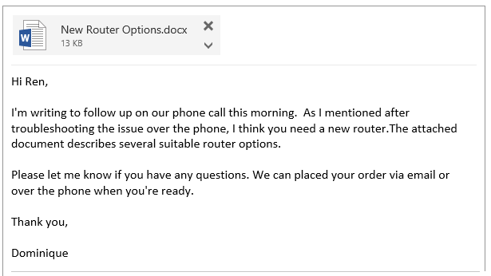
Email Explained
A short, quick form of electronic communication.
The most common type of written communication at work.
Highly social.
Notes:
You’re probably already familiar with email. For example, you know what an email looks like, and you’ve probably heard that an email is a short, quick form of communication that’s more formal than text messaging but less formal than a memo. But did you know that, in interviews with people who work in the cybersecurity field, email was identified as the most common type of writing people do? Other research confirms that email is the most prevalent form of written communication in the workplace. But did you know that email is highly social, meaning that how “good” an email is depends on the context? Let’s take a look at what this means.

Slide 3
Audience Awareness
Subject: Friday
Are we still good for coffee on Friday? At Sunshine Café? I can’t wait to see you! ☺
Notes:
Because email is social, the relationship between the reader and writer determines appropriate email etiquette. In the example on the screen, notice that the writer doesn’t use a formal greeting – they just start directly with the message. They also use a fragment sentence – “At sunshine café” and a smiley face emoticon. These choices that the writer has made makes this email rather informal. Since email is more formal than texting, is it okay that the writer is so informal here? The answer is that it depends. Let’s imagine that this email is being sent between two friends. In that case, it’s okay that this is less formal. But what if this is from an employee to the boss. Maybe some more formal language is in order.

Slide 4
Audience Awareness
Subject: Friday
Hi Tina,
Are we still good for coffee on Friday at Sunshine Café? I’m looking forward to it!
See you then,
John
Notes:
Here’s an example of how you might write differently if you’re writing to your boss. Maybe you would use a greeting and closing, correct the fragment, delete the emoticon, and say something a little more formal like “I’m looking forward to it” instead of “I can’t wait to see you.” Again, though, this is just an example. The point is that email etiquette and the level of formality depends on the audience and the relationship the writer has with the audience. Because email is social it’s rather complex, so let’s look at another, more complicated scenario.

Slide 5
Notes:
Let’s take a closer look at an email. Dominique works for an internet and cable company and Ren is one of Dominique’s customers. In this email, Dominique follows up with Ren about new router options. It looks like they tried to troubleshoot the router over the phone, but that didn’t do the trick. A few things to notice here. First, this email helps Dominique and Ren to work more efficiently. By giving Ren the router options in a document, Dominique can work on other projects until Ren is ready to order. Also, this email helps to continue a positive relationship between Dominique and Ren. Dominique is polite – notice the use of the phrase like “please let me know if you have any questions,” for example. Also, Dominique uses a basic template which keeps the message clear. By using the greeting “Hi Ren,” stating the purpose in the first line, including lengthy information in an attachment, and using a polite sign off, Dominique follows the conventions of email which keeps the message professional and clear. But one more thing. Notice that this email isn’t ready for Dominique to send.

Slide 6
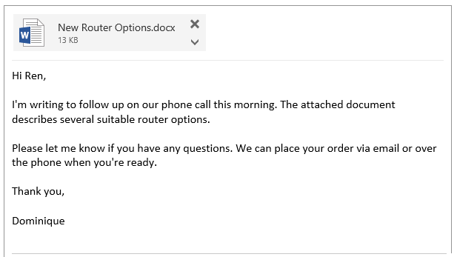
Notes:
Clear emails result from revision. Notice that Dominique has now revised the email to make it even clearer. Dominique deleted the sentence that described their phone conversation since it’s unnecessary. Also, Dominique corrected the typo – the initial email said “we can placed your order” and this one is corrected to “we can place your order.” Dominique knows that clear emails result from revision.

Slide 7
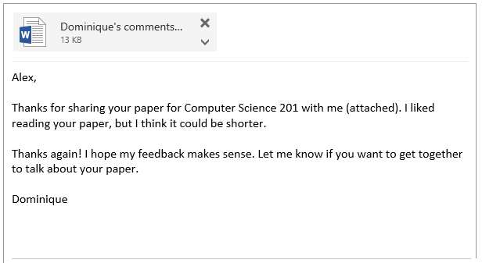
Notes:
Another important thing to know about email, though, is that clear emails differ across contexts. Previously, we looked at an email from Dominique to a customer. Now, let’s imagine Dominique is enrolled part-time in school and is taking a Computer Science class. Their professor asked the students to read and review each other’s papers. Here is Dominique’s email to a classmate, Alex. Notice that Dominique still uses a greeting and closing, but it’s less formal since “hi” and “thank you” are removed. Notice, also, that Dominique’s closing line is a little more conversational. Because Dominique and Alex are peers, Dominique says “I hope my feedback makes sense” to show humility and be more approachable. All in all, this is a clearly written email. However, this email has one main issue that makes it less effective. Notice that Dominique says “I liked reading your paper, but I think it could be shorter.” This isn’t particularly clear, and Alex may indeed write back with multiple questions. For example, what did Dominique like about the paper? Why does it need to be shorter? Since a main goal of email is to increase efficiency, Dominique needs to revise so that Alex won’t be confused about the message.

Slide 8
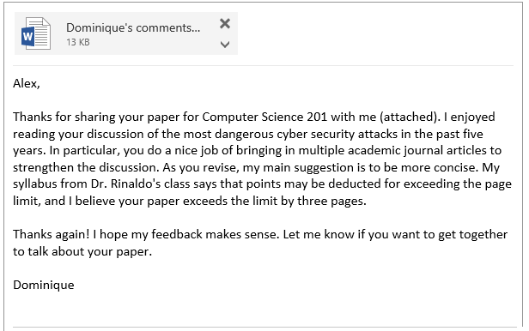
Notes:
Notice that, in this revision, Dominique says what’s strong about the paper – that it uses multiple academic sources. Dominique also says why the paper needs to be shorter – because there’s a page limit on the syllabus. Now, it’s less likely that Alex will be confused and need to request clarification.

Slide 9
Conclusion: The Five Things You Need to Know About Email Messages
Email messages differ across contexts.
Email messages should build, rather than break, relationships.
Email messages follow a basic template.
Email messages should be revised.
Email messages can help people to work efficiently.
Notes:
In conclusion, email is a powerful and commonly used tool for workplace communication. It’s important to remember that although clear email messages differ across contexts, the main goal of emailing is to make everyone’s work more efficient and to build good relationships, so be sure to follow basic templates like including a greeting and closing (since this is considered polite and standard) and to revise to that you remove unnecessary information and correct any typos that may cause confusion. Also, because email messages need to help people work efficiently, try to cut down on the need for someone to ask a clarifying question by adding enough detail that the email message makes sense. Learning these five signs of clear email messages will prepare you to use email in a variety of contexts with ease.

Slide 10
Questions?
Comments?
Visit us at http://www.iup.edu/writingcenter/
W-Center@iup.edu
Property of Indiana University of Pennsylvania, all rights reserved.
Created by: Krista Sarraf July 2018
Notes:
Thanks for watching this tutorial. For more, visit us at www.iup.edu/writingcenter

