Slide 1
APA DOCUMENTATION
Created by tutors at the Kathleen Jones White Writing Center at Indiana University of Pennsylvania
The Kathleen Jones White Writing Center
Revised August 2017
Notes:
Welcome to the writing workshop brought to you Kathleen Jones White Writing Center at Indiana University of Pennsylvania. My name is Krista Sarraf, and today’s topic is APA documentation. As a student, I use APA style frequently, and here I want to clue you in on some of the most important things I’ve learned about APA documentation.

Slide 2
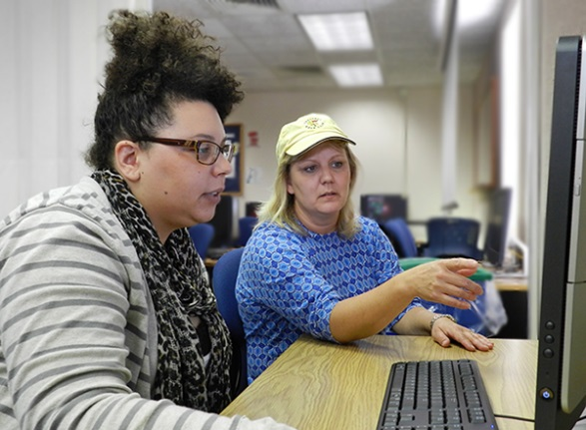
Welcome to the Writing Center!
Find helpful writing resources online at www.iup.edu/writingcenter
Prewriting
Drafting
Revising
Notes:
At the Kathleen Jones White Writing Center, tutors are here to help you with your paper. Writing Center tutors can help with every part of the writing process.
Our Online Writing Center lets you meet with a tutor. You’ll also find handouts and videos to help you with your writing assignments.

Slide 3
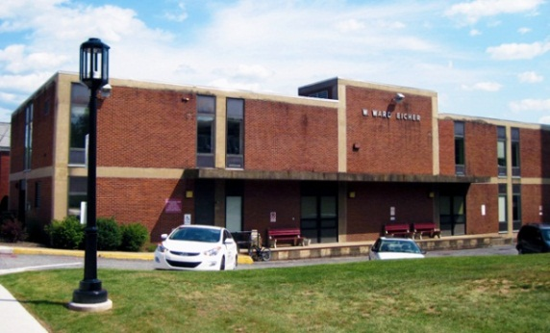
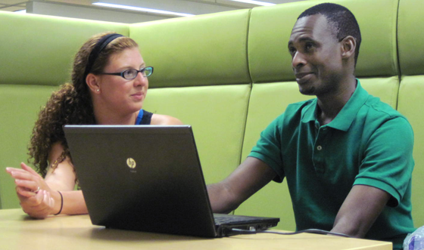
Get help online or on campus
218 Eicher Hall
Meet Us Online
Talk to a tutor through WebEx (like Skype).
Schedule an appointment at iup.edu/writingcenter
Stapleton Library
Monday - Thursday 9:00 am to 8:00 pm
Friday 9:00 am to 3:00 pm
Monday - Thursday 8:00 pm to 11:00 pm
Sunday 5:00 pm to 10:00 pm
Notes:
There are three ways to get help with your paper. The Writing Center is located on campus at Eicher Hall, but you will also find us in Stapelton Library or online.

Slide 4
Today you’ll learn…
Why writers cite
The benefits of APA
In-text citations
Reference lists
Notes:
Today you’ll learn:
Why it’s important to document outside sources
The advantages of using APA Style in a research paper
How to cite sources in your text using APA
How to create an APA references list at the end of your paper

Slide 5
Why do writers cite their sources?
Consistent style
Give credit
Add credibility
Notes:
There are lots of ways to convey citations. Readers find it helpful when a writer uses the same format, such as APA, through the paper. Citations also allow the writer to give credit to the other writers whose ideas or words they’ve borrowed. Citing your sources correctly shows your reader that you’re professional and trustworthy.

Slide 6
You must cite when you…
Borrow words
Borrow ideas
Notes:
In the Writing Center, one of the most common questions tutors get is when to cite. We advise that you should always cite when you Borrow the words from any source
Borrow ideas from a source by paraphrasing or summarizing parts of it, lifting key words or phrases, pulling statistics or facts, or using information from tables, graphs or diagrams

Slide 7
Today you’ll learn…
The benefits of APA
Notes:
We just discussed why it’s important to document outside sources. Now, let’s talk about the advantages of using APA style in a research paper.

Slide 8
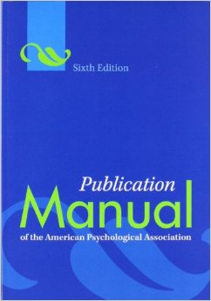
What’s APA Style?
Developed by the
American
Psychological
Association Used in fields like psychology, linguistics, sociology, economics, criminology, business and nursing.
Notes:
APA style was developed by the American Psychological Association in 1929 by editors of psychology journals who wanted to make it easier for people to read research within their discipline. It became such a useful style guide that other fields adopted it, so today many social scientists use APA. Other disciples may use APA style for certain writing assignment, so you will want to check with your professor to see if APA is appropriate for their class.

Slide 9
Why use APA Style?
Credible
Consistent
Readable
Notes:
Because APA style is widely recognized by researchers throughout the world, it makes it easy for writers to be consistent. APA style is not overly complicated, but let’s review some of the basics.

Slide 10
A few basics
In-text and reference page
Double spaced
Title page
Notes:
The most important thing to note here is that every in-text citation must correspond to a reference on your reference page at the end of your paper. It’s also important to note that in APA, you’ll need to double space everything. And unlike MLA style, APA papers must have a title page. Let’s take a closer look.

Slide 11
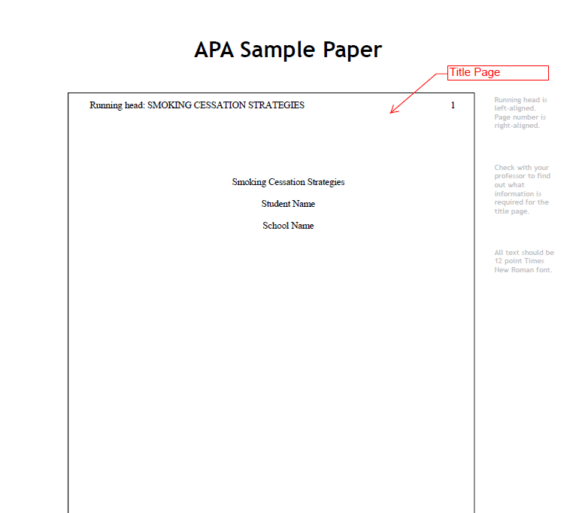
Notes:
Here’s an example of a title page for an APA paper. A few things to notice. On the left hand corner, you include the words “running head” and the title in all capitol letters. In the top right hand corner, include a page number. Center your title, your nice, and our school, and make sure to use 12 point Times New Roman Font. Finally, be sure that everything is double spaced.

Slide 12
The essentials
An in-text citation:
Rumsteine (1996) reported that “Dooliza’s examination of primates in the former century is wildly outdated" (p. 722).
An entry in the References list:
Rumsteine, D. (1996). Primate observation and cognition: Common ground. Social Research Today, 52, 51-70.
Notes:
Beyond including a title page, you’ll want to be sure to cite your sources both within your paper and on your reference list. Let’s look at an example. Notice how the in-text citation includes the author’s last name, the year of the publication, and some of the student’s own writing before the borrowed material in quotes and the page number. Note that this isn’t the only way to incorporate borrowed material.

Slide 13
Today you’ll learn…
How to cite sources in your text using APA
Notes:
Okay, so let’s take a closer look at how to cite sources in your paper using APA.

Slide 14
In-text citations
Let’s break down both essential elements, starting with…
Notes:
Okay, so let’s take a closer look at how to cite sources in your paper using APA.

Slide 15
signal phrase + outside material + parenthetical reference
One researcher reports that “Dooliza’s examination of primates in the former century is wildly outdated" (Rumsteine, 1996, p. 722).
Notes:
There are three key parts to in-text citations: the signal phrase signals that what follows is borrowed from an outside source. Then, you include the outside material which is placed within quotation marks. Finally, you include the parenthetical reference, also called an in-text citation. Since we didn’t say the author’s name in the signal phrase, the in-text citation includes that information as well. And here’s something important to note: keep in mind that because this student is borrowing an outside writer’s materials, the student cannot change the words within the quotation marks.

Slide 16
signal phrase + outside material + parenthetical reference
Rumsteine (1996) reported that “Dooliza’s examination of primates in the former century is wildly outdated" (p. 722).
Notes:
Again, you can use the three key components of an in-text citation – the signal phrase, outside material, and parenthetical reference – but arrange it differently. Here, the author’s name is in the signal phrase, so you only put the page numbers in the parenthetical reference. APA favors keeping the author’s name and the date together, so the year of publication, 1996, is placed beside Rumsteine in parentheses.

Slide 17
signal phrase + outside material + parenthetical reference
University of Pittsburgh (2017) reported that "Pitt researchers led by Jonas Salk developed the first polio vaccine in 1955" (p. 1).
Notes:
Keep in mind, though, that in APA a group can serve as an author. For example, corporations, associations, government agencies, and study groups should be used. In this example, the University of Pittsburgh is he group that authored this quotation.

Slide 18
Signal phrases help you…
Lead into the quotation or outside information
Prepare readers for a change of voice
Keep the parenthetical citation short
Notes:
Let’s look more closely at the first part of the in-text citation: the signal phrase. Signal phrases help to indicate where the borrowing of another author’s idea begins and ends, so when you’re quoting, you use a signal phrase to show the shift between your own ideas and the quotation. You also should use a signal phrase to paraphrase or summarize another writer’s work. We’ll look at an example in a moment.

Slide 19
Signal phrases
Readers should be able to move from your words to the quoted words without feeling an abrupt shift.
Notes:
Signal phrases should help your reader to move between your words and the quoted material.

Slide 20
Use strong verbs
argued
asserted
believed
claimed
commented
has illustrated
has implied
has reported
has suggested
has written
Notes:
In order to make the signal phrase clear to the reader, use strong verbs. A strong verb helps to connect the author to the material, so the reader knows who the material belongs to. For instance, you might say “Smith argued” or “research studies illustrated” or “findings have suggested.”

Slide 21
Laura Smith (2012) described the cultural influence of fictional works. She wrote, “characters like Harry, Ron, and Hermione are now a part of our collective narrative” (p. 61).
Note that the period goes after the parenthetical citation.
Notes:
Here’s an example where the author’s name appears in a sentence before the actual quote. Let’s zero in on the signal phrase, “she wrote.” Notice the punctuation. With APA, the comma appears before the quotation mark.

Slide 22
One researcher illustrated that fictional “characters like Harry, Ron, and Hermione are now a part of our collective narrative” (Smith, 2012, p. 61).
Notes:
Here’s another way to say it. Notice that the phrasing “one researcher illustrated” takes the emphasis away from Smith and places it on the quotation.

Slide 23
Smith (2012) claims that characters from popular books such as Harry Potter help cultures to define their values (p. 61).
Notes:
Now, let’s suppose that instead of directly quoting an author, you decide to paraphrase or summarize. This is a good move, because APA tends to encourage paraphrasing and summarizing over quoting. Here’s an example. Pay attention the bolded text: that’s the signal phrase. Notice the author’s last name, Smith, the year in parenthesis, and the page number in parenthesis at the end of the sentence. APA encourages writers to include a page number when you paraphrase if it will help the reader to find the relevant passage. But the most important thing to remember is that, even when you paraphrase, you still need to signal where the paraphrased material comes from, and the best way to do this is to include the author’s name as the signal phrase.

Slide 24
Using direct quotes
In general, APA prefers summaries over direct quotes. Why?
This means that you should rely more on your own synthesis of the idea of the source and your own summarizing and paraphrasing skills.
Notes:
APA is more concerned about conciseness, so editors want you to summarize more than you quote.

Slide 25
Using direct quotes
However, disciplines like English, education, business and sociology are more accepting of direct quotes.
Let’s look at how to use direct quotes in APA.
Notes:
However, disciplines like English, education, business and sociology are more accepting of direct quotes. Let’s look at how to use direct quotes in APA.

Slide 26
Altering a quote
When using a direct quote in which you insert words of your own, place square brackets [ ] around the word(s) you have inserted.
Example:
One researcher illustrated that “characters like Harry, Ron, [Dumbledore] and Hermione are now a part of our collective narrative” (Smith, 2012, p. 61).
Notes:
Here’s an example of a direct quote. Specifically, this example shows how you might modify a quote, such as when you want to add a word to clarify for the reader. Notice that in APA we use brackets, not parentheses, to insert material into a quotation.

Slide 27
Altering a quote
If you delete part of a quote, use ellipses . . . to indicate where you have removed from the original.
Example:
One researcher illustrated that “characters. . . are now a part of our collective narrative” (Smith, 2012, p. 61).
Notes:
Another question that students often ask us at the writing center is if it’s okay to delete words from a quote. The answer is yes, so long as you don’t alter the meaning. To delete words so that you use only part of the quote, insert an ellipses in place of the deleted text.

Slide 28
What if there are two authors?
When referring to two or more authors within your text, write out the word and.
Research by Walton and Myers (2000) supported the idea…
For the parenthetical citation, use an ampersand (&).
(Walton & Myers, 2000, p. 567).
Notes:
Let’s look at another common scenario. Let’s say you need to cite a resource written by two authors. To do so within your text, simply use the word “and” to separate the author’s names. However, the parenthetical citation is a little bit different. The ampersand for parenthetical citations is a way for the publisher to save space. Note the ampersand between Walton and Myers in the example on the screen.

Slide 29
Try it!
Which is correct?
A. Researchers Walton and Myers (2000) reported that humans had eaten grain for thousands of years without signs of gluten intolerance.
B. Researchers Walton & Myers (2000) reported that humans had eaten grain for thousands of years without signs of gluten intolerance.
Notes:
Take a moment to practice citing a source by two authors. Which example is correct?

Slide 30
Try it!
Which is correct?
A. Researchers Walton and Myers (2000) reported that humans had eaten grain for thousands of years without signs of gluten intolerance.
B. Researchers Walton & Myers (2000) reported that humans had eaten grain for thousands of years without signs of gluten intolerance.
Notes:
The answer is A. When referring to two authors within your paper, use the word “and” between their names.

Slide 31
Try it!
Which parenthetical citation is correct?
Researchers report that humans had eaten grain for thousands of years without signs of gluten intolerance.
A. (Walton and Myers, 2000).
B. (Walton & Myers, 2000).
C. (Walton, Myers, 2000).
Notes:
Now, let’s practice identifying which parenthetical citation is correct. (Read through this).

Slide 32
Try it!
Which parenthetical citation is correct?
Researchers report that humans had eaten grain for thousands of years without signs of gluten intolerance.
A. (Walton and Myers, 2000).
B. (Walton & Myers, 2000).
C. (Walton, Myers, 2000).
Notes:
The answer is B. Use an ampersand between author’s names in an in-text citation.

Slide 33
What if there are many authors?
Three, four or five authors
Name all of the authors the first time you cite the source. Next time, use et al.
(Peters et al., 1998).
Six or more authors
Only list the first author’s name followed by et al.
Roberts et al. (1980) argued…
…(Roberts et al., 1980).
Notes:
If there are more than two authors – for instance, let’s say your source has three, four, or five authors – you name all the authors the first time you cite the source. Next time, use et al. For six or more authors, list only the first author’s name followed by et al.

Slide 34
What if I use a long quote?
Use block quotations when quoting 40 or more words
Indent five spaces from left margin or one-half inch
Do not use quotation marks
Double space the quote
Notes:
Another common question we get in the Writing Center is what to do about long quotes. APA allows you to include lengthy quotations in your paper, but if the quote is 40 or more words, you create a block quotation. A block quotation is a special way to format the text within your paper so that it makes sense for your readers. Indent five spaces from left margin or one-half inch
Do not use quotation marks
Double space the quote

Slide 35
Meckers (2005) described how residents of the nursing home used writing to reexperience memories:
Several residents line the hallway, a monitor beeping from the left, a fish tank gurgling from the right. On each person’s lap is a notepad, and I watch as smiles and laughter emerge as they write down memories (p. 32).
This shows that Meckers exposed geriatric patients to therapeutic writing methods.
Notes:
Here’s an example. Notice the colon before the quotation, that the quotation is indented, that there are no quotation marks, and that everything is double spaced.

Slide 36
What if my source cites somebody else, and I want to use that quote?
In general, APA avoids citing secondary sources (“as cited in” or “quoted in”).
Try to go back to the original writer of the quoted words and cite that source.
Notes:
With APA style, it’s important that you cite the original source. This means that if you see a quotation in a source, your best bet is to track down the original quotation. Otherwise, you might be incorrectly quoting that author since the message might’ve been lost in translation. You can use the words “As cited in” if the original is very difficult to find or it’s in another language.

Slide 37
Can I use footnotes?
Rarely.
Notes:
There isn’t anything a footnote can say that you can’t put in your paper. Most style manuals urge you to include the material in the main body of your paper or leave it out. However, you should use footnotes if your instructor specifically asks you to do so.

Slide 38
Today you’ll learn…
How to create an APA reference list at the end of your paper
Notes:
Okay, we’ve discussed why we cite outside sources, the benefits of APA style, and how to cite sources within your text using APA. Now, let’s discuss how to create a reference list at the end of your paper.

Slide 39
Need examples?
APA Publication Manual, 6th ed.
The Purdue Online Writing Lab (OWL) (owl.purdue.edu)
Notes:
You can find lots of examples of reference list citations. You can look at examples from reputable sources, such as in the APA publication manual – make sure you look at the 6th edition since that’s the most up to date version. You can also visit owl.purdue.edu for examples.

Slide 40
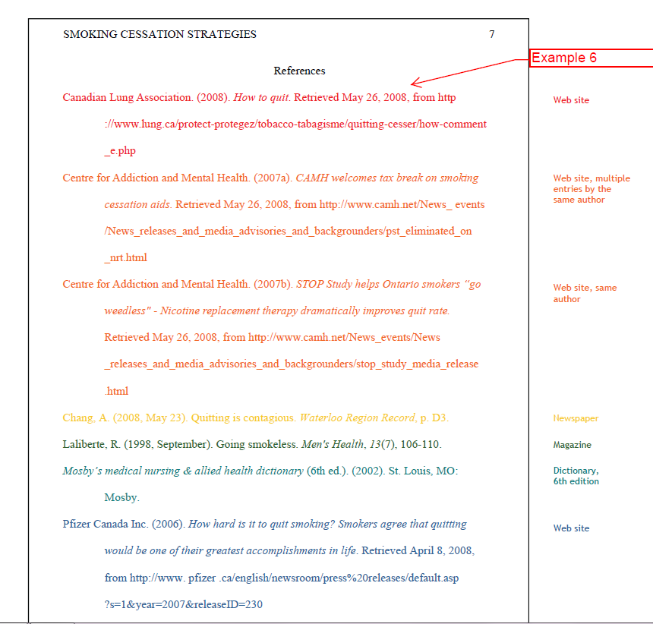
Notes:
Now, of course you’re not going to use bright colors in your reference list, but we’ve color coded this example to make it easier to see the different types of sources. For instance, the red example is how to cite a website. The orange example provides a model for a website with multiple entries by the same author and a website with the same author. The yellow is an example of a newspaper, the green a dictionary, and the blue a website.

Slide 41
How to list a book in the References
Author’s name (Last, First initial)
Year of publication
Title and subtitle (capitalize first letters only)
City of publication
Publisher’s name
Dickinson, B. (2007). The Culture of Brittany Spaniel Trainers. New York: Routledge.
Notes:
One of the most common sources you’ll probably cite, though, is a book. Keep in mind that APA likes the author’s name and the publication year to appear beside eachother. Also, notice that the author’s last name and first initial only are used.

Slide 42
How to list a journal article in the References
Author’s name (Last, First initial)
Year of publication
Title of article (not italicized)
Name of journal, volume, and issue number
Page numbers
If a DOI is provided, included that (doi:xx.xxxxxxxxxx)
Hoxby, R. M. (2002). The power of dance. Education Now, 13(1), 57-68.
Notes:
Another common type of source that you may use is a journal article. Because journal articles share the most up-to-date research, they’re commonly used sources in academic papers such as those for which you’d use APA style. Note that some journal articles provide a DOI, an acronym that stands for Direct Object Identifier, and that this is often provided on the first page of the document. If your article provides a DOI, include it in parenthesis with a colon between DOI and the number. If there’s no number, don’t worry, you don’t have to include one.

Slide 43
How to list something from the Internet in the References
There are several ways to do this. It all depends on what kind of source it is (video, article, Tweet) and whether you have an author and date.
Our advice? Look it up.
Notes:
You may also include something from the internet on your reference list. Since there are many types of internet sources such as videos, articles, and tweets, just to name a few, your best bet is to look up an example in the APA style manual.

Slide 44
Use the Purdue OWL
http://owl.english.purdue.edu/owl/resource/560/01/
Some information in this presentation is based on and comes from this website.
Notes:
If you click on this link, you’ll be redirected to Purdue’s OWL homepage, where you can see the variety of resources available on the site. To access information directly related to APA style, scroll down through the options and click. You can see a sample APA paper; note that there is a link to the sample paper on the bottom of the main APA page.

Slide 45
Let’s recap what you learned
Why it’s important to document outside sources
The advantages of using APA Style in a research paper
How to cite sources in your text using APA
How to create an APA references list at the end of your paper
Notes:
Okay, so we covered a lot of material today. Let’s review. We discussed why it’s important to document your sources and mentioned various reasons, such as that ethically you need to give other writers credit for their work. We discussed how helpful APA is as a style manual because it allows you to cite your sources in a consistent, credible way that readers will recognize. Then, we went over multiple examples for how to cite sources within the paper and how to create that corresponding reference list at the end of the paper.

Slide 46
Get help online or on campus
218 Eicher Hall
Meet Us Online
Talk to a tutor through WebEx (like Skype).
Schedule an appointment at iup.edu/writingcenter
Stapleton Library
Monday - Thursday 9:00 am to 8:00 pm
Friday 9:00 am to 3:00 pm
Monday - Thursday 8:00 pm to 11:00 pm
Sunday 5:00 pm to 10:00 pm
Notes:
If you have questions or would like one of our trained tutors to consult with you about your paper, you can reach us on IUP’s campus or online.

Slide 47
Questions?
Comments?
Contact us at http://www.iup.edu/writingcenter/
W-Center@iup.edu
Notes:
Thank you for tuning in for this workshop from the Kathleen Jones White Writing Center at Indiana University of Pennsylvania. We’ll see you again soon, and in the meantime, happy writing.

