Slide 1
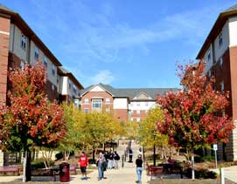
National Cyber Summit
Huntsville, AL
5 June 2019
Cyber Career Opportunities
Brian Gouker
Indiana University of Pennsylvania
CYBERSECURITY DAY
29 October 2019
Brian Gouker
Division Chief
College of Cyber – National Security Agency

Slide 2
National Initiatives in Cyber Workforce Development and Cyber Career Opportunities
Brian Gouker
College of Cyber
National Security Agency

Slide 3
DISCLAIMER The views, comments and opinions presented do not represent the the National Security Agency, the Department of Defense or any branch of the U.S. government. They are solely that of the author. Thanks, Brian

Slide 4
President Obama refutes the misconception
that NSA monitors US communications.

Slide 5
2019 Cyber Challenges …
National-focus (not just government, DOD, NSA …)
Educator shortage / Faculty Professional Development
Competency measurement/metrics
Cooperative education / Apprenticeship / Internships
Community College to BA/BS/MS; CAE to CAE articulation
Peer assistance and evaluation
K-12 pipeline
Notes:
There are several imperatives driving the CAE-CD program. These are challenges and initiatives that are critical to the success of cyber workforce development. In the near term, the goal is to compensate for the negative impact these issues have on growth. In the long term, they will guide our future and must be solved and integrated into funding and standard practice to successfully protect the well being of the nation. (
Growth in education programs is critically dependent on qualified and skilled educators. In the past, schools have scoped their programs to the availability of faculty. Now that there is a recognized shortage, and programs need to expand, the shortage of qualified educators has become a critical limiting factor. The problem is both created by and exacerbated by the reality that students can leave school with a masters degree and command high wages and excellent employment offers that don’t require pursuit of a doctoral degree. The population of students continuing in cybersecurity to the doctoral or post-doc levels is shrinking. And of those that go there, remaining in an academic environment to teach is not a lucrative or enticing prospect against all their other options. Schools consistently have multiple cybersecurity faculty positions open for long periods of time.
The CAE-CD program is actively working to define measures by which schools can document their students’ competencies upon graduation. The 2018 National Defense Authorization Act codifies Congressional interest in measuring competencies of students pursing federal employment, and signals the need for the CAE-CD program to accelerate our ability to offer some measure of competency. The goal is to require competency metrics in the 2019 reporting requirements.
Department of Education, Department of Labor, Department of Commerce and the Office of Personnel Management are all invested in accelerating and expanding cooperative education programs and apprenticeship programs across the country. There was a 2017 Executive Order on the subject. Funding opportunities are growing exponentially as this is seen as one of those short term solutions that can make a difference in the workforce. This is an especially good opportunity for community colleges.
Community Colleges are producing highly qualified students, but the hiring practices and personnel requirements of both government and industry have not shifted to accommodate those qualifications. Most cybersecurity jobs still require at least a bachelor’s (burning glass says 80% of posted jobs), and it will still take years for those barriers to change. In the meantime, we need to find ways to help students continue their education to the maximum level of their aspirations. We have to help talented students with resource challenges. There is unmined potential in underprivileged communities and underrepresented populations we can’t afford to lose. K-12 programs need to prepare students for cybersecurity programs, and leveraging community college opportunities to bridge them into university is a priority for the CAE-CD program. We must create articulation agreements that allow Community College graduates to continue on a broader scale than is currently offered.
We are working within the program to maximize the sharing of good ideas, to recognize leadership and leverage peer-to-peer collaboration as much as possible. Designated schools are helping new schools develop programs that qualify for designation, and we have a network of experienced peer reviewers to both assist in application preparation and to augment the program office staff to evaluate applications.

Slide 6
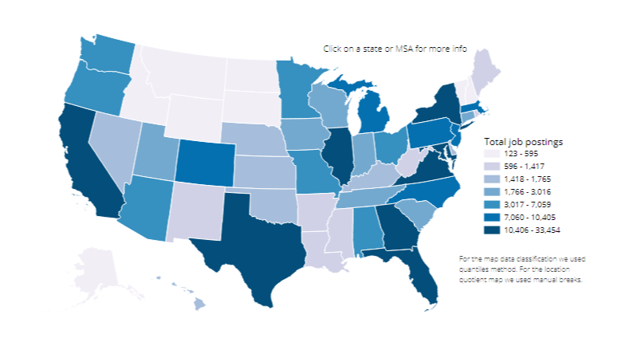
Cyberseek.org PA = 8,482

Slide 7
One of the goals of the
National Security Agency
is to advance the state of
cybersecurity.

Slide 8
NSA employees …

Slide 10
NSA DUDE

Slide 11
Towards that goal…
GenCyber
Centers of Academic Excellence (CAE)
CAE Community
Scholarships & Internships

Slide 12
Three google searches …
CAE CYBER DEFENSE
CAE COMMUNITY
GEN CYBER
Contact: BAGOUKE@NSA.GOV
We partner with
Notes:
NSA has two Centers of Academic Excellence in Cybersecurity programs: Cyber Defense and Cyber Operations
NSA partners with DHS to sponsor the Cyber Defense program. Cyber Defense has three designations:
CAE-2Y designates Community Colleges
CAE-R designates Universities be rated as either a Research University as determined by the Carnegie Foundation Basic Classification system, must be graduating PhD students, and faculty have current publications
CAE-CDE designates schools awarding undergraduate or graduate degrees in Cybersecurity or with an emphasis or certificate in Cybersecurity
Other close partners in cybersecurity education include the National Science Foundation, the National Initiative for Cybersecurity Education (NICE), DoD, and OMB
NSF manages the CyberCorps Scholarship for Service program, which requires participating universities to either be a designated CAE or meet the requirements for CAE. NSF also sponsors several other grants programs in support of the CAE programs and cybersecurity education.
NICE maintains the Cybersecurity Workforce Framework (otherwise known as the NICE Framework), and advocates for cybersecurity education nationally
The Office of Management and Budget (OMB) has been closely involved with development of cybersecurity programs, and has sponsored the CAE-C programs and cybersecurity curriculum development
Workforce work role definitions and specification education and training requirements currently underway at Department of Defense will guide the future development of requirements for the CAE-C programs, and is at the forefront of profession development for the nation. CAE-C program managers at NSA work closely with DoD CIO; the DoD Cybersecurity Scholarship Program is managed by the CAE-CD program office

Slide 13
Who said it …..

Slide 14
If everyone is thinking alike,
then someone’s not thinking.
Never tell people how to do things. Tell them what to do and they will surprise you with their ingenuity …
- GEN George Patton

Slide 15
640K ought to be enough for anybody
If you can’t make it good,
at least make it look good …
- Bill Gates
Chairman, Microsoft
1981

Slide 16
2019 GenCyber Program

Slide 17
Inspiring K-12 Students
NSA / NSF funded grants
… FREE to students & teachers
(decentralized execution)
Hands-On Summer Camps
Targeting Underrepresented Population
Residential / Commuter
Nation-Wide
47 States + DC and Puerto Rico
Special Camps
Girl Scouts (CSUSB)
Deaf Camp (UAH)
Visually Impaired (UAH – 2019)
Spanish Language (in Puerto Rico)

Slide 18
GenCyber Goals
Help students understand correct and safe on-line behavior
Increase interest in cybersecurity and diversity in cybersecurity workforce of the nation
Improve teaching methods for delivering cybersecurity content in K-12 curricula
Notes:
Explain the program…
- Recognize the need for more qualified cybersecurity professional in the workforce – this is for govt, industry and academia.
Creation of the GenCyber Program
- Generated an awareness in Cybersecurity – and stimulated an interesting in Cybersecurity field
Teach participants about GenCyber CyberSecurity First Principles, Safe-on Line Behaviors, Ethical Behaviors
Also have a positive impact on the methods used for teaching cybersecurity content in K-12 curricula.

Slide 19
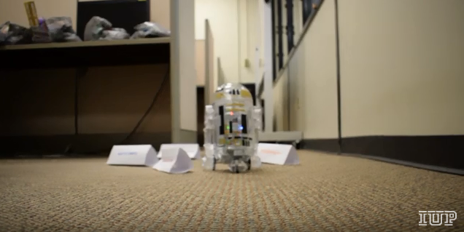
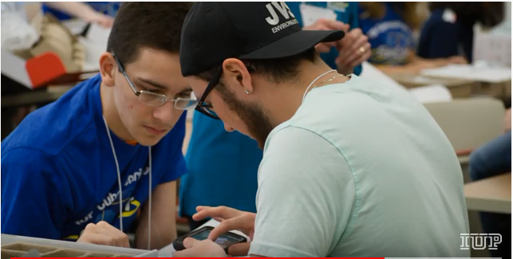

Slide 21
GenCyber
K-12 Cybersecurity Teacher / Student “Summer Camps”
Increase diversity
Inspire interest in cybersecurity careers
Especially underrepresented youth
Teach ethics and safety online
Improve K-12 teaching expertise & methods
 | 2014 | 2018
Teachers Participating | 25 | >1000
Students Participating | 256 | >3,750
Number of Camps | 8 | 150
Number of States with Camps | 2 | 43

Slide 23
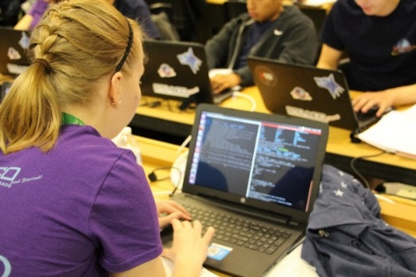
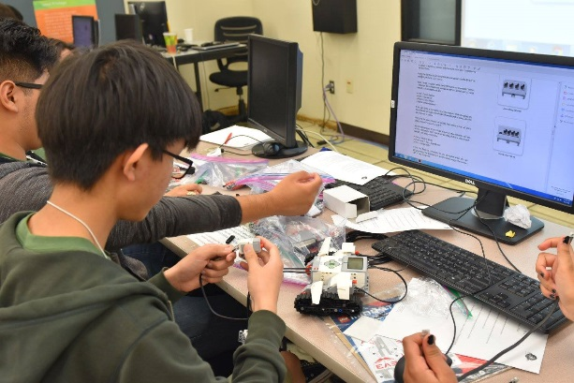
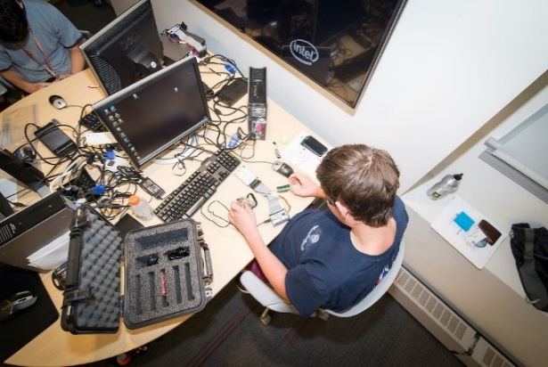
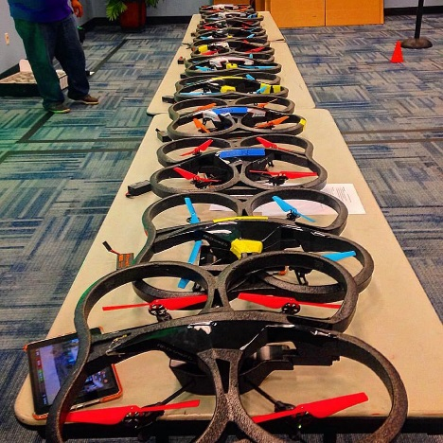
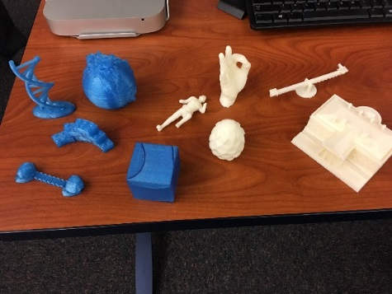
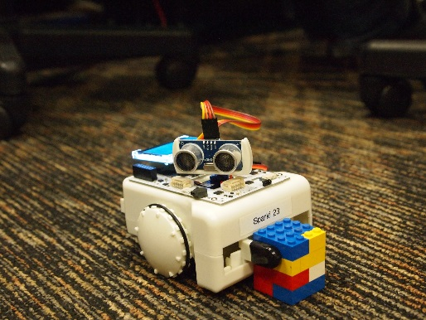
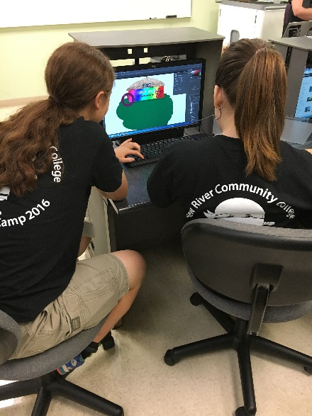
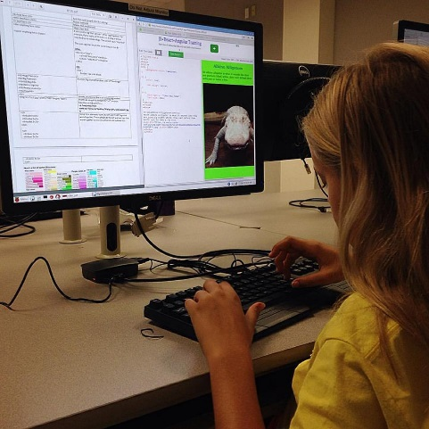
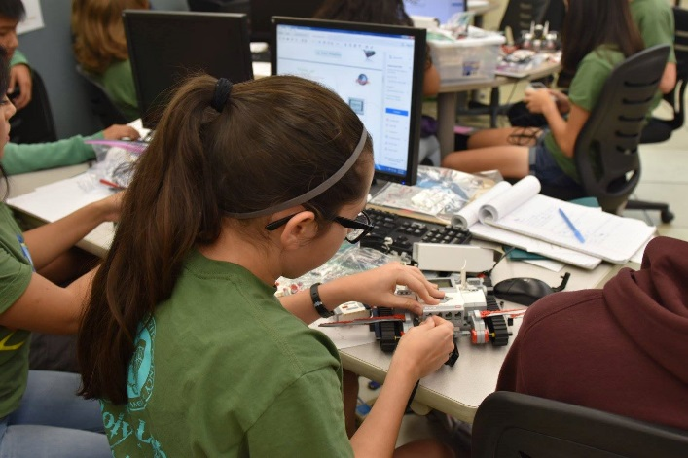
RESIDENT CAMPS
COMMUTER CAMPS
TEACHER CAMPS
SPECIAL CAMPS

Slide 24
Technical or not …
Whether you are a STEM student or not ..
Cyber (cybersecurity) can be applied to
wide variety of subjects and careers …
Ethics, privacy, government,
Cyber bullying, law, medicine,
Business, banking, tech, …

Slide 25
www.gen-cyber.com
www.gen-cyber.com/camps

Slide 26
Forgive your enemies,
but remember their names
The pay is good and I can walk to work…
- President John F Kennedy

Slide 27
National Centers of Academic Excellence in Cybersecurity (CAE-C)

Slide 28
CAE programs
Cyber Defense (CAE-CD)
Cyber Defense Education (CAE-CDE)
Cyber Defense Research (CAE-R)
Cyber Defense 2Y Education (CAE-2Y)
272 schools designated
Cyber Operations (CAE-CO)
21 schools

Slide 29
CAE Evolution & Milestones
Began as CAE – IA (Information Assurance) Program
Designations
- JMU, Idaho, Idaho State, Purdue, Cal Davis, Iowa, George Mason)
2005 DHS Joined Program
2008 Research Designations (CAE –R)
2009 First HBCU (Norfolk State)
2010 Community Colleges (CAE 2Y)
2012 Cyber Operations Program (NSA –only)
Changed designation to “Cyber Defense”
2017 Regional Centers Established
Continually evolving criteria
Increased academic buy-in
Candidates Program
Over 270 Designated CAEs

Slide 30
Similar, but Different …..
CAE in Cyber Defense (CAE-CD) | CAE in Cyber Operations (CAE-CO)
Started in 1999 (now 270+ schools) | Started in 2012 (now 21 schools)
Specific Criteria & Knowledge Units | Specific Criteria & Knowledge Units
Designated for 5 years | Designated for 5 years
Partner w/ DHS: National Workforce Needs | Pending FBI Co-Sponsorship
Broad Academic Foundation | Deeply Technical, Interdisciplinary
Optional Focus Area and/or “R” (Research) Designations | 12-Week Summer Internship
NSF Requirement for Cyber Corps (Scholarship For Service) grants
Notes:
The CAE-CD and CAE-CO programs have common origins and collaborate closely, but have different objectives and requirements. The common thread is that both have specific, well-defined academic and programmatic requirements, and schools are designated for a five year period in both programs. Designation in either program qualifies a university for SFS grants.
The CAE-CD program is approaching 20 years, and has (as of May 2017) 226 designated schools.
NSA partners with DHS on this program, with the objective of providing cybersecurity workforce to meet the needs of the nation, government, industry, and academia.
CAE-CD has a broad academic foundation, with core curriculum common to the CAE-2Y and the CAE-CDE designations, but with more in depth criteria for the CDE designation. The program also has rigourous programmatic requirements that makes the school a leader in cybersecurity education for the nation. More on this in the next slide.
The CAE-CO program began in 2012, and now has 19 designated schools.
This program is focused on workforce development for the Intelligence Community, based on unique mission and authorities associated with that mission
The program is deeply technical, requiring student knowledge in the most complicated and technically-grounded knowledge areas.
The program also manages a unique 12-week summer internship for CAE students. The interns are not integrated into NSA mission areas as most other intern programs are at NSA. They operated as a cohort, attend classes during their summer at NSA, and work on a problem defined by the program management for the summer under the supervision of NSA technical directors.

Slide 31
Designation Process
On Line Application
Extensive evaluation by 2 or 3 experts
Program Office / Technical Directors / Academia
Review all submitted evidence
Syllabi, Resumes, Articulation Agreements, Web Sites, etc
Must Pass each Criteria + All Mandatory KUs+ Optional KUs
Cyber Ops Program Includes On-Site Evaluation
Formal Designation Ceremony
Historical Pass Rates

Slide 32
CAE-CD Designation Criteria
CAE-2Y & CAE-CDE |  | CAE-R
Academic Requirements | Programmatic Criteria
Curriculum mapped to KUs | Articulation Agreements | Carnegie Research Rating
Program/Student Path | Regional Accreditation | University has CD area of study
Faculty Qualifications | Faculty in CD Research | CD Research Collaboration
Program Maturity | Program Outreach | Faculty CV
Interdisciplinary Program | Cybersecurity in practice | Publication & Research
All designations require the institution have an active Cyber Center on campus
Notes:
CAE-CD requirements are both academic and programmatic
For the CAE-2Y and CAE-CDE, the academic requirements are focused on mapping curriculum to specific Knowledge Units.
All candidates map to a core curriculum requirement, with CDE requiring additional optional Knowledge Units depending on the University’s program focus.
The candidate school must demonstrate an individual student can navigate the subject path (or program) during the average career span (2/4/5 years). When the institution is designated, the designation is specific to that path or program.
Institutions may receive designation for multiple paths or programs, as universities frequently have cybersecurity programs in multiple schools (Engineering, CS, IT, Business most common)
The candidate school must demonstrate that faculty teaching in the program are fully qualified (by degree, practice and currency).
The school must have a three year history of teaching the curriculum in the path or program, and at least one cohort of students must have completed the path.
Interdisciplinary programs are encouraged. Many CAE-CDE programs are designated in one college at a university, with participating students taking classes in other colleges
For the CAE-2Y and CAE-CDE, programmatic requirements ensure the institution’s leadership in Cybersecurity education
The institution must have articulation agreements with other degree-granting institutions
The candidate must hold regional accreditation
The faculty must show evidence of current involvement in cyber defense research
The institution must be engaged in program outreach to the surrounding community, which can include work with other universities or community colleges, high schools, and/or student activities with high schools, camps, senior centers, etc.
The school must be practicing cybersecurity, as evidenced by security plans for local networks, inclusion of cybersecurity in other academic programs, student cybersecurity awareness programs, etc.
For the CAE-R designation, requirements are focused on established Universities with extensive cybersecurity research activity.
The University must have a Carnegie Research Rating of Research University - Very High Research Activity (RU-VH), a Research University – High Research Activity (RU-H), or a Doctoral/Research University (DRU)
The University must have a cyber defense area of study in the undergraduate and/or graduate curriculum.
If the University does not already hold a CAE-CDE designation, it must provide evidence of significant engagement in CD research initiatives, community service, outreach, and collaboration regarding CD. Examples include the following: conducting research, serving on technical program committees of CD conferences, editing CD journals, hosting conferences and workshops, and assisting/collaborating with the government (federal, state, local), academia, industry, and the local community.
The University faculty must consist of at least 3 full-time instructors who teach courses that contain CD related material and who conduct research in the CD area. They must substantiate depth and length of faculty expertise through submission of biographies and bibliographies with link to CV including main areas of CD research/expertise.
The University must provide evidence of a strong peer-reviewed publication record by faculty and students, research papers and their impact

Slide 33
CAE-CO Designation Criteria
CAE-Cyber Operations
Academic Requirements | 10 Mandatory KUs + 10/17 Optional KUs
CO Recognition | CO Students must be distinctly recognized
Accreditation /Curriculum review | National/Regional accreditation + on site review
Interdisciplinary Program | Interdisciplinary CO exposure to Students
Robust CO Program | Curriculum is current and maintained
Faculty Teaching Cyber Ops Courses | >= 2 FT faculty teaching CO based courses
Student and Faculty Research in CO | Grants, publications, presentations
Student Cyber Security Outreach | Exercises, campus clubs, law/gov support
CAE-CO Program Support | Application/KU reviews, summer intern instructor
Notes:
Academic Content (includes mandatory and optional content) :: 100% of mandatory / 10 of the 17 optional
Cyber Operations Recognized via Degree, Certificate or Focus Area :: Cyber Operations must be explicitly recognized as a focus area or specialization and students must meet requirements to be awarded such recognition.
Program Accreditation or Curricula Review :: Accreditation of the academic program (CS, EE, CE) on which the proposal is based will be considered a significant plus. All programs who pass documentation reviews will undergo an in-person curriculum review.
Cyber Operations Treated as an Inter-Disciplinary Science :: Cyber operations concepts must be integrated into foundational curriculum courses as appropriate.
Cyber Operations Academic Program is Robust and Active :: Evidence that courses are maintained current and offered frequently (e.g., every 18 months).
Faculty Involvement in Cyber Operations-related Research :: Evidence of faculty grants, papers published, conference presentations related to the field of Cyber Operations (i.e., with a particular emphasis on technologies and techniques related to specialized cyber operations such as collection, exploitation, and response. These technologies and techniques are critical to intelligence, military and law enforcement organizations authorized to perform these specialized operations).
Student Involvement in Cyber Operations-related Research :: Evidence of student work on grant research, papers published, conference presentations related to the field of Cyber Operations (i.e., with a particular emphasis on technologies and techniques related to specialized cyber operations such as collection, exploitation, and response. These technologies and techniques are critical to intelligence, military and law enforcement organizations authorized to perform these specialized operations).
Student Participation in Cyber Service-Learning Activities :: Evidence of participation in local/regional/national cyber exercises, outreach to community colleges and high schools, etc.
Commitment to Support the CAE-Cyber Operations Program :: First application: stated commitment. Renewals: 8 students and 3 faculty members over the course of the 5-year designation window. Can support by doing KU reviews, school application reviews, and teaching during the summer intern program.
Number of Faculty Involved in Cyber Operations Education and Research Activities :: At least 2 faculty actively teaching cyber (i.e., non CS/EE/CE core) courses.

Slide 34
The Why Slide
Advantages to University and Students
Join a select group
Eligible for government scholarships
Join a “community”
Annual Meetings (2)
Eligible for Capacity Planning Grants
Prestige and Recruiting Advantages

Slide 35
CAE Impact
“300% enrollment increase”
“Stopped State Funding Cuts”
“Increased opportunities for NSF grants”
“Influencing regional collegiate programs and outreach activities”
“Increased contact from government and industry seeking partnerships”
“Chosen by State government to consult on Cyber Security Councils ”
“University Administration support to increase faculty and programs for Cyber Operations curriculum”
Notes:
Frequently asked why be designated a CAE-CO school.
Some details:
DSU: A year after being designated, had 300% enrollment increase.
UNOrleans : When UNO threatened by state budget cuts, UNO waved the CAE-CO designation and the cuts were stopped.
Univ of Cincinnati : within a month of being designated, Ohio Governor’s office contacted the new CAE-CO UC POC and asked for support on their Cyber Security Councils
West Point : able to support request to administration to increase funding and positions for their newly designated program.

Slide 36
NSA Workforce Development Programs
Gifted & Talented STEM Summer Program
for High School students
Stokes Educational Scholarship
Computer Science Intern Program
Cyber Summer Program
CAECO (Cyber Ops) ** College of Cyber **
On-Line Application Deadlines ~ 15 Oct
GOOGLE: NSA INTERNSHIPS

Slide 37
CAE – CO Summer Intern Program
Exceptionally competitive, unique 12 week program
Hands-on Education, Academic Lectures, CAPSTONE
All students are FULLY CLEARED (TS-SCI)
And work as a cadre
Instructors are experts from U.S. Universities
Topics directly related to technical Cyber Ops
100% offered NSA jobs / 80 % Accept
Notes:
NEW in 2016 and going forward:
Expansion of the CAE-CO Summer Intern Pgm to Hawaii
Example Summer Topics that could be briefed to the interns include:
Virtualization
Cyber Operations
Security Fundamentals
Software Reverse Engineering
Vulnerabilities and Exploitation
Cellular and Mobile Technologies
SCADA
Digital Forensics
Memory Analysis

Slide 38
You can observe a lot by watching
If you don’t know where you’re
going, you might wind up
someplace else …
- Yogi Berra,
American Baseball Player

Slide 39
NSF Cyber Corps Scholarship for Service (SFS)
www.sfs.opm.gov
Scholarships (max 3 year) include tuition and education plus fees
stipends of $22,500 for undergraduates and $34,000 for graduates
participating CAE institutions only

Slide 40
THE END
Brian Gouker
College of Cyber
National Security Agency

