Slide 1
Virtualization Technologies
By Collin Donaldson

Slide 2
Physical Computing
Install Hardware
Load Operating System and other software
Deploy either manually or via a network
To Run Multiple Operating Systems:
Multi-booting
Run from USB
Run from live disc

Slide 3
Intro to Virtualization
Creating a virtual (rather than actual) version of something, including but not limited to a virtual computer hardware platform, operating system, storage device, or computer network resources.
Virtualization is a fundamental part of cloud computing
Hypervisor: A piece of computer software, firmware or hardware that creates and runs virtual machines.
Type 1: Native/Bare-metal: Run directly on hardware
Type 2: Hosted: Run on a conventional OS

Slide 4
Advantages of Virtualization
Often free or relatively low cost
Easy installation and uninstallation
Less hardware hassles
Hands-on learning of new kinds of technology
Use software normally unavailable on your machine
Test software/hardware in a safe environment
Save energy

Slide 5
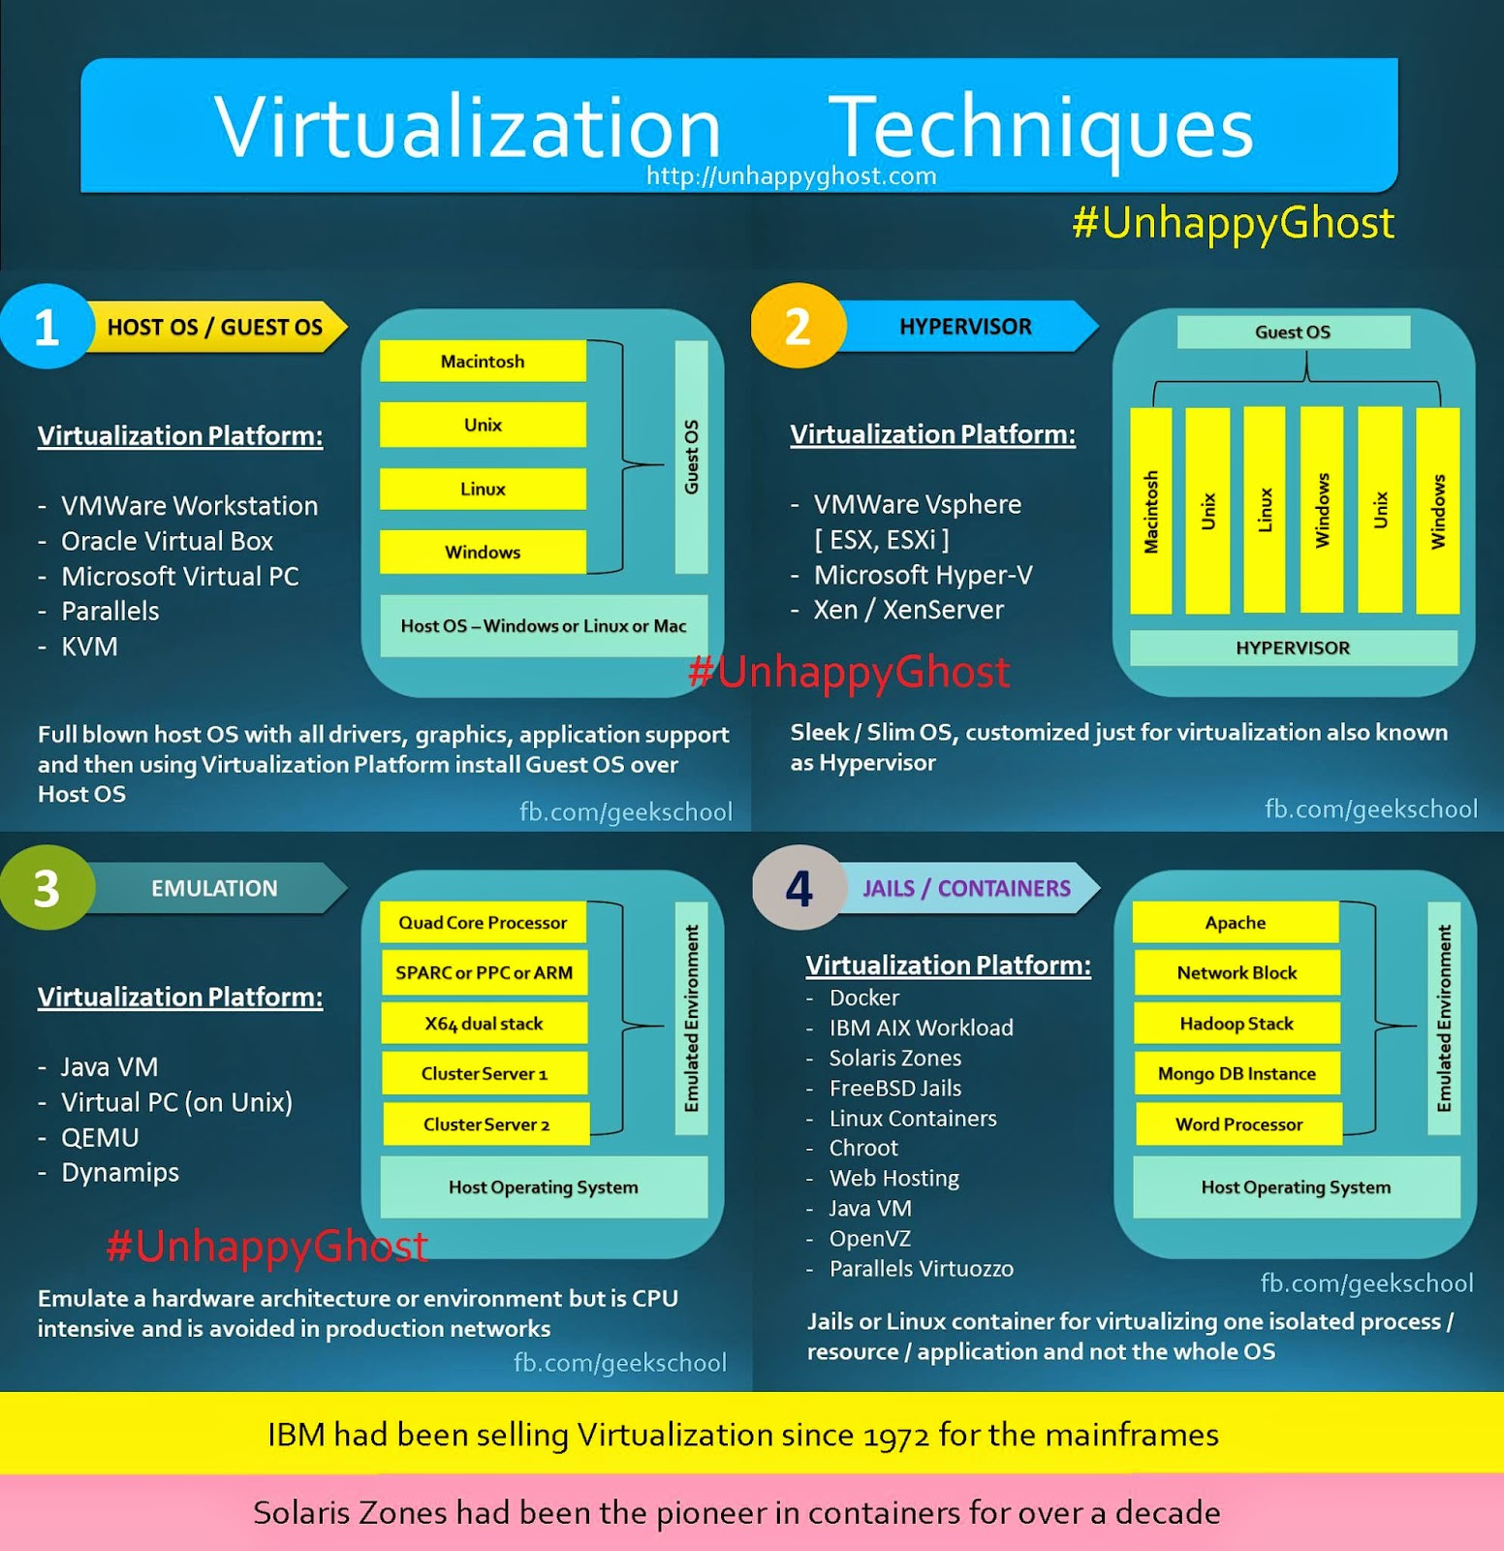
Virtualization Techniques
Host/Guest OS: OS functions as a host, virtual machines are guests/clients. Uses Type 2 hypervisors.
Hypervisor: Uses a Type 1 hypervisor and a custom minimal OS.
Emulation/Simulation: Creates custom virtual hardware/software to imitate real hardware/software.
Jails/Linux Containers: Virtual applications run on a host OS.

Slide 6
Common use of different virtualization techniques
Host/Guest OS: Virtual Desktops.
Hypervisor and Jails: Virtual Servers
Emulators: Custom/Embedded hardware environments and accompanying software (e.g. video game emulators)
We will focus on Host/Guest OS

Slide 7
Virtual Security
Virtual machines have some unique security considerations, as well as applications
Virtual machines can still get viruses and can transmit them to your physical machine, or vice versa
Few viruses target VMs, one such virus is detailed on the next page
VMs you plan on keeping should be protected like their physical counterparts

Slide 8
VM-centric virus “Crisis”

Slide 9
Virtualization-centric Security Techniques
Sandboxing: Run risky applications in a VM that is disconnected from your host OS and network
Server Isolation: Servers running on the same machine can be isolated virtually either by virtualizing them or by running each in its own VM
Virtual Honeypots and Honeynets: Honeypots are computers designed to lure attackers/malware/spam away from your actual computer. Honeynets are n

Slide 10
Demo
http://kanishkashowto.com/2013/09/03/how-to-install-kali-linux-in-virtualbox-step-by-step-guide/

Slide 11
Notes for DOI
Oracle Virtual Box and VMWare Player are good FREE virtualization software
You may have to download operating systems to mount (.iso files)
Some processors have virtualization technology that needs to be enabled via the BIOS menu (your software should indicate such)
Some of your hardware might not jive with your virtual machines
Some Linux and OS-X distributions default to Console view (text only) when you install them, type “startx” to switch to GUI view

