Slide 1
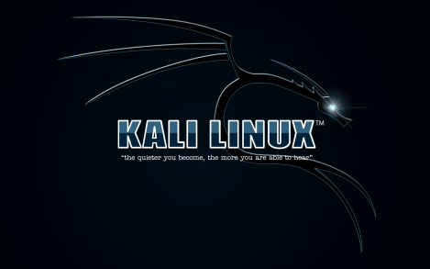
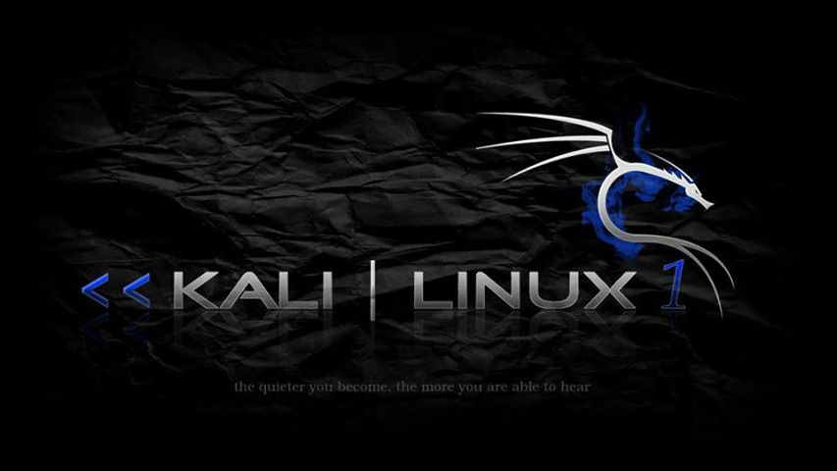
By Collin Donaldson

Slide 2
Roadmap
Origin of an OS: From UNIX to Kali Linux
Linux Architectures and Ubiquity
What is Kali and why should I use it?
Kali’s New Features
Kali’s Toolkit
Installing Kali
Summary

Slide 3
UNIX to Kali Timeline
1968: E.W Dijkstra develops MULTICS (Multiplexed Information and Computing Service) in the Netherlands
1969: Bell telephone (AT&T) lab researcher Ken Thompson developed a new system using MULTICS as part of a team. His coworker Brian Kernighan dubbed it UNICS (UNiplexed Information and Computing Service). It was later changed to UNIX.
Milestone: The UNIX operating system was born.

Slide 4
UNIX to Kali Timeline
1969-1973: Bell Telephone researcher Dennis Richie develops the C language as a systems programming language for UNIX.
1970s: UNIX versions 6 and 7 were developed, first in B and Assembly than C. Originally for academic use, later sold to vendors.
1987: A Unix-like system based on microkernel design known as MINIX was developed.
Milestone: C language developed.

Slide 5
UNIX to Kali Timeline
1980s-1990s: The “UNIX Wars” occur, vendors struggle to standardize UNIX.
1991:Linus Torvalds developed a new operating system called Linux, which is similar to MINIX.
1990s-Today: Various UNIX and UNIX/Linux-like distributions are released, such as: GNU, OS X, Debian, and Ubuntu.
Milestone: Linux was born.

Slide 6
UNIX to Kali History
2006: Linux distribution BackTrack was released by Offensive Security. It becomes the definitive Penetration Testing platform available.
2012: The final BackTrack version, Backtrack 5 R3, is released.
2013: Kali Linux, a.k.a. BackTrack 6, is released by Offensive Security.
Milestones: BackTrack is born, then Kali.

Slide 7
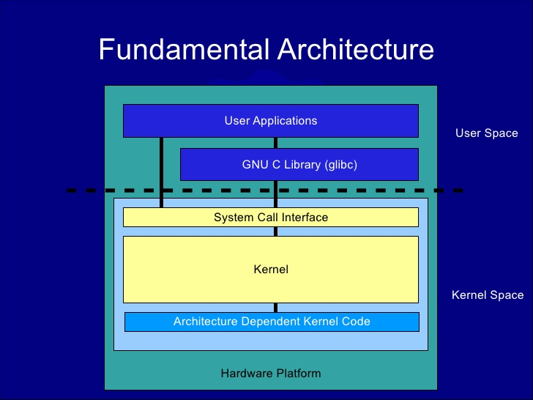
Basic Linux Kernel

Slide 8
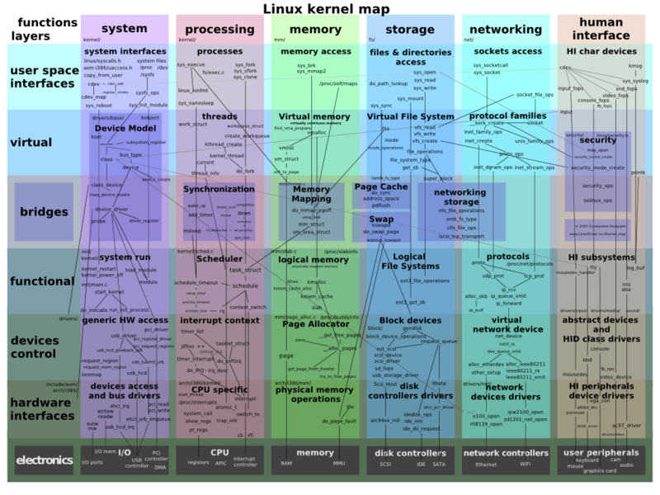
Full Linux Kernel

Slide 9
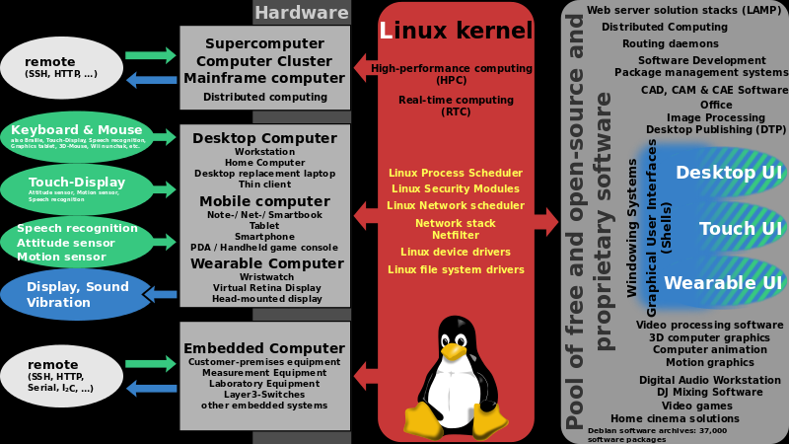
Linux Ubiquity

Slide 10
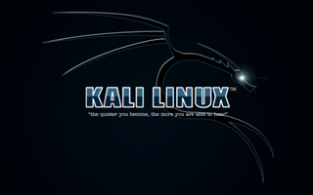

Get to Kali already!!!!

Slide 11
What is Kali Linux?
Kali Linux is an advanced Penetration Testing and Security Auditing Linux distribution (distro). Named after a Hindu god.
It was designed to replace the BackTrack Linux distro.
A Linux distro is a operating system based off the Linux kernel.
Think Windows NT and all the Windows distributions (XP, Vista, 7, 8, etc.)
Linux is itself based off the UNIX kernel.
UNIX > Linux > BackTrack > Kali.

Slide 12
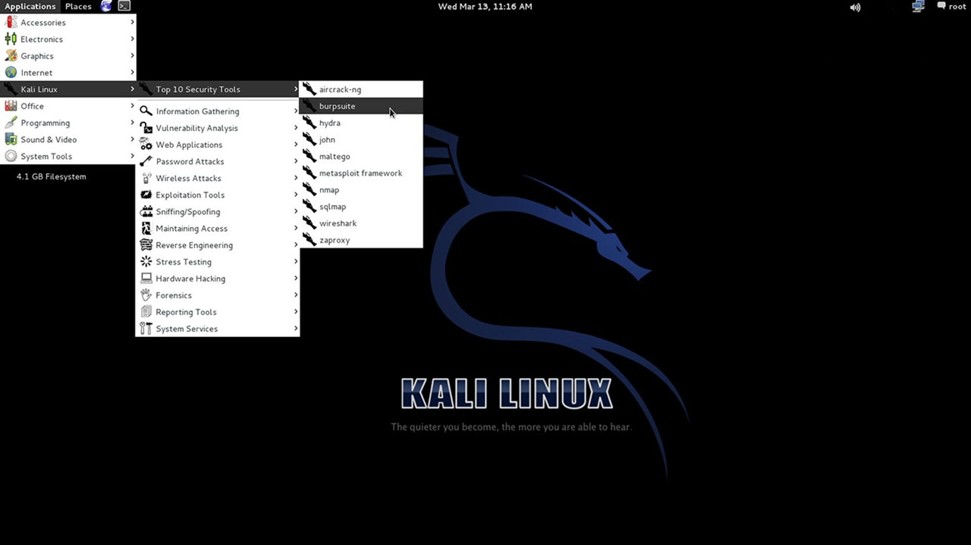

Slide 13
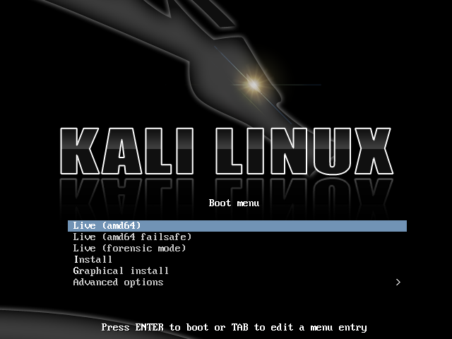

Slide 15
Why use Kali?
It is FREE!!!!!
300+ applications, from password crackers to digital forensics software.
Vast wireless device support (ARM processors).
Completely Customizable.
Multilingual Support.
Secure Development Environment.
Open source Git tree.
Filesystem Hierarchy Standard (FHS) Compliant.
Gnu Privacy Guard (GPG) secure signed packages and repos.

Slide 16
Kali’s New Features
Switched from Ubuntu to Debian.
FHS and Debian compliant.
Can now bootstrap and customize Kali ISOs.
Streaming security and package updates from Debian.
Expanded ARM development.

Slide 17
Kali’s New Features (cont)
Easy upgrade to future versions.
Customizable desktop environment. Automatable Kali Installations.
Streamlined Development Process.
Long Term Tool Packaging and Maintenance.

Slide 18
Kali’s Toolkit (300+!)
Metasploit
Nmap
Wireshark
Aircrack-ng
John the Ripper
CaseFile
THC-Hydra
Arduino
diStorm3
Sqlninja
Proxy Strike
Ghost Phisher
CryptCat
WebScarab
Android-sdk
Maskprocessor
SIPArmyKnife
FERN Wi-Fi Cracker

Slide 19
Installing Kali
Burn to a live disk, insert into disk drive, install.
Format a flash drive, install Kali Linux on it, insert into a computer, at BIOS screen select boot from USB.
Download VMware or other similar software, create a virtual machine, download and install Kali Linux onto virtual machine.
Use a Preboot eXecution Environment (PXE) to install and boot Kali Linux from a server/client network.
Via Physical Media
Via Digital Media

Slide 20
Summary
Bell Telephone (AT&T)’s UNIX > Linus Torvalds's Linux > Offensive Security’s Linux Distribution BackTrack > Kali Linux a.k.a. BackTrack 6.
Kali is the premier operating system for Penetration Testing and other related uses.
Kali was built from the ground up to replace BackTrack.
There are many platforms and installation methods that are Kali-compatible.

Slide 21
Sources
Admin. "Brief History of Unix and Linux Operating Systems." More Process, 18 Oct. 2013. Web. 23 Sept. 2014.
Aharoni, Mati. "Kali Linux | Rebirth of BackTrack, the Penetration Testing Distribution." Kali Linux. Offensive Security, 25 Aug. 2014. Web. 23 Sept. 2014.
Cimafranca, Dominque M. "Architecture Of The Linux Kernel." Architecture Of The Linux Kernel. Ateneo De Davao Universit, 13 Aug. 2009. Web. 23 Sept. 2014.
“Backtrack vs Kali." Diffen.com. Diffen LLC, n.d. Web. 23 Sep 2014.
"Linux vs Unix." Diffen.com. Diffen LLC, n.d. Web. 23 Sep 2014.
Wikipedia. "BackTrack." Wikipedia. Wikimedia Foundation, 23 Sept. 2014. Web. 23 Sept. 2014.
Wikipedia. "Linux." Wikipedia. Wikimedia Foundation, 23 Sept. 2014. Web. 23 Sept. 2014.
Wikipedia. “UNIX." Wikipedia. Wikimedia Foundation, 23 Sept. 2014. Web. 23 Sept. 2014.

Slide 22
Link to install (VMware method)
http://www.kalitutorials.net/2014/09/installing-kali-linux-on-android-via.html

