Slide 1
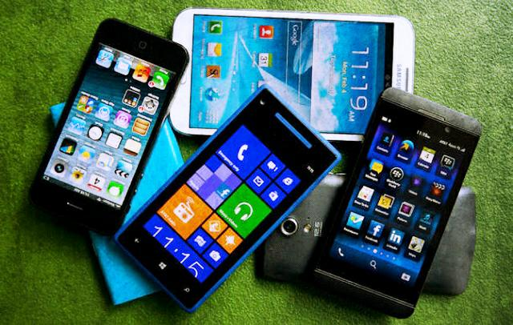
Getting The Most Out Of Your Smartphone
By Collin Donaldson

Slide 2
Conventional vs Phone/Tablet Architecture
In conventional OS architectures, the user accesses the OS via an account that has certain privileges (admin, guest). They can then interact with applications as much as their account status allows them.
Phone/Tablet OS architectures treat applications as individual users requiring their own permissions. The underlying human user is stuck with guest-level privileges.

Slide 3
Why Are You A Permanent Guest?
Safety/Security: You lack “write” access so you cannot accidentally trash your system or install unscrupulous applications.
The OS provider (Google/Apple/Microsoft, etc.) can force you to use their official app store and restrict you from uninstalling their default apps.
Your carrier can restrict you from uninstalling their default apps, changing their version of the OS (if they modified it), and “lock” you from using other carriers.

Slide 4
The Solution?
Gain “Admin” account level privileges!
This lets you:
Install your own software/firmware
Access apps and app features you couldn’t before
Uninstall default apps
Unlock your phone to use other carriers
Access hardware options (overclock/underclock the processor)
And more!

Slide 5
Terminology
Rooting: Process that enables Superuser account (root) on your Android device.
Used as a generic term for gaining Superuser/Root/Admin account status.
Derived from Linux, which Android is partially based on.
Jailbreaking: Rooting an Apple iOS device.
Apple places additional restrictions on rooting such as locking the bootloader, so the term is used for iOS rooting.
Unlocking: Usually refers to bypassing carrier restrictions.
Tethering: Using your phone as a modem (i.e. using your phone as a Wi-Fi hotspot)

Slide 6
More Terminology
Flashing: Installing different firmware or a custom-ROM onto your smartphone.
Custom-ROM: Standalone version of the OS that has been customized by someone.
Typically ROM-images are in .zip or .tar format.
Similar to a recovery image or a game emulator.
Sideloading: Downloading/Installing data on to your phone via methods outside of the official Google/Apple/Microsoft stores.
Examples: USB, Bluetooth, Wi-Fi, SD Card, etc.

Slide 7
Disclaimer!
There are some dangers of rooting your phone.
Incorrectly rooting your phone can “brick” it.
Backup your phone first, rooting will wipe it!
Voids your phone’s warranty (and some app warranties)
Your phone OS is probably not designed to be accessed via root, so it may become more unstable (buggy).
Opens your phone up to more malware if you aren’t careful.
Luckily, rooting is reversible via “unrooting”.

Slide 8
Before We Begin
Exact steps differ depending on OS, Brand, and Model, yet the process is roughly similar for all.
We will be using established root methods, not rooting a never-before rooted device.
There are also more automated services out there like OneClickRoot.
I will briefly explain the steps to manually root a Samsung Galaxy S4 and jailbreak an iPhone 6 manually.
Required: a phone (duh), a PC, a USB cable, an SD card, and 3rd party software.

Slide 9
Before We Begin (cont)
This will not cover how to flash a Custom-ROM or any other software on to your device
However, a useful thing to know for both rooting and flashing is how to get into your phone’s BIOS menu.
Typically, while the power is off, hold power + volume down. Varies depending on device.
There are many rootable devices, and often different approach for different variables (i.e. PC option, Mac option, etc.)

Slide 10
Rooting the Samsung Galaxy S4 (Android)
Download and install Samsung USB Drivers on your computer.
Go to Settings > About Device. Tap “About Device” 7 times to enable Developer options (on older Android versions, this is not necessary).
Go to Developer Options and enable USB Debugging
Plug your device into a PC via a USB cable
Download MotoChopper on your PC

Slide 11
Galaxy S4 Root (continued)
6. Extract the .zip file to your desktop
7. Double click the “run .bat” file inside the extracted folder.
8. When prompted “Allow USB Debugging?” on your phone, press “OK”.
9. In your applications drawer of your phone, check for an app called “Superuser”. If present, your phone is rooted.

Slide 12
Jailbreaking the Apple iPhone 6 (iOS)
Download Pangu Jailbreak to your computer
Connect your device to your computer using a USB cable
Enter Airplane mode, Disable Passcode from Settings > Touch ID & Passcode and turn off Find my iPhone from Settings > iCloud > Find my iPhone.
Launch the Pangu.exe file as an administrator (right-click, run as administrator)

Slide 13
iPhone 6 Jailbreak (cont)
5. Wait for Pangu to detect your device, once it has click “Start Jailbreak”.
6. Click “Already did” on the next screen.
7. Wait for the progress bar to complete. Your iPhone will reboot.
8. Once completed, you should see the Cydia icon on your home screen. If you see it, the jailbreak was sucessful.

