Slide 1
Physical Security
Collin Donaldson

Slide 2
Top Priority
Why bother with anti-virus and passwords if you leave your computer sitting unattended in public?
When you put your computer away at home or work, is it in a locked container?
Do you lock the doors of the rooms you put your computer?
Physical security is very important, ask Dr.Lewis!

Slide 3
User Control
When you think about physical security, what comes to mind first?
Who has access to your computer?
Does anyone else have an account on your computer?
Are they an administrator?
Do you trust them?
Is your computer hidden and in a secure location?

Slide 4
Mind over matter
Do you use strong passwords or biometrics to secure your computer?
Are your passwords in your head, on a sheet of paper, or in an unencrypted word/notepad document?
How safe is your computer if your computer is stolen and the thief takes out the hard drive and places it in a different computer?
Or if they insert a flash drive and load viruses or steal data?

Slide 5
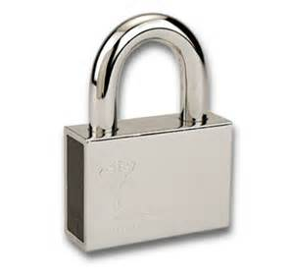
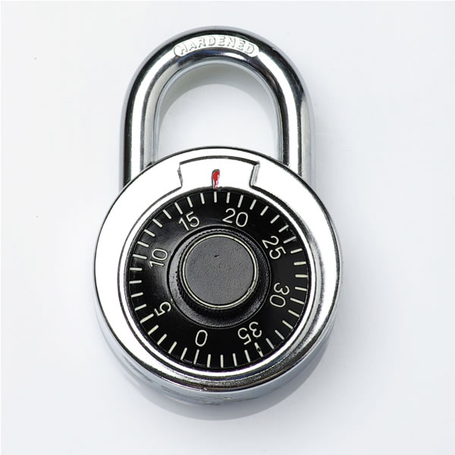
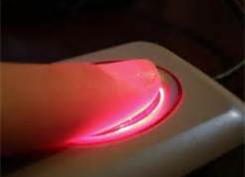
Pictures of Locks
Padlock
Combination Lock
Biometrics

Slide 6
Pro/Cons of Locks
Padlock- Fast and easy: but easily picked, skeleton keyed, or broken and key can be lost, stolen, copied, or even random keys could open lock by chance
Combination Lock- Harder to pick (tumble) and break, but slow and cumbersome to use
Biometrics-High deterrence factor and fast, but can be bypassed with a photo, gel mold, or a lifted print.

Slide 7
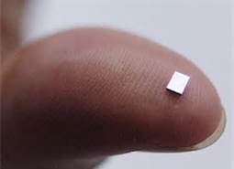
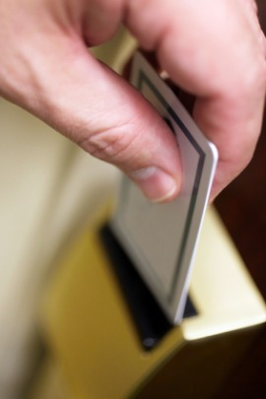
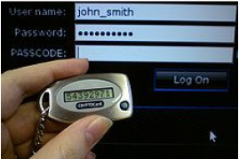
More Lock Pics
RFID Chip
Keycard
Security Token

Slide 8
More Pros/Cons of Locks
Keycard-Simplicity of a padlock but harder to bypass or hack and cannot be broken if intruder wants in, yet card can be lost/stolen/copied, latch can be propped open with a coin, latch can be taped down, or someone could tailgate in.
RFID Chip- Easily concealable, high deterrence, and unobvious, yet radio transmission can be picked up on, chip is hack-able and somewhat unreliable (heat or background noise can disable or hamper them).
Security Token- Can be outfitted with multiple types and layers of security (alarms, biometrics, locks, etc.) Susceptible to various cons from hacking to picking depending on the hardware used.

Slide 9
Disposal
Remember, computers can still be valuable when no longer in your possession!
Whether you give an old computer away your friends/family and those around them can still access your files.
Dumpster divers are out there too!
Use software like Darik’s Boot and Nuke to wipe your old drives multiple times, 3 for standard Government protocol, 7 for DOD standard.
Physically destroy old hardware, everything from hammers to gasoline are effective and fun!

Slide 10
Don’t be Stupid!
Do not say your passwords aloud!
Do not email your PII to people claiming that you are the 100th visitor and will win a car!
Memorize passwords, if written hide/secure them!
Pick a complex password, the word ‘password’ is not a good password.
Don’t leave a public computer unattended, especially without physically/electronically locking it!

Slide 11
Rules of Thumb
Have 2+ layers of security, preferably a mix of differing mediums and methodologies.
Remember that as far as security goes ease of use is inversely proportional to difficulty to bypass and vice versa.
Keep in mind your surroundings and those surrounding you.

Slide 12
FIN

