Slide 1
NSA Recommended Best Practices and the NSA’s Hackers
By Collin Donaldson

Slide 2
Road Map
Password Generation and Management
Safe Social Media
Identity Theft Protection
Securing Your Private Network
Operations Security
The NSA’s Hackers: The TAO Unit

Slide 3
Password Generation and Management
You all have been told dozens of times the importance of choosing strong unique passwords
Passwords that are
  Long (12+ characters)
  Unique (not used elsewhere)
  Contain numbers, lower/uppercase letters, and special symbols
  Do not contain words
However, there are other considerations to be made

Slide 4
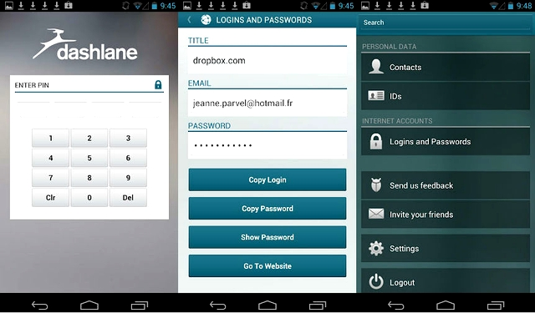
Password Generation and Management
Another consideration is using non-password access control techniques (biometrics, smart-cards, etc.) appropriately.
Biometrics can be effective but discretion is required in choosing which one to use, as they vary wildly in security/usability
Likewise, other methods used often at workplaces and for mobile devices such as smart cards, PINs, and pattern unlocks have their pros and cons.
Another important consideration is whether or not to use software like Dashlane to generate/manage passwords for you

Slide 5
Safely Using Social Media
Social media poses a major threat to both information security for individuals and organizations alike
Some of the threats of using social media include:
  Identity Theft (described later)
  Loss of employment/ Loss of opportunity to gain employment
  Defamation
  Cyberbullying/extortion
  Stalking
  Doxing
  Criminal charges pressed

Slide 6

Safely Using Social Media
Again, everyone has probably heard the “dos and don’ts” of social media, but some are more important
Posting information, particularly Personally Identifiable Information (PII), opens you up to unnecessary threats, so limit how much you post
Another idea is to purposely falsify information
Remember: anything you post can be used against you in the court of law, even if you are a victim

Slide 7
Safely Using Social Media
Probably the single most important step to safely use social media is to keep a high level of vigilance regardless of the social media platform and its context
DO NOT assume what you post is private or anonymous
Enable privacy settings for all the social media accounts you use (can be partially automated with 3rd party software like AVG privacy fix)
Social media platforms like Snapchat, Yik Yak, and Fade: Nothing Lasts Forever all claim to provide various degrees of anonymity, whether that is true is questionable

Slide 8

Identity Theft Protection
As outlined in the previous counter-surveillance presentation, information brokers can discover and share a lot of information about you just from what you put on the internet
This makes it much easier for identity thieves to steal your identity
There are two main ways to avoid this:
  Follow the steps outlined in the counter-surveillance presentation (namely unsubscribe from services that log your info)
  Subscribe for identity theft protection, or simply keep a solid track on your finances and other transactions

Slide 9
Securing Your Private Networks
It is worthwhile to reiterate private network security methods, even though many of them are common InfoSec knowledge.
Steps to take include:
Replace the default password with a strong password of your own
Do not broadcast your SSID
Ensure your network and all endpoint devices are encrypted via WPA2 if possible
MAC filtering is also advisable for adding a further layer of security

Slide 10
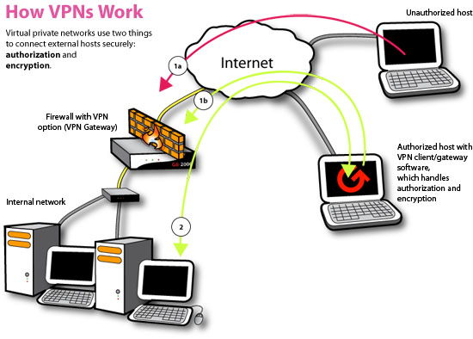
Securing Your Private Network
Some other advice:
Disable remote administration
Enable strict NAT
Close any unnecessary ports on your router
Use a VPN or onion routing for extra security

Slide 11
Operations Security
OpSec is: the process of identifying critical information and determining if it is observable and useful by adversaries.
The idea is to protect little pieces of data that could be grouped together by an adversary to reveal a bigger picture
  “Loose lips sink ships”
Not to be confused with operationAL security
Related to InfoSec, Communications Security (COMSEC), Signal Security (SIGSEC), Transmission Security (TRANSEC), and counter-intelligence.
Originally a military term aimed at opposing armies, the term has expanded to civilian use in reference to hackers, industrial espionage, law enforcement, and mass surveillance.

Slide 12
Operations Security
OpSec can be considered a subset of risk management aiming at keeping information confidential
It includes identifying four phases: critical information, threat analysis, vulnerability analysis, and countermeasures
Phase 1: What is critical to you or your organization? What information can lead to clues about said information?
Phase 2: Who is the adversary and what are their capabilities? Who wants or needs our information? Is the threat active, passive, or inadvertent?
Phase 3: How vulnerable is the information? What can we do to make it more secure?
Phase 4: Eliminate/reduce vulnerabilities, disrupt information collection, or prevent accurate information interpretation

Slide 13
Operations Security in InfoSec Example
Situation: Company employees are attending an important conference to showcase company technology
Phase 1: Trade secrets concerning the technology to be showcased such as specifications, blueprints, and emails about the project
Phase 2: Rival companies, domestic/foreign intelligence, disgruntled insider, malicious hackers
Phase 3: Employees are using public Wi-Fi, posting about the conference on social media, and information regarding the technology (i.e. emails) are not encrypted
Phase 4: Managers make employees use a company VPN, moderate social media and ask employees to refrain from posting anything, and all critical information is encrypted

Slide 14
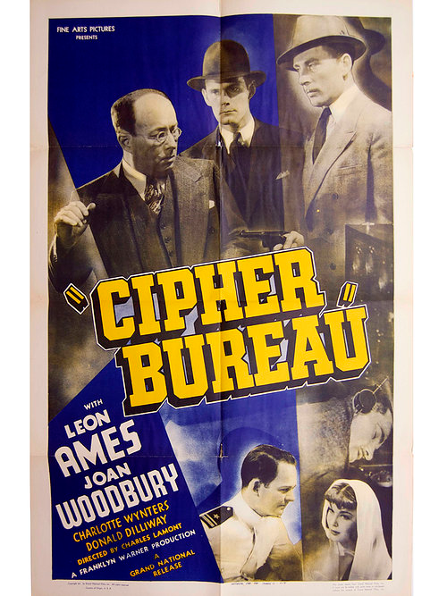
The NSA’s Hackers: The TAO Unit
The NSA has been involved with national security regarding computers and signal intelligence (SIGINT) since its inception in 1952, and even before then by its predecessor The Cipher Bureau (a.k.a. The Black Chamber)
Since Edward Snowden’s leaks, the organization has become synonymous with mass surveillance and hacking
However, it is the activities of the NSA’s Tailored Access Operations (TAO) unit people are actually referring to

Slide 15
The NSA’s Hackers: The TAO Unit
The TAO unit is the centerpiece of the NSA’s SIGINT operations, of over a 1,000 military and civilian employees and assisted by the CIA, FBI, Britain’s GCHQ, and major companies such as Sprint and Microsoft
Some of TAO’s known targets include:
  China
  OPEC
  Mexico’s Secretariat of Public Security
  Tor/Firefox users
  International GRX (tele communications) provides like Belgacom
  Optical submarine fibers and fiber providers

Slide 16
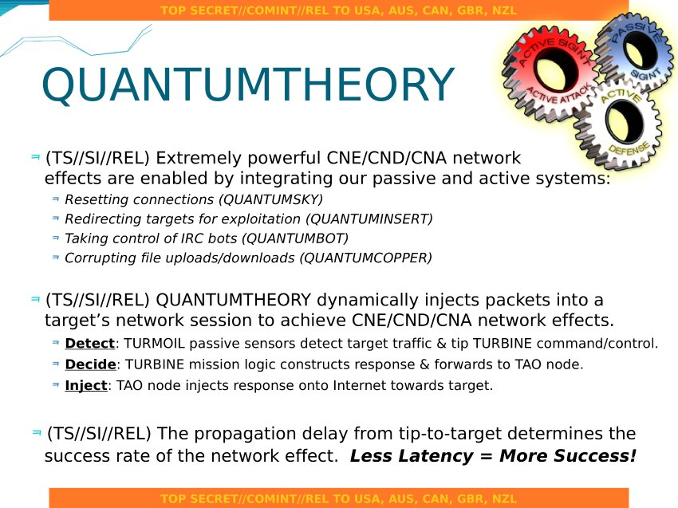
The NSA’s Hackers: The TAO Unit
Some TAO attack vectors include:
  Intercepting purchased computers and installing them with spyware/hardware
  Installing backdoors in company servers and software/hardware products
  Spoofing telecommunications networks
  The ANT catalog showcases a variety of R&D developed software and hardware attack vectors

Slide 17
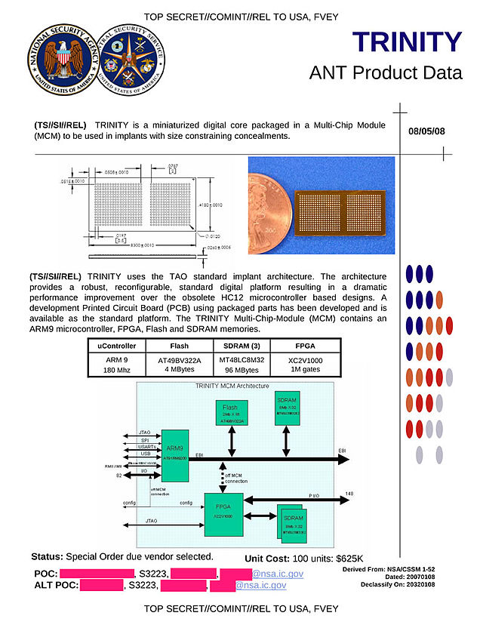
The NSA’s Hackers: The TAO Unit
Some TAO codenames:
QUANTUM attack suite
XKeyScore : Vulnerability database
FOXACID: Browser exploits
CANDYGRAM: Cell tower spoofer
TOTEGHOSTLY: Win-phone Remote Control
RAGEMASTER: VGA signal interceptor
COTTONMOUTH: Compromised USB/Ethernet
HOWLERMONKEY: RF transmitter
SOMBERKNAVE: Remote Access
GENESIS: Phone bug
IRATEMONK: Firmware exploiter

Slide 18
TAO Video
https://www.youtube.com/watch?v=pOMBZPOIigA

