Slide 1
Logic Bombs
By Collin Donaldson

Slide 2
Definition
A logic bomb, also called slag code, is a sequence of code that executes a malicious task, such as clearing a hard drive or deleting specific files, when it is triggered by a specific event.
The event trigger is referred to as positive or negative. Positive means when an event has happened (i.e. a certain date and time is reached) and a negative is when something does not happen (i.e. an admin does not login in for a day).

Slide 3
Background
Logic bombs are not technically viruses because they are not designed to propagate themselves.
However, they can be used in junction with viruses.
Not to be confused with a time bomb (think how free trials expire).
Commonly used by insider threats.
The first logic bomb ever recorded was planted by the CIA on the Trans-Siberian Pipeline after a KGB defector codenamed “Farewell” tipped the CIA off that the computer running the pipeline was stolen from a Canadian firm.

Slide 4
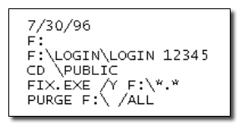
Positive Trigger Example

Slide 5
Negative Trigger Example
Julian Assange of Wikileaks
The reason he has not been imprisoned yet is because he has set up a logic bomb in the Wikileaks system that will release all of the information in every channel to the public if Assange does not enter a specific code into they system daily.

Slide 6
Defenses
Backup all data (preferably more than once) and keep it separate from the original data
Regular AV scans, network sniffing, and manual monitoring
Revoke access to potential insiders (i.e. disgruntled employees) and quarantine their effect on systems.
Password management
Digital Forensics

