Slide 1
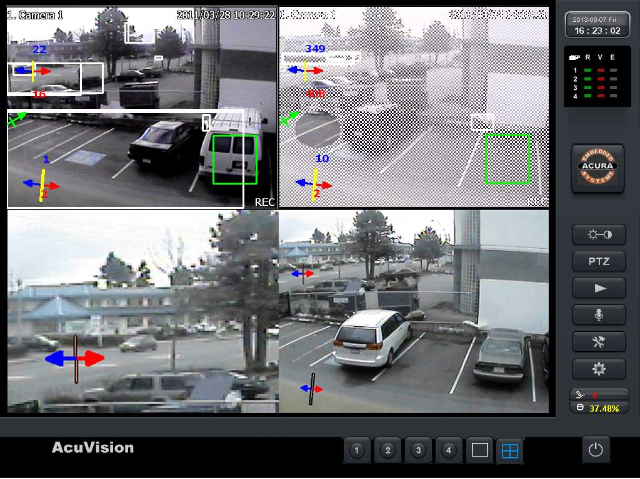
On/Offline Countersurveillance
By Collin Donaldson

Slide 2
The Difficulty of Modern Countersurveillence
Cyber-physical/Embedded System and Cloud Proliferation
Big Data marketization (Data Brokers)
The paradox of countersurveillance (Info in, Info out)
Increased Intelligence Gathering and Sharing
  Between Governments, Companies, etc.
  Doxing (Anonymous, “Human Flesh Search Engine”)

Slide 3
Countermeasures
First Step: Decide how private you want to be
Second Step: Discover specifically who tracks you
Third Step: Control your privacy

Slide 4
Step 1: Ask Yourself
Do you care how visible your social media posts are?
How about your email address?
Location?
Search history/preferences?
Purchase history?
Financial information?
Decide approximately what you wish to safeguard

Slide 5

Step One: Ask Yourself (cont.)
How much convenience will you sacrifice for PSA?
  i.e. The cloud is more convenient than physical storage, but is also less PSA

Slide 6
Step 2: Find out who tracks you
Services like Disconnect and Mozilla Lightbeam will overtime collect information on people that try to follow you
Software like NoScript can block all scripts running on a page, but will also display all the trackers looking at

Slide 7
Step Three Part One: Stop Current Privacy Violations
Change your social media preferences (can automate this with software like AVG’s Privacy Fix)
Use services like Abine's Blur and Dashlane to create and maintain proxy emails, passwords, debit cards, and more
When you have to give information (i.e. security questions) falsify them, when legal
  Consider creating different professional/personal personas

Slide 8
Step Three Part One: Control Your Current Privacy
Check privacy policies, especially for freeware
Default to
  Private Browsing
  Anon Browsing: DuckDuckGo, Startpage, Disconnect Search, Ixquick
  HTTPS
  Anti-tracking
  Block 3rd Party Cookies

Slide 9
Step Three Part One: Control Your Current Privacy
Route traffic through a VPN or Tor (may be covered more in depth in future meetings)
HTTPS secure emails, or use alternative emails (proxies, homebrews, privacy-dedicated like Riseup or MyKolab)
Use a self-destructing text/chat service
Limit location tracking
Turn off Wi-Fi and Bluetooth when not in use
Use PC-level style security for your mobile devices

Slide 10
Step Three Part One: Control Your Current Privacy
Pay with cash or disposable debit cards
Make sure no one can see/hear your keystrokes when entering a PIN or password
Keep devices and documents relatively hidden and secured
Enable device tracking in the event of theft/loss
Defense in Depth

Slide 11
Step Three Part Two: Control Already Exposed Information
Delete unused “orphan” accounts
Use software or shell commands to wipe old data
Adapt privacy-friendly practices
Delete records of credit cards at existing companies that don’t need it
Opt-Out of data broker knowledge list

Slide 12
Data Brokers to Opt-Outs
NAI (Network Advertising Initiative)
DMAchoice (online and off)
DAA Ad Choices
Spokeo
Pipl
ZoomInfo
Whitepages
PeopleSmart
CheckPeople
BeenVerified
Intelius
PublicRecords360
ZabaSearch
US Search
PeopleFinders
PeekYou

Slide 13
Alternatively: Automated Opt-Out Services (paid)
Safe Shepard
Reputation Defender
Delete Me

