Slide 1
Android
By Collin Donaldson
With Strong Contributions From:
Anthony Kopczyk

Slide 2
Architecture

Slide 3
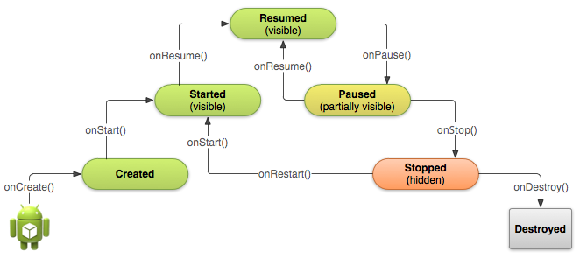
Activity Life Cycle
Notes:
3

Slide 4
Activity Life Cycle - onCreate
Set the Activity's content View; Event Listeners
Find references to any needed Views
Passed-in Bundle allows a programmer to restore the Activity to its previous status
Notes:
4

Slide 5
Activity Life Cycle - onStart
Called when the Activity becomes visible
Initialize any properties requiring information from the Window and contained Views
Notes:
5

Slide 6
Activity Life Cycle - onResume
Called when the Activity is visible and in the foreground
Initialize ability for user to interact with the Activity
Notes:
6

Slide 7
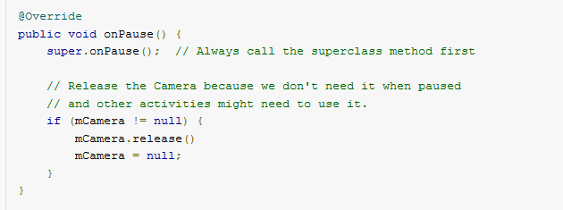
Activity Life Cycle - onPause
Called when the Activity is no longer the foreground
Release system resources
Notes:
7

Slide 8
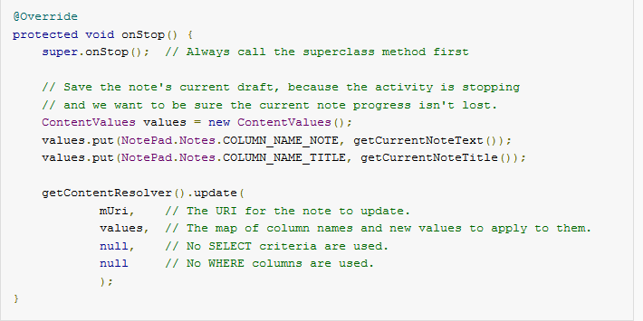
Activity Life Cycle - onStop
Called when Activity is no longer visible
Perform larger operations like writing to a database
Save Activity's state for onStart
Notes:
8

Slide 9
Activity Life Cycle - onDestroy
Called when the system is in need of resources
Last chance to free resources and avoid memory leaks
Notes:
9

Slide 10
Activity Life Cycle
Notes:
10

Slide 11
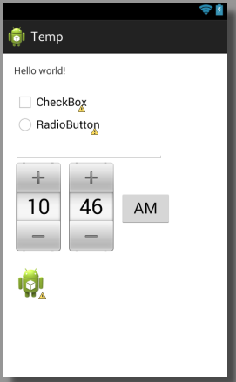
Views
A building block for UI components
Responsible for drawing and event handling
Each View has an id
findViewById(int)
Text box, check box, radio button, time picker, and image view
Notes:
11

Slide 12
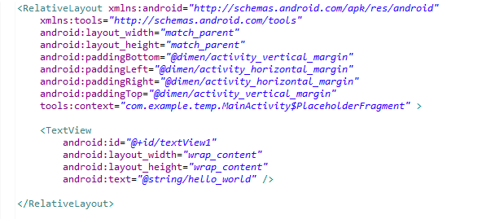
XML
Eclipse IDE
Uses XML files to set up the mobile application
Android Layout File
Notes:
12

Slide 13
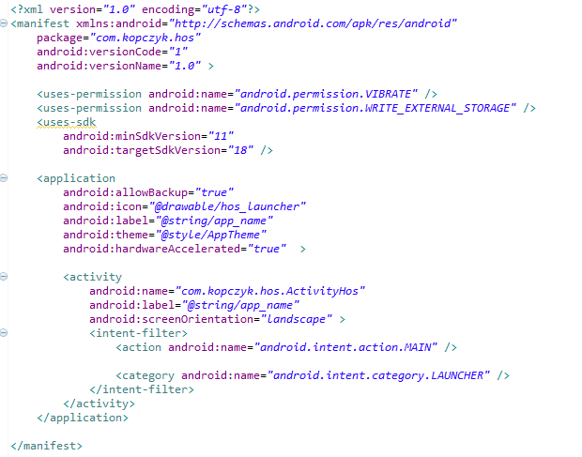
XML - Android Manifest
Contains properties of the application
Permissions, SDK, Icon, Activities
Android Manifest File
Notes:
13

Slide 14
XML - Layout
Defines the layout of the Activity
Set View id values
Could achieve the same results through java code
Android Layout File
Notes:
14

Slide 15
XML – Other Files
Menu – Defines the Menu to bring up
Dimens – Defines dimensions with names and values
Strings – Defines strings with names and values
Lint – Defines exclusion or customization of lint checks
Styles – Defines the style to use in the Activity
Attrs – Defines custom attributes that may be used in XML Layout files
Notes:
15

Slide 16
Input Events
OnClickListener
OnLongClickListener
OnFocusChangeListener
OnKeyListener
OnTouchListener
OnCreateContextMenuListener
Notes:
16

Slide 17
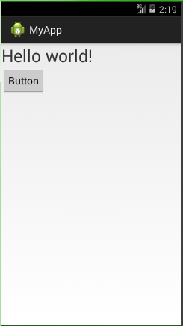
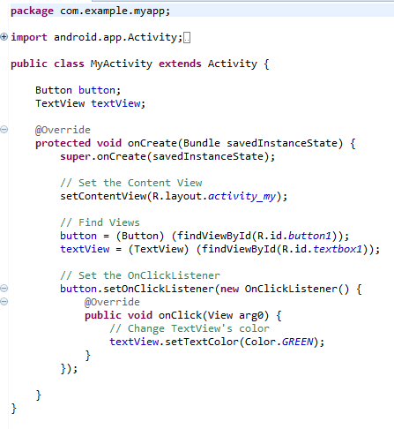
Input Events
Pre-Click
Post-Click
Notes:
17

Slide 18
Intents
Starts an activity or service
Service – operates in the background without a UI
Intents can be sent to other Apps
sendBroadcast()
sendOrderedBroadcast()
sendStickyBroadcast()
Notes:
18

Slide 19
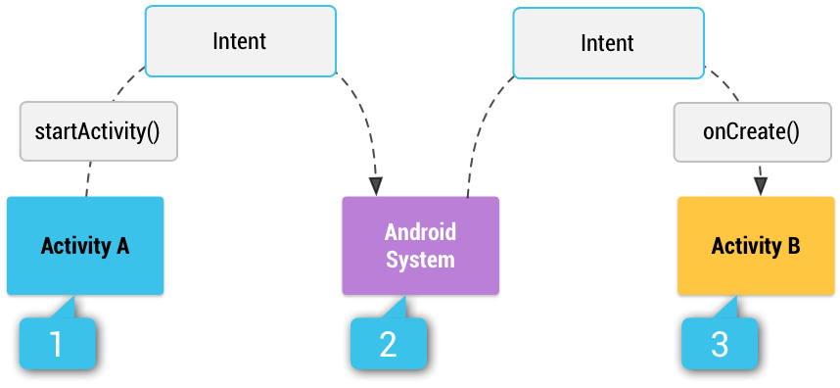
Intents – Explicit vs. Implicit
Explicit Intents specify a component to start.
Implicit Intents give a general action to perform.
Notes:
19

Slide 20
Intents - Intent-Filter
Specified in the Manifest file
Contains the types of Intents the app wants to receive
Allows one app to send an Intent to another
If no intent filters are specified the activity may only be started with an explicit Intent
To ensure security, always use explicit intents when starting a Service
Users can not see when a Service starts
Notes:
20

Slide 21
Permission
Allows developers to use security features
Provides additional capabilities to consumers that otherwise would be impossible
“A central design point of the Android security architecture is that no application, by default, has permission to perform any operations that would adversely impact other applications, the operating system, or the user”
Notes:
21

Slide 22
Permission
When an Application is installed the consumer must accept the permissions requested by an application
Permissions are defined in the Manifest file
Notes:
22

Slide 23
Permission
Facebook Messenger
Identity
Contacts/Calendar
Location
SMS
Phone
Photos/Media/Files
Camera/Microphone
Wi-Fi Connection Information
Device ID & Call Information
Angry Birds
Identity
In-app purchases
Location
Photos/Media/Files
Wi-Fi Connection Information
Device ID & Call Information
Notes:
23

Slide 24
Permission
Camera/Microphone
Allows consumers to use video chat
Photos/Media/Files
Allows consumers to send pictures they have previously taken
In order to give access, one must become more vulnerable – like opening ports on your router
Notes:
24

Slide 25
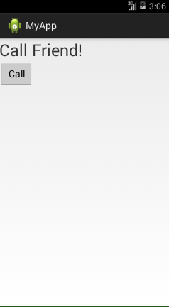
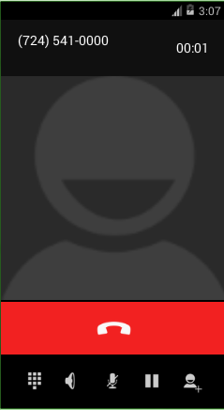
Permission
Using Intents and Permissions a developer can make his/her app call a phone number.
Notes:
25

Slide 26
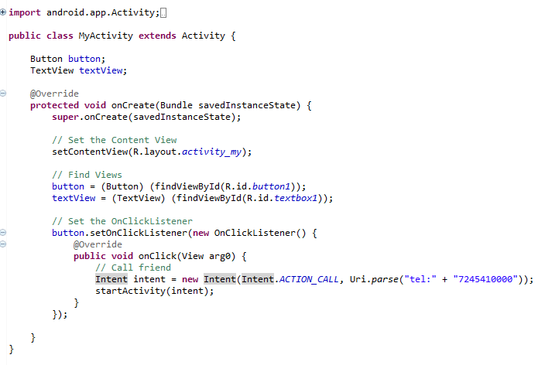
Permission
Activity Class
Notes:
26

Slide 27
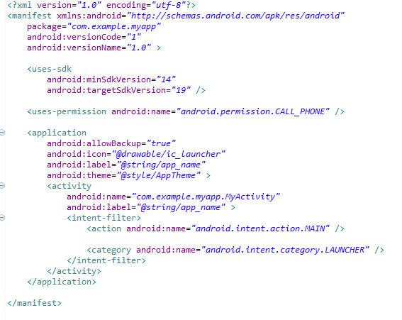
Permission
Manifest File
Notes:
27

Slide 28
Rooting/JailBreaking
Rooting is the process of gaining root (a.k.a. administrator or super user) to a smartphone.
By default, all smartphones only give user’s “guest” privileges.
This is for both safety reasons and to prevent users from doing things developers/carriers don’t like (i.e. getting rid of their bloatware).

Slide 29
Pros and Cons to Root
Pros
Cons
Download more apps and use existing apps to fullest potential
Flash custom ROMs
Access locked hardware/software features
Tune performance
No more bloatware
Wi-Fi/Bluetooth Tethering
Use apps designed for other phones/carriers
Install apps to an SD card
If done incorrectly, can possibly brick phone
Voids any warranties you have (even if you reverse the root)
Less stable/more bugs

Slide 30
General Security Vulnerabilities
Flaws in Android OS itself
Flaws in phone software/firmware
Conventional browser based virus
Vulnerabilities within downloaded apps
Unconventional attacks (injecting code into accelerometers i.e.)

Slide 31
Specific Vulnerabilities
Backdoor.AndroidOS.Obad.a does not have an interface and works in background mode, making it difficult to analyze, but that was only part of the challenge, according to Unuchek. The application exploits an error in the DEX2JAR software – generally used by researchers to convert APK files into the Java Archive (JAR) format) – that disrupts the conversion of Dalvik bytecode into Java bytecode and makes it difficult to run a statistical analysis of the Trojan.
Obad.a also targets an error in Android’s processing of the AndroidManifest.xml file, which exists in every Android application to describe the application’s structure, define its launch parameters and more. Although Obad.a modifies AndroidManifest.xml so that it doesn’t comply with Google standards, the vulnerability enables it to still be processed correctly, complicating any attempt to run dynamic analysis on the application.

Slide 32
Next Time
We will use a Metasploit (with a specific module) to attack an android device.
The “android device” will be a virtual android machine running on an emulator
We may also write a virus and Python and deploy it to a device.

