Slide 1
Google Hacking: Tame the internet
Information Assurance Group 2011

Slide 2
What is Google Hacking?
My Def: Using Google in a clever way to find things that shouldn’t be found.
Wikipedia: Gogle hacking is a computer hacking technique that uses Google Search and other Google applications to find security holes in the configuration and computer code that websites use.

Slide 3
Advanced Search Operators
OPERATOR:KEYWORD
intitle / allintitle - in The title bar
inurl / allinurl – in the URL
link – pages that link to
site - only that site
filetype – only with a certain extension
cache – only search cached copies of pages.

Slide 4
Logic Operators + Numbers
##..## - Number ranges ie. 1..1000
* - Wild card “I * cats” = I love cats, I hate cats, I eat cats…
AND OR NOT –
AND, is default, it tries to find both. TRIES.
OR , I love (dogs OR cats) , but not both. Use pipe symbol |
NOT , use a “minus sign” I love pets –dogs , all but dogs.
+ , use a “plus sign” to force a word to be included.
( ) , Use parentheses for grouping
“ “ , Use quotes for phrases

Slide 5
Getting Creative
Can you think of a way to find social security numbers?
100000000..199999999
What happens? Google knows you’re up to no good.
Try numrange:100000000-199999999 instead
Suggest you are looking for social security numbers, add ssn
Get rid of garbage using the NOT operator -123456789
Specify only SQL Databases. filetype:sql

Slide 6
Using the GHDB
Luckily, there is a database of Google Hacks to find all sorts of things.
http://www.exploit-db.com/google-dorks/
Vulnerable Servers / Files, Login Portals, Passwords, Errors, and more!
Many older Hacks no longer return anything interesting.
Why?

Slide 7
GHDB Demo 1
DVR Login http://www.exploit-db.com/ghdb/1397/
allintitle:”DVR Login”
Filter out some garbage results by subtracting words
-issue -failed -free -forum -download –youtube
Click on some of the links.
The Default login…. admin / admin , But wait!
Lets talk legality….

Slide 8
Is it Legal?
Is it Legal to type admin / admin to see if you can log in?
What about if it didn’t work?
Is it legal to search for these things in google?
Is it legal to click on the search results?

Slide 9
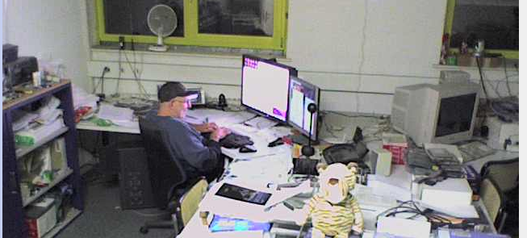
Office Cams
http://www.exploit-db.com/ghdb/1008/

Slide 10
GHDB Demo 2
http://www.exploit-db.com/ghdb/3612/
Somewhere in the links is http://210.75.8.13/level/15/exec/-/clear/ip/igmp/group
A Whois reveals it is in china somewhere.
You can execute commands
But don’t.

Slide 11
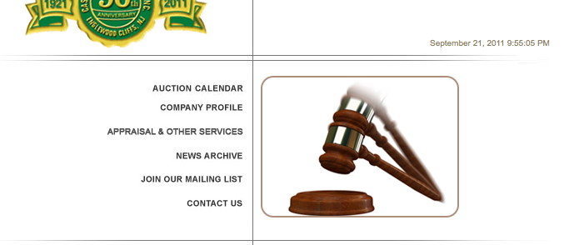
GHDB Demo 3
filetype:sql “phpmyAdmin SQL Dump”
First site, sql database dump. Emails, logins, passwords..

Slide 12
Smarter Google Hacking
It’s fun to just find examples of errors through google,
Say you want to focus on something specific.
Start with site:specificsite.com
Then systematically look for: error pages, different file types, login pages….

Slide 13
One More Thing.
Way Back Machine
Allows you to view web sites from the past.
www.archive.org
Try looking at IUP’s website, in 1999? 2001?

Slide 14
END
Information Assurance Group 2011

