Slide 1

IUP Cybersecurity Club
Meeting 3: 9/18/2024

Slide 2
Overview
We’ll be using the NCAE Minihack to explain the following
  How to read a Network Topology Map
  What is/How to configure:
    Services
    Router
    Web Server
    Database
    DNS
    Backup Servers
Plus some fun CTFs at the end!

Slide 3
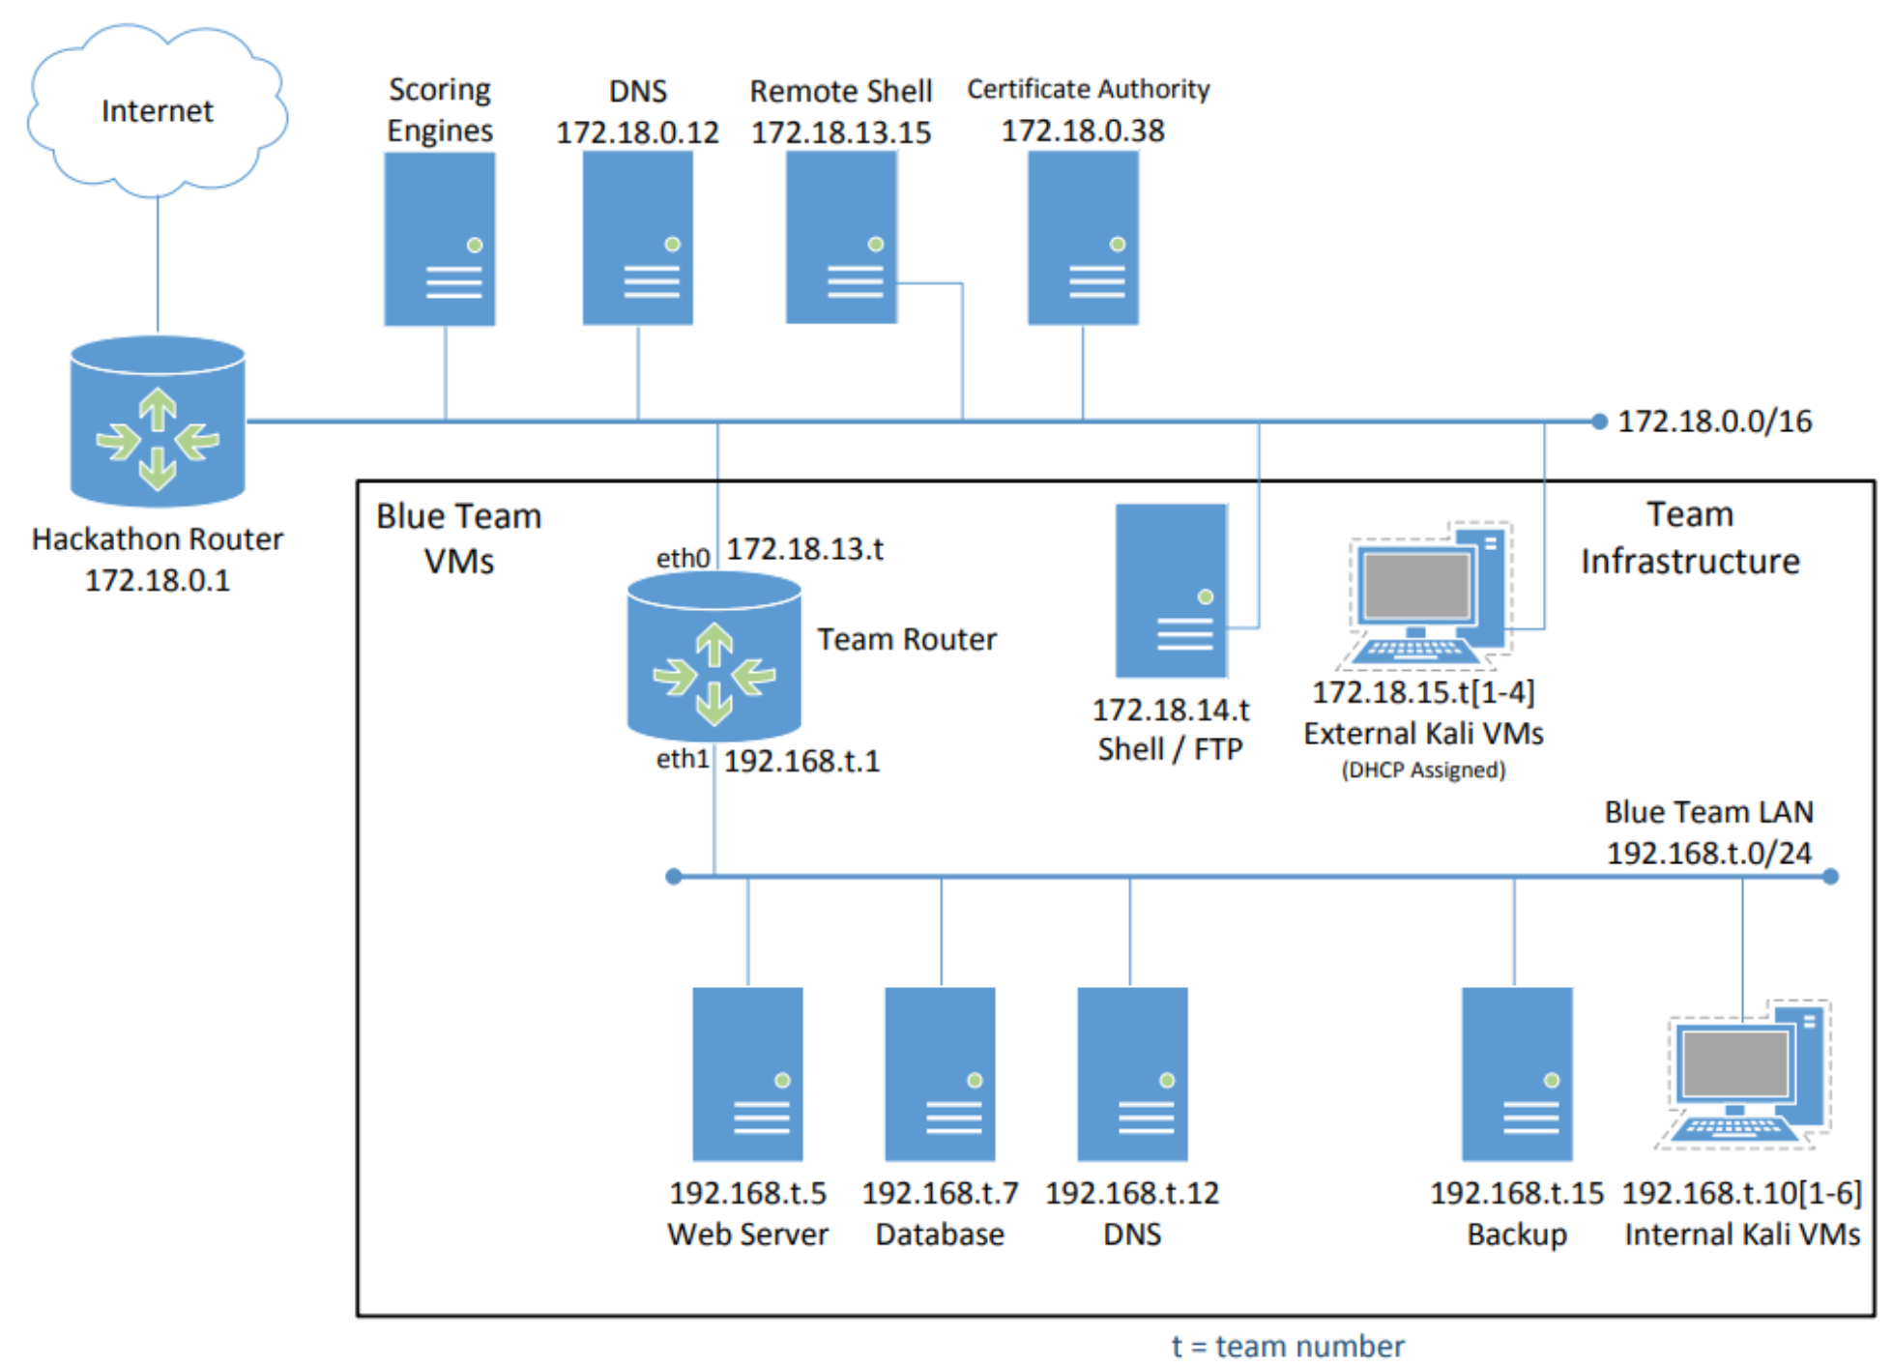
NCAE Topology Ex.
Must set up the following
  Router
  Web Server
  Internal/External Clients
    (Kali machines)
Various Considerations
  External access?
  Layered security
  Access Control

Slide 4
What are we working with?
Hardware – The Router/Web Server/Database machine
  The physical machine that these services operate on
Operating System on the hardware
  Windows, MacOS, Ubuntu, CentOS, Kali Linux, ParrotOS, etc.
Services within the machine
  Ex.
    Apache HTTP Server (httpd) – Web Server
    MySQL – Relational DB management service
    OpenSSH (sshd) – Handles remote login and SFTP through SSH
    DNSMasq – Lightweight DNS forwarder and DHCP server
    Systemd – System and Service manager for Linux operating systems
  We will use a shell (terminal) to configure various required services on these machines

Slide 5
Basic Process to Understanding a Service
What does the service do?
  What is the purpose of the service
  How does it function
  What are other services that require this service?
  What other services does this require if any?
Where are the ‘important’ files?
  Locate the configuration files
    Level of configuration matters – By user or system-wide
Does the service require a restart?
  More often than not services require a restart when configuration files are modified
  Is it running by default?
  Did the service stopping require the restart of any other services

Slide 6
Ex. Gunicorn on a Web Server
Gunicorn (Green Unicorn) is a Python WSGI HTTP server
1. What does the service do?
  Handles HTTP requests from clients (web browsers)
  Dispatches them to the Python application using the WSGI interface
  Normally used with Django or Flask (Python Web Dev libraries)
2. Where are the important files?
  Log files : /var/log/gunicorn
    Sometimes /logs
  Systemd service file
    /etc/system/system/gunicorn.service
  Socket file – if using Gunicorn with a socket
    /run/gunicorn.sock
Does the service require a restart?
  Yes – after making config changes or redeploying new version of python application
    Sudo systemctl restart gunicorn
  You may also have to restart the web server (nginx, apache, etc.) after restarting gunicorn

Slide 7
Now We’ll Look at the Machines
What are these devices and what services do they use? How are they configured?

Slide 8
Understanding IP addresses and netmasks
Public/Private IP
  Public IP:
    Your public IP is a globally unique ip address assigned to your device by your ISP
    “regional internet registries” (RIRs) manage allocating the addresses
  Ex.
    When you visit google.com, your device connects to google’s public ip address
  Ex. 2
    Home/Office networks have a router that is assigned a single public IP address
      All devices behind that router share this public ip address when communicating with the rest of the world (google.com for example).
  Private IP
    Used within a local network
    Certain ranges are reserved for local networks only
      10.0.0.0 to 10.255.255.255 (Class A)
      172.16.0.0 to 172.31.255.255 (Class B)
      192.168.0.0 to 192.168.255.255 (Class C)

Slide 9
Understanding IP addresses and netmasks
Common Netmasks and Their CIDR Notation
255.0.0.0 or /8 (Class A):
  Network: First 8 bits (11111111 00000000 00000000 00000000)
  Hosts: Last 24 bits
  Example: 10.0.0.0 with a /8 allows up to 16.7 million host IP addresses on that network.
255.255.0.0 or /16 (Class B):
  Network: First 16 bits (11111111 11111111 00000000 00000000)
  Hosts: Last 16 bits
  Example: 172.16.0.0 with a /16 allows for 65,534 hosts on the network.
255.255.255.0 or /24 (Class C):
  Network: First 24 bits (11111111 11111111 11111111 00000000)
  Hosts: Last 8 bits
  Example: 192.168.1.0 with a /24 allows for 254 hosts on the network.
255.255.255.255 or /32:
  Network: All 32 bits (11111111 11111111 11111111 11111111)
  This is a single IP address, often used in routing for specifying a single host.

Slide 10
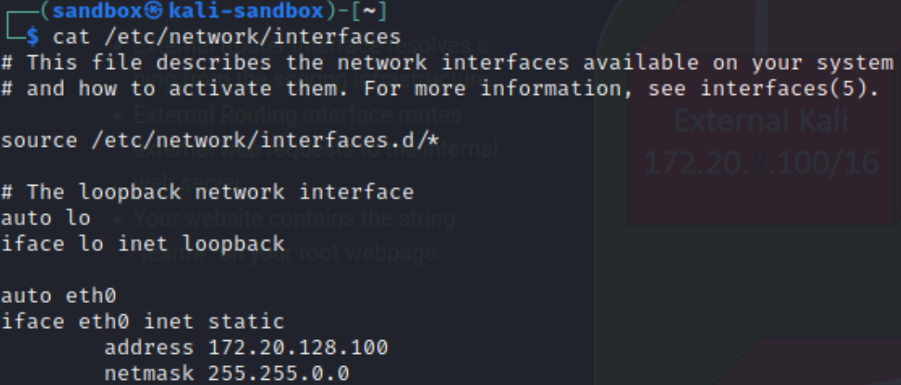
Understanding IP addresses and netmasks cont.
The “netmask” section tells us that the first 16 bits are the network and the last 16 are the host
This device will be able to connect to other devices that are 172.20.x.x

Slide 11
Brief on IPv4 vs IPv6
IPv6 provides an enormous address space compared to IPv4:
  IPv4 uses a 32-bit address space, offering about 4.3 billion possible IP addresses.
  IPv6 uses a 128-bit address space, offering 2^128 (about 340 undecillion addresses)
    This effectively eliminates the risk of running out of IP addresses.
To put it in perspective:
  IPv4: ~4.3 billion addresses. 2^32
    4,294,967,296
  IPv6: ~340 undecillion addresses. 2^128
    340,282,366,920,938,463,463,374,607,431,768,211,456

Slide 12
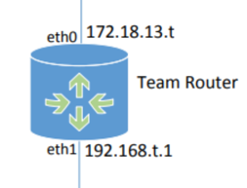
Router: How does it work?
Routing – forwarding IP packets
packets – have a header/payload
  Header contains info about the packet
    Origin and Destination IP address
  Payload
    The actual data
But how do we configure one?

Slide 13
How to configure a Router
Routers must have two different network interfaces
  “network interfaces” – a way to interact with a network
  Two are required because each has to be configured differently
  Traffic has to pass THROUGH the router, therefore…
    It must have an interface to receive external traffic (packets) and send it internally to where it needs to go
    and one to receive internal traffic (packets) and send it externally to where it needs to go

Slide 14
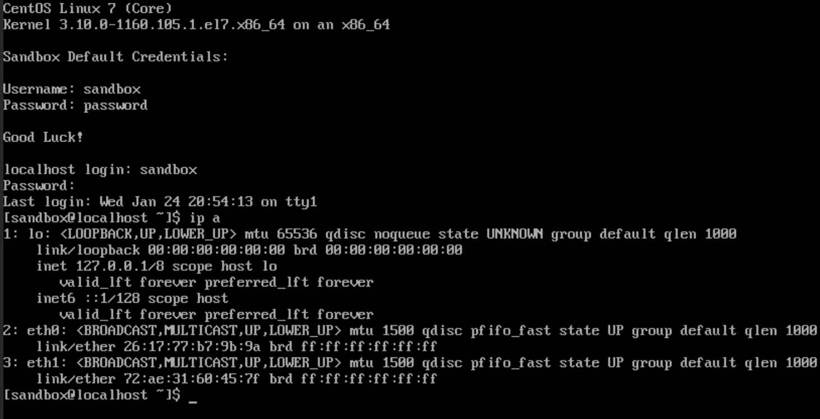
Cent OS `ip a` example

Slide 15

Web Server: How does it work?
A web server is anything that can run a web service and have some form of open port for web access
  Could be sent through a router or exposed to the internet directly (not recommended)

Slide 16
How to configure a web server: ex w/ apache2
  Start apache2 service
    `sudo systemctl enable apache2` (this enables it to start when the machine starts – for future convenience)
    `sudo systemctl start apache2`
    Run `systemctl status apache2` and verify it is running
  Navigate to the /var/www/html and view the index.html file
    This is the static file being served by the apache web server
      Standard location for the index file in Apache
  Another web server like nginx is very similar in its’ setup process

Slide 17
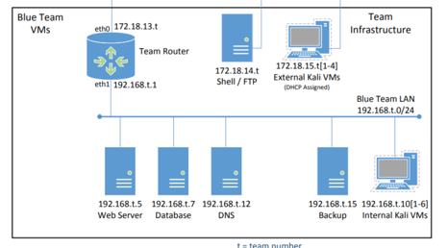
HOWEVER
Getting a web server to the outside world in this scenario is more complicated
  Data has to be requested through the router, sent to the web server, and sent back through the router to be displayed on the public side
It’s important to enable firewalls on your router to support this as well– external and internal zones
Port forwarding would also have to be configured

Slide 18
For next week: a minihack exercise!
Sign up for an account at the ncae cyber games site
  https://ncaecybergames.org
Start up a quick sandbox instance of the minihack
Read the instructions on how to use it
Familiarize yourself with some linux commands
  How to use Nano/Vi text editors
  How to ‘cd’ across directories
  systemctl, ping, cd, nano, vi, and of course sudo
Review this ppt before the meeting for a refresher
It’s not that bad! We will be here to help out

Slide 19
PicoCTF Challenges
Work together with the people next to you to try and solve the following challenges:
  Commitment Issues
  First Grep
  Bases
These challenges will introduce some tools/concepts that will be used in the CTF portion of the NCAE Cyber Games
If those were too easy, try:
  GET aHEAD
  IntroToBurp
  LocalAuthority
These challenges will give exposure to the concepts covered in the next HTB module

