Slide 1
IUP Cybersecurity Club
Meeting 2: 9/11/2024

Slide 2
National Public Data
Who are they/what do they do?
Data broker company that performs employee background checks
Primary service is collecting information from public data sources, including criminal records, addresses, and employment history, and offering that information for sale
Data breach first occurred in April
Affected over 270 million Americans
Includes names, addresses, and social security numbers
Does this affect me?
Probably…
https://npd.pentester.com/
What to do?
Freeze your credit at the three major credit reporting agencies
https://www.experian.com/freeze/center.html
https://www.equifax.com/personal/credit-report-services/credit-freeze/
https://www.transunion.com/credit-freeze

Slide 3
Using Linux
Basic Commands and Server Navigation

Slide 4
Installing Parrot OS VM
Open VMware Workstation Pro
File > New Virtual Machine
Select “Typical” install
Select “Installer disc image file (iso)”
Browse to Parrot OS iso
For Guest operating system, select “Linux”
Version: “Other Linux 6.x kernel 64-bit”
Choose a name and location of VM
Ex: “C:\Users\<Your User>\.vmware\Parrot OS VM”
Choose disk capacity (16 GB or more)

Slide 5
Installing Parrot OS VM (cont.)
Click “Customize Hardware…”
Change memory allocation to at least 6 GB (for install, can be tweaked later)
Change processors to have 2 cores per processor (if possible)
Click “Finish”
Power on VM
Select “Try/Install”
Do these next steps AFTER club
Once at Desktop, click “Install Parrot” icon on Desktop
Make sure all Time zones/Layouts are correct
Once in “Partitions” section, select “Erase disk” option
Create User account
Click “Install” (will take a while)
Once done installing, restart VM
If prompted after reboot, install updates

Slide 6
Installing WSL/Configuring User Accounts (Optional)
Install WSL
In Powershell `wsl –install`
follow prompts to create initial user
Launch wsl with `wsl` in powershell
Add User
`sudo su` (switches to root user)
`sudo su – username` to change to selected user
Assign User to Group
`usermod -aG sudo username` (adds ‘username’ user to sudo user group)

Slide 7
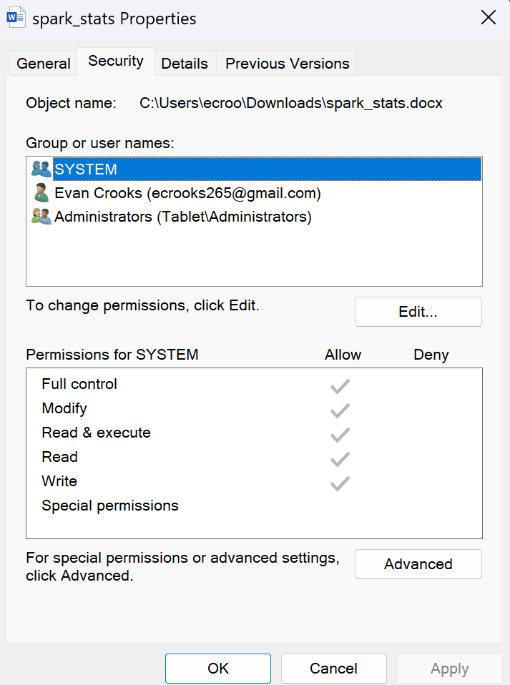
Windows and Linux differences
File Access
Windows has:
Read, Write, Execute, Delete, Modify, Full Control, Special Permissions
Linux has:
Read, Write, Execute
User Groups
Windows has:
Users and Groups
Permissions are inherited from parent folders
Linux has:
Users, Groups, and Others
Does NOT have permission inheritance

Slide 8
Linux File Permissions
Read
Files: Grants the ability to view or read the contents of the file
If user has read permission on a file, they can open it and see its data.
Directories: Allows the user to list the contents of the directory
Does not allow opening the files inside unless the user also has execute permission on the directory
Write
Files: Grants the ability to modify, alter, or delete the file’s contents
If a user has write permission on a file, they can edit and save changes to it
Directories: Allows the user to create, delete, or rename files within the directory
To perform these actions, execute permission on the directory is also usually needed
Execute
Files: Grants the ability to run or execute the file as a program or script.
For running executable files or scripts that contain code
Directories: Allows the user to cd into the directory and access its files and subdirectories
Without execute permission, even if a user can read the directory’s contents, they cannot navigate into it or access its files directly

Slide 9
So Why Use Linux?
Reliability
Uptime is typically higher in unix-based systems
Not as many updates, required reboots
Typically well-optimized systems
Cost
Often free and open source tools
Security
File permissions allow for better security
Drawback is open source is also open to bad actors

Slide 10
Changing User Passwords in Linux
`sudo passwd username` to change password of user ‘username’
*Important not to use default passwords EVER*
Show all users on a server - `cat /etc/passwd`

Slide 11
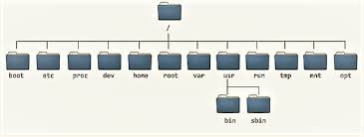
Basic Navigation and File Structure
Cd – change directory
`cd ..` go up a directory
`cd ./mnt/c` open the mnt/c directory from your current location
Pwd – print working directory
**Use `man command_name` to see options/description of a command**

Slide 12
Common Commands
cd – change directory
mkdir – make directory
pwd – print working directory
ls – list directory
touch – changes ‘last modified’ timestamp (creates file if not exist)
cat – list contents of specified file
man – lists manual for given command
rm – remove file or directory
cp – copy file/directory from >> to
head/tail – prints top or bottom part of file
chmod – changes file permissions or directory permissions
chown – change owner of a file
chgrp – change group owner for file
tar/unzip – zip files and unzip files
ps – display actively running processes
grep – search plaintext using regex

Slide 13
Example Usage on Servers
crontab – regulate backups, scans, logging, etc.
nano/vi – edit config files on a server, write scripts, etc.
firewall-cmd & iptables – configure firewall options on server
Nginx & Apache – common web server tools
Ping, nslookup, dig – resolve various DNS issues

Slide 14
Cyber Resiliency—What to Do
Backdoors
SSH keys
Check .ssh directory for keys that look suspicious – remove them
Common SSH Exploitations
Crontab
Check the crontab for unknown scripts/suspicious scripts
Check the scripts that you DO know as well
Could be modified
Unknown Users/Unauthorized Users in User Groups
Can be used as backdoors
Users with elevated privileges will have access to more within the system
Would have to change passwords, check last login status, last commands ran etc.
Ideally would have logs being created and saved to track this

Slide 15
Practice
Bandit Labs
Hack The Box – Linux Fundamentals

Slide 16
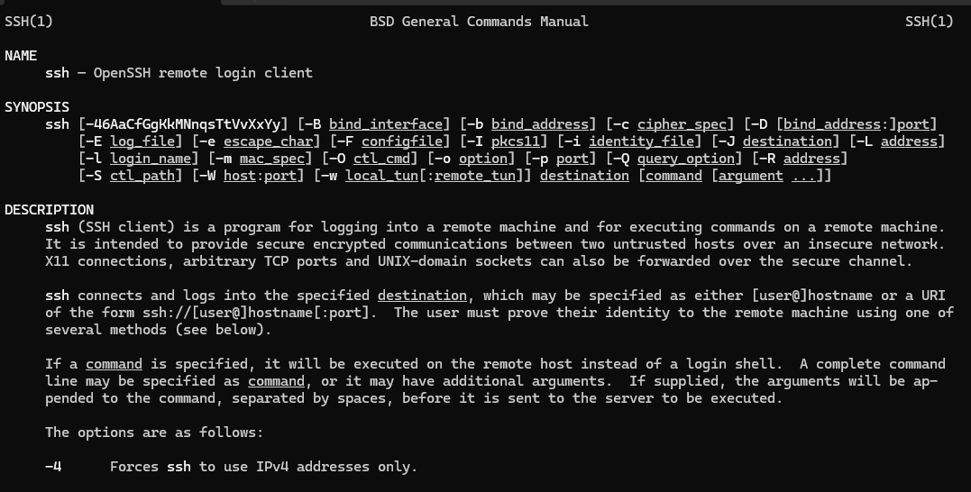
Bandit Labs 0-5
ssh bandit0@bandit.labs.overthewire.org -p 2220
After finding the flag for each level, you can ssh into the next one by running the above command, but incrementing the user
So level 1 would look like this
ssh bandit1@bandit.labs.overthewire.org -p 2220
Remember to use the man command for commands you are unfamiliar with
Ex. `man ssh` will tell you use cases for the ssh command
Read the description of the bandit problem on the overthewire site before attempting

Slide 17
Bandit 0-5 Solutions
Bandit 0 – readme file
Must output contents of readme file in home directory
Bandit 1 – ‘-’ file
Output contents of ‘-’ file
Run the command `cat ‘./-’`
Bandit 2 – ‘spaces in this filename’
Output contents of the ‘spaces in this filename‘ file
Run the command `cat ‘./spaces in this filename’`
Bandit 3 – find hidden file
`cd inhere`
`ls –al`
`cat …hiding-from-you`

Slide 18
Bandit 0-5 solutions continued
Bandit 4
`cd inhere`
`ls`
cat out contents of each file until you find a plaintext password in one of the files
`cat ‘./-file00’` etc…
could also use the strings command
Will only output strings of plaintext
Bandit 5
Search inhere directory ` find ./ -size 1033c`
Can also specify –f to only search files
1033c is the specified size, 1033 is the size, and c specifies that it is 1033 bytes
Only one file is returned
‘cat './maybehere07/.file2’`

