Slide 1
IUP Cybersecurity Club
Meeting 8: 10/30/2024

Slide 2
General Housekeeping
NCAE Cybergames
One more slot available on Team1 (can still have an additional Team2)
For those signed up already:
Anyone interested in a focused group to do mini-hack and bring everyone up to speed?
If not, please do the mini hack on your own
It is okay to ask questions!
LEARN VIM BASICS PLEASE
Additional CTF Competitions
Anyone interested?
HTB Uni CTF
13th - 15th December, 2024
PicoCTF
Sometime mid March

Slide 3
Fuzzing
What is fuzzing?
A method of testing via automated software that provides invalid, unexpected, or random data as inputs to a program
These inputs could be randomly generated or pulled from a wordlist.
What is it used for?
Finding unexpected behavior or hidden functionality
This behavior/functionality could then be leveraged for exploitation

Slide 4
Web Fuzzing
Similar to regular fuzzing
Seeks to uncover things such as:
Vhosts and subdirectories
APIs
GET and POST parameters/values
Typically uses wordlists to accomplish tasks
https://github.com/danielmiessler/SecLists/
Uncovers attack vectors for exploitation

Slide 5
How the ffuf do I Fuzz the Web?
Various open-source tools available:
ffuf
dirbuster
gobuster
Order of operations:
Find target site
Fuzz for extensions on index (.html, .php, etc)
Almost all sites will have a page titled index
Fuzz for vhosts/subdomains
Ex: https://FUZZ.iup.edu
Fuzz for subdirectories/pages of each vhost/subdomain
Fuzz for GET and POST parameters
Fuzz for corresponding parameter values
PROFIT (maybe)

Slide 6
Using ffuf for Fuzz Time
A ffuf command will have the following:
A wordlist, specified with –w
A target site, specified with –u
Optional useful parameters include:
-fs
Filters out certain size of response
-fc
Filters out certain response codes (200, 301, etc)
-e
Specifies extension for pages (.html, .php, etc)
-t
Specifies number of threads (speeds up request rate)
-recursion
Enables recursive fuzzing
-recursion-depth
Specifies depth of recursion

Slide 7
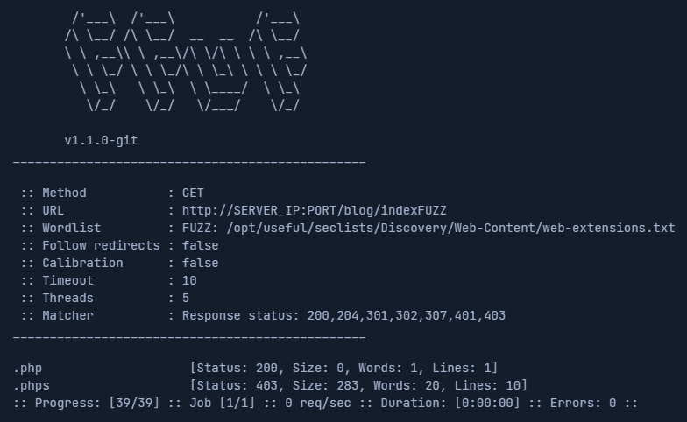
Fuzzing for Extensions
ffuf –w /PATH/TO/seclists/Discovery/Web-Content/web-extensions.txt:FUZZ -u http://SERVER_IP:PORT/indexFUZZ
-w specifies wordlist
web-extensions.txt
-u specifies target

Slide 8
Fuzzing for Vhosts/Subdomains
Subdomain:
ffuf –w /PATH/TO/seclists/Discovery/Web-Content/subdomains-top1million-5000.txt:FUZZ –u http://FUZZ.SERVER_IP:PORT/
Vhost:
After adding target ip and url to /etc/hosts
ffuf –w /PATH/TO/seclists/Discovery/Web-Content/subdomains-top1million-5000.txt:FUZZ –u http://TARGET.URL/ -H ‘Host: FUZZ.TARGET.URL’
-H is used to specify certain headers in requests
In this case the Host header

Slide 9
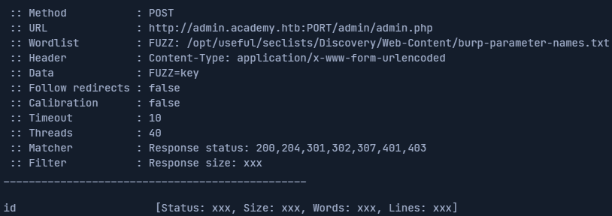
Fuzzing for Parameters (GET/POST)
GET
ffuf –w /PATH/TO/seclists/Discovery/Web-Content/burp-parameter-names.txt:FUZZ -u http://SERVER_IP:PORT/TARGET_PAGE?FUZZ=key
POST
ffuf -w /PATH/TO/seclists/Discovery/Web-Content/burp-parameter-names.txt:FUZZ -u http://SERVER_IP:PORT/TARGET_PAGE -X POST -d 'FUZZ=key' -H 'Content-Type: application/x-www-form-urlencoded’
-X specifies HTTP Method
-d represents POST data

Slide 10
Fuzzing for Parameter Values (GET/POST)
GET
ffuf –w /PATH/TO/VALUE_WORDLIST:FUZZ -u http://SERVER_IP:PORT/TARGET_PAGE?=key
POST
ffuf -w /PATH/TO/VALUE_WORDLIST :FUZZ -u http://SERVER_IP:PORT/TARGET_PAGE -X POST -d 'FUZZ=key' -H 'Content-Type: application/x-www-form-urlencoded’
-X specifies HTTP Method
-d represents POST data

Slide 11
Questions?
If not and time permits, go and do more Natas OTW
See me for event sign-ups if interested
NCAE Cybergames
February 17th, 2024
HTB Uni CTF
December 13th - 15th, 2024
PicoCTF
TBD (Sometime mid March)

