Slide 1

IUP Cybersecurity Club
Meeting 5:10/2/2024

Slide 2
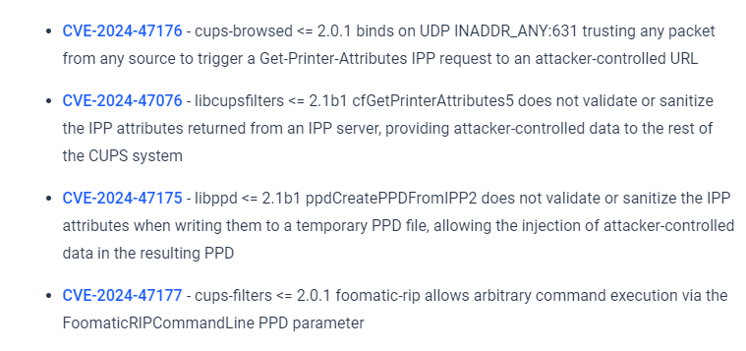
OpenPrinting Common Unix Printing System (CUPS) Vulnerability
Lack of validation/sanitization of network data allows the user to install a malicious driver
Print job then gets sent to the printer that executes malicious code
Realistically these CVEs are probably not a large-scale issue
  CVE chain will not work on systems with default configuration for CUPS
  Users on a network would have to print to a printer they do not recognize for the RCE to become possible
However, the CVEs are not currently patched, so it IS a problem

Slide 3
NCAE Minihack

Slide 4
We will be doing the NCAE Minihack today!
Go to NCAE Sandbox, and launch/deploy the minihack environment
  https://ui.sandbox.ncaecybergames.org/challenges
Work with a group of people around you
  Can use one computer to build the sandbox
  Will most likely have to do research!
There is a ‘guide’ in the discord #resources channel
Please ask questions!
  It will not be “easy” or straightforward
  Use the guide as a checklist
We will post a full guide to the solution AFTER the meeting

Slide 5
Things to consider before starting
Every machine will have different services
  CentOS does not have nano, has vi
    Using vi is completely different from using nano
Every OS has a different ‘network’ service to control the network interfaces
  Ex. Of restarting network service in each OS
    `sudo systemctl restart network` (CentOS)
    `sudo systemctl restart netplan` (Ubuntu)
      ‘sudo netplan apply` ALSO works
    `sudo systemctl restart networking` (Kali)
You will have to restart relevant services after applying changes to actually see the changes

