Slide 1
IUP Cybersecurity Club
Meeting 7: 10/16/2024

Slide 2
Understanding Web Vulnerabilities
What is a web vulnerability?
A weakness in a web application that attackers can exploit
Why does web security matter?
Web applications can host pieces of sensitive information
Ex: SSN, DoB, Addresses, etc.
Potential impact of web vulnerabilities
Data breaches and financial losses
Service downtime
Loss of trust
Legal consequences

Slide 3
Broken Authentication/Access Control
Broken Authentication
Allows for attackers to bypass authentication functions
Can allow:
Normal users becoming an admin
Attacker logging in without valid credentials
Broken Access Control
Allows for attackers to access things that they shouldn’t
Ranked #1 on OWASP Top 10
Ex: Normal users gaining access to an admin panel

Slide 4
Broken Authentication/Access Control cont.
Prevention
Deny by default except for public resources
Disable web server directory listing
Log access control failures
Implement stateful session identifiers and invalidate them on logout
Example Scenario
An attacker simply modifies the browser's 'acct' parameter to send whatever account number they want. If not correctly verified, the attacker can access any user's account.
https://example.com/app/accountInfo?acct=notmyacct

Slide 5
Command Injection
Execution of arbitrary commands on the web server via the web application
Occurs when applications pass unsafe user input to a system shell
Commands are executed with the privileges of the application
Prevention
Filter and sanitize user input
Escape special characters (. , ‘ “ \ & ;)

Slide 6
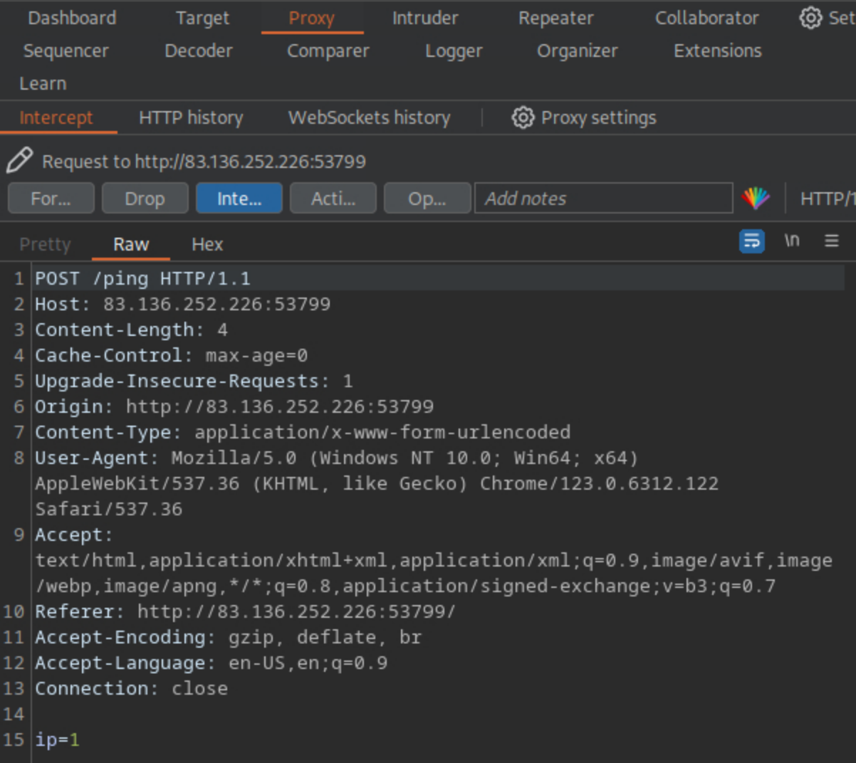
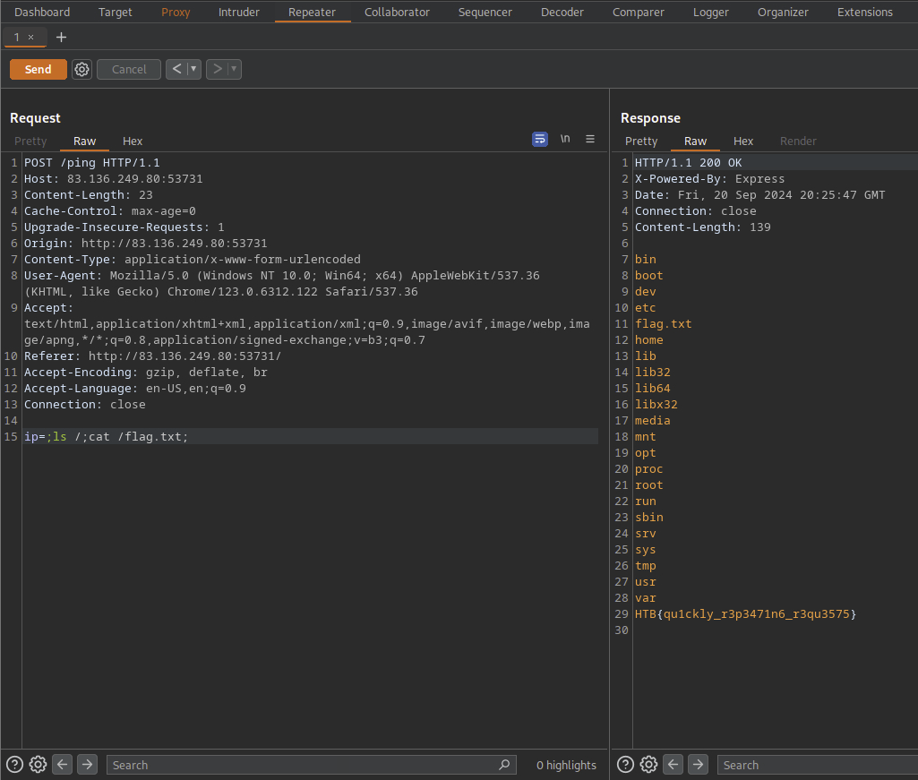
Command Injection Example

Slide 7
Cross-Site Scripting
A type of injection in which malicious scripts are injected into otherwise benign and trusted websites
Occurs when an attacker uses a web application to send malicious code to a different end user
Typically in the form of a browser side script i.e. Javascript
Types of XSS
Reflected
Injected script is reflected off web server
Delivered via malicious link
https://vulnerable-website.com/search?q=<script>alert('XSS')</script>
Stored
Injected script is stored on the target server
In database, messages, visitor log, comments, etc.

Slide 8
Cross-Site Scripting cont.
Prevention
Sanitize user input
Encode data on output
Prevents input from being interpreted as active content
Use appropriate response headers
If response should not contain HTML or JavaScript, make sure the Content-Type and X-Content-Type-Options headers are set to reflect that

Slide 9
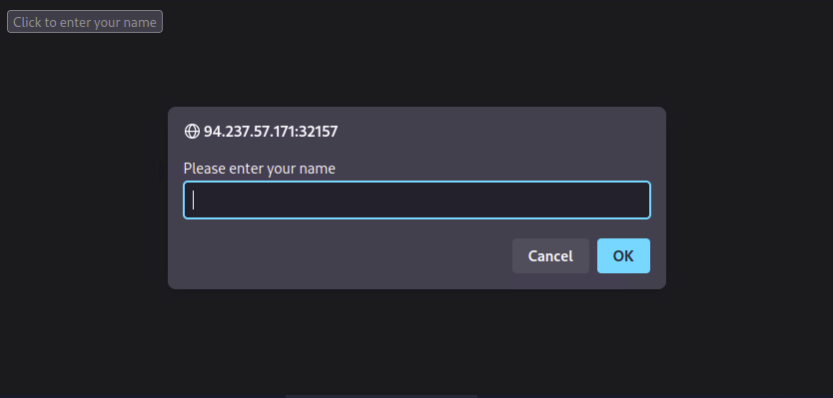
Cross-Site Scripting Example
← Vulnerable Website
Vulnerable JavaScript →

Slide 10
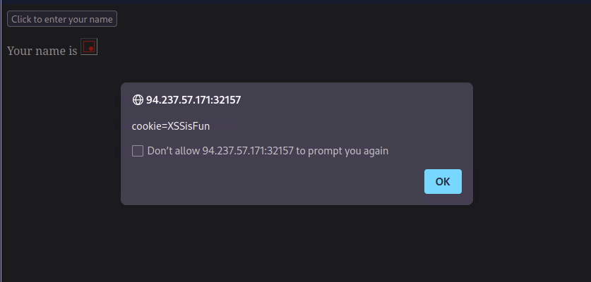
Cross-Site Scripting Example cont.
When <img src="/" onerror="alert(document.cookie)"> is inputted:
Website triggers an alert with the user’s cookie value
This alert function could be substituted for more malicious functions:
Used to steal authentication and session tokens
Used to redirect to attacker’s malicious site
Used to execute malicious scripts on target system

Slide 11
Conclusion
Sanitize and don’t trust user input
Prevents numerous issues/vulnerabilities
Many more vulnerabilities than presented
Presented were some common vulnerabilities
Check out owasp.org for listing and guides on vulnerabilities
Questions?
Proceed with OverTheWire Natas Exercises
Focuses on server-side web security
Talk to Thomas if you want to participate in NCAE Competition
Need your school email to sign up

Slide 12
References
https://owasp.org/www-community/vulnerabilities/
https://owasp.org/Top10/A01_2021-Broken_Access_Control/
https://owasp.org/Top10/A03_2021-Injection/
https://owasp.org/www-community/attacks/Command_Injection
https://portswigger.net/web-security/cross-site-scripting
https://www.rapid7.com/fundamentals/web-application-vulnerabilities/
https://academy.hackthebox.com/module/75/section/764

