Slide 1
IUP Cyber Security Club
Meeting 1: 09/06/2023

Slide 2
Introductions
President - Meghan Schilpp, Cyber Security, Class of 2024
Vice President - Jordan Fischer, Software Engineering, Class of 2024
Secretary - Noah Suley, Cybersecurity, Class of 2024
Treasurer - Matt Conrad, Cyber Security, Class of 2024
Social Media Manager - Dylan Timbrook, Cybersecurity, 2025
Faculty Advisor - Dr. Waleed Farag

Slide 3
Meeting Agendas
Cybersecurity in the news
An overview of a technical topic in cybersecurity
Possible topics to be covered this year:
Kali Linux tools, Malware Analysis using Wireshark, Steganography, Cross-Site Scripting, Web Exploitation, Open-Source Intelligence
Professional Development Activities: resume building, internship searches, etc.
Any topic ideas?
Hands-on activities related to the technical topic

Slide 4
Other Activities
Hackathons and CTFs
Hackathon
Student competition where teams compete against one another to complete computer science-related challenges such as maintaining an IT infrastructure or completing Capture The Flag (CTF) challenges.
CTF
Capture the flag
Challenges that range in cybersecurity topics (networking, open-source intelligence, forensics, reverse engineering, binary exploits, etc.)
Jeopardy style

Slide 5
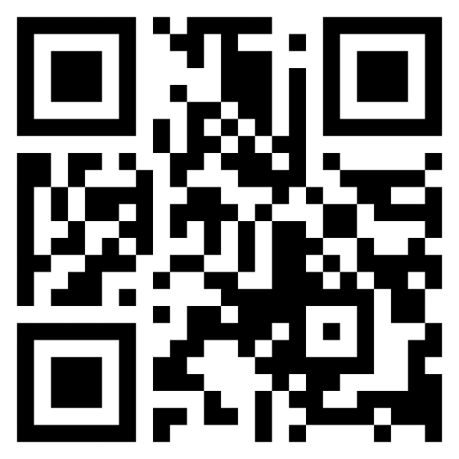
Communication
Communication about meetings will be done through Discord, email, and Crimson Connect
Discord link: https://discord.gg/MQ9q9TKqG
Please fill out the club information form so that you can be added to the email list:
https://forms.gle/uUGfm8qAWT1Rrhfn8

Slide 6
Important Dates
IUP Day: Friday, September 8th from 3-6pm
Cyber Security Day: October 31st
NCAE Cyber Games: TBD
https://www.ncaecybergames.org/
NSA Codebreaker: Starts Sept. 28th
https://nsa-codebreaker.org/home

Slide 7
DoD Scholarship
https://www.iup.edu/cybersecurity/grants/dod-cyber-scholarship-program/index.html
Advantages:
Full tuition and fees paid, $27,000 stipend for room/board, All book fees up to $1,250, laptop (up to $1,500)
Requirements:
GPA of 3.2, Junior/Senior, US Citizen, DoD civilian work after graduation, letters of recommendation
All sophomores and juniors will be able to apply this following application cycle for the upcoming academic year
Deadline: TBD, around Jan/Feb. 1

