Slide 1
IUP Cyber Security Club
Meeting 1 - 9/4/2022

Slide 2
Introductions
President - Malcolm Holden, Cyber Security Major, Class of 2024
Vice President - Ethan Buhl, Languages and Systems, Class of 2023
Secretary - Meghan Schilpp, Cyber Security Major, Class of 2024
Treasurer - VACANCY
Want to volunteer for a position? Let us know!
{graphics design, competition team lead, etc.]
Our Discord: https://discord.gg/kYFC3VTM9r
https://www.iup.edu/cybersecurity/

Slide 3
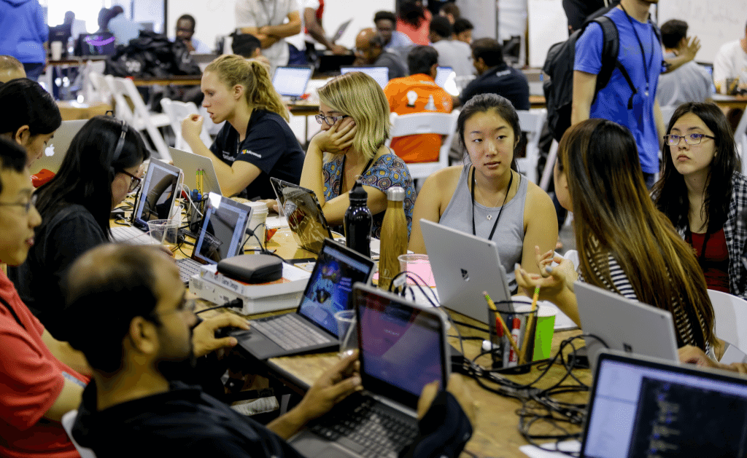
What do we do here?
Hackathons / CTF Competitions
Cyber Security in the News
Deeper coverage of specific cyber security topics
Any ideas?
IUP Day
Volunteers?
Cyber Security Day

Slide 4
What is a Hackathon / CTF Competition?
Hackathon
Student competition where teams compete against one another to complete computer science-related challenges such as maintaining an IT infrastructure or completing Capture The Flag (CTF) challenges.
Usually have prizes
Good resume-builder and experience teacher.
CTF Competition
Capture The Flag
Challenges that involve searching a computer system or scavenging the internet in order to complete a task
Sometimes programming-related

Slide 5
Important Dates
October 13th- International Cyber League: Collegiate Cup competition
https://icl.cyberbit.com/?utm_medium=Hubspot&utm_campaign=ICL_Cold
October 15th - 2022 NSA Hivestorm REGISTRATION ENDS SEPTEMBER 23.
https://www.hivestorm.org/
September 14 - IBMz Hackathon https://www.hackerearth.com/challenges/hackathon/ibm-z-student-contest-2022/
NSA CodeBreaker Challenge: https://nsa-codebreaker.org/home
NCAE CyberGames https://www.ncaecybergames.org/

Slide 6
DoD Cyber Security Scholarship
https://iup.edu/cybersecurity/grants/dod-cyber-scholarship-program/index.html
Advantages:
Full tuition and fees paid, $27,000 stipend for room/board, All book fees up to $1,250, laptop (up to $1,500).
Requirements:
GPA of 3.2, Junior/Senior, US Citizen, DoD civilian work after graduation, letters of recommendation

Slide 7
For Next Meeting: VM Installation
Either VMware Workstation Pro: https://www.vmware.com/products/workstation-pro/workstation-pro-evaluation.html
Use Product Key→ ZF3R0-FHED2-M80TY-8QYGC-NPKYF
OR use VirtualBox https://www.virtualbox.org/wiki/Downloads
—-----------------------------------------------------------------------------------------------------------------
Kali VM:
https://www.kali.org/get-kali/#kali-virtual-machines

