Slide 1

IUP Cyber Security Club
Meeting 6 - 1/24/2023

Slide 2

Today’s Agenda
Cyber Security in the News
  Forbes Security Predictions
  Paypal Cyber Attack
Announcements
  DoD Scholarship
  T-Shirts
  NCAE CyberGames

Slide 3
Cyber Security in the News

Slide 4

Forbes’ Cybersecurity Predictions for 2023
Forbes Magazine released a set of predictions for how the cybersecurity industry and business organizations in that respect will be affected in 2023 based on current trends
Social Media Scams Give Rise to A New Social Engineering Battleground
Catastrophic Attacks on Critical Infrastructure
Deepfake Attacks Become More Convincing
New Threats Emerge With The Metaverse
Organizations Shift Their Focus On Creating A Culture of Security
https://www.forbes.com/sites/forbestechcouncil/2023/01/24/five-cybersecurity-predictions-for-2023/?sh=54c420e8df9b

Slide 5
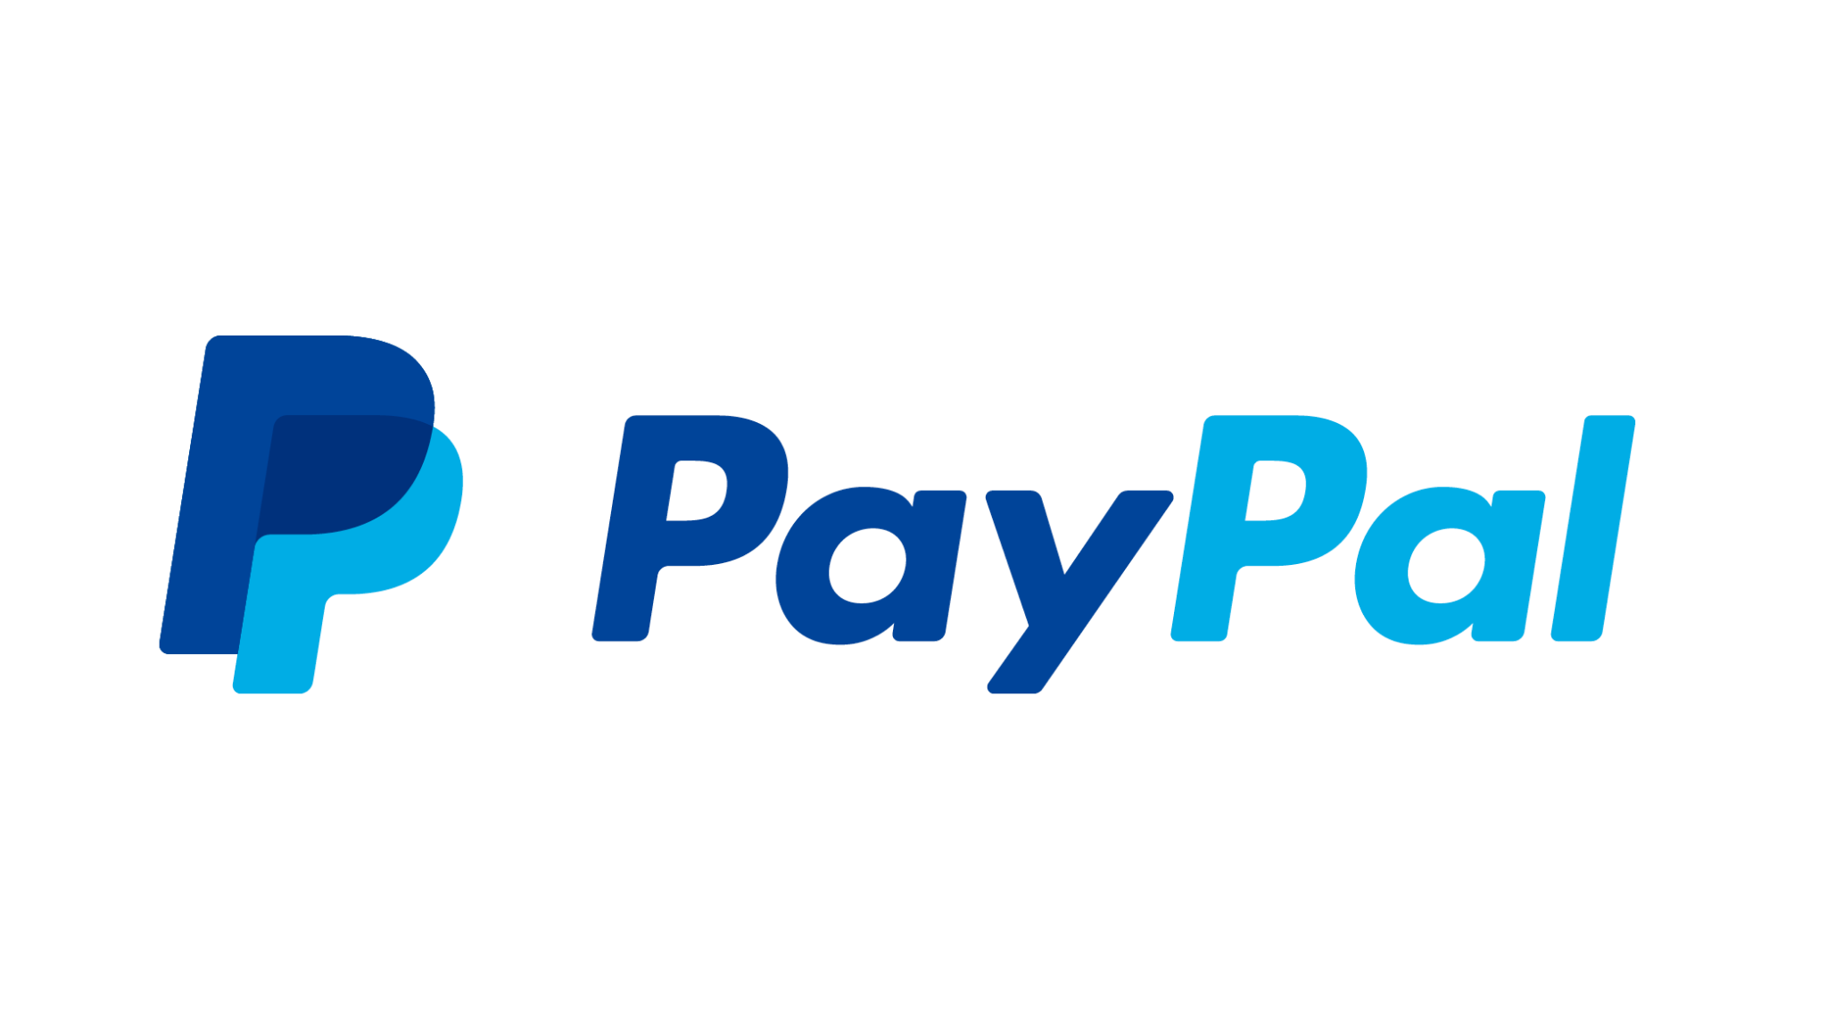
Paypal Cyber Attack
Cyber attack on Paypal exposes user social security numbers
35,000 customers’ SSN stolen in December from a credential-stuffing attack
  Occurred between Dec 6-8 and was discovered on Dec 20
Compromised information: SSN, usernames, addresses, birth dates, tax identification numbers
Paypal’s response → providing identity theft services through Equifax for next two years
https://www.cnet.com/tech/services-and-software/social-security-numbers-stolen-in-paypal-cyber-attack/

Slide 6
Announcements

Slide 7

DoD Cyber Security Scholarship
https://iup.edu/cybersecurity/grants/dod-cyber-scholarship-program/index.html
Advantages:
Full tuition and fees paid, $27,000 stipend for room/board, All book fees up to $1,250, laptop (up to $1,500).
Requirements:
GPA of 3.2, Junior/Senior, US Citizen, DoD civilian work after graduation, letters of recommendation
DEADLINE - February 1, 2023

Slide 8

T-Shirts
Should be sent out within next week or two
Link is in discord to order more!

Slide 9
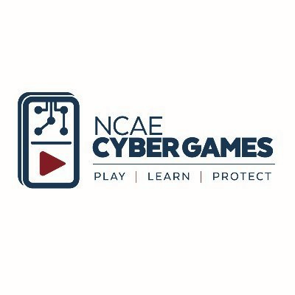
NCAE CyberGames
Various NCAE schools compete
The competition is split into half infrastructure and half CTF
Only 10 competitors from each school
Sandbox tutorials available now.
Team registration starts now and ENDS FEBRUARY 6TH
https://www.ncaecybergames.org/

Slide 10
NCAE CyberGames… continued
First competition date: Saturday Feb. 18th @ 9AM
Second competition date: Saturday March 11th @ 9AM
Looks great on resumes for internships/jobs
IF more than 10 students are interested, we can do two teams.
  Teams cannot collaborate together on competition day
Sandbox practice on website: https://www.ncaecybergames.org/tutorials

Slide 11
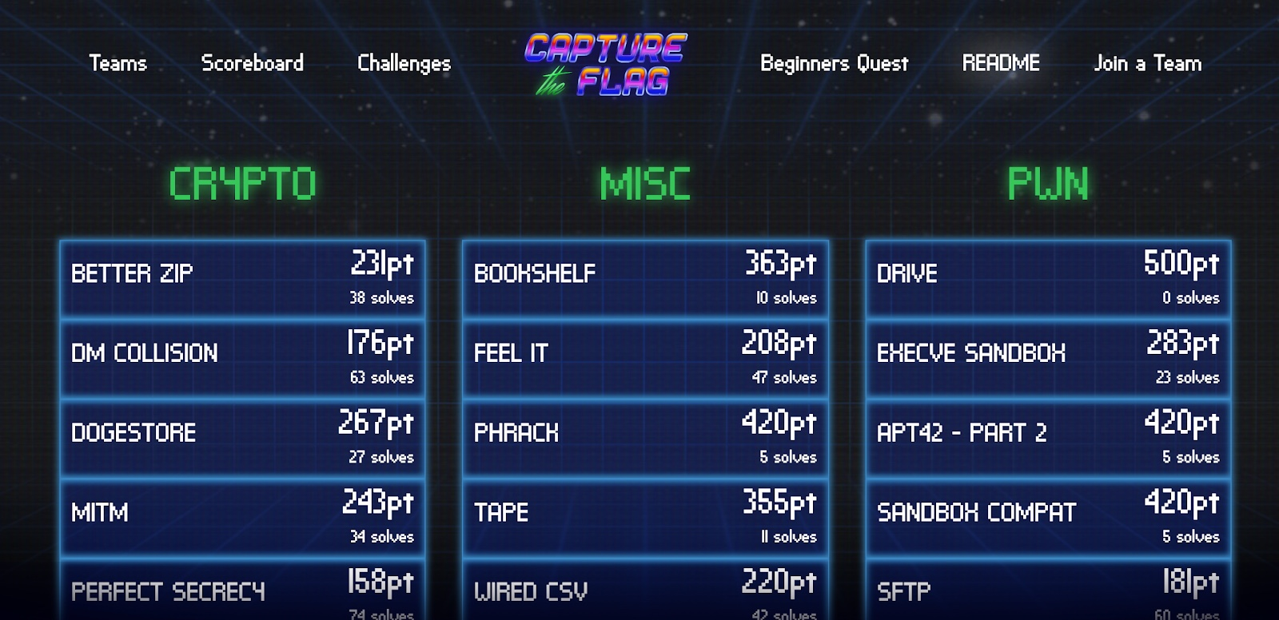

Slide 12
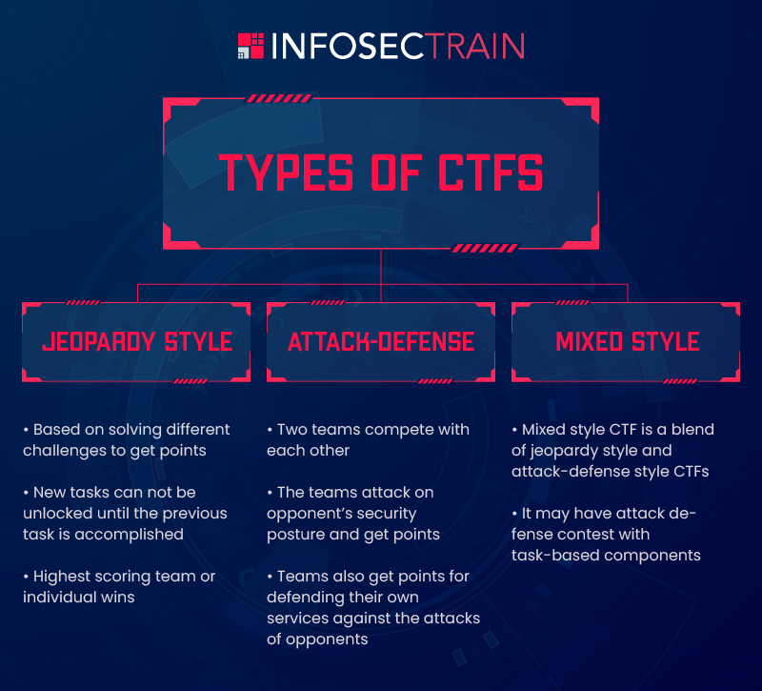

Slide 13
Team Composition
Encryption / Linux Admin Group (beginner)
Networking Group (intermediate)
Routing / Services Group (intermediate)
https://forms.gle/2d7CGYZx8grcfCEeA

Slide 14
Competition Prep
Break off into teams and then respective groups.
Discuss skillsets / divvy up responsibilities of knowledge
Start watching tutorial videos on cyber games site
Practice with sandbox on site
Come up with team meeting time to regroup/re-analyze

