Slide 1
IUP Cyber Security Club
Meeting 3 - 10/4/2022

Slide 2
Today’s Agenda
Cyber Security in the News
Optus Data Breach
Lazarus Attack
Networking / PenTesting Basics
Exploitation Activity
CTF Teams
Moving Forward

Slide 3
Cyber Security in the News

Slide 4
Optus Data Breach
On September 22, there was data breach on the Australian telecommunication company Optus
Breached the names, DOB, addresses, and information of 11 million people
Hacker claimed to access an unauthenticated API endpoint and that the data was all open to the internet
The API was used for customers to gather their own data, but the API url had full access control to customer data
Once the hacker had access, they enumerated customer data through contact ID
https://www.cshub.com/attacks/news/iotw-everything-we-know-about-the-optus-data-breach

Slide 5
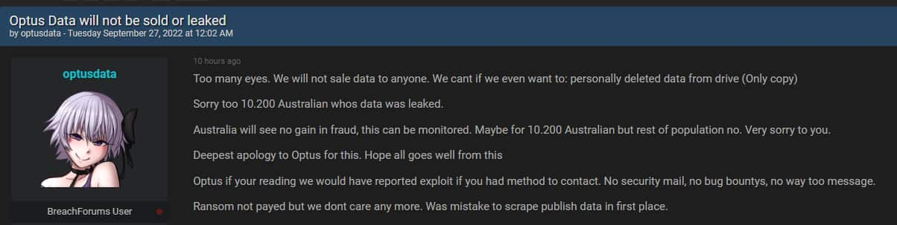
Optus cont.
Hacker originally demanded a $1 million ransom or the data would be leaked
Hacker posted a text file 0f 10,000 customer data when Optus did not pay ransom
However, on September 27th, the hacker released a post rescinding their demand and apologizing for the attack

Slide 6
Lazarus Attack
On October 3rd, a group known as Lazarus (a North Korean ransomware gang) exploited a Dell hardware driver flaw for a Bring Your Own Vulnerable Driver (BYOVD) attack
This occurs when an attacker loads legitimate signed drivers into Windows that also contain vulnerabilities
They are carrying out this malware campaign by targeting users with fake job offers via email
Once the job offer document is opened a remote template is downloaded from a hardcoded address. Followed by infections that involves malware loaders, droppers, custom backdoor, and other types of malicious activity.
https://cisoseries.com/cyber-security-headlines-microsoft-zero-days-lazarus-attacks-dell-nsa-employee-caught/

Slide 7
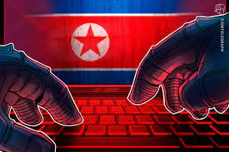
Lazarus Continued…
The group is targeting mostly users in the EU some of which include an aerospace expert from the Netherlands and a well known political journalist from Belgium.
The aim of the campaign is to conduct cyber espionage and steal data from high profile individuals.

Slide 8
Network / Penetration Testing Basics

Slide 9
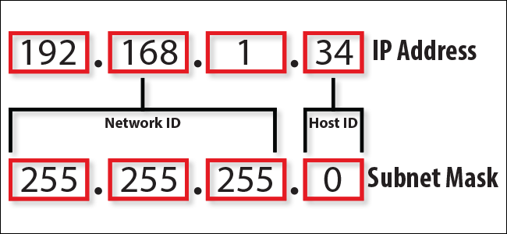
IP Addresses
A unique string of characters that identifies a device on a network

Slide 10
SSH
Secure Shell Connection
Command used to connect to a remote host from the command line.
Prompts user for a username.
localhost:~$ ssh -p 22 -C neo@remoteserver

Slide 11
Ports
Software defined number associated with a specific protocol or service.
Well Known Ports
20 and 21 FTP
22 Secure Shell (SSH)
25 SMTP
53 DNS
80 HTTP

Slide 12
Reverse Shell / Bind Shell
GOAL: Gain root privileges.
Reverse Shell
Taking advantage of system’s vulnerabilities to gain access to a “shell”.
What is a shell? → Exposure of OS commands/services to a user
Sets a trap on the host to connect the machine to an attacking machine.
Bind Shell
Connects to the host using a listener in order to gain remote access to the machine.

Slide 13
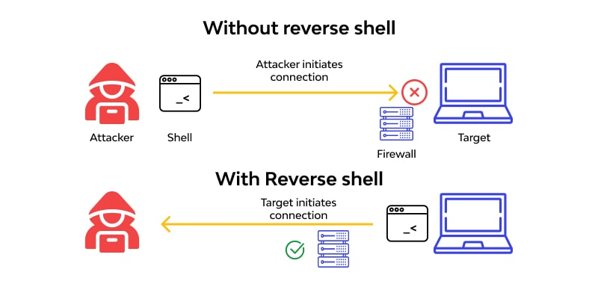

Slide 14
Penetration Testing Stages
There are three primary stages of penetration testing: The Three E’s.
Enumeration
Gaining information such as IP addresses, open ports, usernames, etc. from a system
Evaluation
Doing a deeper dive into discovering what the vulnerabilities are in the system and recording them.
Exploitation
Exploiting the vulnerabilities.
“hacking”

Slide 15
Payload staged and stageless
Payloads are data packets that are sent from one IP to another. In penetration testing specifically, this refers to the malicious code that will be sent out to the target to compromise its system.
Staged
Packets are sent out in stages. Piece by piece, similar to a ‘class’ system in programming, with a ‘main’ packet that comes in last and activates them all.
Stageless
One large packet is sent to the target. Sometimes can be detected and prevented (harder to accomplish than staged).
https://www.techtarget.com/searchsecurity/definition/payload

Slide 16
Exploitation Activity
! <DISCLAIMER> !
Only use these tools on virtual machines or machines that you own and/or have permission to use these tools on. For legal reasons.
! <DISCLAIMER> !

Slide 17
VulnHub’s Virtual Machines
Free community-driven site
Virtual Machines with open vulnerabilities
Perfect for practicing exploitation in a controlled and legal environment.
https://www.vulnhub.com/

Slide 18
CTF Teams

Slide 19
CTF Teams
Teams of 4-6 people
Come up with team name
Try to be mix of different skill levels
Pick team captain
Make a group chat
This will be your CTF team for different in-club activities and possibly as well as future CTF events
GOOGLE FORM IN DISCORD

Slide 20
Next Meeting Objectives
Research Hashcat tool on Linux. Next meeting we will do a deeper dive into that.
How many are interested in T-Shirts?

