Slide 1
IUP Cyber Security Club
Meeting 2 - 9/20/2022

Slide 2
Today’s Agenda
Cyber Security in the News
Twitter Breach
Uber Breach
American Airlines Breach
Click Fraud Campaign
Virtual Machines
Linux Basics
CTF Teams
Moving Forward

Slide 3
Twitter Confirms Data Breach - July 2022
In January, Twitter identified and patched up a vulnerability that was found by the white hat hacker Zhirinovskiy
Vulnerability: revealed specific Twitter account names if an associated email address or phone number was entered into the log-in flow

Slide 4
Twitter Breach … continued
https://www.malwarebytes.com/blog/news/2022/08/twitter-confirmed-july-2022-data-breach-affecting-5.4m-users
However, this vulnerability was taken advantage of before it was patched
On July 21st, the hacker named 'devil' posted that they had obtained the personal data of 5.4 million Twitter users (including email address and phone number)
This was done by scraping publicly known information

Slide 5
Uber Data Breach - September 15
The lone hacker, linked to the Lapsus$ group, gained access by social engineering; they posed as an IT worker and tricked an employee into giving their credentials
They located passwords and gained access to the system admin privilege
They gained access to the cloud-based systems where sensitive customer and financial data is stored

Slide 6
Uber Data Breach … continued
https://arstechnica.com/information-technology/2022/09/uber-was-hacked-to-its-core-purportedly-by-an-18-year-old-here-are-the-basics/
The hacker revealed himself in the company slack and posted screenshots of his intrusion into the system
18 year old kid
Not known how long they hacker was inside or how much data was stolen

Slide 7
American Airlines - September 19
American Airlines is the latest big name to release a statement about a recent data breach.
In their brief statement they mentioned that a small number of customer and employee information was contained in a small phishing attack which led to, “the unauthorized access to a limited number of team-member mailboxes.
At this time they are unaware of who was behind it but is investigating the breach with a third party vendor at this time.

Slide 8
American Airlines… continued
https://www.itsecurityguru.org/2022/09/20/american-airlines-announce-data-breach-exposing-customer-and-staff-information/
At this time they are unsure of who is behind the attack. They are suspicious of a previous group that had breached their information in the past with the intent of finding frequent flyer miles.
The information gained by this attack includes: names, DOB, addresses, driver license numbers, passport numbers, phone numbers, and medical information
American airlines is providing the customers affected two years worth of identity theft protection from Experian for this inconvenience.

Slide 9
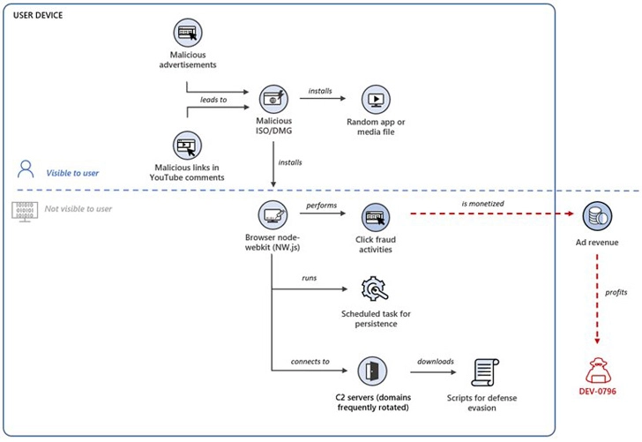
Click Fraud - September 19
Microsoft has been investigating a large scale click fraud campaign targeting gamers
For the past few months gamers have been targeted by stealthily deployed browser extensions on compromised systems
The Attackers monetize clicks by generated by a browser webkit or a malicious browser extension secretly installed on devices
The way this works is when a victim clicks on a malicious ad or comments on Youtube an ISO file. When the file is opened its designed to install a browser node-webkit (aka NW.js) or a rogue browser extension

Slide 10
Click Fraud… continued
Microsoft disclosed that they are tracking the threat cluster known currently known as DEV-0796
Currently are also working with a Russian cyber security firm to find the group responsible
They are possibly aged around 18-30 years old and have suspected around 20 members
https://thehackernews.com/2022/09/microsoft-warns-of-large-scale-click.html

Slide 11
Virtual Machines

Slide 12
Virtual Machines
“Virtual” computers that run on top of physical computers
Hardware of one computer is abstracted to run several execution environments
Hypervisor - application that runs over top of standard operating system that can run guest operating systems in their own environments
First introduced commercially in 1972 by IBM
Oracle’s open-source VirtualBox allowed programs to run Windows, Linux, macOS, and Solaris OS on all different machine hardwares.

Slide 13
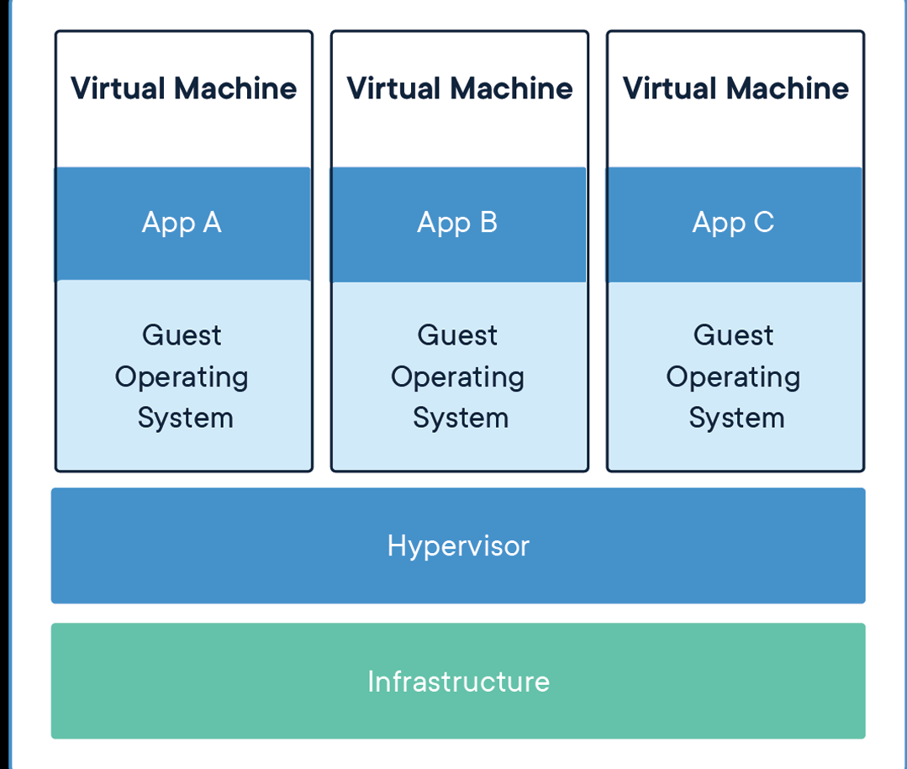
Benefits of VM’s
Isolated environment
Protected and abstracted from hardware
Environment suspension
Saving instance “snapshots”
Easy manipulation of resources
Duplicating systems

Slide 14
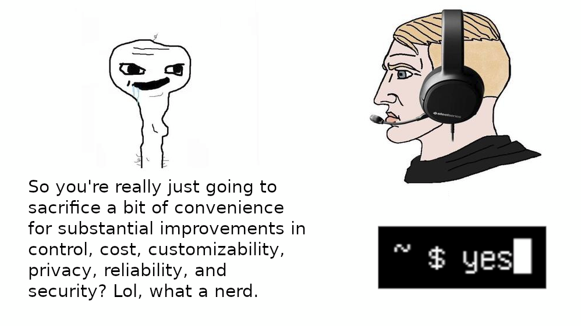
Linux Environment
Similar to Windows, but much more can be done through the use of the command line / terminal:
File manipulation
Network scans
Scripting
Network settings
User creation / modification
Permission settings

Slide 15
Linux Basics

Slide 16
Installing Software
Typically with linux, you use the command “sudo apt install [software]” in order to install software that is not on it.
You can also use “[software] --version” to check the version of what is installed
For example: “python --version”

Slide 17
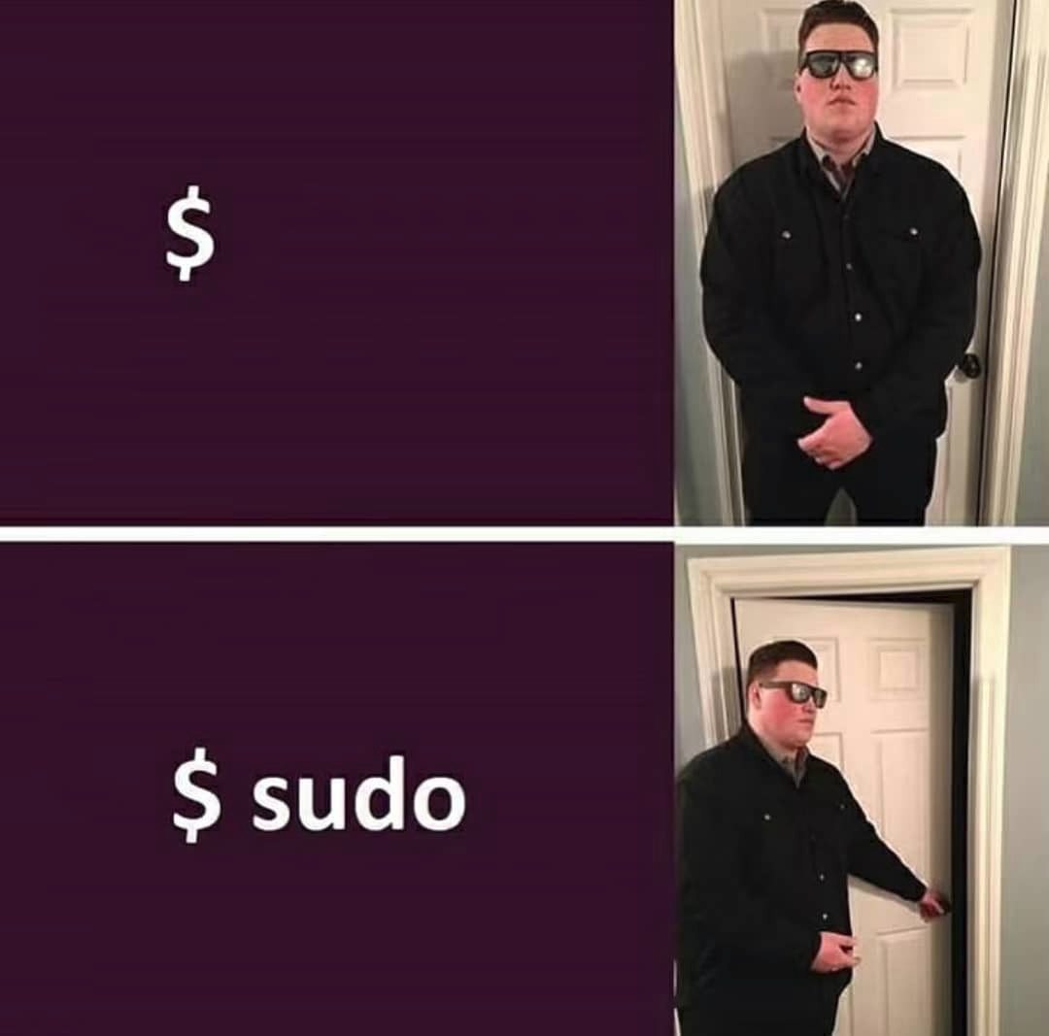
Commands
Typical format looks like the following: username$ [command] [flags] [path]
Example: ls -a ./FolderName
Super-User : Administrator mode / sudo
Some installations of software or other processes will require you to use sudo in order to do them.

Slide 18
Some basic commands
ls
-a -l
cd .. [PATH]
pwd
locate fileName
echo
cat fileName < [COMMAND]
cp
mv
rm
mkdir
chmod
nano
alias

Slide 19
Chmod Command
User, Group, Other Permissions
Read, Write, Execute rwx
4 = Read, 2 = Write, 1 = Execute
4+2+1=7, so 7=All Permissions
For example: 777 = Read, Write, Execute for all users.
chmod 777 joji.txt

Slide 20
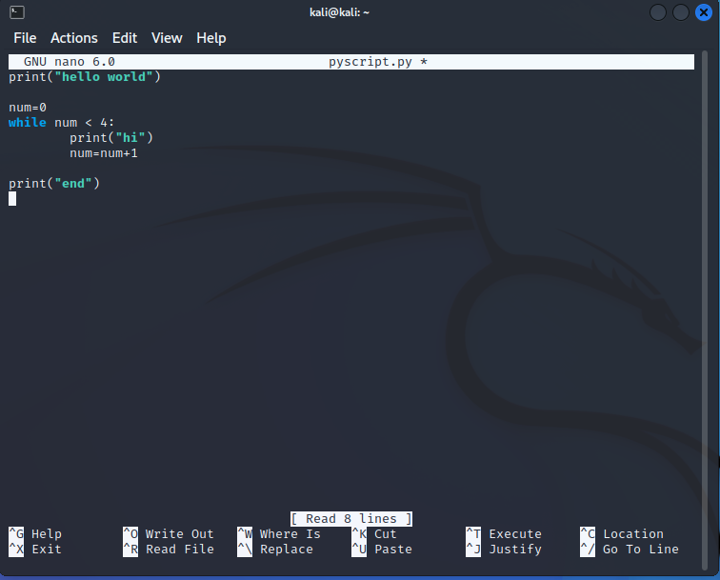
Nano Text Editor
Use Control instead of ^
^O to save as
^X to exit

Slide 21
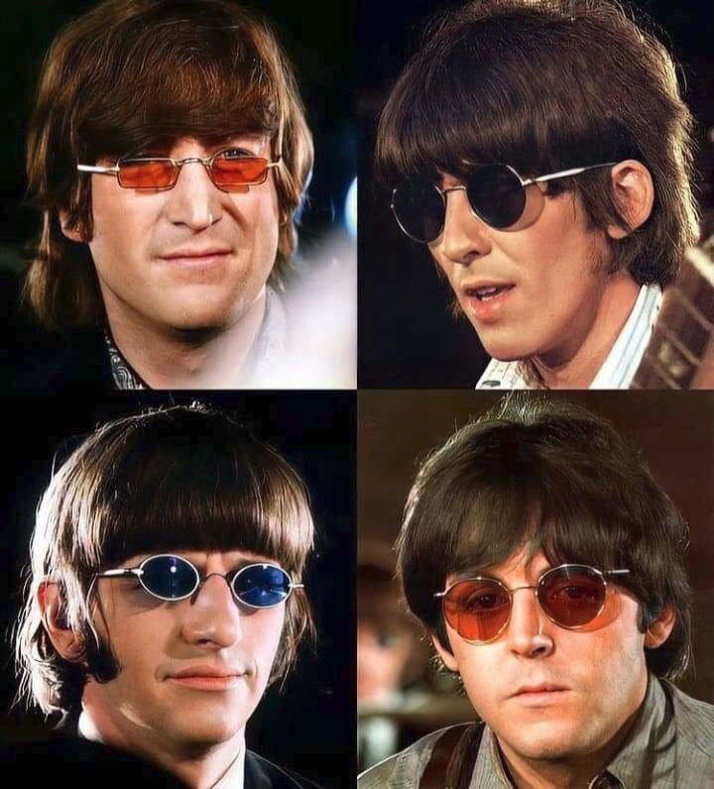
Activity 1: Simple file management
Create 6 files: john.txt, george.txt, paul.txt, ringo.txt, mick.txt, keith.txt
Create new directory called “beatles” and directory called “stones”
Move john, george, paul, and ringo.txt’s to “beatles” and the other two to “stones”
Give john.txt and mick.txt Read/Write/Execute permissions to everyone.
Give paul.txt and keith.txt Read/Write permissions to ONLY User.
Give ringo.txt ONLY Read permissions to everyone.
Test that your rwx settings are correct using “ls -l”

Slide 22
Scripting
Multiple languages available
Python and Bash are most used for our purposes.
Bash is easier for using several terminal commands at once.
Python can be easier to understand and write more intricate scripts using the “os” package. https://docs.python.org/3/library/os.html

Slide 23
Bash Scripting
Always start with #!/bin/bash at the top
Execute using ./filename.sh
Variables are signified with $.
If you use $1 or $2, etc. it will use those numbers as whatever parameter was added.
For example: ./hello.sh pink will set $1 to “pink”.
“Sleep” command can be used to make the system wait to execute the next command
After writing bash script, you must edit permissions to be executable.

Slide 24
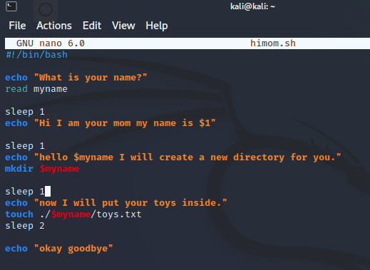
Bash Scripting Example
Try this bash script. When you run it, be sure to include a motherly name as your parameter.
For example:
./himom.sh Janet
Afterwards, check out the directory and file that was created.

Slide 25
Activity 2
Perform the same tasks as Activity 1 but by running ONE bash script!
Create 6 files: leonardo.txt, raphael.txt, donatello.txt, michaelangelo.txt, shredder.txt, splinter.txt
Create new directory called “tmnt” and directory called “not_tmnt”
Move leonardo, raphael, donatello, and michaelangelo.txt’s to “tmnt” and the other two to “not_tmnt”
Give leonardo.txt and raphael.txt Read/Write/Execute permissions to everyone.
Give donatello.txt and michaelangelo.txt Read/Write permissions to ONLY User.
Give splinter.txt ONLY Read permissions to everyone.

Slide 26
CTF Teams

Slide 27
Current Competition: HackerEarth
https://www.hackerearth.com/challenges/hackathon/ibm-z-student-contest-2022/#overview
Ongoing competition, Individuals
Competition Coordinators

Slide 28
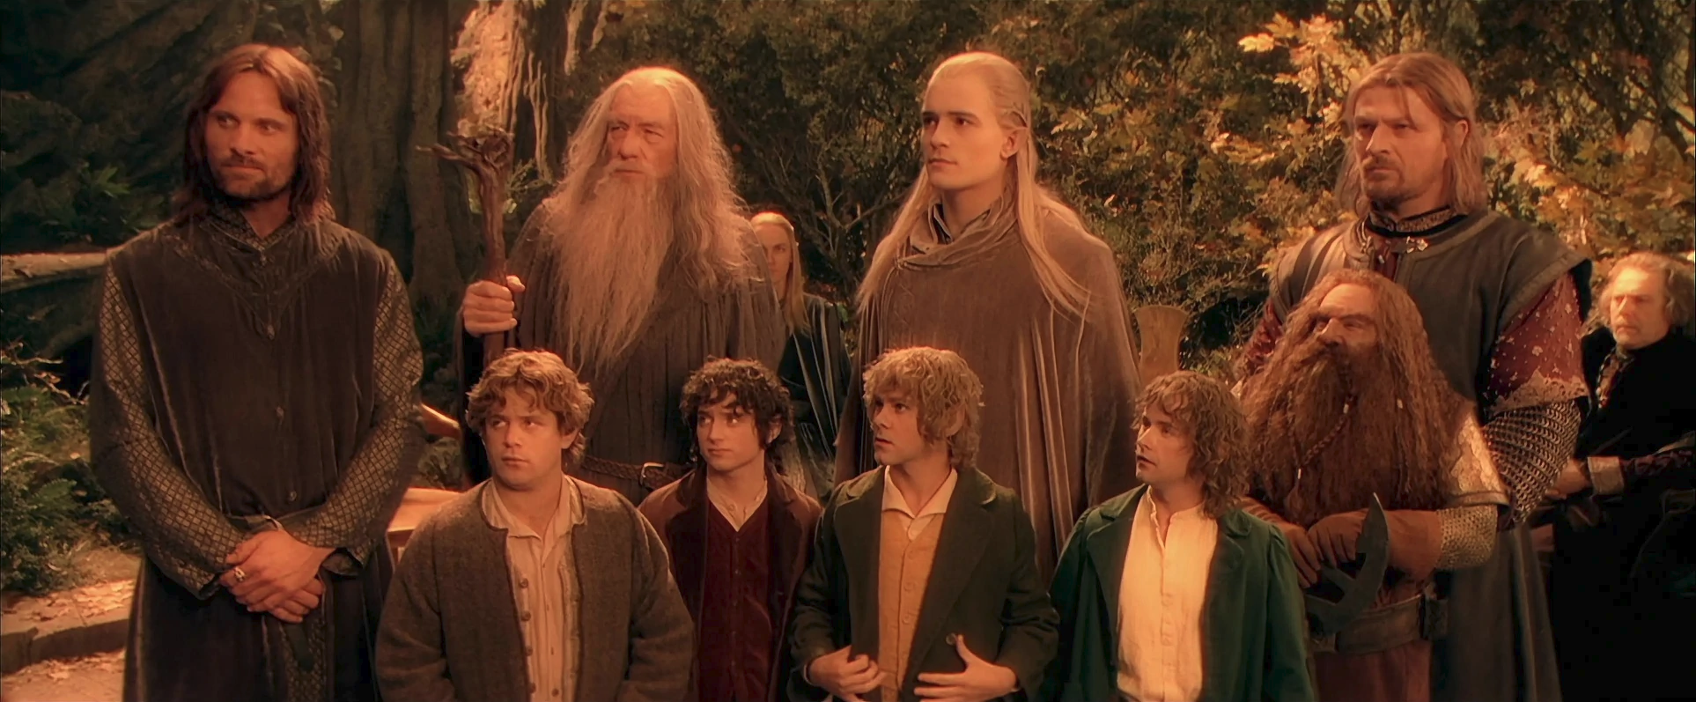
CTF Teams
Teams of 4-6 people
Come up with team name
Try to be mix of different skill levels
Pick team captain
Make a group chat
This will be your CTF team for different in-club activities and possibly as well as future CTF events
GOOGLE FORM IN DISCORD

Slide 29
Next Meeting Objectives
Research Hashcat tool on Linux. Next meeting we will do a deeper dive into that.
Set up two more VM’s and set them up in a “virtual network”.
Share your findings in the discord!
We will further expand on using other network scan tools such as Wireshark and Nmap.
Practice CTF…?

