Slide 1
Cyber Security club 9-28-21
Franklin May

Slide 2
Cyber security in the news
Exchange/Outlook Autodiscover Bug
Leaks $100K+ Email Passwords
When adding a new Microsoft Exchange account to Outlook via the auto account setup
Autodiscover attempts to put together a URL to get configuration data based on the email domain
If it cannot find a domain, such as this it will attempt to build a URL using Autodiscover.com which means that the person who owns this domain will receive any of these xml documents containing log in information

Slide 3
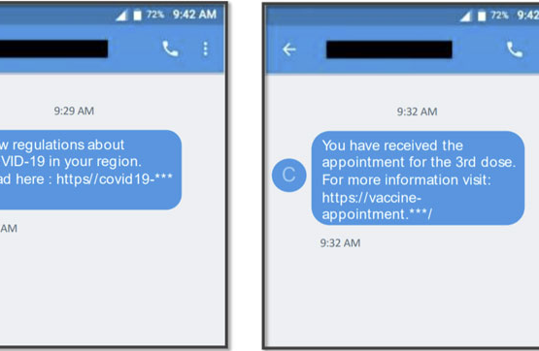
New android malware targeting us and Canadian users
Emerging malware called “TangleBot”
Called this because the malware has many layers of control over different device functions
Such as contacts, SMS, call logs, internet access, camera
Starts as an SMS message claiming to contain new information on the COVID-19 vaccine

Slide 4
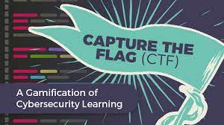
Capture The flag

Slide 5
Different formats
Jeopardy
Complete as many categories from a given section
Common categories include, but are not limited to: programming, applications, networking, forensics, mobile, cryptography, and reverse engineering
Attack-Defense
Team must either defend or capture vulnerable computer systems
To gain points teams need to maintain possession of as many systems as possible while keeping competitors out

Slide 6
History of ctf
One of the first prominent CTFs occurred during DEF CON 1996
DEF CON and other Computer Security conventions have consistently held various forms of Capture the Flag since
CTF is an example of a wargame coined from the movie WarGames (1983)
Used to teach the basics of web attacks and web security

Slide 7
Why participate in a ctf competition?

Slide 8
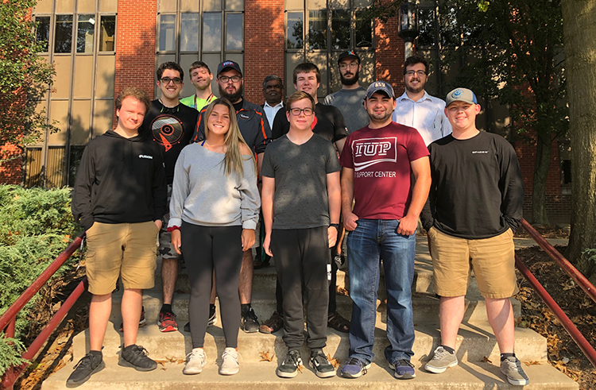
2019 CAE-NE HAckathon
CTF held remotely by CAE-NE
Hybrid CTF using both Jeopardy style and Attack-Defense style
Separated into two sections one working on each portion
Ran from around 9AM to around 4PM along with a few hours for set up the night before
Competed against 8 different colleges around the area

