Slide 1
Cyber Security Club 9-14-2021
Franklin May &
Ethan Buhl

Slide 2
Cyber Security In The News
FTC is warning the LGBTQ+ community about extortionists on dating apps
Scammer on apps such as Grindr and Feeld
They will send explicit phots, and ask the target to reciprocate
They will then blackmail their target into paying a ransom
Some scammers will also out ‘closeted’ individuals found on these apps
FTC warns that users should not share explicit photos on these apps as there has been a massive increase in ‘sextortion’ attacks since January 2021

Slide 3
Cryptominers Hiding Logic Bombs in Python Packages
Researchers discovered a logic bomb attack in the Python Package Index (PyPI)
PyPI is a code repositor for Python developers
Aim was to get honest software developers to deliver these bombs
It is believed that the payloads included have been downloaded around 5,000 times
The purpose of this is to hijack these systems for cryptomining

Slide 4
Python Packages cont.
Complex event due to multiple different kinds of attacks
Logic bombs
A set of instructions incorporated in a program that will carry out when a certain condition is met
Cryptojacking
Malicious cryptomining by hacking into a computer to install software to mine cryptocurrencies
Software Supply Chain Attacks
When a threat actor infiltrates a software vendor and employs malicious code before the vendor sends it to their customer

Slide 5
Phishing
Ethan Buhl

Slide 6
What is phishing?
“The fraudulent practice of sending emails purporting to be from reputable companies in order to induce individuals to reveal personal information, such as passwords and credit card numbers.”
Type of Social Engineering

Slide 7
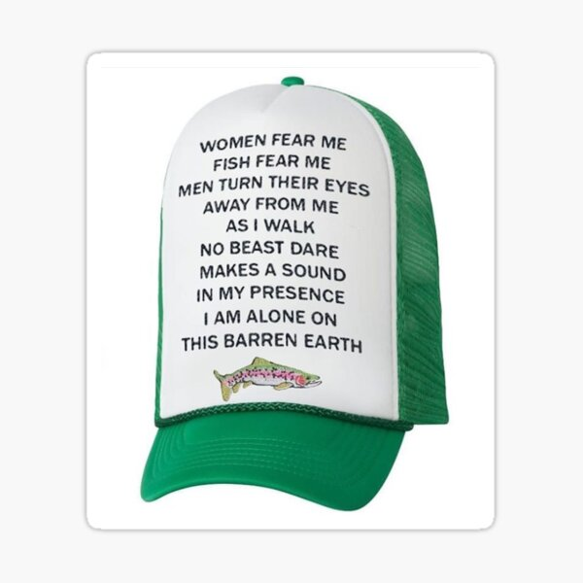
History
1995
Didn’t get popularized till 2000
ILOVEYOU
Destroyed files
$5.5 – $8.5 Billion in damages

Slide 8
(Not so) Fun Facts
32% of data breaches
88% of companies experienced spear phishing
New phishing site very 20 seconds

Slide 9
Types of Phishing
Spear Phishing
Specifically tailored
Phone Phishing
Scam Calls
Phishing Website
Slightly varied URL
Ex. www.paypa1.com instead of www.paypal.com

Slide 10
How to defend?
Traditional defenses won’t work
Training Employees
Err on the side of caution
Being diligent

Slide 11
Questions or Discussion?

Slide 12
Simple Phishing Attack

