Slide 1
Red Team Strategies
GenCyber Summer 2021

Slide 2
Hackers: The Good, The Bad, and The Ugly
When people typically think of “hackers” they typically think of what we call Black-Hat hackers
A hacker that breaks through computer security for their own gain, typically with malicious intent
Criminal / Illegal
However, there are also legal, ethical hackers: Red Team hackers.
Their job: legally hacking, either using physical or cyber means, into a company or building in order to expose the security weaknesses and help them get repaired.

Slide 3
Red Team vs Blue Team
RED TEAM
Offense
Detect Weaknesses in a company’s security
Penetration Testing
Social Engineering/Phishing
Physical Security Access
BLUE TEAM
Defense
Incident Response
Maintaining the network
Risk Assessment

Slide 4
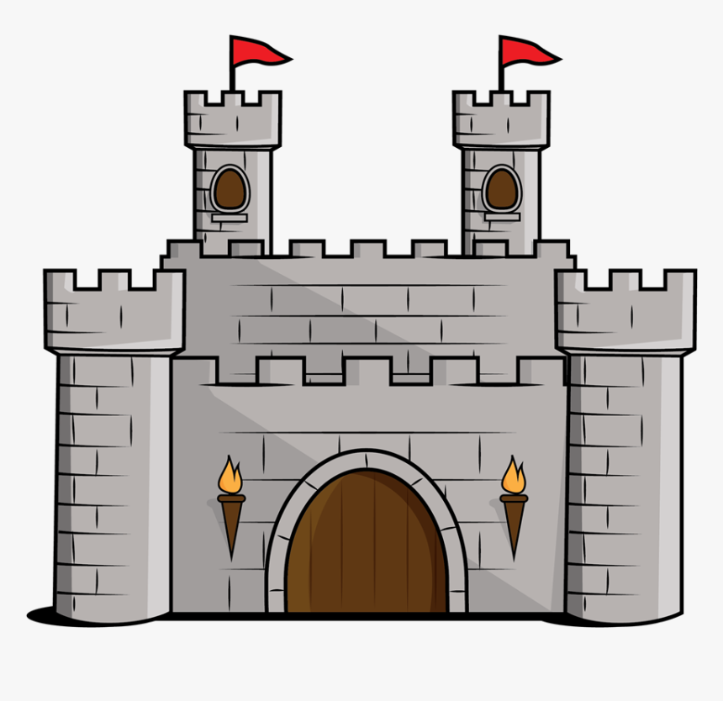
Physical Security in Cyber Security
One of the most important tactics in keeping a computer system secure is ensuring its physical security.
Red Team physical penetration testers are hired to test the effectiveness and sustainability of a company’s physical security
They hack into the building as well as the cyber systems and then report their findings to the company.
Physically Protected Spaces keep a company’s data and computer network secure

Slide 5
Physically Protected Space (PPS)
An area that is guarded from those with malicious intent to access it
Usually contains multiple layers of security
Takes CPTED and applies it to a real life situation
Example: the Google Data Center
Six Layers of Security
1. Signs, Fences, road, etc.
2. Smart Fencing, Guard patrols, cameras
3. Building Access: Card access, Iris Scanning
4. Security Operations Center: 24/7 Observation of Cameras, Scanners, etc.
5. Data Center Floor: Massive server room with only as-needed access
6. Disk Erasion Room: Room that destroys hard disks. Two-way locker system so that only few designated workers are allowed to erase the drives.
For more info: https://www.youtube.com/watch?v=kd33UVZhnAA (6 min)

Slide 6
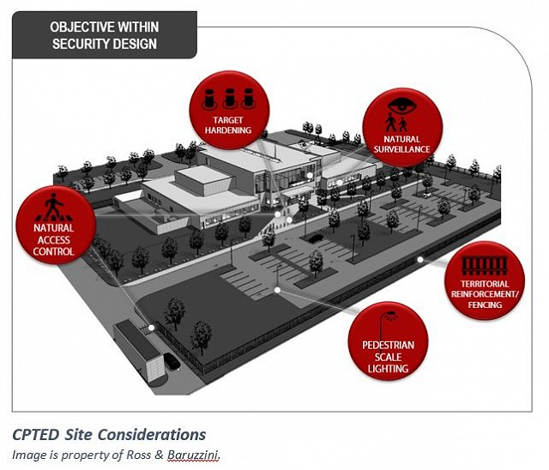
Crime Prevention Through Environmental Design (CPTED)
Also known as Design Out Crime
Multi-disciplinary approach to preventing crime
Planning the layout of an environment with security in mind

Slide 7
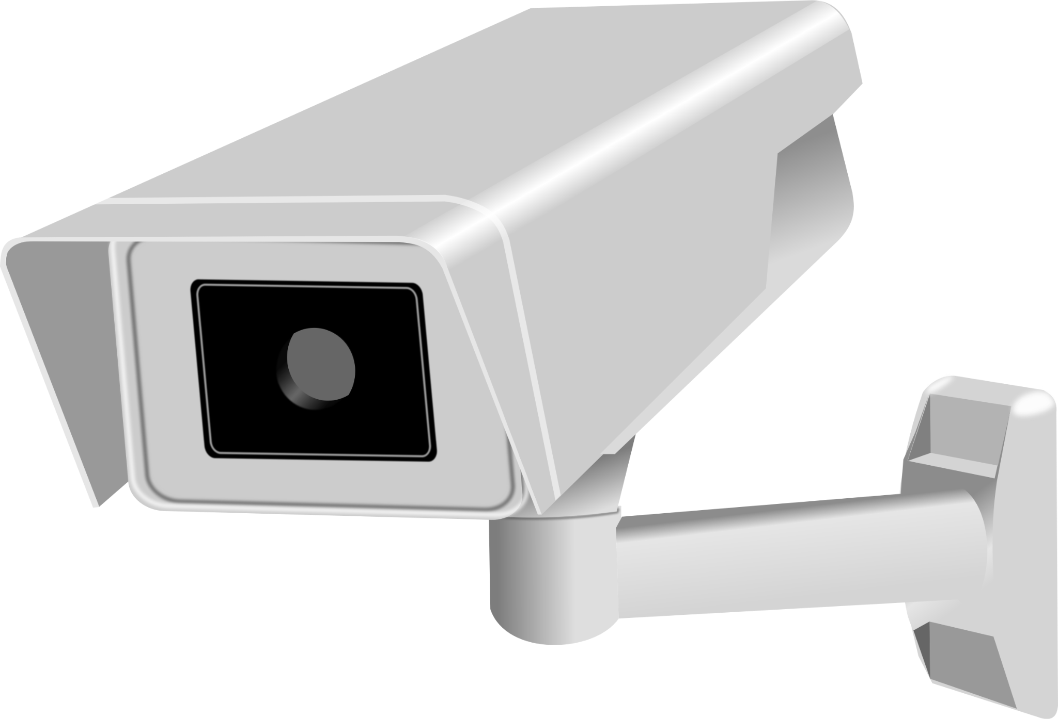
Four Principles of CPTED
Natural Surveillance
Visibility
Placement of both physical and social features
Ex: windows, no blind corners, support desks, etc.
Natural Access Control
Restricting and encouraging movement in different parts of the building
Ex: clear and limited entrances, security checkpoints, etc.
Territorial Reinforcement
Publicly distinguished security areas
Ex: restricted areas, gates, security level access requirements, etc.
Maintenance
Well maintained grounds to show that structure is well-kept and being used

Slide 8
What Red Team Physical Pen-Testers Look For...

Slide 9
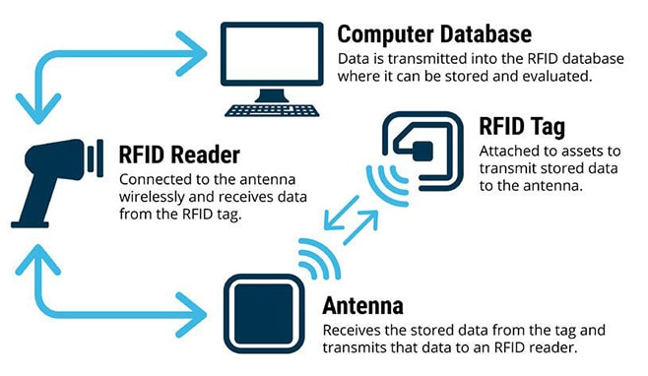
Common Security Components
RFID (Radio-Frequency Identification)
Basics
RFID systems consist of a tag (RFID label), a reader, and an antenna
Often used for physical security components like door access/locks
Attack
RFID tags can be cloned if an attacker can pick up and read signals from the card to reader
Once cloned, a hacker can recreate the RFID tag
Solution
Use an RFID system with mutual authentication or stronger security measures (like Smart Card chips or Biometrics)

Slide 10
Common Security Components
REX (Request-to-Exit) Sensors
Basics
Simple passive thermal sensors detect people exiting and unlock the door
Commonly used sensors do not detect heat change, but rather anything different in the area
Attack
Blowing cloud of gas through door to trip sensor
Solution
Dual-technology REX sensor
Uses both passive infrared and radar technology
The sensor will trip once a heat change AND human-sized object is detected

Slide 11
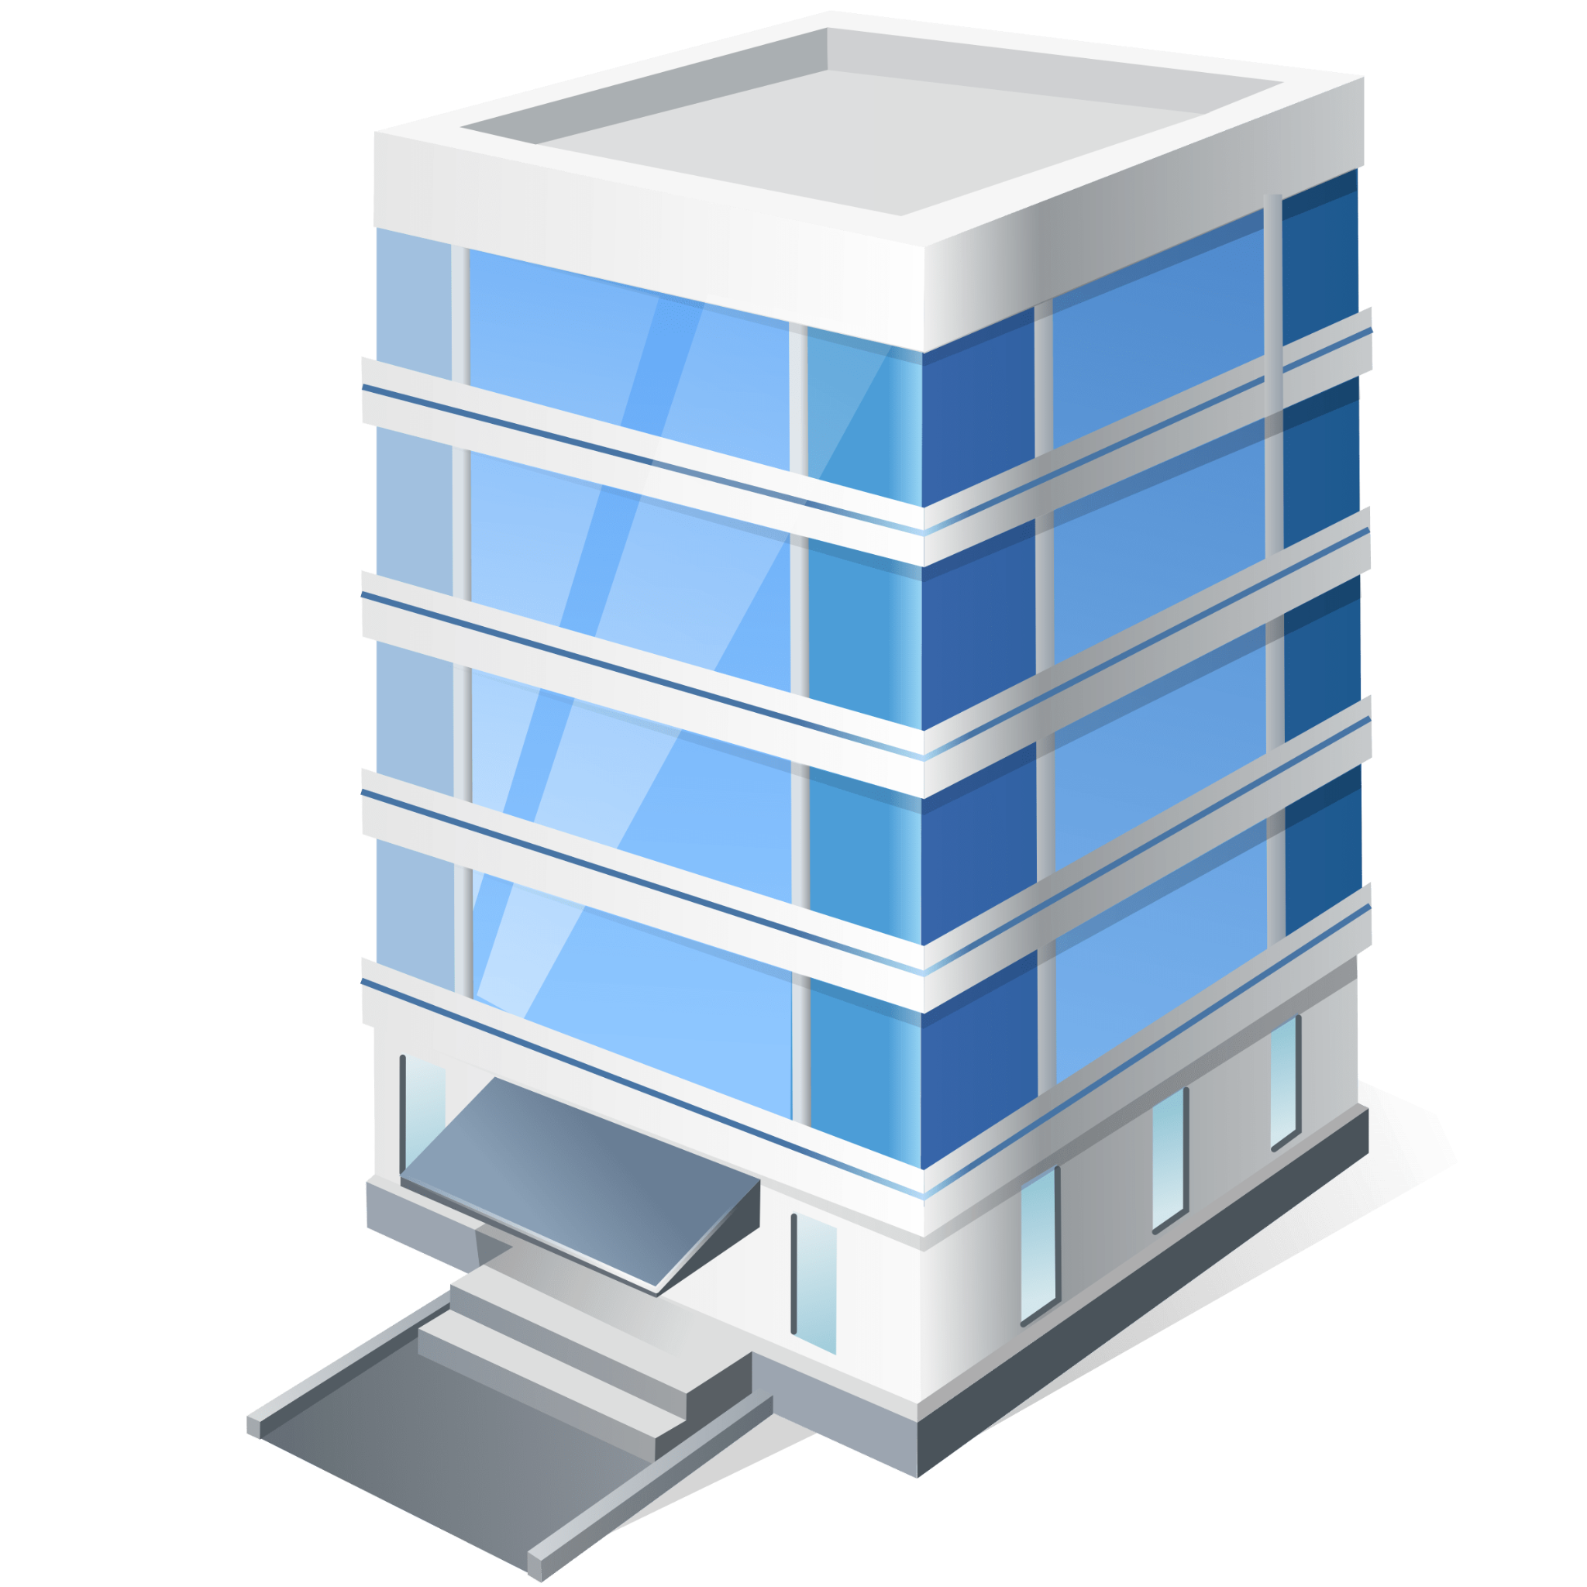
Designing Your Own Secure Building

Slide 12
Instructions
Use the link provided in your breakout room to enter Google Drawings
As a team create a secure building based on the previous requirements
Be prepared to have your final copy shared at the end
If you would like to discuss or explain your floorplan there will be time for that as well

Slide 13
Requirements
Building must be in the shape of the letter H
The building needs to have at least 6 rooms
One room must be a secure server room
One room must be the security guard office
You may not have any empty rooms

Slide 14
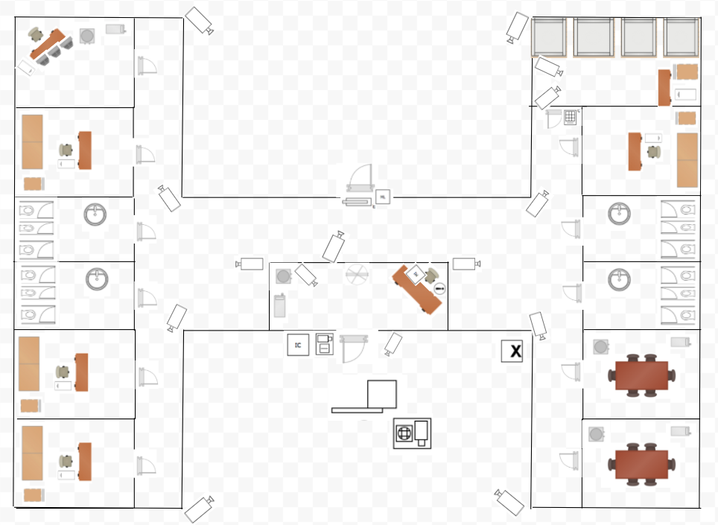
EXAMPLE FLOOR PLAN

Slide 15
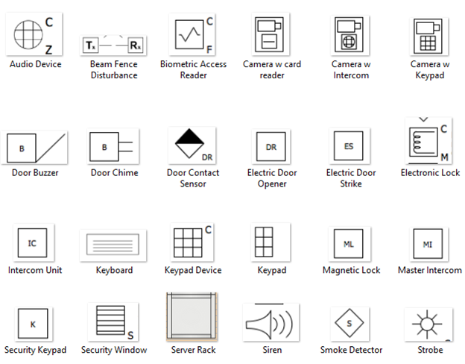
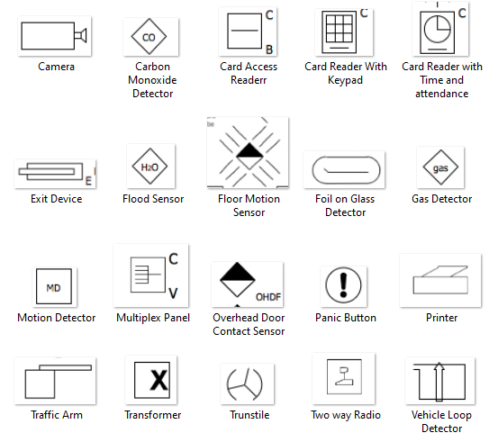
Example of Key

Slide 16
Tips
Helpful symbols can be found in the Red Team Strategies folder
The requirements for the activity can be found alongside the key in the file named “Required-Key”
You are not limited to supplies given to you
If you have an idea and would like to use items feel free to use your own!

