Slide 1
Presentation on AMOS
Analysis of MOment Structures
By James Bowers, Jr., MA
Ben Jarrett, BS
from the
Applied Research Lab

Slide 2
This presentation was adapted from:
Arbuckle (2007) Amos 16.0 User’s Guide
Blunch (2008) Introduction to structural equation modeling: Using SPSS and AMOS
Byrnr (2001) Structural Equation Modeling with AMOS
Additional resources: a page at the end

Slide 3
Topics to be covered:
-Applications
-Assumptions
-Hypothesis Testing
-Analysis
-example you can participate in

Slide 4
AMOS is a program to assist with SEM; part of SPSS
-structural equation modeling (SEM) also known as:
-analysis of covariance structures
-causal modeling

Slide 5
In short: modeling with subgroups

Slide 6
Why path analysis?
It “can be used to analyze models that are more complex (and realistic) than multiple regression”
“It can compare different models to determine which one best fits the data”
“It can disprove a model” (Streiner, 2005, p.115)

Slide 7
Latent variables not directly measured
Ex. Psychology: self-concept; motivation
Sociology: powerlessness; anomie
Economics: capitalism; social class (Byrne, 2001)
Observed variables aka manifest variables
Indicators of the construct
Ex. Income or any other direct measure

Slide 8
Exogenous variables “synonymous with independent variables” (Byrne, 2001)
Endogenous variables “synonymous with dependent variables” (Byrne, 2001)

Slide 9
Exploratory factor analysis (EFA) “designed for the situation where links between the observed and latent variables are unknown or uncertain” (Byrne, 2001)
Confirmatory factor analysis “used when the researcher has some knowledge of the underlying latent variable structure” (Byrne, 2001)

Slide 10
Structural model “[describes] the causal connections among the latent variables” (Blunch, 2008)

Slide 11
Assumptions
Appropriate sample size
Linear relationship
Non-zero covariances
No multicollinearity
Interval data
Theoretically identified (include proper variables and leave out the unimportant one)
No outliers
Normal distribution of variables (Garson, 2009)

Slide 12
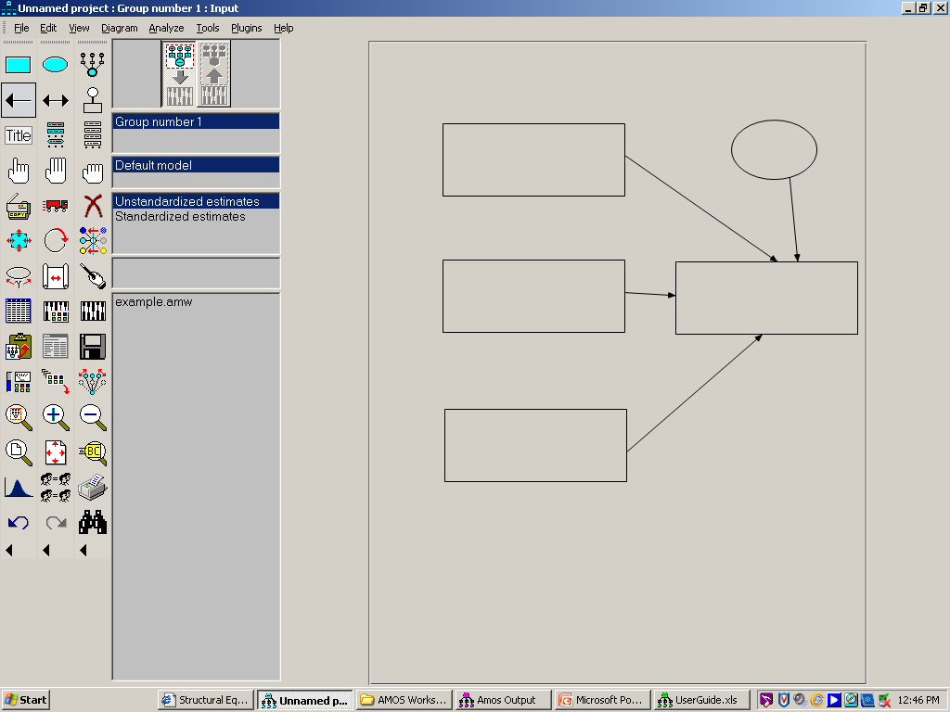

Slide 13
Manifest variable
Latent variable
Indicator Icon
Path Icons
Error Icon
Variable List: Model
Variable List: Data Set
Reshape
Rotate Icon
Reflect Icon
SPSS file linked
Can you find copy, move, erase, save, zoom in, zoom out, magnify, print, undo, redo, search?

Slide 14
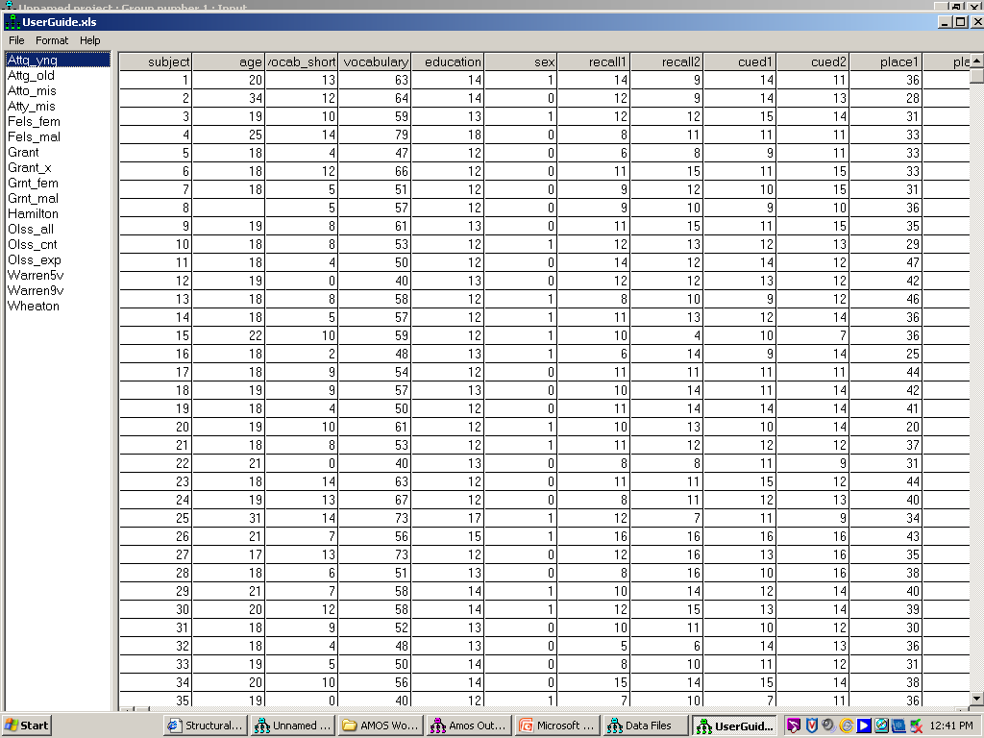
Attig (1983) data on subject recall by cues and place

Slide 15
THIS
AFFECTS
THAT

Slide 16
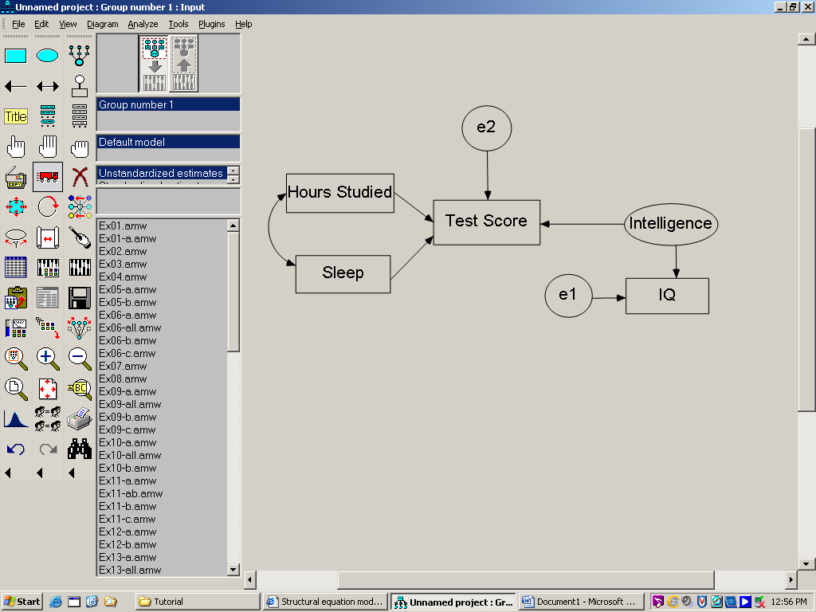
Error
Direct Measure (boxes)
Interaction (arrows)
Latent variable (ovals)

Slide 18
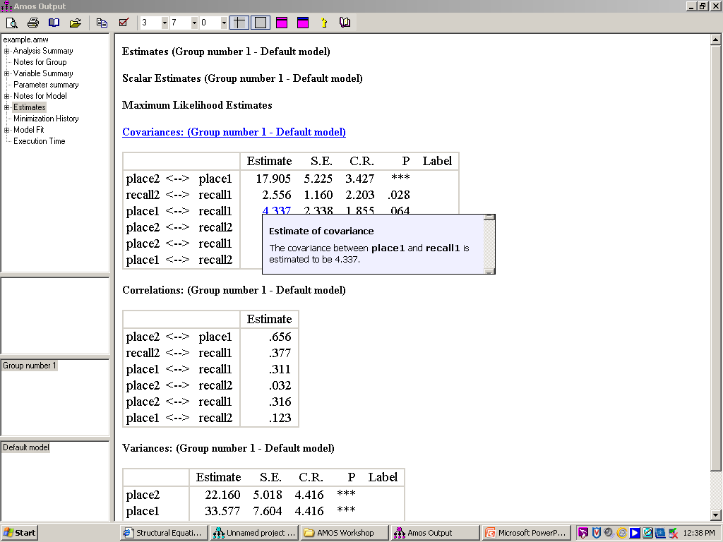

Slide 19
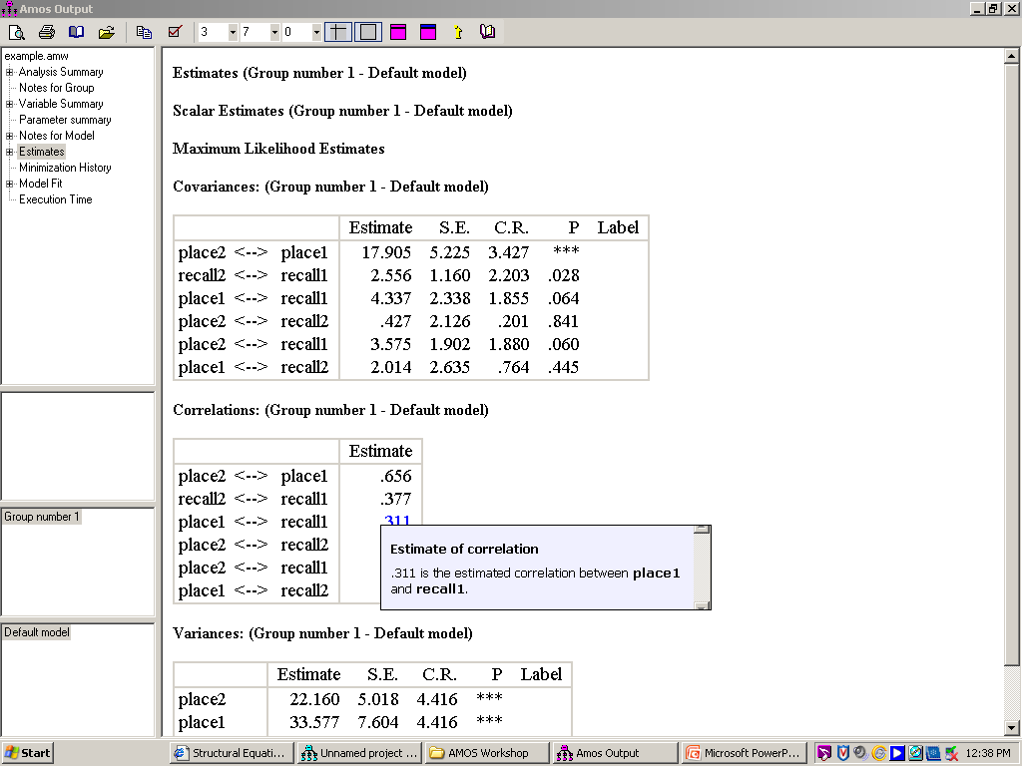

Slide 20
Mixture modeling (AKA latent class analysis)—”appropriate when you have a model that is incorrect for an entire population, but where the population can be divided into subgroups in such a way that the model is correct in each subgroup” (p. 7)

Slide 21
So, now we have the data, and a working model, then what?

Slide 22
Analyze, then Calculate Estimates
Output either “text” or “graphics”

Slide 23
Some of the basics: un-standardized estimates (apples to oranges) standardized estimates (apples to apples)

Slide 24
Arbuckle noted “in AMOS graphics, the rule is to assume a correlation or covariance of 0 for any two variables that are not connected by arrows” (p. 29).
0
Measured variable
Latent variable

Slide 25
The estimate is the estimated correlation.
Estimate—”an observation on an approximately normally distributed random variable centered around the population covariance with a standard deviation of about [s.e.] “(p. 32).

Slide 26
H₀ : the model fits the data (you want chi-square values to be low)
H₁ : the model doesn’t fit the data
-you can never accept, just fail to reject
-small samples/ large samples
-relationship of variables/ overall fit of model
-p<0.05, reject model

Slide 27
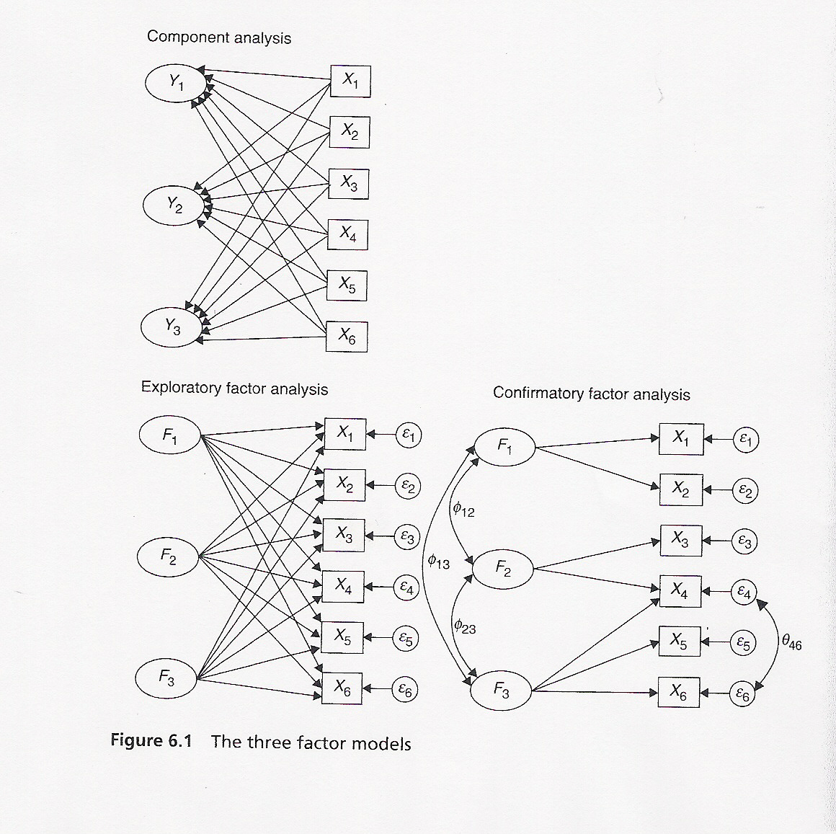
Copy page 128 of Blunch (2008)

Slide 29
Used when research has an idea of latent variable structure

Slide 30
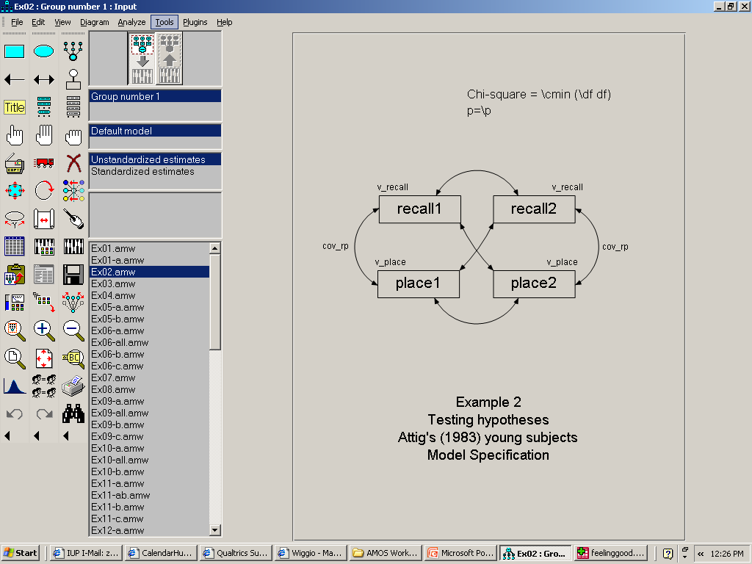

Slide 31
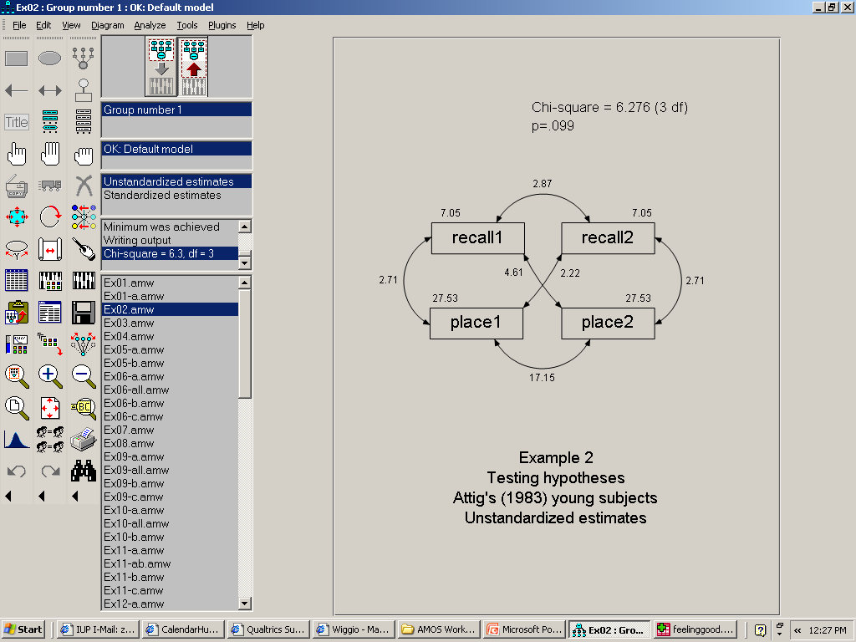

Slide 32
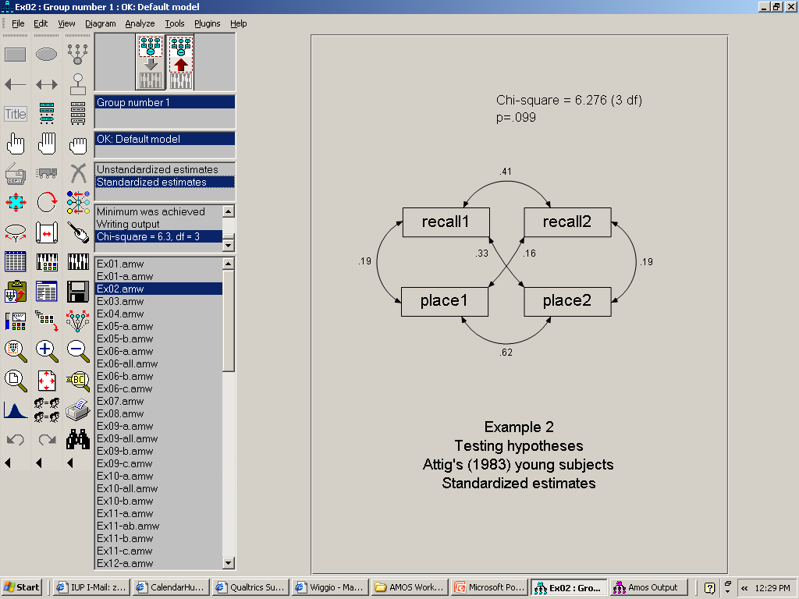

Slide 33
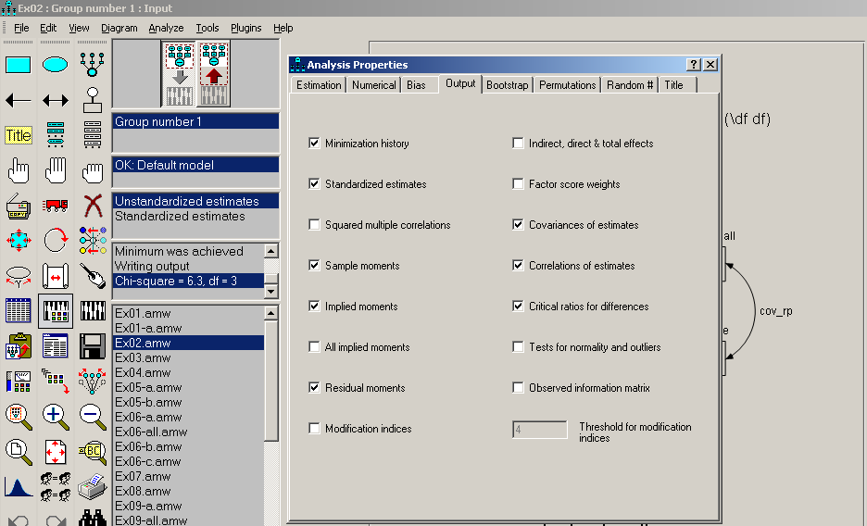

Slide 34
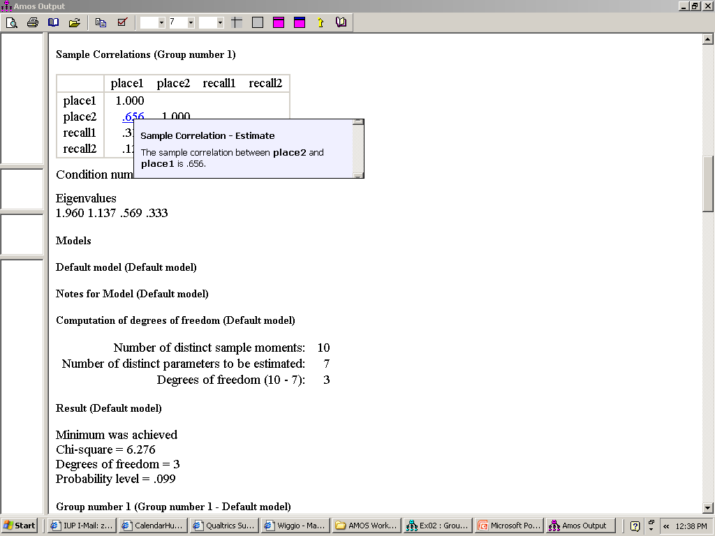

Slide 35
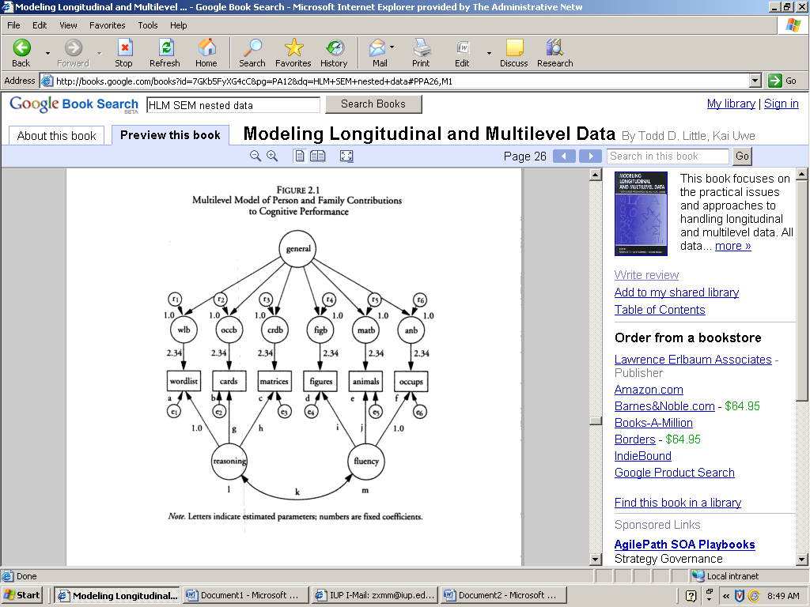
SEM can be used for nested models
Little et al., 2000, p. 26

Slide 36
SEM/ HLM
Little et al. (2000)
SEM/ HLM…”both approaches are flexible tools for examining complex structures in a feasible way” (p. 12).
They are “not completely interchangeable” (p. 12).

Slide 37
SEM “has tremendous ability in modeling error structures” (p. 12).
HLM handles missing data better.
“not all data structures can be handled in SEM or HLM” (p. 12).

Slide 38
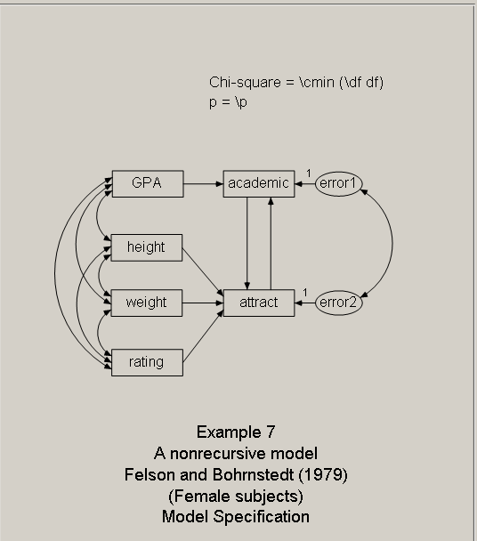
Non-recursive --means there’s a feedback loop.

Slide 39
Hierarchical linear modeling (HLM)
  also know as:
Variance-component model
Random-coefficient model
Multilevel modeling
Applying a multilevel-regression model
(as cited Hox’s chapter in Little et al., 2000, p.15)

Slide 40
Factor Analysis
Holzinger and Swineford (1939)
26 psychology tests
301 7th and 8th grade students
73 girls

Slide 41
visperc—visual perception scores cubes—test of spatial visualization lozenges—test of spatial orientation paragraph—paragraph comprehension sentence—sentence completion score wordmean—word meaning test score

Slide 42
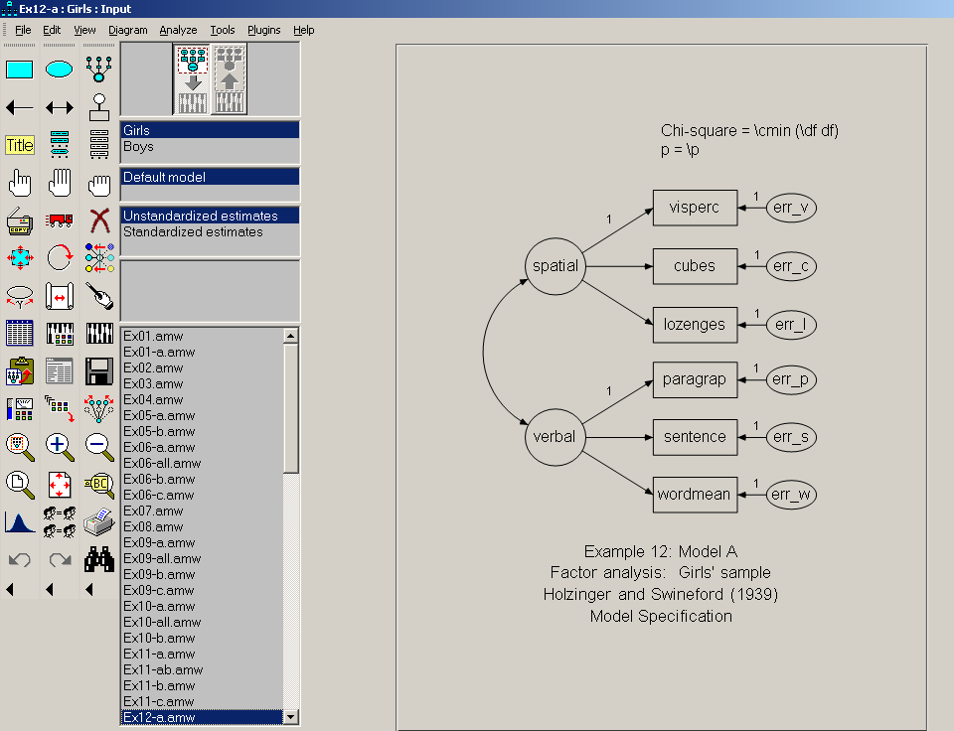

Slide 43
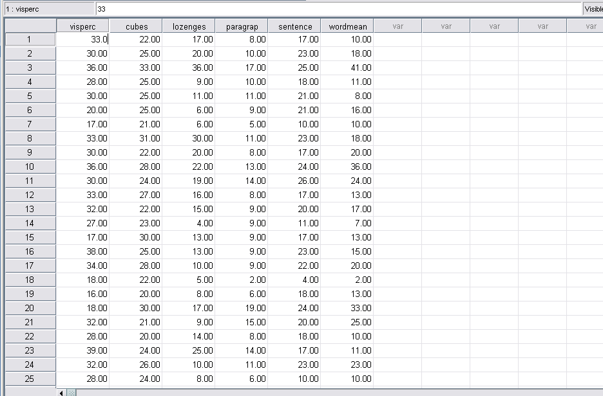

Slide 44
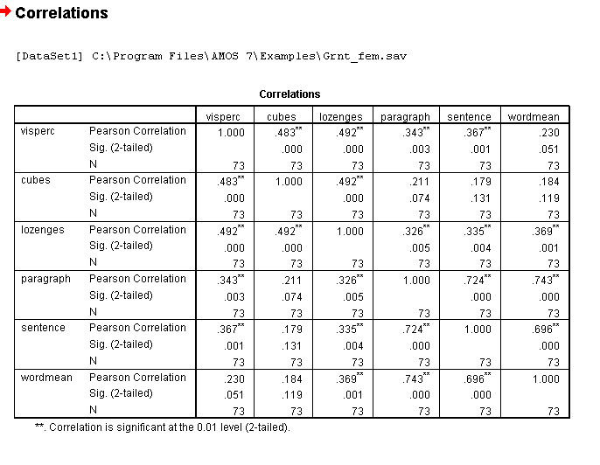

Slide 45
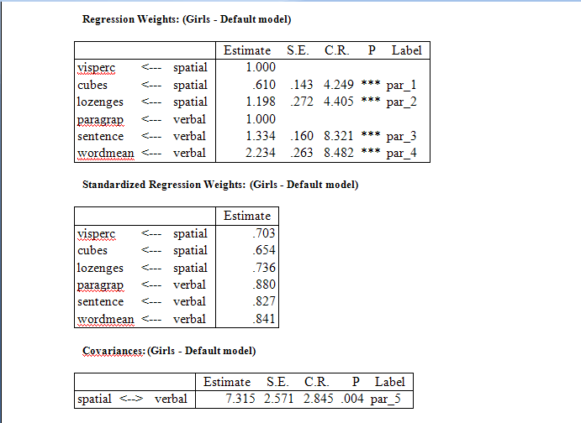

Slide 46
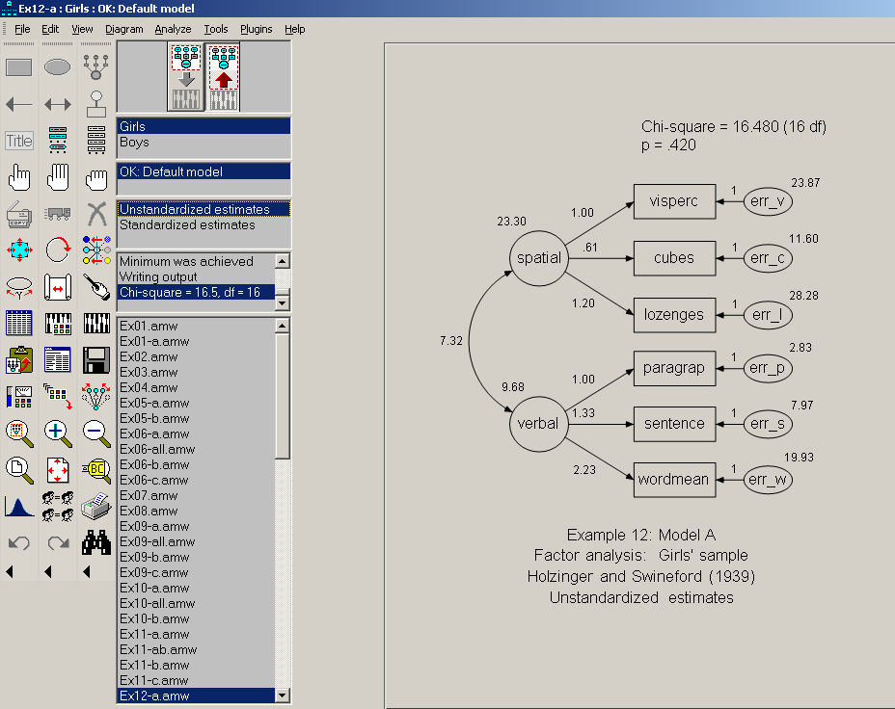

Slide 47
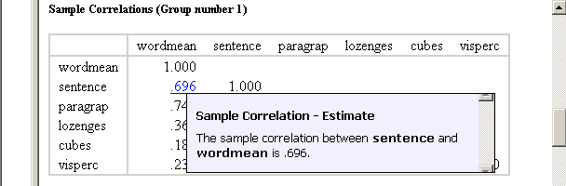
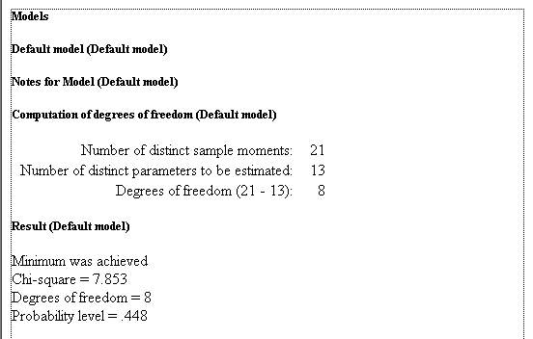

Slide 48
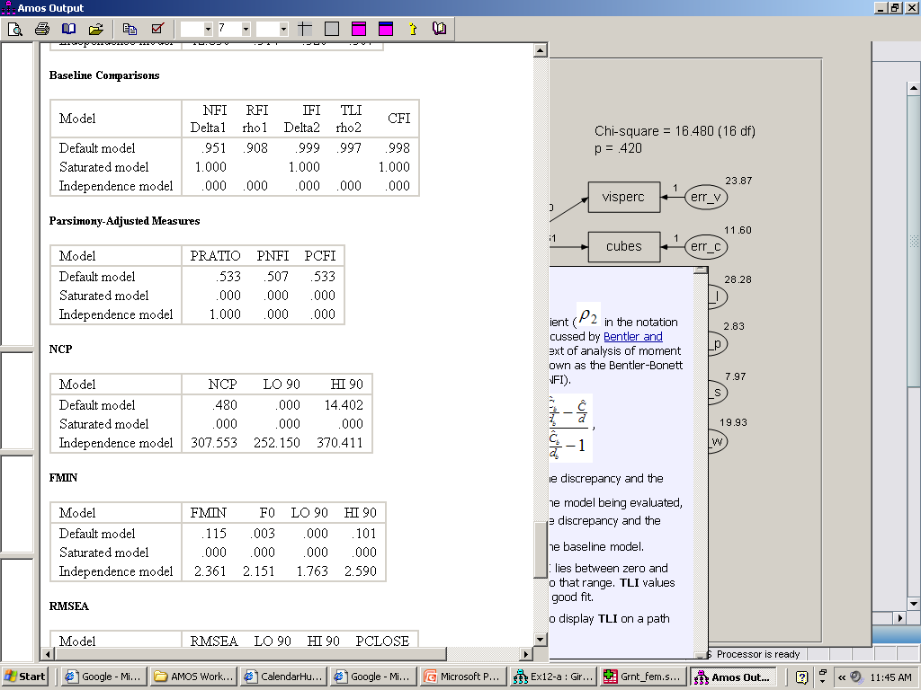
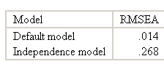
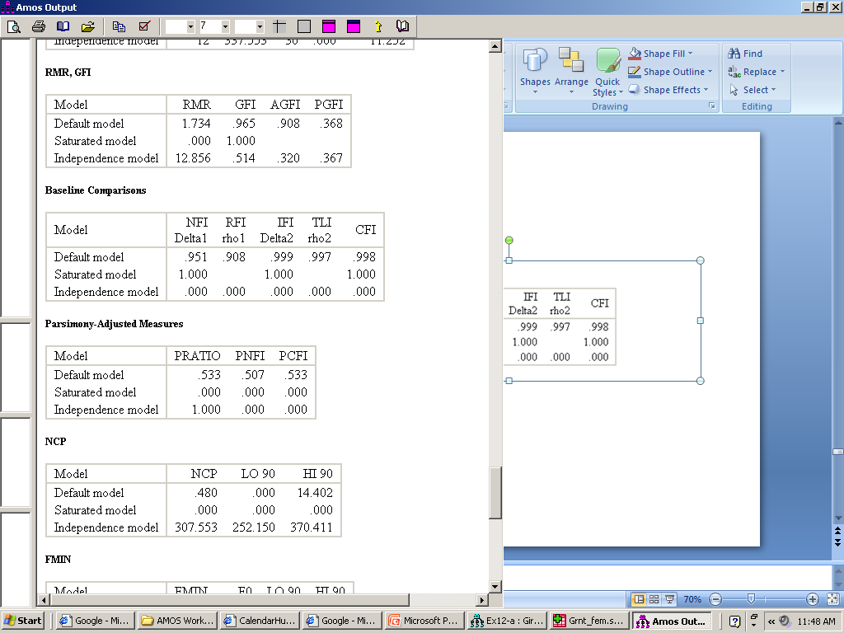
Relative Fit (In Model Fit Summary)
Tucker-Lewis Index (TLI)
Root Mean Square Error of Approximation (RMSEA)
“Good” models should have RMSEA below 0.06 and
TLI above 0.95 (Hu and Bentler)

Slide 49
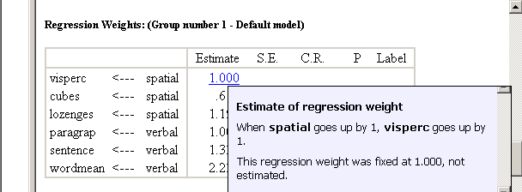
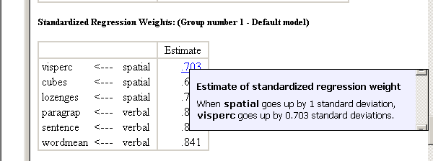

Slide 50
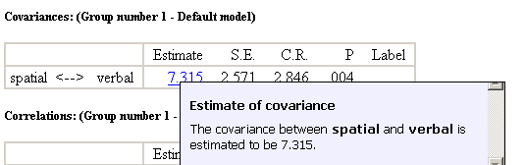
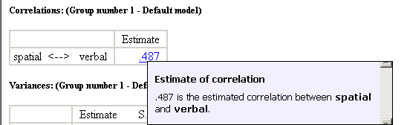

Slide 51
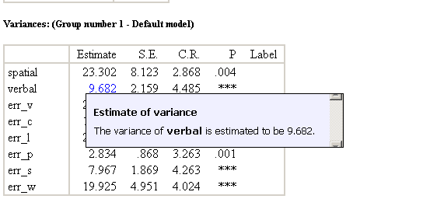
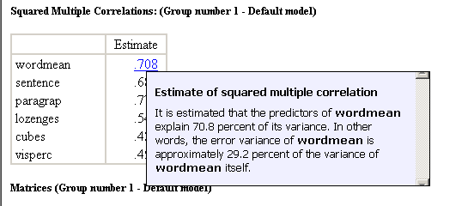

Slide 52
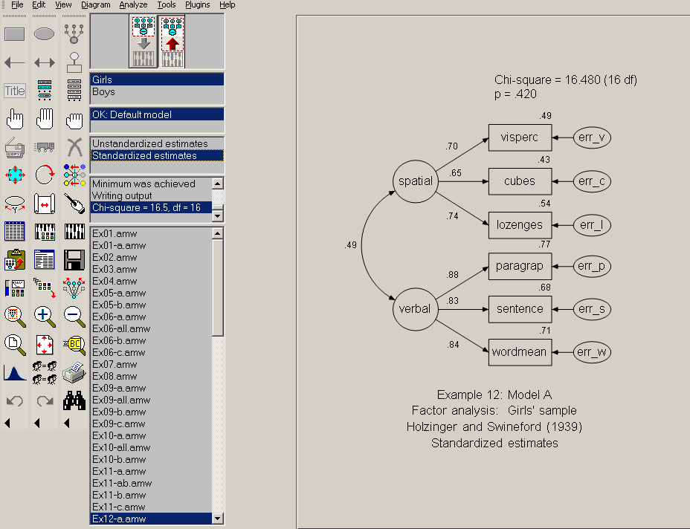

Slide 53
What happens if a model is bad?
Models can be modified
(connections can be added or removed)
New variables can be added
(if you have the data)
Variables can be dropped
“it is what it is”—the theory could be bad
You must think—does it make sense conceptually?—or am I trying to fit the data?

Slide 54
Example
We will walk through a hands on example, after a short break

Slide 55
Other sources on Internet
http://ssc.utexas.edu/consulting/tutorials/stat/amos/#theory
http://faculty.chass.ncsu.edu/garson/PA765/semamos1.htm

Slide 56
The End

