Slide 1
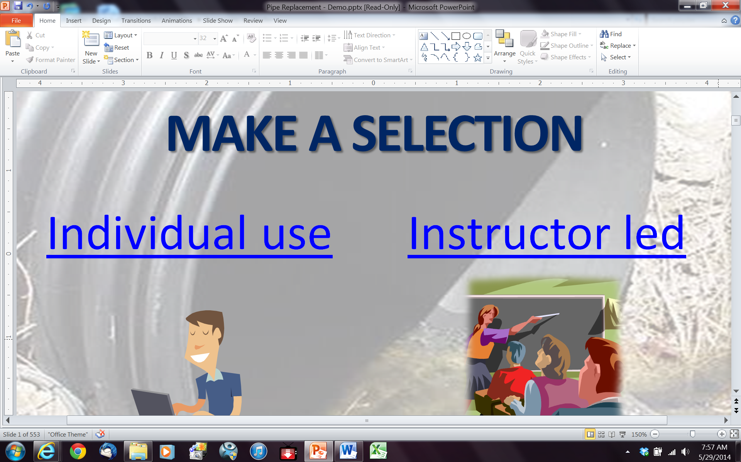
make a selection
Please use this training in SLIDE SHOW mode
Individual use
Instructor led

Slide 2

Maintenance Activity Training (MAT) Pipe Replacement
Welcome
to the PennDOT
Pipe Replacement
Maintenance Activity Code:
711-7324-01
Revised December, 2012
introduction
Notes:
Welcome to the PennDOT training for pipe replacement.
This training is intended for PennDOT department force personnel responsible for planning scheduling and completing this activity.

Slide 3
Welcome to Pipe Replacement
This training is intended for PennDOT personnel responsible for
Planning, Scheduling, and Conducting Pipe Replacement Activities.
Copyright © 2011 by the Commonwealth of Pennsylvania. All rights reserved. No part of this training may be reproduced, stored in a retrieval system, or transmitted in any form or by any means electronic, mechanical, photocopying, recording or otherwise without prior written permission by PennDOT.
This training course was developed in partnership with the Pennsylvania Department of Transportation’s Business Leadership and Administrative Services Office and the Bureau of Maintenance and Operations, and the Indiana University of Pennsylvania. It is offered as part of the Pennsylvania Department of Transportation’s Highway Administration Comprehensive Training Plan exclusively through the Technical Training and Development Section.
introduction

Slide 4
How to use this training
This training is non-linear, which allows for:
  Flexibility to select modules based on classification of the participant
  Can be adjusted for time allotments
  Can be used at remote training sites
introduction

Slide 5
How to use this training
Managers participating in this training should review at a minimum the following modules:
  Project Planning
  Project Preparation
  Concurrent Activities
  Scheduling
  Safety
  Quality Assurance
  Environmental Concerns
  Risk Management
  Follow-up Activities
  Preventive Maintenance
introduction

Slide 6
How to use this training
Foremen participating in this training should review all modules in this training.
Crew members participating in this training should review at a minimum the following modules:
  Safety
  Work Zone Traffic Control
  Quality Assurance
  Environmental Concerns
  Risk Management
  Operational Sequence
introduction

Slide 7
How to use this training
Navigate from slide to slide using the navigation arrows in the lower right hand corner of the slide.
Return to the module selector slide at any time by clicking on the training logo in the lower left-hand corner.
Click any text in this highlighted field to view the corresponding text or graphics
introduction
Notes:
To navigate this training you can use the up and down arrow keys on your keyboard or use the arrows in the lower right hand corner of the slide.
When you see a highlighted field on a slide click on the highlight to view additional information or graphics. Click on the highlight a second time to restore the slide.

Slide 8
How to use this training
Navigate from slide to slide using the navigation arrows in the lower right hand corner of the slide.
Go back to the module selector slide at anytime by pressing the training logo in the lower left-hand corner
Click any text in this highlighted field to view the corresponding text or graphics
This is where additional information can be found.
Return to selector page
introduction
Notes:
To navigate this training you can use the up and down arrow keys on your keyboard or use the arrows in the lower right hand corner of the slide.
When you see a highlighted field on a slide click on the highlight to view additional information or graphics. Click on the highlight a second time to restore the slide.

Slide 9
At the start of each module, you will see a list of learning objectives.
These are the primary objectives of the module and where you should focus your attention.
introduction

Slide 10
Within the module, the key topics from the learning objectives will be indicated by this KEY TOPICS tag.
introduction

Slide 11
Each learning module will end with a summary of the learning objectives and key topics that were addressed in the module.
introduction

Slide 12
The Director’s Safety Message
Take Safety Seriously!
While mission is the central focus of our operations, safety is paramount. Ignoring it results in increased costs and lost production. More importantly it can result in lost lives or disabling injuries for co-workers and/or customers with irreversible impacts on their lives and families.
Reducing or eliminating risks which create unsafe conditions is an essential part of any job. Getting the job done is only half of it. Getting the job done right ensures the safest conditions for our fellow employees and our customers who entrust us with their lives and livelihood with each journey on our roads.
This training addresses essential maintenance activities which you will encounter in your job as well as the risks associated with them. It emphasizes the safe way to perform each task to reduce or eliminate these risks.
For your safety and those whose lives are affected by your actions, don’t take risks. Take Safety seriously!
introduction
Notes:
Each training module has activity specific safety concerns. For the safety of the crew members and motoring Public it is important that every crew member associated with the activity be familiarized with the safety concerns.

Slide 13
Safety concerns for this learning module
Like many activities performed by PennDOT Maintenance Personnel, these operations can be extremely dangerous.
Please review and pay close attention to the Safety and Work Zone Traffic Control Modules of this training.
Never compromise the safety of the crew or the motoring Public while performing this or any other maintenance activity!
introduction

Slide 14
Pipe Replacement (711-7324-01)
This activity includes all tasks and related actions associated with the installation or replacement of pipes and culverts under 36 inches in diameter
such as:
introduction

Slide 15
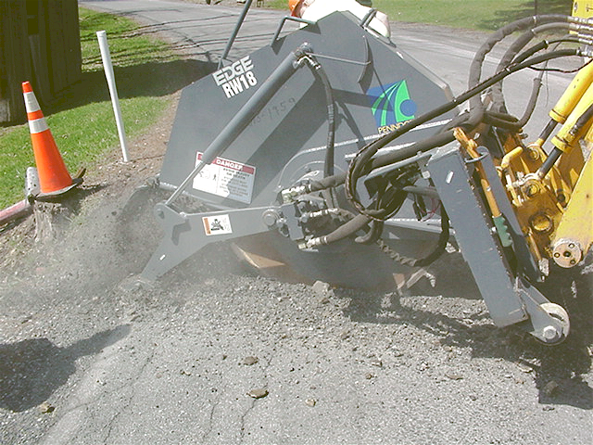
Sawing or cutting the pavement
introduction

Slide 16
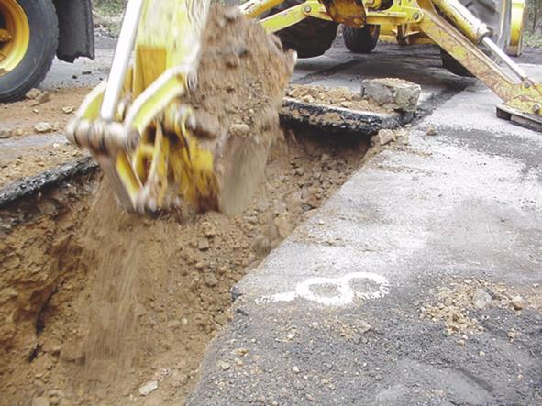
Excavating the trench
introduction

Slide 17
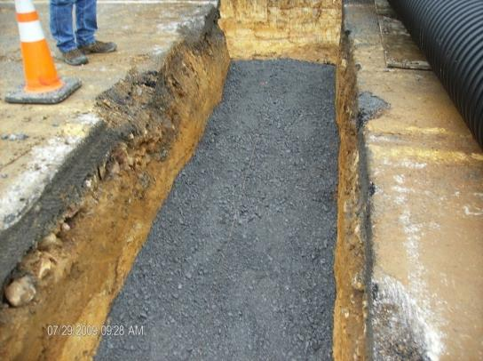
Placing the bedding material
introduction

Slide 18
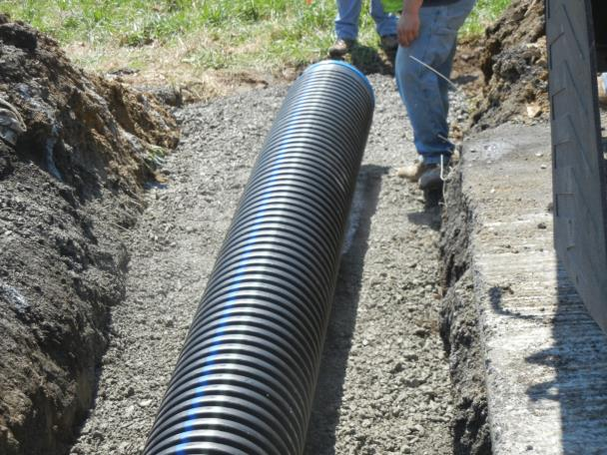
Installing the pipe
introduction

Slide 19
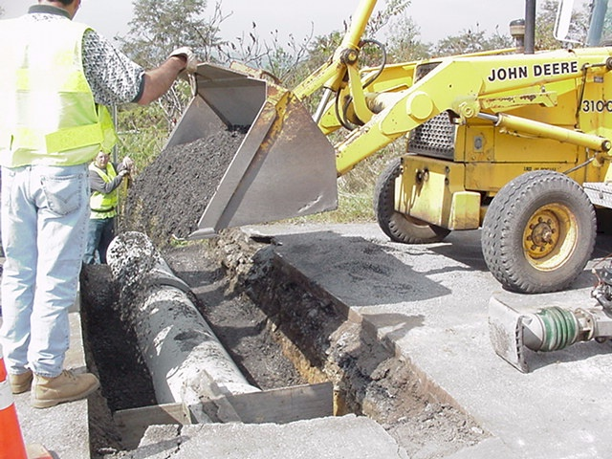
Backfilling
introduction

Slide 20
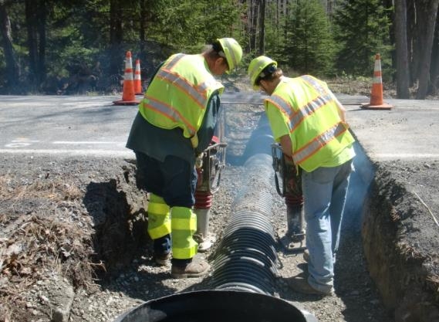
Trench compaction
introduction

Slide 21
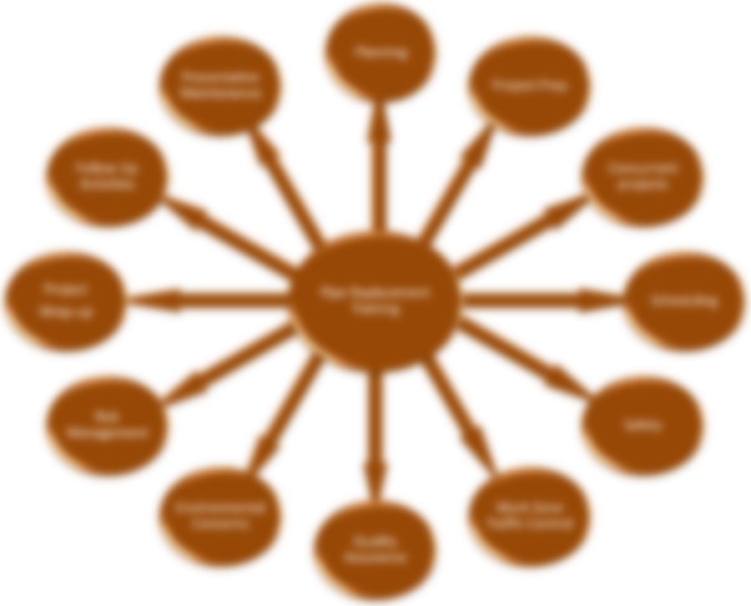
The following slide allows you to select the specific training module you would like to view.
To return to this module selector, simply click the module icon located in the lower left-hand corner of every slide.
introduction

Slide 23
Planning
Planning

Slide 24
Define Maintenance Planning Strategies
Describe proactive maintenance strategies
Compare and contrast the different maintenance planning strategies
Planning

Slide 25
Maintenance Planning Strategies
Maintenance Strategies are the practices used to provide a deliberate and coherent 'road map' for County Management to follow in order to achieve the following goals:
  Reduce breakdowns, maximize the life of the roadways and bridges and improve productivity
  Maximize limited resources through controlled spending and adherence to budgets
  Ensure compliance with established Department goals and objectives
  Adherence to all applicable policies and regulations
Planning

Slide 26
Reactive vs. Proactive Strategies
Demand Maintenance (reactive)
Preventive Maintenance (proactive)
    Preventive Maintenance
    Cyclical Preventive Maintenance
    Surface Improvement Preparatory
Planning

Slide 27
Demand Maintenance Strategies
  Simply put, demand or reactive maintenance is any activity conducted in response to a maintenance condition or deficiency that demands a maintenance activity be performed to correct it.
Planning

Slide 28
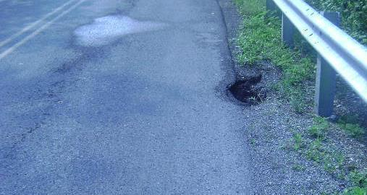
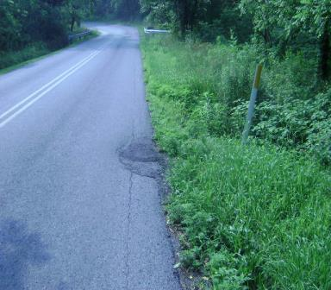
Examples of Demand Maintenance for Pipe Replacement
The pipe has separated or collapsed
Planning

Slide 29
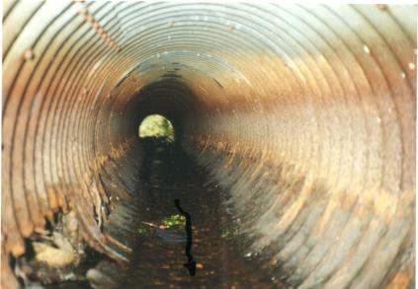
Examples of Demand Maintenance for Pipe Replacement
The pipe has rusted out
Planning

Slide 30
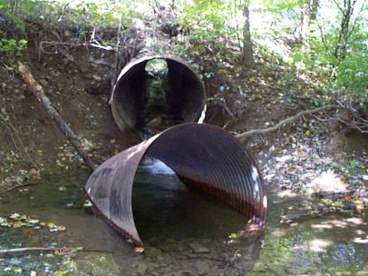
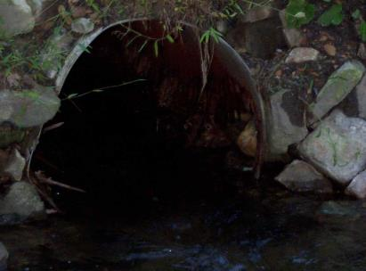
Examples of Demand Maintenance for Pipe Replacement
Maybe a little of both?
Planning

Slide 31
Preventative Maintenance Strategies
  Preventive Maintenance
  Schedule of planned maintenance actions aimed at the prevention of breakdowns and failures
  Primary goals:
    prevent the failure of roadways and bridges before it occurs
    extend the serviceable life of the roadways and bridges
  Strategies include:
    Cyclical Maintenance
    Preventative Maintenance
    Surface Improvement Preparatory Maintenance
Planning

Slide 32
Cyclical Strategies
  Cyclical preventive maintenance is preventive maintenance performed on a pre-established interval
  All cyclical maintenance is preventative but not all preventative maintenance is cyclical.
Planning

Slide 33
Cyclical Strategies
  Cyclical preventive maintenance is preventive maintenance performed on a pre-established interval
  All cyclical maintenance is preventative but not all preventative maintenance is cyclical.
Cutting shoulders is a preventive maintenance activity, cutting shoulders at pre-determined intervals such as every three to five years is cyclical preventive maintenance.
Planning

Slide 34
Surface Improvement Strategies
  Surface improvement preparatory activities are activities that should be completed prior to performing a surface improvement project.
  Completion of these activities helps maximize the useful lifespan of the completed surface improvement project.
Planning

Slide 35
Surface Improvement Strategies
  Surface improvement preparatory activities are activities that should be completed prior to performing a surface improvement project.
  Completion of these activities helps maximize the useful lifespan of the completed surface improvement project.
Preparatory activities include; pipe replacement, widening, base repair, crack sealing, pothole repair, shoulder cutting and brushing.
Planning

Slide 36
Preventive Maintenance for Pipe Replacement
Preventive and Cyclical Preventive Maintenance
are not the most effective proactive strategies for pipe replacement.
However,
Pipe replacement in preparation for surface improvement activities is not only more effective, it is critical to the longevity of the completed surface improvement project.
Planning

Slide 37
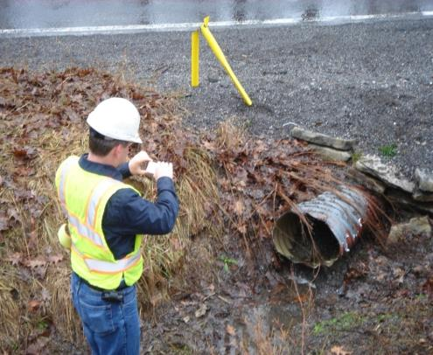
Example of Preventive Maintenance for Pipe Replacement
Strategy:
Identify and replace any pipes that could fail before the new surface improvement project reaches the end of its predicted lifecycle.
Planning

Slide 38
Maintenance Planning Strategies Compared
Qualities | Demand | Preventative | Preparatory
Reactive | ✓
Inefficient | ✓
Hampers immediate and long-range planning efforts | ✓
Proactive |  | ✓ | ✓
Efficient |  | ✓ | ✓
Supports immediate and long-range planning efforts |  | ✓ | ✓
Helps extend useful life of surface improvement project |  |  | ✓
Planning

Slide 39
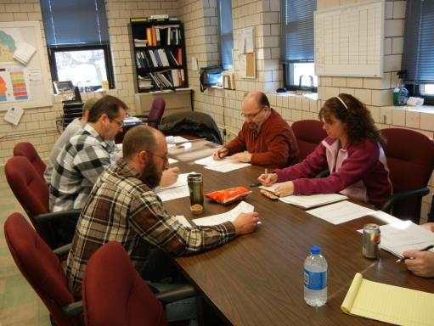
Weekly Planning Meeting
All of the long-range planning comes together at the Weekly Planning Meeting
Planning

Slide 40
Weekly Planning Meeting
Planning and preparation for a quality pipe replacement operation begins long before the Weekly Planning Meeting.
This is true for all maintenance related operations.
Planning

Slide 41
Issues Discussed at the Weekly Planning Meeting
  What you plan to do?
  Where you plan to do it?
  How much will be completed?
  Work Zone Traffic Control required
  Environmental concerns
    Permits
    Erosion and sedimentation controls
Planning

Slide 42
Issues Discussed at the Weekly Planning Meeting
  (continued)
  Customer concerns
  Required resources such as:
    Personnel
    Equipment
    Materials
Planning

Slide 43
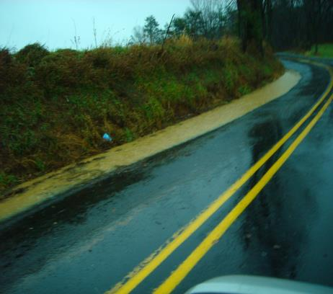
Attributes of a Well-Planned Activity
Cost effective
Includes planned events, such as widening or surface improvements
Helps extend useful life of roadway
Minimizes tort liability
Planning

Slide 44
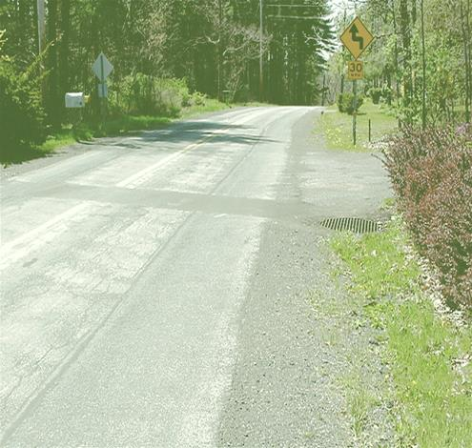
Attributes of a Well-Planned Activity
Reflects best use of resources – manpower and equipment
Attracts positive PR
Maximizes life of the asset (pipe)
Planning

Slide 45
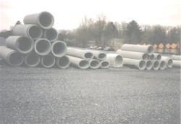
Attributes of a Well-Planned Activity
Enables competitive pricing and advance stocking for necessary materials
Planning

Slide 46
Attributes of a Well-Planned Activity
Enables improved coordination of other related activities.
Planning

Slide 47
Attributes of a Well-Planned Activity
Enables improved coordination of other related activities.
Examples of related activities for pipe replacement are; headwalls, cleaning inlet ditches and tail ditches, trench restoration, installation of delineators and resetting guiderail.
Planning

Slide 48
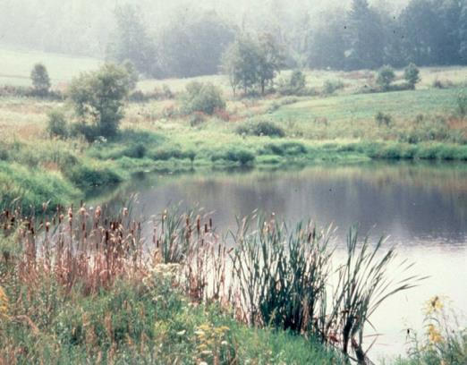
Attributes of a Well-Planned Activity
Allows time to obtain necessary permits
Minimizes environmental impacts
Planning

Slide 49

Attributes of a Well-Planned Activity
Addresses safety issues
811
Know what's below,
Call before you dig.
Planning

Slide 50
Agility
Consider using Agility Agreements as part of your work planning to improve operational efficiency and enhance collaboration within your county.
Click here to learn more about Agility
Planning

Slide 51
Define Maintenance Planning Strategies
Identify reactive and proactive maintenance strategies
Compare and contrast the different maintenance planning strategies
Planning

Slide 52
Define Maintenance Planning Strategies
Identify reactive and proactive maintenance strategies
Compare and contrast the different maintenance planning strategies
Reactive or Demand Maintenance is performed to address an existing condition. Proactive or preventive Maintenance is performed to prevent breakdowns and failures.
Planning

Slide 53
Define Maintenance Planning Strategies
Identify reactive and proactive maintenance strategies
Compare and contrast the different maintenance planning strategies
Demand Maintenance
Preventative Maintenance
Cyclical Preventative Maintenance
Surface Improvement Preparation
Planning

Slide 54
Define Maintenance Planning Strategies
Identify reactive and proactive maintenance strategies
Compare and contrast the different maintenance planning strategies
Pro-active strategies are more effective, more efficient and support the organization’s intermediate and long-range planning efforts.
Planning

Slide 56
What is Agility?
Agility

Slide 57
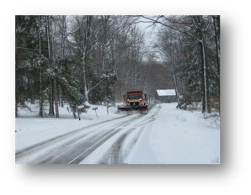
Agility is …
Agility is a “way of doing business”
  Allows PennDOT and eligible partners to exchange services with each other
  Develops relationships between PennDOT and partners
  Service exchanges are reasonably equal in value
City of Hermitage is providing winter services to PennDOT as an Agility exchange
Agility
Notes:
Alternative way of doing business that:
Saves money and improves cash flow
Improves service quality
Improves safety
Stretches available resources
Focuses on collective organizational strengths
Develops and strengthens relationships

Slide 58
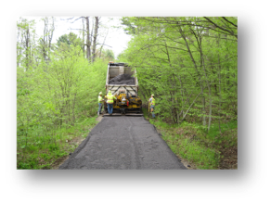
Agility at PennDOT
New focus on Modernization:
Regionalizing Services
  Sharing of equipment
  Training Sessions
Increasing inter-agency cooperation
  Pennsylvania Turnpike Commission (PTC)
  Pennsylvania Human Relations Commission (PHRC)
  Department of Conservation & Natural Resources (DCNR)
Agility strengthens relationship between PennDOT and DCNR
Agility

Slide 59

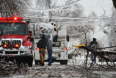

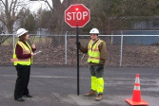
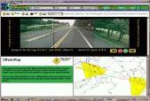
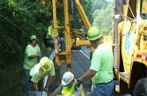
Agility Examples …
What are some potential Agility exchange opportunities for your organization?
Plowing
Line Painting
Seal Coating
Mowing
Communications
Information sharing
Back-up crews
Debris removal
Services
Emergency Response
Low-cost safety improvements
Brush/tree trimming
Sign maintenance
Training
Sharing
Storage
Maintenance
Training
Facilities/
Equipment
Safety
Mapping
Roadway Inventories
Maintenance
Graphic Services
Technical
Management
Software
First Aid/CPR
CDL
Technology
Training
Agility

Slide 60
Agility Examples
Category | Agility Partner | Partner Activity | PennDOT Exchange
Maintenance | Municipality | Mowing | Sign & post installation
 | Municipality | Winter maintenance | Reface bridge abutments
 | DCNR | Boats for bridge inspections | Dust control
Bridges | Fire Department | Bridge flushing | Parking lot paving
 | State University | Training Meeting facilities | Installation of Timber Bridge Deck
Safety | Municipality | Ongoing removal of tree limbs | Installation of rumble strips
Note to self … change following slides to table
Agility

Slide 61
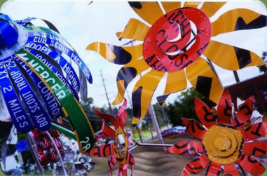
To get started….
CONTACT:
  Agility Division at 717-705-1333
  District Agility Coordinator
  County Agility Coordinator
Agility partnership with Allegheny College
Agility
Next
Notes:
This is great cooperation! Students from Allegheny College in Pennsylvania team up with PennDOT to produce lovely metal flowers from old road signs.

Slide 62
Project preparation
Project preparation

Slide 63
Identify preparatory activities associated with a typical pipe installation project.
Identify the time frames associated with each of the activities.
Identify and describe the supporting documents typically needed for a pipe installation project.
Project preparation

Slide 64
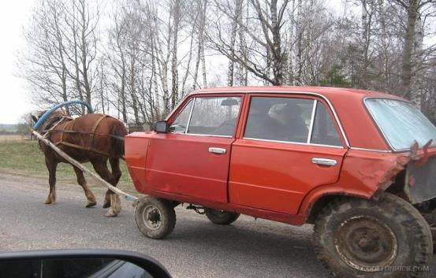
Project Preparation
Project preparation ensures activities are identified and completed in the correct order…
Project preparation

Slide 65
Why preparation is important
Improves activity efficiency:
  Lowers cost
  Improves productivity
Improves activity effectiveness:
  Correct number of personnel are trained and available
  Correct types and amounts of equipment are available
  Correct types and amounts of materials stocked and ready for use
Project preparation

Slide 66
Why preparation is important
Minimizes Environmental Impacts:
  Hydraulic Studies are completed
  Permits are obtained
  Erosion & Sedimentation controls are available
Improves Safety:
  Work Zone Traffic Control plans are established
  Identifies and addresses jobsite safety concerns
Project preparation

Slide 67
Project Preparation Time Frames
Long-range Plan
1 Year + prior to the start of the activity
Intermediate-range Plan
Several weeks to 1 year
Short-term Plan
1 day to several weeks
Project preparation

Slide 68
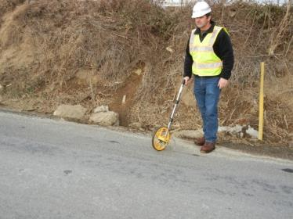
Long-range
Preparatory Activities
Conduct site visit to determine:
    Existing condition
    Appropriate response to condition
      Clean pipe
      Replace pipe
    Identify potential environmental impacts
      Proximity to streams
      Historical values
    Identify the limits of work
      Length of pipe
      Inlets or headwalls
      Type pipe
            Corrugated plastic
            Reinforced concrete
            Corrugated metal
            Round or elliptical
Authorization to Enter form M-666
Project preparation

Slide 69
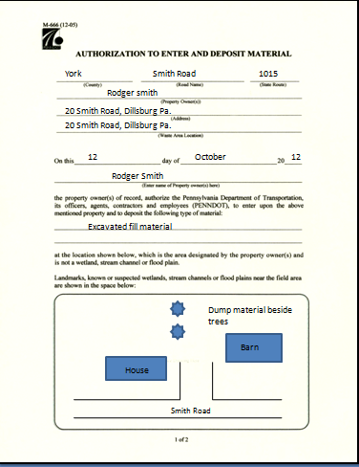
Project preparation

Slide 70
Long-range
Preparatory Activities
Prepare hydraulic studies if required
  If changing pipe size or current pipe appears to be inadequate, request a hydraulic study through the Engineering District
Secure environmental permits as required
  When environmental permits are required, work with the Engineering District
Identify stakeholders affected by the activity
  Adjacent property owners
  Businesses
  Municipalities
  Department of Environmental Protection (DEP)
  U.S. Army Corps of Engineers
  Soil Conservation Offices
Project preparation

Slide 71
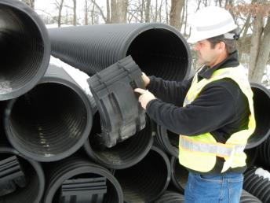
Intermediate-range Preparatory Activities
Determine and procure materials for activity
  Pipe
  Aggregate
  E&S controls
  Trench restoration material
Determine specialized equipment availability
  Excavator
  Compactors
Project preparation

Slide 72
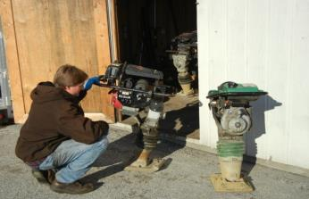
Intermediate-range Preparatory Activities
Determine personnel skills needed, ensure certified TEO’s are available for specialized equipment
  Excavator operator
Provide training to crew to include
  Pipe QA
  Trench restoration
Project preparation

Slide 73
Intermediate-range Preparatory Activities
    Review site to determine safety needs
      Work zone traffic control
      Worksite safety issues
      Trenching/Shoring requirements
      Backing Equipment
    Identify waste dump sites and complete “Authorization to Enter” form (Form M666)
    Notify select customer
      Schools
      Emergency services providers
      Businesses
      Municipalities
      Other community leaders
Project preparation

Slide 74
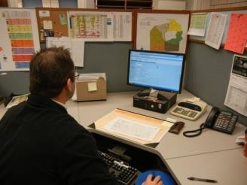
Short-term
Preparatory Activities
Schedule activity (one week prior to start of the activity)
  In accordance with Publication 113 Assembly Requirements
Identify and schedule concurrent activities (one week prior to start of the activity)
  In accordance with Publication 113 Assembly Requirements
    Headwalls/inlets
    Clean tail ditches
    Reset affected guiderail and signs
    Install delineators
    Brushing
    Litter pickup
Project preparation

Slide 75
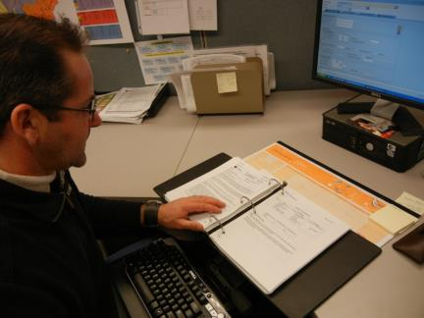
Short-term
Preparatory Activities
  3. Review relevant Publications (one to two weeks prior to start of the activity)
      Pub. 113
      Pub. 23
      Pub. 213
      Pub. 464
Project preparation

Slide 76

Short-term
Preparatory Activities
  3. Review relevant Publications (one to two weeks prior to start of the activity)
      Pub. 113
      Pub. 23
      Pub. 213
      Pub. 464
Project preparation

Slide 77
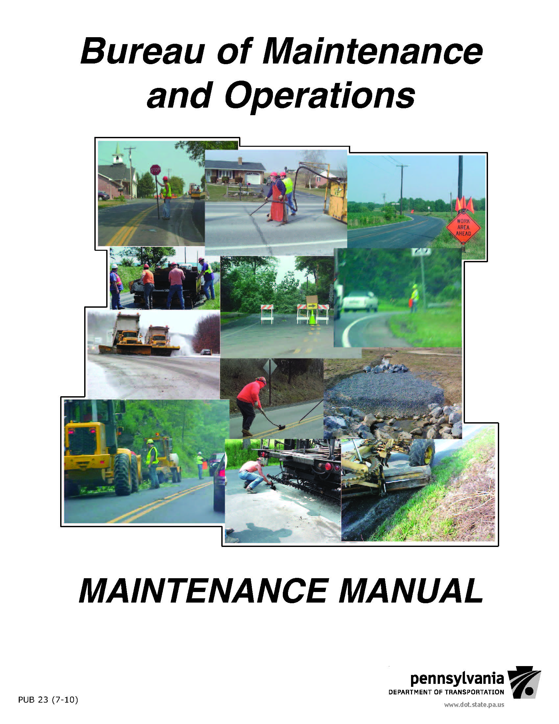
Short-term
Preparatory Activities
  3. Review relevant Publications (one to two weeks prior to start of the activity)
      Pub. 113
      Pub. 23
      Pub. 213
      Pub. 464
Project preparation

Slide 78

Short-term
Preparatory Activities
  3. Review relevant Publications (one to two weeks prior to start of the activity)
      Pub. 113
      Pub. 23
      Pub. 213
      Pub. 464
Project preparation

Slide 79
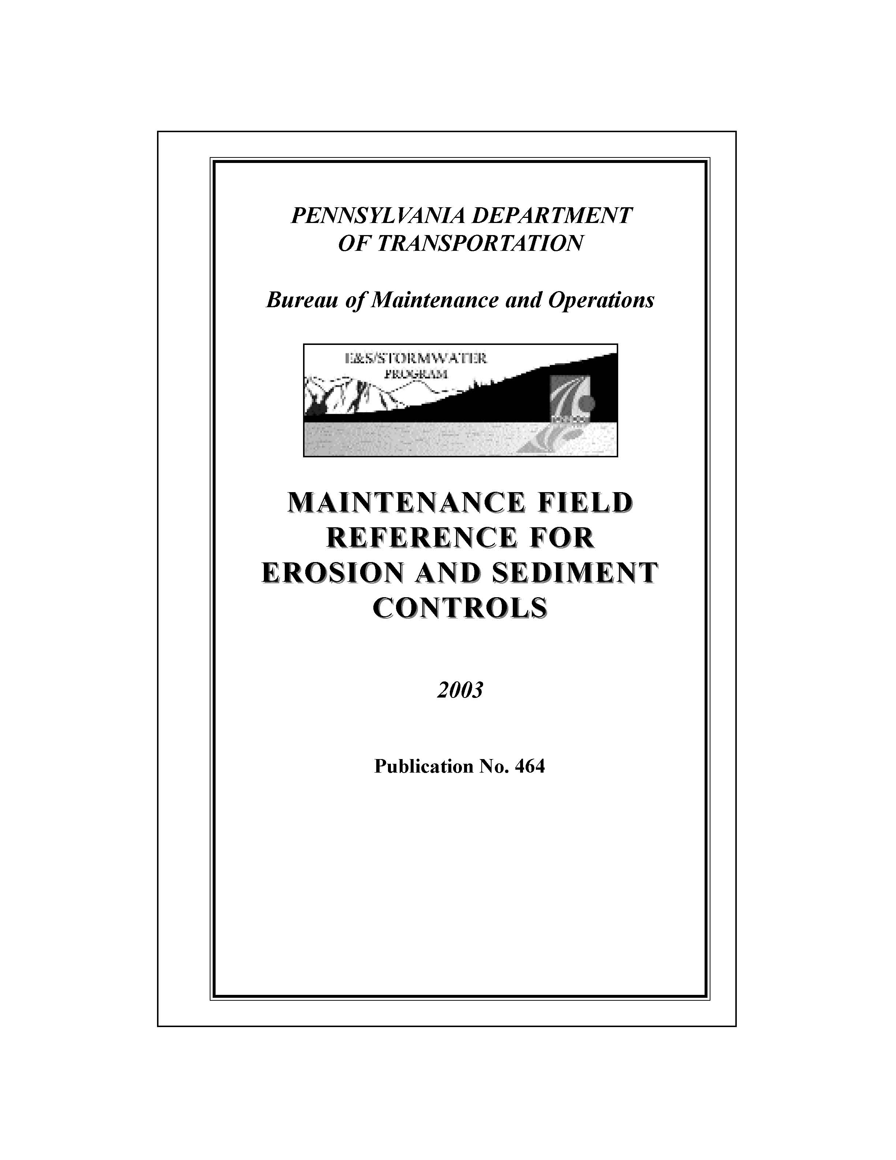
Short-term
Preparatory Activities
Jeremy, Pub 464 cover here
  3. Review relevant Publications (one to two weeks prior to start of the activity)
      Pub 113
      Pub 23
      Pub 213
      Pub 464
Project preparation

Slide 80

Short-term
Preparatory Activities
Initiate PA One Call (up to ten working days and no less than three working days prior to the start of the activity)
Cut the roadway and establish grade (at least one day prior to the start of the activity)
Project preparation

Slide 81
Short-term
Preparatory Activities
Verify material availability (one week prior to the start of the activity)
  Pipe
  Pipe bands
  Aggregates
  Trench restoration material
Verify equipment availability (one week prior to the start of the activity)
  Excavator
  Compactors
  Trucks
  Loader at stockpile
Check leave schedule for personnel availability (one week prior to the start of the activity)
Project preparation

Slide 82
Short-term
Preparatory Activities
Communicate pending activities
  Inform motoring Public
  Notify affected property owners
  Notify businesses
  Consider concurrent activities and community events
Vary communication methods
  Variable message boards
  Weekly news release
  Traffax (radio and television traffic updates)
Project preparation

Slide 83
Identify preparatory activities and time frames associated with a typical pipe installation project Long-range
Identify the time frames associated with each of the activities
Identify and describe the supporting documents typically needed for a pipe installation project
Project preparation

Slide 84
Identify preparatory activities and time frames associated with a typical pipe installation project Long-range
Identify the time frames associated with each of the activities
Identify and describe the supporting documents typically needed for a pipe installation project
Conduct site to determine; existing conditions, potential environmental impacts and the limits of work.
Prepare hydraulic studies, secure environmental permits and identify stakeholders affected by the activity.
Project preparation

Slide 85
Identify preparatory activities and time frames associated with a typical pipe installation project Long-range
Identify the time frames associated with each of the activities
Identify and describe the supporting documents typically needed for a pipe installation project
Long-range - Determine and procure materials, determine specialized equipment availability, determine personnel skills needed, ensure certified TEO’s are available and provide training to the crew.
Intermediate-range - Review worksite to determine safety needs, identify waste dump sites and prepare documentation and notify adjacent property owners, EMS and schools.
Short-term - Review relevant PennDOT Publications, initiate PA 1 call and schedule the work activity along with concurrent activities that are to be completed.
Establish grade and cut roadway.
Project preparation

Slide 86
Identify preparatory activities and time frames associated with a typical pipe installation project Long-range
Identify the time frames associated with each of the activities
Identify and describe the supporting documents typically needed for a pipe installation project
Publication 113, Highway Foreman Manual,
Publication 23, PennDOT Maintenance Manual,
Publication 213, Temporary Traffic Control Guidelines, and
Publication 464, Erosion and Sedimentation Control Best Practices.
Project preparation

Slide 88
Concurrent maintenance activities
Concurrent Activities

Slide 89
Understand why we plan for and conduct concurrent maintenance activities
Identify concurrent maintenance activities associated with a pipe replacement project
Concurrent Activities

Slide 90
Planning and Conducting Concurrent Maintenance Activities
Not performing concurrent or secondary maintenance activities in conjunction with the primary activity is like going to the grocery store and not purchasing everything on your list. You will have to go back, it will cost more, and there may be serious consequences.
Concurrent Activities

Slide 91
Planning for concurrent maintenance activities is important
Benefits - Operational Efficiency:
    Performing multiple activities reduces mobilization and travel costs.
    Some activities can be performed during slow periods of the primary activity which will help keep crew members productive.
    More work is completed during an average crew day.
Consequences - Tort Liability:
    Temporary trench restoration to minimize loose aggregate hazards
    Delineator installation identifies ditch or headwall
    Replacement of signs and guiderail to inform and protect the motoring Public
Concurrent Activities

Slide 92
Concurrent activities associated with a pipe replacement project
Activities that can/should be performed and charged in conjunction with a typical pipe replacement activity:
    Construction of inlets and end walls
    Inlet and tail ditch cleaning, greater than 15 feet from the pipe
    Rock filters and other erosion and sedimentation controls
    Delineator installation
    Sign and guiderail reinstallation
Concurrent Activities

Slide 93
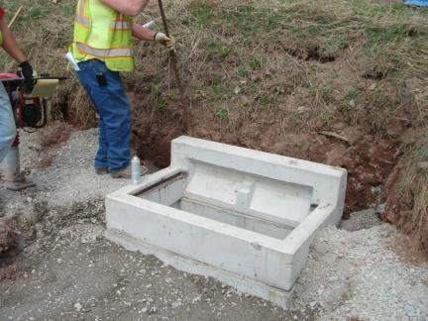
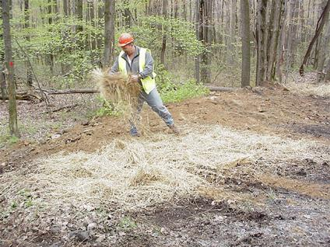
Installing inlets
Erosion Control
Concurrent Activities

Slide 94
Concurrent activities associated with pipe replacement
Additional activities that can and should be performed and charged that are not usually performed in conjunction with a typical pipe replacement activity:
    Brush cutting
    Litter pickup
Concurrent Activities

Slide 95
Understand why we plan for and conduct concurrent maintenance activities
Identify concurrent maintenance activities associated with a pipe replacement project
Concurrent Activities

Slide 96
Understand why we plan for and conduct concurrent maintenance activities
Identify concurrent maintenance activities associated with a pipe replacement project
Improves operational efficiency and helps reduce tort liability.
Concurrent Activities

Slide 97
Understand why we plan for and conduct concurrent maintenance activities
Identify concurrent maintenance activities associated with a pipe replacement project
Construction of inlets and end walls
Inlet and tail ditch cleaning, greater than 15 feet from the pipe
Rock filters and other erosion and sedimentation controls
Delineator installation
Sign and guiderail reinstallation
Brush cutting
Litter pickup
Concurrent Activities

Slide 99
Project scheduling
Project Scheduling

Slide 100
Understand how proper crew size is determined.
Realize the affects of correct and incorrect crew sizing on budget and plan.
Project Scheduling

Slide 101
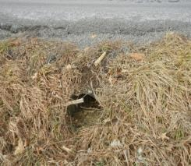
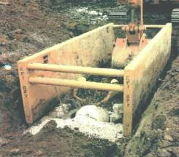
Scheduling a Pipe Replacement Crew
Not every pipe replacement operation is “textbook standard”
Schedule and utilize the right personnel and equipment for the conditions encountered
Project Scheduling

Slide 102

“Right Sizing” the Crew
Too many
Wasteful
Not enough
    Unsafe, Inefficient
Right size
    Number of personnel & equipment reflects conditions/needs
Project Scheduling

Slide 103
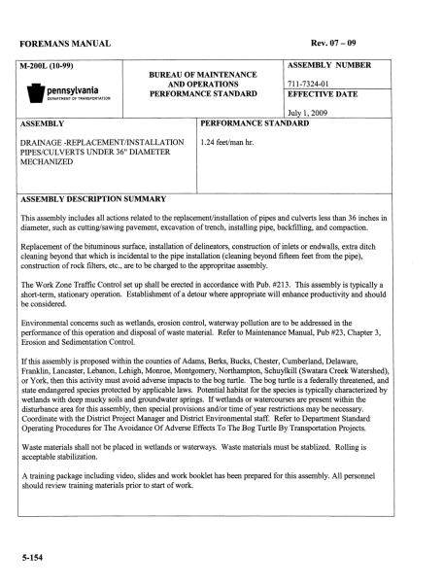
Guidelines for proper crew size can be found in Publication 113
Project Scheduling

Slide 104
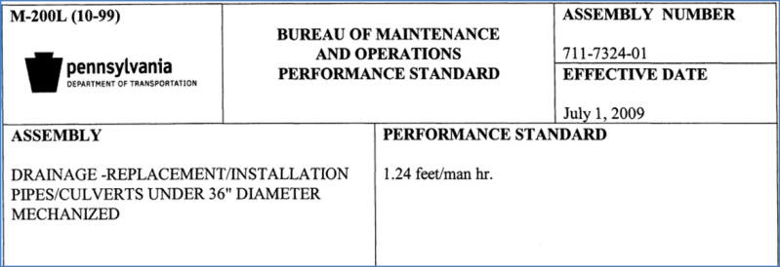
Guidelines for proper crew size can be found in Publication 113
Project Scheduling

Slide 105
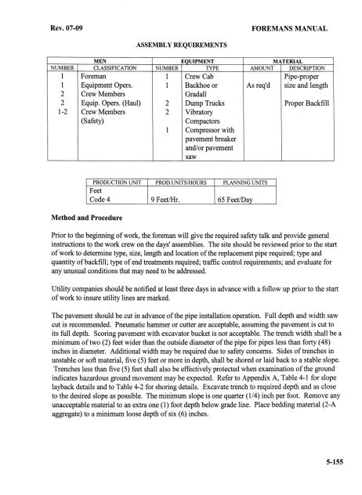
Pub 113
Assembly Requirements for
Pipe Replacement
Standard Crew Size
Standard Equipment List
Production Standards
Project Scheduling

Slide 106
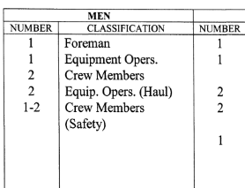
Pub 113
Assembly Requirements for
Pipe Replacement
Standard Crew Size
Standard Equipment List
Production Standards
Project Scheduling

Slide 107
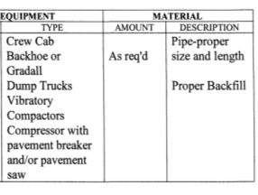
Pub 113
Assembly Requirements for
Pipe Replacement
Standard Crew Size
Standard Equipment List
Production Standards
Project Scheduling

Slide 108

Pub 113
Assembly Requirements for
Pipe Replacement
Standard Crew Size
Standard Equipment List
Production Standards
Project Scheduling

Slide 109
Affect on Budget & Plan
Crew too Large
Drives up costs
    Adding more personnel or equipment than required inflates project cost
Drives down productivity
Prevents other needed work from being completed
  Every hour needlessly spent on a project prevents another project from being completed
Project Scheduling

Slide 110
Affect on Budget & Plan
Crew too Small
Inefficient
    Can result in overtime costs
  May compromise quality
    Time consuming portions of the operation such as proper backfilling and compaction tend to be sacrificed
  Unsafe
    Never sacrifice safety due to short crew staffing
Project Scheduling

Slide 111
Affect on Budget & Plan
Right Size
Personnel and equipment types and amounts are based on Publication 113, “Assembly Requirements for Pipe Replacement” with adjustments for field conditions
When more personnel are assigned than required, additional work activities should be identified and assigned
When fewer personnel are assigned than required:
    Request additional resources
    Maintain quality standards
    Sacrifice productivity when necessary
  Never compromise the safety of the crew or motoring Public
Project Scheduling

Slide 112
Understand how a proper crew size is determined
Realize the affects of correct and incorrect crew sizing on budget and plan
Project Scheduling

Slide 113
Understand how a proper crew size is determined
Realize the affects of correct and incorrect crew sizing on budget and plan
Proper crew size guidelines for every maintenance activity can be found in Publication 113. Field conditions may require adjustments to the recommended guidelines.
Project Scheduling

Slide 114
Understand how a proper crew size is determined
Realize the affects of correct and incorrect crew sizing on budget and plan
Overstaffing a crew drives costs up and productivity down. Understaffing a crew can be inefficient may affect quality and could compromise the safety of the crew and the motoring Public.
Project Scheduling

Slide 116
safety
Safety

Slide 117
Identify and refer to the source documents for safety related information
Identify the safety concerns relative to a pipe replacement operation
Safety

Slide 118
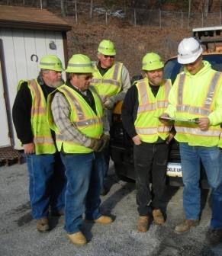
Source Documents
Publication 445, “Safety Policy Manual”
    Daily Safety Talks
    Proper attire
    Personal Protective Equipment (PPE)
    Injury management procedures
Safety

Slide 119
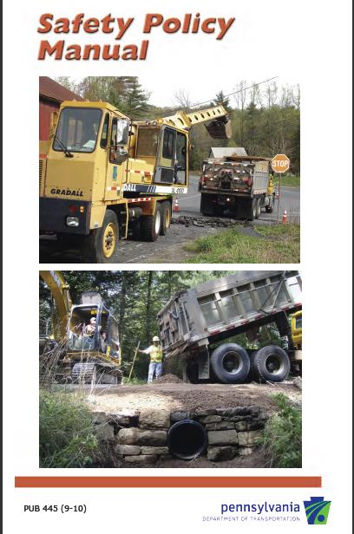
Source Documents
Publication 445, “Safety Policy Manual”
    Daily Safety Talks
    Proper attire
    Personal Protective Equipment (PPE)
    Injury management procedures
Safety

Slide 120
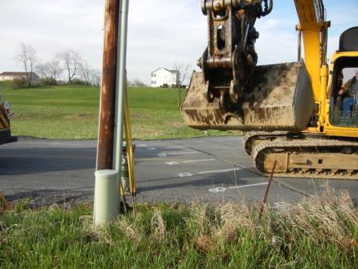
Source Documents
Publication 113, Highway Foreman Manual
    Buried/underground hazards
Safety

Slide 121
Source Documents
Publication 113, Highway Foreman Manual
      PA One-Call (up to ten working days before the operation begins, no less than three working days)
811
Know what's below,
Call before you dig.
Safety

Slide 122
Source Documents
IT IS A LAW. Failure to comply not only endangers the crew, it places you and the Department at risk for civil and criminal prosecution.
Publication 113, Highway Foreman Manual
      PA One-Call (up to ten working days before the operation begins, no less than three working days)
811
Know what's below,
Call before you dig.
Safety

Slide 123
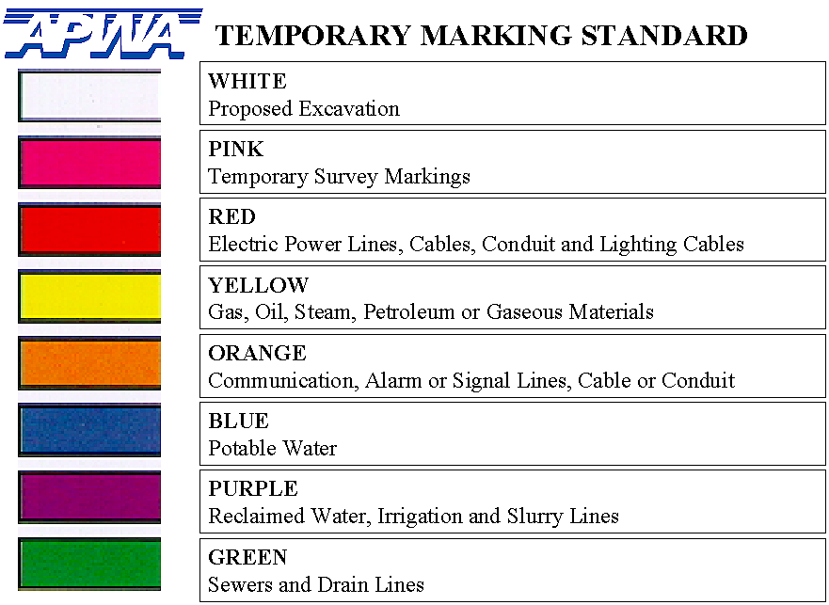
Disruption of any one of these services can adversely impact day to day life, and unexpectedly finding any one of these during an excavation operation can be very costly, both in terms of human life and money.
Safety

Slide 124
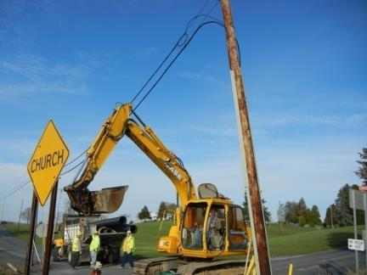
Source Documents
Publication 113, Highway Foreman Manual
    Overhead Hazards
Safety

Slide 125

Source Documents
Publication 113, Highway Foreman Manual
    Trench Safety (trenches greater than 5 feet deep require wider cuts or shoring)
Safety

Slide 126
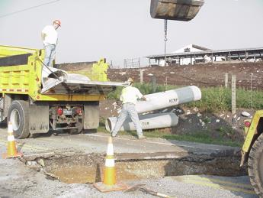
Source Documents
Publication 113, Highway Foreman Manual
    Material handling, care should be taken to not maneuver pipe over the heads of the personnel
Safety

Slide 127

Source Documents
Publication 113, Highway Foreman Manual
    Encroaching into the travel lanes
Safety

Slide 128
Source Documents
Publication 213, Temporary Traffic Control Guidelines, Pennsylvania Typical Applications (PATA) 10a and 11d
  PATA 10a (most commonly used)
  PATA 11d (recommended when possible)
Safety

Slide 129

Source Documents
Publication 213, Temporary Traffic Control Guidelines, Pennsylvania Typical Applications (PATA) 10a and 11d
  PATA 10a (most commonly used)
  PATA 11d (recommended when possible)
Safety

Slide 130

Pipe Replacement
Work Zone Traffic Control
PATA 10a
Most Commonly Used Traffic Control PATA
Before selecting and applying this or any other traffic control figure, reference and review all of the notes on the related page(s) of the current traffic control Publication.
Safety

Slide 131

Pipe Replacement
Work Zone Traffic Control
PATA 10a
Most Commonly Used Traffic Control PATA
Before selecting and applying this or any other traffic control figure, reference and review all of the notes on the related page(s) of the current traffic control Publication.
Safety

Slide 132

Pipe Replacement
Work Zone Traffic Control
PATA 11d.
This is by far the preferred environment in which to perform roadway maintenance ….one where there is no traffic. This short term daylight detour affords maintenance crews an opportunity to detour traffic around their operation, reducing manpower requirements for flagging, and increasing both efficiency and quality. Remember to review all notes when using this PATA.
Safety
.

Slide 133

Pipe Replacement
Work Zone Traffic Control
PATA 11d.
This is by far the preferred environment in which to perform roadway maintenance ….one where there is no traffic. This short term daylight detour affords maintenance crews an opportunity to detour traffic around their operation, reducing manpower requirements for flagging, and increasing both efficiency and quality. Remember to review all notes when using this PATA.
Safety
.

Slide 134

Pipe Replacement
Work Zone Traffic Control
Many crews utilize high strength steel plates to accommodate thru traffic under PATA 10a. Extreme caution must be exercised during placement and removal.
Safety

Slide 135

Pipe Replacement
Work Zone Traffic Control
PATA 10a.
Using steel plates to accommodate thru traffic
Safety

Slide 136
More detailed training on work zone traffic control can be found in the
Work Zone Traffic Control
Module
of this program
Safety

Slide 137
Identify and refer to the source documents for safety related information
Identify the safety concerns relative to a pipe replacement operation
Safety

Slide 138
Identify and refer to the source documents for safety related information
Identify the safety concerns relative to a pipe replacement operation
Safety related source documents include; Publication 113 (Highway Foreman Manual), Publication 445 (Safety Policy Manual) and Publication 213 (Temporary Traffic Control Guidelines)
Safety

Slide 139
Identify and refer to the source documents for safety related information
Identify the safety concerns relative to a pipe replacement operation
Pipe replacement safety concerns include; buried/underground hazards, overhead hazards, trench safety and work zone traffic control.
Safety

Slide 141
Work zone traffic Control
(WZTC)
WZTC

Slide 142
Improve focus on Work Zone Traffic Control to reinforce Department’s commitment to safety.
Reference specific information to improve safety in Department work zones.
Be familiar with Publication 213, PENNSYLANIA TYPICAL APPLICATIONS (PATA) and associated common problem areas.
Identify the primary topic areas and guidelines in Publication 213.
WZTC

Slide 143
Why Is WZTC Important?
We have the responsibility to protect
  our work force
  the motoring Public.
It can minimize tort liability
It is the law.
WZTC

Slide 144
Manual on Uniform Traffic Control (MUTCD)
Defines “minimum” traffic control requirements under the Law
Directs the installation and maintenance of traffic control devices used by road managers nationwide
Includes all Public streets, highways, bikeways, and private roads open to Public traffic
Published by the Federal Highway Administration (FHWA)
  23 Code of Federal Regulations (CFR), Part 655, Subpart F.
State Supplement
  Chapter 212 and Chapter 213, Title 67, Pennsylvania Code
  Pub 236, “Official Traffic Control Devices”
WZTC

Slide 145

WZTC:
Primary Components
Advanced warning of work area
Specific directions and instructions
Delineation of the work area
WZTC

Slide 146
WZTC: Primary Components
Advanced Warning of Work Area signing includes:
  “Road Work Ahead”
  “One Lane Road Ahead”
  “Flagger Ahead”
  “Road Closed Ahead”
  “Be Prepared to Stop”
WZTC

Slide 147
WZTC: Primary Components
Specific directions and instructions for:
  Flaggers
  Proper Placement of Flagger
  Tapers
  “Reduced Speed Limit” signing
  Arrow boards
  Pilot vehicles
WZTC

Slide 148
WZTC: Primary Components
Delineation of the work area
  Vertical Panels
  Cones
  Barrels
  Barriers
WZTC

Slide 149
Work Zone Traffic Control
Work Zone Traffic Control is required on highway construction, maintenance operations and utility work or incident management, either on a highway or so close to a highway that workers, equipment or materials encroach on the highway.
Compliance with this subchapter does not relieve the contractor or others of their general responsibility for the protection of the Public and the employees in work zones.
Minimum requirements for the development and administration of traffic control plans and the application, maintenance and disposition of traffic control devices.
WZTC

Slide 150
WZTC: Pipe Replacement
PATAs most commonly used
Pub. 213 PATA 10a. – Stationary, Short Term Operation, Two-Lane, Two-Way Roadway – Flagging
Pub. 213 PATA 11d. – Stationary, Short Term Operation, Two-Lane, Two-Way Roadway – Road Closure
WZTC

Slide 151
WZTC: Routine Maintenance Focus Areas
Commonly used PATAs and Related Maintenance Activities
Pub. 213 PATA 10a. – Stationary, Short-Term Operation, Two-Lane, Two-Way Roadway - Flagging
    Base Repair
    Pipe Replacement
    Standard Pothole Patching
    Inlet Repair and Replacement
WZTC

Slide 152

WZTC

Slide 153
WZTC: Routine Maintenance Focus Areas
Commonly used PATAs and Related Maintenance Activities
Pub. 213 PATA 11d - Stationary, Short-Term Operation, Two-Lane, Two Way Roadway – Road Closure
    Pipe Replacement
    Milling Paving
    Liquid Seal Coat and Surface Treatment
WZTC

Slide 154

WZTC

Slide 155
Selecting the Appropriate PATA
Step 1: Understand the requirements of the work activity
    What equipment and materials will you be using?
    To what extent will they be encroaching on the
    roadway during the operation?
    Will your operation be Stationary or Mobile?
    Check the Foreman’s Manual (Pub.113)
WZTC

Slide 156
Selecting the Appropriate PATA
Step 2: Be familiar with where you will be working
    What type of roadway is it?
    What is the ADT?
    Are there any unique or unusual traffic patterns?
    Does the location present any problems with sight distance?
    Is closing the road to thru traffic during the operation a possibility?
    Are there any intersections that may warrant special or additional traffic control?
    Will you be required to maintain traffic at an intersection?
    What is the posted or normal speed limit?
WZTC

Slide 157
Selecting the Appropriate PATA
Before moving on to Step 3 (Selecting a PATA), we need to review definitions associated with some of the terms and references used so far.
Definitions
Short - Term Stationary Operation - Work that occupies a location up to 24 hours. (Ref. Pub. 213 General Notes / Reference Guide)
Long - Term Operations - Work that occupies a location more than 24 hours. (Ref. Pub 213 General Notes / Reference Guide)
WZTC

Slide 158
Selecting the Appropriate PATA
Definitions
Active work zone - The portion of a work zone where construction, maintenance or utility workers are on the roadway or on the shoulder of the highway, and workers are adjacent to an active travel lane. Workers are not considered adjacent to an open travel lane if they are protected by a traffic barrier and no ingress or egress to the work zone exists through an opening in the traffic barrier. ( Ref. Chapter 212.1 )
Work Zone - The area of a highway where construction, maintenance or utility work activities are being conducted, and in which traffic-control devices are required in accordance with this chapter. ( Ref. Chapter 212.1 )
WZTC

Slide 159
Selecting the Appropriate PATA
Step 3: Selecting the PATA
  Use the Reference Guide in Publication 213
    Type of Highway
    Condition
    PATA Number
WZTC

Slide 160

WZTC

Slide 161
WZTC

Slide 162
WZTC

Slide 163
WZTC

Slide 164
Example
WZTC

Slide 165
Applying and Maintaining the Selected PATA
Now That You’ve Selected a PATA…
Review the traffic control devices required by the PATA.
Read the notes on the PATA, they are important
Check your inventory of traffic control devices. Do you have all the required signs, cones, paddles, portable sign stands, etc.?
Now that you’re in the process of securing the traffic control devices required under the PATA, is there anything else you need to know about them?
WZTC

Slide 166
Signs
Do they Meet Department Specifications?
  Clean and in a good state of repair
  “Like new” condition
  Legible
  Highly reflective qualities – day and night
WZTC

Slide 167
The Setup
Signs must be placed at the proper distance intervals
  Reference: Publication 213, General Notes & PATA
  Review the selected PATA and associated notes
  Signs may be adjusted based on field conditions
WZTC

Slide 168
The Setup
Signs must be properly ballasted
  Ballasting may be accomplished by placing sandbags on the lower parts of the frame or stay or by storing sand within the hollow components in the bottom of the barricade.
  Block, bricks, large rocks or similar types of material are not permitted to be used as a ballast.
  Sandbags are not permitted to be placed on top of or suspended from signs, rails or any other device.
WZTC

Slide 169

Signs must be installed correctly.
WZTC

Slide 170
The Setup
When Required, arrow panels must be of the correct size
  Reference: Pub. 213 General Notes, Table 5
Signs must be visible to approaching traffic
  Signs shall be placed in positions where they will effectively convey their messages. Therefore, their placement shall be accommodated to the highway design and alignment.
  Signs shall also be placed so that drivers will have adequate time for response.
WZTC

Slide 171

Sign positioned 10 feet from edge of pavement in the weeds.
WZTC

Slide 172
The Setup
Signs must be clean, legible, and in a good state of repair
Signs must be properly located laterally and at the proper height
  Reference Pub 213, Page 6 of 113, PATA Sign layout
WZTC

Slide 173

Correct sign, properly placed.
WZTC

Slide 174
The Setup
Signs shall not obstruct sight distance at driveways, intersections or any existing sign or applicable traffic control device
  Orange flags are NOT required on advance warning signs
WZTC

Slide 175
The Setup
Flags are optional
Reminder: Pub. 213 represents the minimum requirements.
Flags may be used if it is felt they enhance visibility of signs – (optional).
Be consistent, if flags are used, place them on all signs in the setup.
WZTC
Notes:
Foreman should be encouraged to utilize optional flags when they feel it will enhance the safety of the work zone.
Some districts require that flags be used.
When flags are used try to be consistent as not to confuse the motoring Public.

Slide 176
The Setup
Hand signaling devices are of the appropriate size and type
Taper(s) and longitudinal channelization properly installed. All devices of the same type, properly spaced, and correctly aligned
  Reference: Chapter 212.406 (a) / Pub 213 General Notes Tables 1, 2, and 3
If using barricades, must be of appropriate type and properly striped
WZTC

Slide 177

WZTC

Slide 178

Flaggers
Monitor flagger conduct.
Ensure all flaggers have
attended Flagger Training
and are properly attired.
WZTC
Notes:
Ensure that the flaggers are where they are supposed to be and that they are monitoring and controlling the traffic flow.

Slide 179






Flaggers Attire
Helmet/Hard hat
Class 2 garment high visibility yellow with orange stripes
Leggings / Chaps – high visibility yellow
    Daytime optional
    Nighttime required
Class 2 high visibility yellow rain gear in inclement weather
Proper footwear
WZTC
Notes:
Equipment is not the only tool available to flaggers to assist them in completing their duties. Proper attire is also critical for safety.
All persons performing flagging work in Pennsylvania are required to wear a protective helmet. In addition to the helmet, PennDOT employees performing flagging duties are required to wear a high-visibility fluorescent yellow-green garment with retroreflective orange stripes that meets performance Class 2 requirements in the ANSI 107-2004 standard. High visibility fluorescent yellow-green pants, leggings or chaps are optional while flagging during the day, but are REQUIRED at night for PennDOT employees. The additional background color and retroreflective material provided in the pants or leggings must ensure that flagger attire satisfies performance Class 3 requirements in the ANSI 107-2004 standard. During inclement weather, high visibility fluorescent yellow-green ANSI Class 2 rain gear may be used. The use of these colors will help provide you with the greatest color contrast with your surroundings. Proper footwear should also be worn by PennDOT flaggers. Ask your foreman or assistant county maintenance manager if you have questions on this attire.

Slide 180
The Setup
Shadow vehicle used as required and properly positioned
  Reference: Pub 213
When used, warning lights are of appropriate type &
correctly placed/positioned
Flaggers properly attired and correctly positioned
  For Department personnel a high visibility pants or leggings are required in combination with high visibility vest and hard hat while flagging at night. Reference: Safety Policy Manual (Pub 445 9-10).
  Reference: Chapter 212.411
WZTC

Slide 181

Leggings are optional for daylight operations.
WZTC

Slide 182
The Setup
Initial drive-thru..
All components correct? Any confusion?
Don’t assume that all devices are correctly positioned and all features of your setup are functioning as designed. Make certain that they are.
Drive Thru and put yourself in the position of our customers.
    Does everything make sense?
    Does the advance warning meet the required sight distance?
    Do you feel comfortable with the amount of advance warning?
  If not, you may have to consider adjustments.
  All Distances listed are minimum, not only do you have the right to make adjustments under the law, you have an obligation to do so.
WZTC

Slide 183
During the Operation
Your Pub. 213 or TCP must be maintained on the work site
  Reference: WZTC QA, Item B.1.
  Be prepared to respond to questions regarding you setup
  Reference: WZTC QA, Item B.11.
Monitor and maintain the integrity of your setup
  Reference: WZTC QA, Item C.2.
WZTC

Slide 184
During the Operation
Monitor and observe the effectiveness of flagging operations and flagger conduct
  Reference: Flagger Handbook – Pub.234
Be prepared to identify and properly sign and protect the motoring Public from any temporary surface irregularities or potential
hazardous conditions that will remain after you vacate the site
  Use “low shoulder”, “no guiderail”, “bump”, or “no pavement marking” signs as needed
WZTC

Slide 185

WZTC

Slide 186

WZTC

Slide 187
Ending the Day’s Operation
If materials and/or equipment are to be stored at or near the site
  30 feet minimum from edge of travel lane
  Behind guide rail or barrier
  2 feet behind curb
  If materials and or equipment stored at site do not meet the above criteria they must be delineated.
WZTC

Slide 188

Stockpiled construction materials must be placed at least 30 feet from the travel portion of the roadway.
WZTC

Slide 189
Ending the Day’s Operation
The Closeout Discussion
Involve as many members of your crew as possible in the Work Zone Traffic Control process.
  They see things you don’t
  Their input is critical to improving the quality of all aspects of our field operations
  They can help assure that everyone goes home safe and sound, crew members and customers alike.
WZTC

Slide 190
Ending the Day’s Operation
If materials and/or equipment are to be stored at or near the site
  30 feet minimum from edge of travel lane
  Behind guide rail or barrier
  2 feet behind curb
WZTC

Slide 191
Ending the Day’s Operation
The Closeout Discussion
Involve as many members of your crew as possible in the Work Zone Traffic Control process.
  They see things you don’t
  Their input is critical to improving the quality of all aspects of our field operations
  They can help assure that everyone goes home safe and sound, crew members and customers alike.
WZTC

Slide 192
Improve focus on Work Zone Traffic Control to reinforce Department’s commitment to safety
Reference specific information to improve safety in Department work zones
Be familiar with Publication 213 PATAs and associated common problem areas
Identify the primary topic areas and guidelines in Chapter 212/Publication 213 PATAs/MUTCD
WZTC

Slide 193
Improve focus on Work Zone Traffic Control to reinforce Department’s commitment to safety
Reference specific information to improve safety in Department work zones
Be familiar with Publication 213 PATAs and associated common problem areas
Identify the primary topic areas and guidelines in Chapter 212/Publication 213 PATAs/MUTCD
We have the responsibility to protect our work force and the motoring Public.
WZTC

Slide 194
Improve focus on Work Zone Traffic Control to reinforce Department’s commitment to safety
Reference specific information to improve safety in Department work zones
Be familiar with Publication 213 PATAs and associated common problem areas
Identify the primary topic areas and guidelines in Chapter 212/Publication 213 PATAs/MUTCD
The three primary components of a work zone are:
Advanced warning of work area
Specific directions and instructions
Delineation of the work area
WZTC

Slide 195
Improve focus on Work Zone Traffic Control to reinforce Department’s commitment to safety
Reference specific information to improve safety in Department work zones
Be familiar with Publication 213 PATAs and associated common problem areas
Identify the primary topic areas and guidelines in Chapter 212/Publication 213 PATAs/MUTCD
The 2 most commonly used Publication 213 PATAs for pipe replacement are; Pub. 213 PATA 10a. and Pub. 213 PATA 11d.
WZTC

Slide 196
Improve focus on Work Zone Traffic Control to reinforce Department’s commitment to safety
Reference specific information to improve safety in Department work zones
Be familiar with Publication 213 PATAs and associated common problem areas
Identify the primary topic areas and guidelines in Chapter 212/Publication 213 PATAs/MUTCD
The primary topic areas needed to determine the correct work zone setup are; “Type of Highway”, “Condition” and Figure Number”.
WZTC

Slide 198
Quality assurance
Quality Assurance

Slide 199
Identify and refer to PennDOT Publications relative to a quality pipe installation project
Identify the applicable information from each Publication
Demonstrate a working familiarity with the Pipe Replacement Quality Assurance Review Form
Quality Assurance

Slide 200
Pipe replacement
Quality Control Source Documents
The pipe replacement quality control source documents are:
      Publication 113
      Publication 72M
      Publication 464
      QA review form M-7324
Quality Assurance

Slide 201


Pub 113
Quality Assurance

Slide 202


Pub 113
Quality Assurance

Slide 203


Pub 113
Quality Assurance

Slide 204

Pub 72M, RC Standards
Quality Assurance

Slide 205

RC-10
Quality Assurance

Slide 206

RC-30
Quality Assurance

Slide 207
Pipe replacement
Quality Control
Source Documents
    Publication 464 applicable Best Maintenance Practices (BMPs):
      1 Seeding
      2 Mulching
      3 Rock Stabilization
      6 Surface Preparation
Quality Assurance

Slide 208


Quality Assurance

Slide 209


Quality Assurance

Slide 210

Quality Assurance

Slide 211


Quality Assurance

Slide 212
Pipe replacement
Quality Control
Source Documents
    Quality Assurance Review Form QA – M-7324
Quality Assurance

Slide 213

Quality Assurance

Slide 214
Quality Assurance
Pipe Replacement Operations
The Q A Process Identifies Those Components or Elements of an Operation Required to Realize an Objective. The Objective Here…Quality Pipe Replacement.
Each Element Consists of Indicators Representing Levels of Performance in the Execution or Completion of a Given Element:
Each Element is Then Grouped Into One of Three Categories:
  most critical
  moderately critical
  nominally critical
Quality Assurance

Slide 215
Quality Assurance
Pipe Replacement Operations
Category A: Elements grouped into this category are representative of
functions deemed most critical to the overall quality and
longevity of the finished product. Failure to achieve a
“satisfactory” level of performance on any one of these
elements will most likely result in the immediate failure
of the finished product or contribute directly to its
shortened life span.
Category B: Elements grouped into this category are representative of
functions Deemed moderately critical to the overall
quality and longevity of the finished product. Unlike
category A, “marginal” performance on a given element
in this category (although not desirable), will in all
likelihood not contribute directly to the immediate
failure or shortened life span of the finished product.
Category C: Elements grouped into this category are representative of
functions deemed nominally critical to the overall
quality and longevity of the finished product. Unlike
category B, “less than marginal” performance (although
not desirable), will not contribute to the premature
failure of the finished product.
Quality Assurance

Slide 216
Category A
Category A:
First group of quality assurance elements
The elements that are grouped into this category are representative of functions deemed most critical to the overall quality & longevity of the finished product
Failure to achieve a “satisfactory” level of performance on any one of these elements will most likely result in the immediate failure of the finished product or contribute directly to its shortened life span
Quality assurance
Notes:
The first group of quality assurance elements belongs to Category A. The elements that are grouped into this category are representative of functions deemed most critical to the overall quality and longevity of the finished product. Failure to achieve a “satisfactory” level of performance on any one of these elements will most likely result in the immediate failure of the finished product or contribute directly to its shortened life span.

Slide 217
Category A
1. Flow Line
2. Inlet/Outlet Flow Established
3. Backfill
4. Compaction
5. PA 1-Call
6. Location/Length
7. Trench Width
Quality assurance
Notes:
The first group of quality assurance elements belongs to Category A. The elements that are grouped into this category are representative of functions deemed most critical to the overall quality and longevity of the finished product. Failure to achieve a “satisfactory” level of performance on any one of these elements will most likely result in the immediate failure of the finished product or contribute directly to its shortened life span.

Slide 218

Quality Assurance
Pipe Replacement Operations
A. 1. Flow Line (Ref. Pub 113, Pub 408 Sec. 601)
1. Improper slope.
3. Grade line slightly irregular, with minimum slope of ¼” of fall per foot overall.
5. Uniform slope of ¼” or greater of fall per foot.
Note that ¼” per foot is the “Minimum” Fall per Foot
¼” of Fall/Ft. or > Overall
Vertical Alignment is True
Quality Assurance

Slide 219



Quality Assurance
Pipe Replacement Operations
2. Inlet/Outlet Flow Established
1. Inlet and/or outlet ditches restricted > 30%.
3. Inlet and/or outlet ditch partially restricted <30%.
5. Inlet and outlet ditches open with no restrictions.
Outlet ditch completely blocked. Additional ditch cleaning required.
Inlet partially restricted.
Quality Assurance

Slide 220


Quality Assurance
Pipe Replacement Operations
A. 3. Backfill * (Ref. Pub 113, Pub 408 Sec. 601)
1. Using existing excavated or improper material; or placing backfill in loose lifts exceeding 8” in depth prior to compaction.
3. Proper material placed in loose lifts of 4” to 8” in depth prior to compaction.
5. Proper material placed in loose lifts no greater than 4” in depth prior to compaction or 8” loose lifts compacted with a vibratory roller.
Approved backfill material is 2A aggregate
Material should most desirably be at or near its’ optimum moisture content value….(it should be damp but with no water running from it).
Field test by compressing in hands in the shape of a ball. If material retains shape when hands are opened, the material is suitable for use.
Quality Assurance

Slide 221


Quality Assurance
Pipe Replacement Operations
A. 3. Backfill (cont’d.)
Introducing Backfill to the Trench
Material introduced to the trench via Backhoe
Material introduced to the trench via skid-steer loader.
Utilization of the skid-steer loader on Pipe Replacement Operations has been identified as a “best practice”
and rightfully so.
Skid-steer loaders are very versatile, require a much smaller work platform than the Backhoe and afford the crew an opportunity to continue with excavation while introducing backfill.
Production is increased and efficiency enhanced thru the use of skid-steer loaders…especially in those situations where traffic is detoured and the roadway closed to thru traffic.
Quality Assurance

Slide 222


Quality Assurance
Pipe Replacement Operations
A. 3. Backfill
Use of Flowable Fill
Ready-mixed flowable fill is commonly a blend of cement, fly ash, sand, and water. Typically it is designed as a low strength, flowable material requiring no subsequent vibration or tamping to achieve 100% consolidation.
Considerations when used as bedding/backfill in
pipe replacement operations:
* Pipe must be held in a stable position of alignment
both vertically and horizontally during the
introduction of material
* Pipe must be elevated from the bottom of the
excavation to allow fill material to completely
surround the pipe.
* Pipe trench must be encapsulated to prevent the
material from escaping the trench.
Quality Assurance

Slide 223
Quality Assurance
Pipe Replacement Operations
A. 4. Compaction * (Ref. Pub 113, RC-30, Pub 408 Sec. 601)
1. No compaction or compaction effort terminated while extensive backfill movement remained beneath compaction device(s).
3. One upright compactor used, backfill material moist and compaction effort extended till little or no evidence of backfill movement remained beneath the compaction device.
5. Two upright compactors or vibratory roller used, backfill material moist and compaction effort extended till little or no evidence of backfill movement remained beneath the compaction device and compaction devices were not used directly over the centerline of the pipe until the depth of fill reached 12”
Quality Assurance

Slide 224



Quality Assurance
Pipe Replacement Operations
A. 4. Compaction
Initial compaction effort
Backfill depth < 12” over pipe
Backfill depth 12”
and > over pipe
Compactors should be operated in tandem to avoid moving the pipe out of horizontal alignment
No compaction directly over the top of the pipe until the depth of backfill over the pipe is 12” and >
Compaction effort directed over the full width
of the trench after depth of backfill is 12” and >
over the top of the pipe
Quality Assurance

Slide 225

Quality Assurance
Pipe Replacement Operations
A. 4. Compaction
Satisfactory Compaction
The compaction effort is complete when there is little or no evidence of movement of the backfill material beneath the compaction device(s)
Quality Assurance

Slide 226

Quality Assurance
Pipe Replacement Operations
5. PA 1-Call (Ref. PA-1 CALL)
1. No PA 1-Call made as prescribed by law or excavation begun prior to three working days after placing the PA 1-Call.
3. PA 1-Call made but excavation begun outside the prescribed time frame. (Ten working days beyond notification date ).
5. PA 1-Call made as prescribed by law, work conducted within the prescribed time frame and related PA 1-Call documentation on site ( copy of notification form w/registration # or documentation with notification date & registration # ).
You Want to Know This Gas Line is There “Before” you Begin to Excavate !!!
Know the Law !!!!!
Quality Assurance

Slide 227
Quality Assurance
Pipe Replacement Operations
A. 5. PA 1-Call (cont’d.)
Who Should Make the Call?
All contractors, including sub-contractors, should make their own notification.
Contractor Responsibilities
To provide a One Call System with specific information to identify the site so that facility owners might provide indications of their lines.
A contractor shall use the color “white” to mark a proposed excavation site when exact site information cannot
be provided.
Notification shall be not less than three nor more than ten working days in advance of beginning excavation or demolition work.
Site: The specific place where excavation or demolition work is being or is planned to be performed.
Working Day: A working day means any day except a Saturday and Sunday or a legal holiday prescribed by
the act of the General Assembly.
Quality Assurance

Slide 228

Quality Assurance
Pipe Replacement Operations
A. 5. PA 1-Call (cont’d.)
Disruption of any one of these services can adversely impact day to day life, and unexpectedly finding any one of these during an excavation operation without having made the required notification can be very costly, both in terms of human life and $.
Quality Assurance

Slide 229
Quality Assurance
Pipe Replacement Operations
A. 6. Location/Length
1. Pipe including any inlet, endwall or end section does not meet the alignment and grade line and does not meet the slope / flowline intercept.
3. Pipe including any inlet, endwall or end section meets the alignment and grade line of the watercourse but does not extend beyond the slope / flowline intercept.
5. Pipe including any inlet, endwall or end section meets the alignment and grade line of the watercourse and extends beyond the slope / flowline intercept for a distance of 1’ or a distance sufficient to insure or improve the stability of the slope.
Quality Assurance

Slide 230

Quality Assurance
Pipe Replacement Operations
A. 6. Location/Length (cont’d.)
This pipe was replaced at the same elevation as the original pipe. The inlet end is under less than 12” of cover. Lowering the outlet end 18” and extending it would have stopped the ongoing erosion of the slope.
Quality Assurance

Slide 231

Quality Assurance
Pipe Replacement Operations
A. 7. Trench Width **
1. Too narrow. Insufficient width to allow for compaction equipment on both sides of the pipe for the entire length of the installation.
3. Too wide. Greater than 4’ wider than the outside diameter of the pipe.
5. Sufficient width. Width from 2’ to 4’ greater than the outside diameter of the pipe.
** Width measured from band or bell to trench wall. Additional width permitted for safety to protect workers. Additional width is also acceptable as a means of accommodating water along one side of the trench during installation.
Sufficient trench width is determined by measuring here.
Insufficient trench width means insufficient compaction.
It can also result in damage to the pipe. The operator attempted to force the compactor by the bell of the pipe and in doing so, the pipe was spalled.
Width of this Tamper Foot was 10”
Quality Assurance

Slide 232

Quality Assurance
Pipe Replacement Operations
A. 7. Trench Width (cont’d.)
Maximum performance when operated in a vertical position.
14”
26”
12”
10”
90
Impact value is maximized and energy properly directed when operated in vertical position.
10”
10”
Trench too narrow to allow compactor
to be operated in a vertical position.
Quality Assurance

Slide 233


Quality Assurance
Pipe Replacement Operations
A. 7. Trench Width (cont’d.)
Maximum performance when operated in a vertical position.
14”
26”
12”
10”
Impact value is
decreased and
energy is
misdirected.
90
10”
10”
Trench too narrow to allow compactor
to be operated in a vertical position.
Quality Assurance

Slide 234

Quality Assurance
Pipe Replacement Operations
A. 7. Trench Width (cont’d.)
Horizontal Deflection During Excavation
Width of cut on surface
Trench width at planned elevation of installation.
(Midpoint of pipe)
Width of Cut on Surface
x
Y
Excavator bucket deflection resulting from resistance.
Width at planned elevation of installation. (Midpoint of pipe)
This Type of Horizontal Deflection is a Common Occurrence During Excavation. Is it a Problem?
It can be… if your trench width calculations simply included the greatest outside dimension of the pipe and to it you added 2’ (1’ on each side of the pipe), and failed to recognize the deflection that routinely occurs, you will have insufficient width at the point of installation (midpoint of the pipe), as illustrated above.
Is There a Standard Formula That I Can Apply to Determine How Wide The Width of Cut on the Surface Should Be?
Because of all of the variables such as soil types, depth of excavation, length of excavation, and different types of excavation equipment, there is no one-size-fits-all formula. Your determination of width of cut on surface should consider: soil type; depth of excavation; greatest outside dimension of the pipe; length of the excavation; and required clear width on each side of the pipe at the planned installation elevation (by spec. This can be up to 2’).
Quality Assurance

Slide 235
Quality Assurance
Pipe Replacement Operations
A. 7. Trench Width (cont’d.)
Horizontal Deflection During Excavation
As a rule, horizontal deflection cannot be eliminated during excavation, but it is possible to minimize it
if:
You’re using a backhoe to do the excavation
The width of the trench on surface is 60” or >
No Lateral Resistance
Lateral Resistance
Beginning excavation in the center of the trench increases the extent to which horizontal deflection will occur along the trench wall
Remove bituminous wearing and base course.
Continue excavation against adjacent trench wall.
( 1. )
Lateral resistance
( 3. )
Begin excavation against trench wall.
Excavate material from center of trench. Repeat sequence (2. Thru 4.)
Quality Assurance
( 2. )
( 4. )

Slide 236



Quality Assurance
Pipe Replacement Operations
A. 7. Trench Width (cont’d.)
It Won’t Fit……
What Happened?
Trench width was adequate
Very likely that this will be the end result..Here, no compaction will be possible for a distance of approximately 8’ on one side of the pipe.
Pipe not placed true to the centerline of the trench
If the first section is incorrectly positioned and backfilled, the entire installation will be skewed
Be certain alignment is true “before” placement and backfilling begins.
Quality Assurance

Slide 237

Quality Assurance
Pipe Replacement Operations
A. 7. Trench Width (cont’d.)
Considerations in Determining Trench Width:
Greatest outside diameter of pipe to be installed
Depth of the excavation, specifically to the midpoint or springline of the pipe being installed
Nature of the soil to be excavated
Length of the excavation
Quality Assurance
Is Kilroy going to be operating the backhoe again?!@!#!

Slide 238
Category B
Category B:
Second group of quality assurance elements
The elements that are grouped into this category are representative of functions deemed moderately critical to the overall quality & longevity of the finished product
Marginal performance on a given element in this category, although not desirable, will not in all likelihood directly contribute to the immediate failure or shortened life span of the finished product
Quality assurance
Notes:
238
The second group of quality assurance elements belongs to Category B. The elements that are grouped into this category are representative of functions deemed moderately critical to the overall quality and longevity of the finished product. Unlike Category A, a marginal performance on a given element in this category, although not desirable, will not in all likelihood directly contribute to the immediate failure or shortened life span of the finished product.

Slide 239
Category B
Category B Elements:
  End Treatment
2. Bedding
3. Joints
4. Cover
5. Grade Control
6. E. & S. Controls
7. Waste Disposal
8. Trench Stability
Quality assurance

Slide 240
Quality Assurance
Pipe Replacement Operations
B. 1. End Treatment
1. Not properly aligned (parallel), with edge of roadway, no end treatment applied, or established width of the shoulder restricted by placement too close to edge of pave.
3. Stone headwall only.
4. Properly constructed stone headwall and endwall.
5. Concrete, masonry, pre-fabricated plastic or treated timber headwall; gabion basket; drop inlet or flared end section. Installed or scheduled and properly aligned (parallel) with edge of roadway and established shoulder width not restricted.
SHOULDER
Encroachment into the established shoulder area most frequently occurs when constructing or installing endwalls or headwalls on drainage systems that run diagonally to the centerline of the roadway.
Quality Assurance

Slide 241



Quality Assurance
Pipe Replacement Operations
B. 1. End Treatment (cont’d.)
Some standard and not so standard approaches
Formed in place and pre-cast drop inlets
Loosely placed field and mountain stone
Plastic Endwalls
Quality Assurance

Slide 242



Quality Assurance
Pipe Replacement Operations
B. 1. End Treatment (cont’d.)
Some standard and not so standard approaches
Stone Masonry
Stacked 90Lb. Bags of Quikrete
Cement Block
Quality Assurance

Slide 243

Quality Assurance
Pipe Replacement Operations
B. 1. End Treatment (cont’d.)
A unique, quick, and unconventional approach to drop inlet construction
The opening was contoured to fit around the exterior of a section of 18” RCCP
The section of 36” plastic pipe was previously cut to a predetermined length
Quality Assurance

Slide 244

Quality Assurance
Pipe Replacement Operations
B. 1. End Treatment (cont’d.)
A unique, quick, and unconventional approach to drop inlet construction
With the concrete pipe in position in the trench, crew members position the plastic pipe over the inlet end. The upright section of plastic rests on an 8” bed of compacted 2A aggregate.
Quality Assurance

Slide 245

Quality Assurance
Pipe Replacement Operations
B. 1. End Treatment (cont’d.)
A unique, quick, and unconventional approach to drop inlet construction
The installation is backfilled and compacted with 2A aggregate in 8” lifts to grade.
If you consider this method of drop inlet construction, it is recommended that the point of entry be sealed around the circumference of the concrete pipe prior to backfilling and that a concrete floor be poured in the bottom of the installation to a depth equal to the flow line of the concrete pipe.
Quality Assurance

Slide 246


Quality Assurance
Pipe Replacement Operations
B. 1. End Treatment (cont’d.)
A unique, quick, and unconventional approach to drop inlet construction
An approved, bicycle safe circular drop inlet grate is installed and the area around the installation is paved at the time trench restoration is completed.
This type of installation should always be placed in the flow line and never
be placed on the traveled portion of the shoulder.
Quality Assurance

Slide 247

Quality Assurance
Pipe Replacement Operations
B. 2. Bedding ***
1. No bedding or insufficient depth…< 6” or no cradle where required.
3. Sufficient depth…> 6” – improper material, or proper material installed to a depth > 6” but compacted where compaction/consolidated is not required/warranted.
5. Sufficient depth…> 6” – proper material used and cradle installed where required. End sections compacted as required.
*** Proper bedding material – Concrete pipe – 1B and 2A, all others 2A or OGS material. Cradle required with squash/elliptical pipe equal in depth to 15% of the vertical rise of the pipe.
Quality Assurance

Slide 248
Quality Assurance
Pipe Replacement Operations
B. 2. Bedding (cont’d.)
Plastic & CMP Pipe
(Round)
Roadway
Wearing Course
Base Course
6” is the “minimum” bedding depth.
To address contour irregularities in the trench bed, use an 8” bedding depth in your installation plan….Nobody digs a perfect trench.
“Bedding”
minimum
depth 6”
Loosely placed 2A aggregate
Quality Assurance

Slide 249
Quality Assurance
Pipe Replacement Operations
B. 2. Bedding (cont’d.)
CMP
(Elliptical)
6” is the “minimum” bedding depth.
Roadway
Wearing Course
Base Course
To address contour irregularities in the trench bed, use an 8” bedding depth in your installation plan….Nobody digs a perfect trench.
x
“Bedding”
minimum
depth 6”
Cradle height equal to 15%
of vertical rise of pipe
Cradle
Loosely placed 2A aggregate
Quality Assurance

Slide 250
Quality Assurance
Pipe Replacement Operations
B. 2. Bedding (cont’d.)
Concrete
(Elliptical)
6” is the “minimum” bedding depth.
Roadway
Wearing Course
Base Course
To address contour irregularities in the trench bed, use an 8” bedding depth in your installation plan….Nobody digs a perfect trench.
x
“Bedding”
minimum
depth 6”
Cradle
Cradle height equal to 15%
of vertical rise of pipe
Loosely placed 1B aggregate
“outlet end section bedded
on compacted 2A”
Quality Assurance

Slide 251
Quality Assurance
Pipe Replacement Operations
B. 2. Bedding (cont’d.)
Concrete
(Round)
Roadway
Wearing Course
Base Course
6” is the “minimum” bedding depth.
To address contour irregularities in the trench bed, use an 8” bedding depth in your installation plan….Nobody digs a perfect trench.
“Bedding”
minimum
depth 6”
Loosely placed 1B aggregate
“outlet end section bedded
on compacted 2A”
Minimum depth of bedding beneath bell = 2”
A recess must be formed in the bedding to receive
the bell. Pipe must be supported by the pipe barrel.
Quality Assurance

Slide 252



Quality Assurance
Pipe Replacement Operations
B. 2. Bedding *** (cont’d.)
*** Proper bedding material – Concrete pipe – 1B and 2A, all others 2A or OGS material. Cradle required with squash/elliptical pipe equal in depth to 15% of the vertical rise of the pipe.
Bedding material compacted
Additional 2A added and cradle shaped w/ rake
2A bedding material placed
at outlet end
Quality Assurance

Slide 253

Quality Assurance
Pipe Replacement Operations
B. 3. Joints
1. No joint material; caulk, mortar, mastic or bands used as warranted by the pipe installed.
3. Improper sealant or mismatched bands.
4. Slight misalignment ( vertical or horizontal ). Approved sealant and/or bands used.
5. Pipes properly joined.
Concrete Pipe
Installation Sequence
Tongue and Groove
Groove
Groove
Tongue
Flow
Tongue
Installation to Begin at the Outlet End
Quality of Joint Improved When Gravity is Working With You
Bell and Spigot
Bell
Bell
Spigot
Flow
Quality Assurance
Create Recess in Bedding to Receive Bell
Spigot

Slide 254




Quality Assurance
Pipe Replacement Operations
B. 3. Joints cont.
Rolled pipe joint mastic
Unroll, press into place,
remove paper backer
Pipe joint compound
(5 gal. Buckets)
Troweled into place
Quality Assurance

Slide 255




Quality Assurance
Pipe Replacement Operations
B. 3. Joints (cont’d.)
Metal bands secured with nuts and bolts. During the process of tightening the bands, periodic tapping will be necessary to insure a snug fit. A rubber mallet should be used to avoid damage to the galvanized coating. Always wear gloves.
Plastic bands secured with nylon draw straps. Bands are constructed to match the exterior contour (valleys and ridges) of the pipe used. Always wear gloves.
Do Not Use Steel
Hammers
Quality Assurance

Slide 256
Quality Assurance
Pipe Replacement Operations
B. 4. Depth of Cover
1. Less than 1’ of cover where possible to attain.
5. Greater then 1’of cover or not possible to attain.
Minimum Cover Over Pipe is 1’ (12”)
This measurement is taken from the greatest vertical dimension of the pipe at the band or bell to the elevation of the roadway surface
If lowering the flow line of the replacement pipe to acquire the required cover (12”) is not possible, assuming the intent was to install a round pipe, consideration should be extended to installing an elliptical or squash pipe of equal carrying capacity.
Reducing the size of the replacement pipe to acquire the required cover should be avoided.
In some situations, acquiring the required cover over the replacement installation may not be possible. However, every effort should be made to exhaust all practical possibilities to secure the required cover.
Quality Assurance

Slide 257
Quality Assurance
Pipe Replacement Operations
B. 4. Depth of Cover (cont’d.)
TYPE
OF PIPE
I.D.
O.D.
(BARREL)
O.D.
(BELL)
ELIPTICAL AND ARCH PIPE
I.D.
SPAN RISE
O.D.
SPAN RISE
Concrete
Standard
Bell & Spigot
(Round)
18”
22 1/4”
27”
24”
29”
34”
30”
35 3/4”
40”
36”
42 1/2”
46 3/4”
42”
49 1/4”
54”
48”
55 3/4”
59 3/4”
Concrete
Tongue
&
Groove
(Round)
18”
22 1/4”
24”
29”
30”
35 3/4”
36”
42 1/2”
42”
49 1/4”
48”
55 3/4”
Concrete
Tongue
&
Groove
(Elliptical)
Equivalent Round Size:
18”
21”
15”
25 1/4”
19 1/4”
24”
28”
20”
33”
33”
30”
35”
24”
40 3/4”
29 3/4”
36”
42”
29”
48 1/2”
35 1/2”
42”
49”
33”
56 1/4”
40 1/4”
48”
57”
38”
64 3/4”
45 3/4”
Corrugated
Metal
“CMP”
(Round)
18”
20 1/2”
24”
26 1/2”
30”
33”
36”
39”
42”
45”
48”
51”
Corrugated
Metal
“CMP”
(Arch)
Equivalent Round Size:
18”
21”
15”
23 1/2”
17 1/2”
24”
28”
20”
30 1/2”
22 1/2”
30”
35”
24”
38”
27”
36”
42”
29”
45”
32”
42”
49”
33”
52”
36”
18”
22”
48”
57”
38”
60”
41”
Plastic
“Polyethylene”
(Round)
24”
26”
30”
32 3/4”
36”
36”
Commonly used pipe and related dimensions
Quality Assurance

Slide 258

Quality Assurance
Pipe Replacement Operations
B. 5. Grade Control
1. No instruments used in determining and/or controlling the installed depth and slope of the replacement pipe or carpenters level used.
3. Line level used to determine and control the installed depth and slope of the replacement pipe.
5. Locke level, dumpy level or transit used in determining and controlling the installed depth and slope of the replacement pipe.
Quality Assurance

Slide 259

Quality Assurance
Pipe Replacement Operations
B. 5. Grade Control (cont’d.)
The key word is “control”. It begins here during the initial field inspection.
Quality Assurance

Slide 260



Quality Assurance
Pipe Replacement Operations
B. 5. Grade Control (cont’d.)
Control continues thru each phase of the pipe replacement operation.
Excavation
Placement of Bedding
Quality Assurance
Placement of the pipe

Slide 261


Quality Assurance
Pipe Replacement Operations
6. E & S Controls “Environmental Conduct (Ref.Pub.113, “711-7324” & Pub.23, Chap.3, pg.16)
1. No erosion and/or sedimentation control measures taken as required.
5. Erosion and/or sedimentation control measures taken as required.
Erosion
&
Sedimentation
Quality Assurance

Slide 262


Quality Assurance
Pipe Replacement Operations
B. 6. E & S Controls “Environmental Conduct” (cont’d.)
Seeding
Mulching
Quality Assurance

Slide 263



Quality Assurance
Pipe Replacement Operations
B. 6. E & S Controls “Environmental Conduct” (cont’d.)
Rock Lining
Hay/Straw Bales
Silt Fence
Erosion and sedimentation controls are only effective if properly installed and maintained
Quality Assurance

Slide 264
Quality Assurance
Pipe Replacement Operations
B. 6. E & S Controls “Environmental Conduct” (cont’d.)
Seeding
DEFINITION:
The establishment of a permanent vegetative cover on disturbed areas using rapidly growing plants.
PURPOSE:
Seeding with various grass or grass and leguminous plant mixtures necessary to restore vegetative cover to soil surfaces exposed during excavation operations. Restoring the vegetative cover with deep-rooted, long lived and persistent adapted plant species is the most effective measure to prevent extensive soil erosion and any accompanying sediment loss and deposit in undesired areas. The use of permanent seeding or mulching must be anticipated during all earthwork operations.
Applications, methods and procedures
Permanent seeding and mulching shall be placed when project areas are constructed to finish grade.
Mulch or ecb (erosion control blankets) must always be applied after seed has been applied. Apply in accordance with the applicable best management practice for the materials selected.
In situations where there is not an opportunity for seed to germinate and establish, use mulch or ecbs for temporary stabilization.
Compost must be applied if all soil containing grass roots is removed.
Sow seeds uniformly on the prepared areas by helicopter, hydraulic placement, broadcasting, drilling, or hand seeding methods. Inspect seeding equipment and adjust if required to assure the specified application rates. Periodically perform a check on the rate and uniformity of application.
Quality Assurance

Slide 265
Quality Assurance
Pipe Replacement Operations
B. 6. E & S Controls “Environmental Conduct” (cont’d.)
Seeding formula descriptions, rates of application and seeding dates
Seeding
Formula
Seeding Rate
kg per 1000 m2
(lbs. Per SY)
Description
Seeding Dates
A refined lawn type generally used on non-steep surfaces where a more highly maintained and mowed surface is desired. Use only on areas which have topsoil.
March 15 to June 1
August 1 to October 15
Formula B
11.5 (21.0)
Generally used on slopes steeper than 3:1 where mowing is not anticipated or desired. Topsoil application is not necessary, do not use within 6.1 meters (20 feet) of areas where evergreen trees, shrubs, seedlings, or vines are to be planted. Crownvetch will hinder the invasion of adjacent native vegetation for many years.
Ryegrass:
March 1 to October 15
Formula C
5.0 (9.0)
Crownvetch:
March 1 to October 15
Generally used on most highway slope areas not receiving Formula C where mowing may or may not be designated. Normally used in drainage channels or swales requiring permanent seeding.
March 15 to June 1
August 1 to October 15
Formula D
11.5 (21.0)
Generally used to quickly stabilize exposed soil surfaces because it generally germinates within 2 weeks in favorable climate conditions. Considered most often for temporary use on unfinished graded areas during construction since the life cycle averages 1 – 2 years.
Formula E
5.5 (10.0)
March 15 to October 15
Can be used on low maintenance slope areas which are not mowed and on flatter areas that are mowed 2 times per year or less. Should not be mowed to a height less than 150 mm (6 inches). Not very adaptive to wet soil conditions.
March 15 to June 1
August 1 to October 15
Formula L
13.0 (24.0)
Formula W
Can be used on a wide assortment of conditions from fairly dry to fairly wet soils wheere non-mow conditions are desired, such as wetland replacement areas or wildlife habitat areas.
April 1 to June 15
August 16 to Sept. 15
5.5 (10.5)
Most commonly applied formulas in drainage related activities
Quality Assurance

Slide 266
Quality Assurance
Pipe Replacement Operations
B. 6. E & S Controls “Environmental Conduct” (cont’d.)
Seeding
Applications, Methods and Procedures
When seed (generally formulas b, d, and l) is applied to areas that will be mowed (slopes 3:1 or flatter), topsoil should be used. Refer to PennDOT Pub. 408 for general installation guidelines.
Spread seed within seeding dates identified for the formula used. If conditions warrant, the dates may be extended. If extended, either apply full treatment or apply 50% of permanent seeding and soil supplements and apply the remaining 50% within the next seeding dates.
In critical areas such as those adjacent to or within 15 meters (50 feet) of streams, ponds, or wetlands, use a protective blanket for seeded areas. Seeded areas on slopes steeper than 3:1 shall be covered with protective blankets…reference Pub. 464 “maintenance field reference for erosion and sediment controls” for erosion control blanket (ecb) types and application methods and procedures.
When wetland areas are temporarily disturbed, isolate and stockpile topsoil for replacement after grading is complete. If temporary vegetative stabilization is necessary, apply annual ryegrass at the rate of 22 kilograms (48 pounds) pls. Mulch using clean straw at the rate of 7200 kilograms per hectare (3 tons per acre). Soil amendments are not needed.
Vegetated areas are considered permanently stabilized when a uniform 70% perennial vegetative cover has been achieved, or the disturbed area is covered with an acceptable bmp(erosion and sediment control “best management practice”.
Refer to PennDOT Pub. 464 “maintenance field reference for erosion and sediment controls” for additional application information as well as alternative and companion best management practices related to seeding.
Quality Assurance

Slide 267
Quality Assurance
Pipe Replacement Operations
B. 6. E & S Controls “Environmental Conduct” (cont’d.)
Mulching
Definition:
Temporary cover of plant material used to control erosion and sediment, or used during seeding for stabilization and to propagate initial seed growth.
Purpose:
Absorb rainfall impact, increase the rate of infiltration, reduce soil moisture loss due to evaporation, moderate soil temperatures, provide a suitable environment for seed germination, and protect the seedling from intense sunlight.
Applications, Methods and Procedures
Mulch or erosion control blankets (ecbs) must always be placed over seeded areas.
In areas where the slope is 3:1 or greater erosion control blankets are to be used….Not mulch.
Mulches specified in the table below can be used alone as temporary stabilization in areas where there is no opportunity for seed to germinate and establish. Apply mulches at the rate shown in the table.
Mulch is to be placed immediately after seeding.
Mulch
Type
App. Rate (Min.)
Temporary
Stabilization
kg Per
1000 m2
lbs Per
1000 SY
Notes
Either wheat or oat straw, free of weeds, not chopped or finely broken.
Straw
650
1,200
Yes
Timothy, mixed clover and timothy, or other native forage grasses.
Hay
650
1,200
Yes
Pelletmulch
293
320
Thoroughly wet with water after applying.
No
Quality Assurance

Slide 268
Quality Assurance
Pipe Replacement Operations
B. 6. E & S Controls “Environmental Conduct” (cont’d.)
Maintaining seeding and mulching
* Maintenance and inspection of the installation must be continued until the site is permanently
stabilized.
* The installation should be inspected after each runoff event until permanent
stabilization is realized.
* Perform all required preventive and remedial maintenance work, including clean-out, repair,
replacement, re-grading, reseeding, re-mulching, and re-netting immediately following inspection.
* If the installation fails to perform as expected, the situation must be addressed immediately with
alternative erosion and sedimentation best management practices or modifications of those
installed. Reference Pub. 464 “maintenance field reference for erosion and sediment controls”
Quality Assurance

Slide 269
Quality Assurance
Pipe Replacement Operations
B. 6. E & S Controls “Environmental Conduct” (cont’d.)
Outlet Protection
Definition:
An energy dissipater constructed in the area of an outfall to provide scour protection for discharges from pipes and channels.
Purpose:
To prevent erosion in areas immediately downstream of pipe and channel outlets.
Applications, Methods And Procedures
Place outlet protection at the outlet of any concentrated flow, such as outlets of storm drains, ponds, temporary slope pipes, ditches, or other conveyances.
Two types of outlet protection (rock basins and rock energy dissipaters) are presented in PennDOT Pub. 464 “maintenance field reference for erosion and sediment controls”. This training package will address “rock energy dissipaters”. Reference Pub. 464 for details relative to the application, methods and procedures associated with “rock basins”.
Quality Assurance

Slide 270
Quality Assurance
Pipe Replacement Operations
B. 6. E & S Controls “Environmental Conduct” (cont’d.)
Outlet Protection
“Rock Energy Dissipater”
PIPE END TREATMENT AS REQUIRED
E
D
D
FLOW
FLOW
E
TRANSITION INTO
EXISTING DRAINAGE
CHANNEL
PLAN VIEW
SLOPE
1.5 : 1
FINISH SLOPE
AS REQUIRED
SLOPE
1.5 : 1
600 mm
(2 ft.)
R-5
ROCK
3.0 m
(10 FT.)
R-7
ROCK
600 mm
(2 ft.)
600 mm
(2 ft.)
900 mm
(3 ft.)
MIN.
CLASS 2, TYPE A
GEOTEXTILE LINING
3.0 m
(10 ft.)
4.5 m
(15 ft.)
4.5 m
(15 FT.)
900 mm
(3 ft.)
MIN.
CLASS 2, TYPE B
GEOTEXTILE LINING
CLASS 2, TYPE A
GEOTEXTILE LINING
SECTION D-D
SECTION E-E
Quality Assurance

Slide 271
Quality Assurance
Pipe Replacement Operations
B. 6. E & S Controls “Environmental Conduct” (cont’d.)
Maintaining Rock Energy Dissipaters
* Maintenance and inspection of the installation must be continued until the site is permanently
stabilized.
* The installation should be inspected after each runoff event until permanent
stabilization is realized.
* Perform all required preventive and remedial maintenance work, including clean-out, repair,
replacement, re-grading, and reshaping immediately following inspection.
* If the installation fails to perform as expected, the situation must be addressed immediately with
alternative erosion and sedimentation best management practices or modifications of those
installed. Reference Pub. 464 “maintenance field reference for erosion and sediment controls”
* If scour is discovered at the outlet, enlarge the size of the stone or energy dissipater to protect
the eroded area.
Quality Assurance

Slide 272
Quality Assurance
Pipe Replacement Operations
B. 6. E & S Controls “Environmental Conduct” (cont’d.)
8’ Maximum center to center
36” minimum length post, driven
a minimum of 18” into ground
(posts are 2” by 2” wood or equivalent)
15” minimum height of filter
fabric (geotextile, class 3)
6” Minimum depth in ground
Standard Silt Barrier (18” High)
FLOW
FLOW
UPSTREAM PERSPECTIVE
FILTER FABRIC
POST SECTION MAXIMUM
18” ABOVE GROUND
FLOW
UNDISTRUBED GROUND
PLAN VIEW
BACKFILL TO BE COMPACTED
FILTER FABRIC EMBEDED A MINIMUM OF 6” VERTICALLY INTO GROUND
POST DRIVEN A MINIMUM
OF 18” INTO GROUND
POSTS
Cross Section
STAPLE
Both ends of each fence section should extend at least
2.4 m (8 feet) upslope at 45 degrees to the main fence alignment.
STAPLE
JOINING TWO ADJACENT SILT
FENCE SECTIONS
Silt barrier fence should be at least 2.4 m (8 feet) from the toe of fill slopes
Quality Assurance

Slide 273
Quality Assurance
Pipe Replacement Operations
B. 6. E & S Controls “Environmental Conduct” (cont’d.)
Standard And Reinforced Silt Barrier Fence
Definition:
Temporary barrier of entrenched geotextile (filter fabric) stretched across and attached to supporting posts, which is used to remove sediment from runoff from disturbed areas.
Purpose:
Controls sheet flow runoff from disturbed areas where discharge is to a stable area.
Install downslope of all disturbance in existing ground, and parallel to existing contours.
Do not use silt barrier fence in areas of concentrated flow such as channels, swales, erosion gullies, across pipe outfalls, or as inlet protection.
Maximum Up-Slope Length
Slope
Percent
Maximum Slope Length Above Fence
18” High Fence (Standard)
30” High Fence (Reinforced)
2 (or less)
45 m (150 ft.)
150 m (500 ft.)
5
30 m (100 ft.)
75 m (250 ft.)
10
15 m (50 ft.)
45 m (150 ft.)
15
10 m (35 ft.)
30 m (100 ft.)
20
8 m (25 ft.)
20 m (70 ft.)
25
6 m (20 ft.)
17 m (55 ft.)
30
4.5 m (15 ft.)
14 m (45 ft.)
35
4.5 m (15 ft.)
12 m (40 ft.)
40
4.5 m (15 ft.)
11 m (35 ft.)
45
3 m (10 ft.)
9 m (30 ft.)
Quality Assurance
50
3 m (10 ft.)
8 m (25 ft.)

Slide 274
Quality Assurance
Pipe Replacement Operations
B. 6. E & S Controls “Environmental Conduct” (cont’d.)
8’ MAXIMUM CENTER TO CENTER
48” MINIMUM LENGTH POST, DRIVEN
A MINIMUM OF 18” INTO GROUND
(POSTS ARE 2” BY 2” WOOD OR EQUIVALENT)
30” MAXIMUM HEIGHT OF FILTER
FABRIC (GEOTEXTILE, CLASS 3)
6” MINIMUM DEPTH IN GROUND
UPSTREAM PERSPECTIVE
FLOW
FLOW
REINFORCED SILT BARRIER (30” HIGH)
(MESH REINFORCED)
CUTAWAY VIEW
REINFORCING MESH
EITHER INDUSTRIAL POLYPROPOLENE OR
STEEL MESH WITH 150mm (6”) MAX.
OPENING STEEL MESH SHALL BE 14 GA. MIN.
CLASS 3
GEOTEXTILE FABRIC
FILTER FABRIC
(MESH REINFORCED)
* MIN. 10 GA. WIRE
POST SECTION MAXIMUM
30” ABOVE GROUND
FLOW
UNDISTRUBED GROUND
PLAN VIEW
25mm x 50mm x 300mm
(1” x 2” x 12”)
STAKES
POSTS
BACKFILL TO BE COMPACTED
POST DRIVEN A MINIMUM
OF 18” INTO GROUND
FILTER FABRIC EMBEDED A MINIMUM OF 6” VERTICALLY INTO GROUND
STAPLE
CROSS SECTION
STAPLE
* In Reinforced Silt Barrier Fence, Attach Upslope Guy Wires to the
Side of the Stakes or Place a Continuous Row of Staked Bales.
Quality Assurance
JOINING TWO ADJACENT SILT
FENCE SECTIONS

Slide 275

Quality Assurance
Pipe Replacement Operations
B. 6. E & S Controls “Environmental Conduct” (cont’d.)
8’ MAXIMUM CENTER TO CENTER
48” MINIMUM LENGTH POST, DRIVEN
A MINIMUM OF 18” INTO GROUND
(POSTS ARE 2” BY 2” WOOD OR EQUIVALENT)
30” MAXIMUM HEIGHT OF FILTER
FABRIC (GEOTEXTILE, CLASS 3)
6” MINIMUM DEPTH IN GROUND
REINFORCED SILT BARRIER (30” HIGH)
(STRAW BAIL SUPPORTED)
FLOW
FLOW
UPSTREAM PERSPECTIVE
STRAW BAILS – INSTALLED CONTINUOUSLY
AGAINST DOWNSLOPE SIDE OF SILT BARRIER FENCE
FILTER FABRIC
(MESH REINFORCED)
POST SECTION MAXIMUM
30” ABOVE GROUND
FLOW
UNDISTRUBED GROUND
PLAN VIEW
BACKFILL TO BE COMPACTED
POSTS
FILTER FABRIC EMBEDED A MINIMUM OF 6” VERTICALLY INTO GROUND
POST DRIVEN A MINIMUM
OF 18” INTO GROUND
TWO SUPPORT STAKES REQUIRED PER BAIL.
STAPLE
CROSS SECTION
STAPLE
JOINING TWO ADJACENT SILT
FENCE SECTIONS
Quality Assurance

Slide 276
Quality Assurance
Pipe Replacement Operations
B. 6. E & S Controls “Environmental Conduct” (cont’d.)
10’ MAXIMUM CENTER TO CENTER
72” MINIMUM LENGTH POST, PLACED
A MINIMUM OF 36” INTO GROUND
(POLES ARE 2 ½” DIAMETER GALVANIZED STEEL OR ALUMINUM )
33” MAXIMUM HEIGHT OF FILTER
FABRIC (GEOTEXTILE, CLASS 3)
8” MINIMUM DEPTH IN GROUND
HEAVY DUTY SILT FENCE
FLOW
FLOW
UPSTREAM PERSPECTIVE
NO. 7 GA. TENSION WIRE
WOVEN WIRE FENCE
PLAN VIEW
FILTER FABRIC
(CLASS 3 GEOTEXTILE)
(GEOTEXTILE JOINING AND FASTENING)
FASTENERS
POLE SECTION MAXIMUM
36” ABOVE GROUND
POLE
FASTENERS
FLOW
WOVEN WIRE FENCE
NO. 7 GA.
TENSION WIRE
UNDISTRUBED GROUND
BACKFILL TO BE COMPACTED
FILTER FABRIC EMBEDED A MINIMUM OF 8” VERTICALLY INTO GROUND
POLE DRIVEN A MINIMUM
OF 36” INTO GROUND
150 mm
(6 in) MIN.
GEOTEXTILE, CLASS 3
CROSS SECTION
AT JOINTS BOTH ENDS OF FABRIC SHOULD BE OVERLAPPED A MINIMUM OF 150 MM (6 INCHES), FOLDED AND SECURED TO THE FENCE.
Quality Assurance

Slide 277
Quality Assurance
Pipe Replacement Operations
B. 6. E & S Controls “Environmental Conduct” (cont’d.)
Heavy Duty Silt Barrier Fence
Definition:
A temporary barrier of entrenched geotextile (filter fabric) backed with chain link fence with both stretched across and attached to supporting posts. Super (heavy duty) silt fence is used to remove sediment from runoff drainage areas when the maximum slope lengths for reinforced silt fence cannot be met and sufficient room for construction of sediment traps or basins does not exist.
Purpose:
Controls sheet flow runoff from disturbed areas where discharge is to a stable area.
Install downs lope of all disturbance in existing ground, and parallel to existing contours.
Do not use silt barrier fence in areas of concentrated flow such as channels, swales, erosion gullies, across pipe outfalls, or as inlet protection.
Slope
Percent
Maximum Up-Slope Length
2 (or less)
300 m (1000 ft.)
5
150 m (500 ft.)
10
90 m (300 ft.)
20
60 m (200 ft.)
30
30 m (100 ft.)
40
25 m (75 ft.)
50
15 m (50 ft.)
Heavy Duty Silt Fence
Quality Assurance

Slide 278
Quality Assurance
Pipe Replacement Operations
B. 6. E & S Controls “Environmental Conduct” (cont’d.)
Maintaining Silt Barrier Fence
* Maintenance and inspection of the installation must be continued until the site is permanently
stabilized.
* The installation must be inspected after each runoff event.
* Perform all required preventive and remedial maintenance work, including clean-out, repair, and
replacement immediately following inspection.
* If the installation fails to perform as expected, the situation must be addressed immediately with
alternative erosion and sedimentation best management practices or modifications of those
installed. Reference Pub. 464 “maintenance field reference for erosion and sediment controls”
* Sediment must be removed when accumulations reach ½ the above ground height of the fence.
Dispose of sediment in stockpile behind silt barrier fence, stabilizing with seed or other methods.
* Undermined or topped sections must be immediately replaced with a rock filter outlet.
Quality Assurance

Slide 279

Quality Assurance
Pipe Replacement Operations
B. 6. E & S Controls “Environmental Conduct” (cont’d.)
FLOW
STRAW BAIL BARRIERS
COMPACTED BACKFILL
4” VERTICAL FACE
18”
POSTS DRIVEN A MINIMUM
OF 18” INTO GROUND
BEDDING DETAIL
TO ANCHOR BAILS TOGETHER, ANGLE FIRST STAKE TOWARD PREVIOUSLY LAID BAIL
FLOW
COMPACTED BACKFILL
BOUND BALES
(NOTE POSITION OF BINDING)
2” X 2” X 36” STAKES DRIVEN A MINIMUM OF 18” IN GROUND. STAKES ARE TO BE DRIVEN FLUSH WITH THE TOP OF THE BALES
Quality Assurance

Slide 280
Quality Assurance
Pipe Replacement Operations
B. 6. E & S Controls “Environmental Conduct” (cont’d.)
Straw Bale Barriers
Definition:
A temporary barrier consisting of a row of entrenched and anchored straw bales or similar material used to remove sediment from runoff from small areas of disturbed soil.
Purpose:
Straw bales may be used only in applications involving sheet flow and for durations lasting
less than 3 months.
Install down slope of all disturbance in existing ground, and parallel to existing contours.
Do not use straw bale barriers in areas of concentrated flow such as channels, swales, erosion gullies, across pipe outfalls, or as inlet protection.
Straw Bale Barriers
Slope
Percent
Maximum Up-Slope Length
2 (or less)
46 m (150 ft.)
5
30 m (100 ft.)
10
15 m (50 ft.)
15
11 m (35 ft.)
20
8 m (25 ft.)
25
6 m (20 ft.)
30
5 m (15 ft.)
35
5 m (15 ft.)
40
5 m (15 ft.)
45
3 m (10 ft.)
Quality Assurance
50
3 m (10 ft.)

Slide 281
Quality Assurance
Pipe Replacement Operations
B. 6. E & S Controls “Environmental Conduct” (cont’d.)
Maintaining Straw Bale Barriers
* Maintenance and inspection of the installation must be continued until the site is permanently
stabilized.
* The installation must be inspected after each runoff event.
* Perform all required preventive and remedial maintenance work, including clean-out, repair, and
replacement immediately following inspection.
* If the installation fails to perform as expected, the situation must be addressed immediately with
alternative erosion and sedimentation best management practices or modifications of those
installed. Reference Pub. 464 “maintenance field reference for erosion and sediment controls”
* Sediment must be removed when accumulations reach 1/3 the above ground height of the straw
bale
* Undermined or topped sections must be immediately replaced with a rock filter outlet.
* Sediment deposits left after removal of barriers should be contoured to the existing grade and
seeded.
Quality Assurance

Slide 282
Quality Assurance
Pipe Replacement Operations
B. 6. E & S Controls “Environmental Conduct” (cont’d.)
Rock Filter
Definition:
Small, temporary, stone filter dams installed across a channel or swale.
Purpose:
The primary purpose of a rock filter is to remove sediment from flows in a channel.
Applications, methods and procedures
Rock filters may be used below construction work within an existing stream while flow is being diverted past the work area.
Rock filters should not be used in channels less than 0.3 meters (1 foot) in depth.
Do not use geotextile lining or straw bales in, or with, rock filters.
To construct a rock filter determine the required length for the ditch or depression. Place rock evenly with a minimum of voids.
Construct filters equal in height to half the total depth of the channel.
The center depression shall be equal to ½ the filter height or 15 millimeters (6 inches), whichever is less.
Place a 0.3 meter (1 foot) thick layer of ASHTO #57 aggregate on the upstream side of the filter.
Immediately upon stabilization of the channel, remove the accumulation of sediment, use rock from filter as outlet protection, and stabilize the disturbed areas.
Quality Assurance

Slide 283
Quality Assurance
Pipe Replacement Operations
B. 6. E & S Controls “Environmental Conduct” (cont’d.)
0.3 m. (1 ft.)
ROCK FILTER
2
.
2
DITCH BOTTOM
FLOW
1
1
150 mm
(6 in.)
AASHTO #57
1 : 1
ROCK (SEE TABLE BELOW)
PROFILE
TOP OF CHANNEL
150 mm (6 in) OR ½ FILTER HEIGHT
(WHICHEVER IS LESS)
ROCK SIZE
Channel Total Depth
Rock Size
Greater than 0.9 m (3 ft.)
R-4
0.6 m to 0.9 m (2 ft to 3 ft)
R-3
0.3 m to 0.6 m (1 ft to 2 ft)
R-2
Less than 0.3 m (1 ft)
Do not use rock filter
0.3 m (1 ft) MIN.
CROSS SECTION
CENTERLINE LOOKING UPSTREAM
FILTER HEIGHT SHOULD EQUAL ½ THE TOTAL DEPTH OF THE CHANNEL
Quality Assurance

Slide 284
Quality Assurance
Pipe Replacement Operations
B. 6. E & S Controls “Environmental Conduct” (cont’d.)
Maintaining Rock Filters
* Maintenance and inspection of the installation must be continued until the site is permanently
stabilized.
* The installation must be inspected after each runoff event.
* Perform all required preventive and remedial maintenance work, including clean-out, repair, and
replacement immediately following inspection.
* If the installation fails to perform as expected, the situation must be addressed immediately with
alternative erosion and sedimentation best management practices or modifications of those
installed. Reference Pub. 464 “maintenance field reference for erosion and sediment controls”
* During inspection, observe if water is eroding around the sides of the rock filter. If so, address
immediately.
* Remove sediment when accumulation reaches ½ the height of the filters at the center depression.
Quality Assurance

Slide 285
Quality Assurance
Pipe Replacement Operations
B. 7. Waste Disposal “Environmental Conduct”
(Ref.Pub.113, “711-7324” & Pub.23, Chap.3, pg.16)
1. Excavated earth, stone and/or bituminous materials disposed on non-Department owned property and no release (M-666) secured or release secured and site on which materials are deposited exhibits obvious wetland characteristics, or steel reinforced concrete and excavated corrugated metal pipe not segregated from excavated earth, stone and bituminous materials prior to disposal, or project-related litter and debris left on site.
5. Excavated earth, stone and bituminous materials properly disposed, required releases (M-666) secured and on site, steel reinforced concrete and scrap metal segregated from excavated earth, stone and bituminous materials prior to disposal, steel reinforced concrete and scrap metal properly disposed or stored for scrap sale or recycling and site is free of project-related litter and debris. Environmental due diligence forms completed as required.
Pipe Replacement Operations Generate Three Different Types of Waste:
Excavated Earth and Stone
Bituminous Materials
Metal….Routinely in the Form of Excavated Corrugated Metal Pipe
Quality Assurance

Slide 286



Quality Assurance
Pipe Replacement Operations
B. 7. Waste Disposal “Environmental Conduct” (cont’d.)
Excavated Earth & Stone
Excavated Metal Pipe
Quality Assurance
Excavated Bituminous Material

Slide 287
Quality Assurance
Pipe Replacement Operations
B. 7. Waste Disposal “Environmental Conduct” (cont’d.)
It All Adds Up!
Pipe Replaced During Fiscal year 2001-2002 …..
216,000 Feet
(Approximately 41 Miles of Pipe)
* Excavated Material Requiring Disposal:
Earth and Stone – 150,000 Cubic Yards
6,818 Tri-Axle Dump Truck Loads (22 c.y. capacity)
If Lined up End to End – 38Miles
Bituminous Material – 18,000 Tons
This Amount of Bituminous Material Would Cover
18 Miles of Roadway 20 Feet Wide at an Inch and a Half in Depth
900 Tri-Axle Dump Truck Loads (22 c.y. capacity)
Metal Pipe – 918 Tons
102 Tri-Axle Dump Truck Loads (22 c.y. capacity)
* Estimates Assume the Following:
Trench Width 5’; Total Trench Depth 4 ½’; Depth of Bituminous Pavement Removed 5”; Total Length of Pavement Removal Equal to 50% of Pipe Placed; Length of Pipe Removed Equal to 85% (183,600’) of Pipe Replaced (216,000’); All Pipe Removed was Metal; O.D. of Pipe Removed 15”; Weight per Foot of Pipe Removed 10 Lbs.
Quality Assurance

Slide 288



Quality Assurance
Pipe Replacement Operations
B. 7. Waste Disposal “Environmental Conduct” (cont’d.)
Releases Secured
Metal Properly Disposed of or Stored
Worksite Clean and Free of All
Project Related Debris and Waste
Quality Assurance

Slide 289
Quality Assurance
Pipe Replacement Operations
B. 8. Trench Stability “Worker Safety Element” (N/A . Not Applicable. Score This Element “N/A” When Not Warranted ) (Ref. Pub.113, Chap.9, table 4.1 & 4.2)
1. Safety measures relative to shoring requirements required but not taken.
5. Adequate measures taken to insure trench wall stability where required.
OSHA Requirements
Trenches over 5 feet in depth must be shored
trenches less than 5 feet in depth should be shored if hazardous ground movement may be expected
Ladders placed in all trenches over 4 feet in depth (spaced at 25 feet)
Side rails of ladder extending 3 feet above trench
All materials, tools and equipment to be stored a
minimum 2 feet back of trench edge
Quality Assurance

Slide 290
Quality Assurance
Pipe Replacement Operations
B. 8. Trench Stability “Worker Safety Element” (cont’d.)
Approximate Angle of Repose for Sloping Sides of Excavations
Compacted Angular Gravels 1/2 : 1
Well Rounded Loose Sand
2 : 1
Compacted Sharp Sand
1-1/2 : 1
Clays, Silts, Loams, & Non-Homogenous Soils Require Shoring & Bracing
Solid Rock or Shale Vertical (90º )
Average Soils 1 : 1 (45º )
Presence of Ground Water Requires Special Treatment
Quality Assurance

Slide 291


Quality Assurance
Pipe Replacement Operations
B. 8. Trench Stability “Worker Safety Element” (cont’d.)
Shoring and Shielding
Quality Assurance

Slide 292
Category C
Category C:
Third group of quality assurance elements
The elements that are grouped into this category are representative of functions deemed nominally critical to the overall quality & longevity of the finished product
Less than marginal performance on a given element in this category, although undesirable, will not contribute to the premature failure of the finished product
Quality assurance
Notes:
292
The third, and final, group of quality assurance elements belongs to Category C. The elements that are grouped into this category are representative of functions deemed nominally critical to the overall quality and longevity of the finished product. Unlike Category B, less than marginal performance on a given element in this category, although not desirable, will not contribute to the premature failure of the finished product.
Let’s get started with Category C.

Slide 293
Category C
Category C Elements:
Pavement Cutting
2. Size
3. Damaged Pipe
4. Unsuitable Material
5. Horizontal Pipe Alignment
Quality assurance

Slide 294






Quality Assurance
Pipe Replacement Operations
C. 1. Pavement Cutting
1. Not cut.
2. Pavement cut– Adjacent surface damaged during excavation.
3. Uneven or partial depth cut. No damage to adjacent pavement during excavation.
5. Uniform, full depth cut. No damage to adjacent pavement during excavation.
Concrete Saw
Tools of the Trade
Vermeer Wheel
Jackhammer
Cutoff Saw
Pizza Wheel
Quality Assurance

Slide 295



Quality Assurance
Pipe Replacement Operations
Actual Depth of Pavement Varied from 6” to 8” in Depth
C. 1. Pavement Cutting (cont’d.)
Saw Cut Depth was 3 ½” to 4”
A Cutoff Saw was Used
Maximum Cut Depth is 4” w/ 12” Blade; 5” w/14” Blade; and 6” w/16” Blade
End Product of a Partial Depth Cut
Dolly Mounted Cutoff Saw
Adjacent Pavement Severely Fractured and Faulted
Quality Assurance

Slide 296
Quality Assurance
Pipe Replacement Operations
C. 1. Pavement Cutting (cont’d.)
Objective: Removal of bituminous material with minimal or
no damage to the adjacent pavement surface
Saw cut to full depth of bituminous wearing and base course
Bituminous wearing
and base course
Subbase
Saw Cuts Straight
and Parallel
Saw cuts extend to full depth of pavement for entire width of pavement including shoulders if paved
Quality Assurance

Slide 297


Quality Assurance
Pipe Replacement Operations
C. 1. Pavement Cutting (cont’d.)
Pavement cut to full depth
Excavation begins with careful
removal of the bituminous surface
Quality Assurance

Slide 298
Quality Assurance
Pipe Replacement Operations
C. 1. Pavement Cutting (cont’d.)
Adjacent Pavement Damage During Initial Phase of Excavation
Causes:
Adjacent Pavement Faulted During Excavation
Pavement Not Cut to Full Depth
Excavator Operator Overly Aggressive at Onset of Excavation
Pavement Surfaces Bound During Excavation Because Angle of Attack Slightly Diagonal to Saw Cut
Quality Assurance

Slide 299

Quality Assurance
Pipe Replacement Operations
C. 1. Pavement Cutting (cont’d.)
Guaranteed Full Depth Pavement Cut
Cut Depths from 12” to 18”
Support Requirements:
Water Supply
Trailer
Additional Personnel
Concrete Saw
Quality Assurance

Slide 300



Quality Assurance
Pipe Replacement Operations
C. 1. Pavement Cutting (cont’d.)
Very labor intensive
Pavement depths of 4” and greater are rarely cut to their full depth
Adjacent pavement always fractured using this method
Inside of Trench
Material displaced…
not cut
Displacement exaggerated with pointed bit
Inside of trench
Pneumatic Hammer (Jackhammer)
Bit must be chisel faced
Pointed
Chiseled face to be directed to inside of trench
Quality Assurance

Slide 301

Quality Assurance
Pipe Replacement Operations
C. 1. Pavement Cutting (cont’d.)
C-Clamp configured scoring wheel. designed to be attached to the bucket of a front end loader or the blade of a grader
Lines scored in pavement are erratic
(not straight)
Adjacent surfaces severely faulted
Minimal penetration
2 ½” to 3”
This is the least desirable method of “cutting” the pavement over the trench.
Pizza Cutter
Quality Assurance

Slide 302


Quality Assurance
Pipe Replacement Operations
C. 1. Pavement Cutting (cont’d.)
Cutting depth up to 18”
Cuts through concrete & ½” re-bar
Vermeer Cutting Wheel Mounted on Bobcat
Use of the Bobcat-mounted Vermeer Wheel
has been identified as a “best practice” in addressing pavement cutting requirements
on pipe replacement operations.
Quality Assurance

Slide 303

Quality Assurance
Pipe Replacement Operations
C. 1. Pavement Cutting (cont’d.)
Vermeer Wheel in Operation
Quality Assurance

Slide 304


Quality Assurance
Pipe Replacement Operations
C. 1. Pavement Cutting (cont’d.)
Pavement depth was 6”
Width of pavement 18’
Cutting time: 30 seconds
Quality Assurance

Slide 305


Quality Assurance
Pipe Replacement Operations
C. 1. Pavement Cutting (cont’d.)
Loose material swept back into open kerfs
Width of kerf approximately 5”
No binding w/adjacent pavement during initial excavation of paved surface over trench
Quality Assurance

Slide 306

Quality Assurance
Pipe Replacement Operations
C. 2. Pipe Size
1. Reduced size of existing pipe or installed pipe > 48” dia. without hydraulic study.
3. Replaced 15” in kind.
5. Installed 18” to 48” dia. pipe or > 48” dia. pipe with hydraulic study.
Maintenance:
Any activity involved in maintaining something in “good working order”
Performance indicators recognize increased storm water runoff generated by changes in land use over the past 20 to 40 years
Most pipe requiring replacement today were originally installed 20 to 40 years ago
Replacing a 15” pipe in kind rarely addresses these changes
Performance indicators also recognize current laws relative to storm water management
Replacing this 15” pipe “in kind” may not represent
maintaining the facility in “good working order”
Quality Assurance

Slide 307

Quality Assurance
Pipe Replacement Operations
C. 3. Damaged Pipe
1. Damaged ends and/or holes in pipe.
2. Damaged ends and/or major unrepaired coating damage.
3. No end damage – minor unrepaired coating damage.
4. No end damage – coating damage repaired.
5. No visible damage.
Care must be taken during transportation, storage and placement
Most vulnerable to damage are
concrete and metal pipe
Quality Assurance

Slide 308


Quality Assurance
Pipe Replacement Operations
C. 3. Damaged Pipe (cont’d.)
Concrete pipe damaged by excavator bucket during installation
Mortar mix used to repair damage
Quality Assurance

Slide 309
Quality Assurance
Pipe Replacement Operations
C. 3. Damaged Pipe (cont’d.)
Damage to galvanized CMP routinely occurs as a result of careless handling or improper installation procedures
Repair of Damaged Galvanized Coating
At galvanized surfaces, apply organic zinc repair paint complying with requirements of ASTM A 780. Galvanizing repair paint shall have 95 percent zinc by weight. Thickness of applied galvanizing repair paint shall be not less than coating thickness required by ASTM A 123 or A 153 as applicable. Touch-up of galvanized surfaces with aerosol spray, silver paint, bright paint, brite paint, or aluminum paints is not acceptable.
Do not use steel hammers
Damage to galvanized coating accelerates corrosion and shortens the life expectancy of the installation
Quality Assurance

Slide 310

Quality Assurance
Pipe Replacement Operations
C. 4. Unsuitable Material
1. Unsuitable material not removed.
3. Unsuitable material removed to an insufficient depth….> 6” but < 12”.
4. Unsuitable material removed to proper depth in accord with RC-30 and replaced with suitable material compacted to grade in loose lifts exceeding 8” in depth.
5. Unsuitable material removed to proper depth in accord with RC-30 and replaced with suitable material properly compacted to grade in loose lifts not exceeding 8” in depth.
Unsuitable Material
Material containing debris, organic matter, frozen material or large stones with a diameter greater than one half the thickness of the compacted layers being placed *.
Pipe Trench
“Planned Depth”
of Trench
Unsuitable Material Encountered
Additional Excavation Required
Remove unsuitable material to a minimum depth of 12” below the “planned depth” of the trench
Backfill and compact with suitable material (2A aggregate), in loose lifts not exceeding 8” in depth to the “planned depth” of the trench.
Quality Assurance
* Stone Greater Than 4” in Diameter

Slide 311

Quality Assurance
Pipe Replacement Operations
C. 5. Horizontal Pipe Alignment
1. No daylight visible through pipe.
2. > 3” deviation in alignment.
3. Minor misalignment (< 3” deviation).
5. No discernable misalignment.
Some Vertical Misalignment “Apparent”
Target Should Appear Equally Segmented Here
Vertical Axis
Horizontal Axis
Horizontal Alignment “Appears” to be Relatively True
Quality Assurance

Slide 312
Identify the PennDOT Publications relative to a quality pipe installation project
Identify the applicable information from each Publication
Demonstrate a working familiarity with the Pipe Replacement Quality Assurance Review Form
  “Most Critical Items”,
  “Moderately Critical Items”, and
  “Nominally Critical Items”
Quality Assurance

Slide 313
Identify the PennDOT Publications relative to a quality pipe installation project
Identify the applicable information from each Publication
Demonstrate a working familiarity with the Pipe Replacement Quality Assurance Review Form
  “Most Critical Items”,
  “Moderately Critical Items”, and
  “Nominally Critical Items”
Quality assurance information for pipe replacement can be found in; Publication 113 (Highway Foreman Manual), Roadway Construction Standards 10 and 30, Publication 464 (Erosion and Sedimentation Best Practices) and the Pipe Replacement Quality Assurance Review Form.
Quality Assurance

Slide 314
Identify the PennDOT Publications relative to a quality pipe installation project
Identify the applicable information from each Publication
Demonstrate a working familiarity with the Pipe Replacement Quality Assurance Review Form
  “Most Critical Items”,
  “Moderately Critical Items”, and
  “Nominally Critical Items”
Category A, Most Critical Items include:
  Flow-line
  Inlet/outlet flow-line established
  Backfill
  Compaction
  Backfill
  Worker safety
  Pipe location
  Trench width
Quality Assurance

Slide 315
Identify the PennDOT Publications relative to a quality pipe installation project
Identify the applicable information from each Publication
Demonstrate a working familiarity with the Pipe Replacement Quality Assurance Review Form
  “Most Critical Items”,
  “Moderately Critical Items”, and
  “Nominally Critical Items”
Category B, Moderately Critical Items include:
  End treatments
  Bedding
  Pipe joints
  Depth of cover
  Grade control
  Environmental conduct
  Trench stability
Quality Assurance

Slide 316
Identify the PennDOT Publications relative to a quality pipe installation project
Identify the applicable information from each Publication
Demonstrate a working familiarity with the Pipe Replacement Quality Assurance Review Form
  “Most Critical Items”,
  “Moderately Critical Items”, and
  “Nominally Critical Items”
Category C, Nominally Critical Items include:
Pavement cutting
Pipe size
Damaged pipe
Unsuitable materials in trench
Pipe alignment
Quality Assurance

Slide 318
Environmental concerns
Environmental Concerns

Slide 319
Identify and refer to the PennDOT source documents that relative to environmental stewardship during pipe replacement operations
Identify potential environmental concerns associated with pipe replacement operations
Select and initiate corrective action for environmental concerns identified
Understand proper erosion and sedimentation control practices
Demonstrate a working familiarity with the Environmental Stockpile Review
Environmental Concerns

Slide 320
Environmental Policies & Regulations
Source Documents
Publication 464, “Maintenance Field Reference for Erosion and Sedimentation Control”
Publication 113, “Highway Foreman’s Manual”
Publication 23, “PennDOT Maintenance Manual”
M-7324, “Pipe Replacement Quality Assurance Form”
Environmental Concerns

Slide 321
Environmental Policies & Regulations
Source Documents
Back
Environmental Concerns

Slide 322
Environmental Policies & Regulations
Source Documents
Back
Environmental Concerns

Slide 323
Environmental Policies & Regulations
Source Documents
Back
Environmental Concerns

Slide 324

Environmental Policies & Regulations
Source Documents
Back
Environmental Concerns

Slide 325
Environmental Policies & Regulations
Publication 464
Identifies BMPs required for Pipe Replacement Activities
Defines and describes activities associated with:
    S T. 1 . SEED Seeding
    S T. 2 . MLCH Mulching
    S T. 3 . ROCK Rock Stabilization
Environmental Concerns

Slide 326
Environmental Policies & Regulations
Publication 464
Identifies BMPs required for Pipe Replacement Activities
Defines and describes activities associated with:
    S T. 1 . SEED Seeding
    S T. 2 . MLCH Mulching
    S T. 3 . ROCK Rock Stabilization
The establishment of a vegetative cover, permanent or temporary, on disturbed areas using rapidly growing plants.
Environmental Concerns

Slide 327
Environmental Policies & Regulations
Publication 464
Identifies BMPs required for Pipe Replacement Activities
Defines and describes activities associated with:
    S T. 1 . SEED Seeding
    S T. 2 . MLCH Mulching
    S T. 3 . ROCK Rock Stabilization
Temporary cover of various organic and non-organic materials used to control erosion and sediment, or used during seeding for stabilization and to propagate initial seed growth.
Environmental Concerns

Slide 328
Environmental Policies & Regulations
Publication 464
Identifies BMPs required for Pipe Replacement Activities
Defines and describes activities associated with:
    S T. 1 . SEED Seeding
    S T. 2 . MLCH Mulching
    S T. 3 . ROCK Rock Stabilization
Using rock or coarse aggregate to stabilize an eroded or washed out area of a slope, channel, or outfall.
Environmental Concerns

Slide 329
Environmental Policies & Regulations
PENNDOT’S Green Plan Policy
As a direct result of our commitment to assuring adequate, safe and efficient intermodal transportation facilities and services at reasonable cost to the citizens of the Commonwealth of Pennsylvania, the Department of Transportation will play a leading role in the administration of environmental responsibility. The Department will demonstrate this leadership by committing to the following principles relative to the planning, design, construction, operation and maintenance of Pennsylvania’s balanced intermodal transportation system.
Principle 3.
Comply with applicable environmental legislation and regulations.
Principle 4.
Establish a program of review and continual improvement of environmental performance which accounts for technical and economic developments, scientific understanding, and significant environmental impacts.
Principle 1.
Plan, design, build, operate and maintain a statewide transportation system that protects the environment, prevents pollution and uses resources efficiently.
Principle 5.
Establish relevant and measurable objectives which endeavor to improve environmental performance and provide the means to gauge progress.
Principle 2.
Contribute to economic vitality and quality of life by applying sound environmental management practices which address the requirements of the public, users, carriers, industry and labor.
Principle 6.
Ensure employees understand these principles as well as their priority, and are furnished with the means to fulfill them.
These principles are essential elements for the management of the Department as we enter the 21st century. As part of a fully integrated environmental management system, these principles should be incorporated into the policies, programs and practices of all Department of Transportation organizations.
Environmental Concerns

Slide 330
Environmental Policies & Regulations
Publication 113
Identifies special provisions for maintenance organizations affected by bog turtle habitat
and
Describes methods for disposal of waste material
Environmental Concerns

Slide 331

Environmental Policies & Regulations
Publication 113
Identifies special provisions for maintenance organizations affected by bog turtle habitat
and
Describes methods for disposal of waste material
Environmental Concerns

Slide 332
Environmental Policies & Regulations
Publication 23, Chapter 3
Communicates Department Erosion and Sedimentation Control Policy (Chapter 3.12)
Illustrates Erosion and Sedimentation Control Procedures for PennDOT Maintenance Activities (Figure 3.12.1)
Describes the Erosion and Sedimentation Control Plan for Routine Maintenance Activities
Environmental Concerns

Slide 333

Environmental Policies & Regulations
Publication 23, Chapter 3
Communicates Department Erosion and Sedimentation Control Policy (Chapter 3.12)
Illustrates Erosion and Sedimentation Control Procedures for PennDOT Maintenance Activities (Figure 3.12.1)
Describes the Erosion and Sedimentation Control Plan for Routine Maintenance Activities
Environmental Concerns

Slide 334
Environmental Policies & Regulations
Quality Assurance (QA) Review Form
  Category B.6. - Erosion and Sedimentation
  Category B.7. - Waste disposal
  For a complete review of the Quality Assurance Evaluation for Pipe Replacement please see the Quality Assurance Module of this training program.
Environmental Concerns

Slide 335


Quality Assurance, Erosion & Sedimentation
Rock lining to minimize erosion
Environmental Concerns

Slide 336



Quality Assurance, Erosion & Sedimentation
Straw bales and silt fence help minimize sedimentation only when properly installed and maintained
Environmental Concerns

Slide 337



Quality Assurance, Waste Disposal
Excavated Earth & Stone
Excavated Metal Pipe
Environmental Concerns
Excavated Bituminous Material

Slide 338
Additional Environmental Concern
Use of equipment near waterways
  Have spill kits available for emergency spills
  Train personnel for spill emergencies
  Conduct drills
Environmental Concerns

Slide 339
Identify and refer to the PennDOT source documents that relative to environmental stewardship during pipe replacement operations
Identify potential environmental concerns associated with pipe replacement operations
Select and initiate corrective action for environmental concerns identified
Understand proper erosion and sedimentation control practices
Demonstrate a working familiarity with the Environmental Stockpile Review Form
Environmental Concerns

Slide 340
Identify and refer to the PennDOT source documents that relative to environmental stewardship during pipe replacement operations
Identify potential environmental concerns associated with pipe replacement operations
Select and initiate corrective action for environmental concerns identified
Understand proper erosion and sedimentation control practices
Demonstrate a working familiarity with the Environmental Stockpile Review Form
Publication 464, “Maintenance Field Reference for Erosion and Sedimentation Control”
Publication 113, “Highway Foreman’s Manual”
Publication 23, “PennDOT Maintenance Manual”
M-7324, “Pipe Replacement Quality Assurance Form”
Environmental Concerns

Slide 341
Identify and refer to the PennDOT source documents that relative to environmental stewardship during pipe replacement operations
Identify potential environmental concerns associated with pipe replacement operations
Select and initiate corrective action for environmental concerns identified
Understand proper erosion and sedimentation control practices
Demonstrate a working familiarity with the Environmental Stockpile Review Form
Seeding
Mulching
Rock Stabilization
Environmental Concerns

Slide 342
Identify and refer to the PennDOT source documents that relative to environmental stewardship during pipe replacement operations
Identify potential environmental concerns associated with pipe replacement operations
Select and initiate corrective action for environmental concerns identified
Understand proper erosion and sedimentation control practices
Demonstrate a working familiarity with the Environmental Stockpile Review Form
Environmental Concerns

Slide 344
Risk management
Risk Management

Slide 345
Identify potential tort liabilities associated with pipe replacement activities
Risk Management

Slide 346
Areas of Significant Risk
PA 1-Call
Work Zone Traffic Control
Trench Restoration
Proper Storage of Equipment and Material
Risk Management

Slide 347
Risk Management
PA 1- Call
  Failure to initiate
  Work started before three days from call or after ten days
  Appropriate paperwork not on site
811
Know what's below,
Call before you dig.
Risk Management

Slide 348
Risk Management
Work Zone Traffic Control
  Signing
    Failure to use the correct PATA
    Failure to continuously maintain work zone setup
Risk Management

Slide 349

Risk Management
Work Zone Traffic Control
  Signing
    Failure to use the correct PATA
    Failure to continuously maintain work zone setup
Risk Management

Slide 350



Risk Management
Work Zone Traffic Control
  Maintaining traffic in the work area
    Encroachment of equipment into travel lanes
    Flaggers
    Use of steel plates
Risk Management

Slide 351

Risk Management
Trench restoration
  Improperly compacted trenches
    Excessive settlement
  Failure to restore pipe trench
    Loose aggregate
    Failure to maintain until permanently restored
  Failure to delineate pipe trenches and inlets
Risk Management

Slide 352

Risk Management
Proper storage of equipment and material within the work area
      out of the work zone
      pre-stocking of equipment and material (30 feet from roadway)
Material is stocked too close to roadway.
Risk Management

Slide 353
Identify potential tort liabilities associated with pipe replacement activities.
Risk Management

Slide 354
Identify potential tort liabilities associated with pipe replacement activities.
Potential risks associated with pipe replacement include:
WZTC signing
Maintaining traffic in work zone
Improperly compacted trenches
Failure to restore pipe trench
Use of steel plates
Delineation of the pipe trench
Proper storage of equipment within the work area
Risk Management

Slide 356
Project wrap-up
Project wrap-up

Slide 357
Identify activities that must be performed at the completion of a pipe replacement activity.
  At the worksite
  At the assembly area
  At the office
Project wrap-up

Slide 358


Project Wrap-up
At the Work Site
Delineate trench and inlet
Clean work site
Remove/turn WZTC signing
Project wrap-up

Slide 359


Project Wrap-up
At the Assembly Area
Dispose of waste properly
Clean and properly store equipment
Prepare for next day’s activities
Project wrap-up

Slide 360


Project Wrap-up
Administrative Duties
Complete payroll
Review, approve, and input payroll
Enter data and notes
File documents for future reference
Project wrap-up

Slide 361
Identify activities that must be performed at the completion of a pipe replacement activity.
Project wrap-up

Slide 362
Identify activities that must be performed at the completion of a pipe replacement activity.
Activities that must be performed at the completion of a pipe replacement activity include:
Trench and inlet delineation
Clean work site
Remove/turning WZTC signing
Complete payroll
Review, approve, and input payroll
Data entry, notes, etc.
File Documents for Future Reference
Project wrap-up

Slide 364
Follow-up activities
Follow-up Activities

Slide 365
Identify actions needed after the activity is completed to ensure that the completed work functions as designed.
Follow-up Activities

Slide 366

Follow-up Pipe Replacement Activities
Field view during inclement weather to ensure the entire drainage facility functions
Follow-up Activities

Slide 367

Follow-up Pipe Replacement Activities
Check after rain events to see if there is water standing on the roadway, schedule follow-up actions as required
Follow-up Activities

Slide 368


Follow-up Pipe Replacement Activities
Monitor environmental issues
  Additional mulching if needed
  Monitor seeded areas for growth
  Maintain rock filters
  Maintain silt fences
  Removal silt fences and other E&S devices when no longer needed
Follow-up Activities

Slide 369


Follow-up Pipe Replacement Activities
Permanent replacement of temporary maintenance features
  Permanent pipe trench restoration
  Place headwalls, inlets, etc.
Follow-up Activities

Slide 370

Follow-up Pipe Replacement Activities
Permanent replacement of temporary maintenance features (continued):
  Click here to go to the Pipe Trench Restoration Training Module.
Follow-up Activities

Slide 371

Follow-up Pipe Replacement Activities
Complete follow-up activities as required by permits issued by DEP/COE (Corps of Engineers)
Follow-up Activities

Slide 372
Follow-up Activities
Identify and communicate overall Best Management Practices (BMPs)
Follow-up Activities

Slide 373
Identify actions needed after the activity is completed to ensure that the completed work functions as designed.
Follow-up Activities

Slide 374
Identify actions needed after the activity is completed to ensure that the completed work functions as designed.
Actions needed after the activity is completed to ensure that the completed work functions as designed include:
Field view during inclement weather to ensure the entire drainage facility functions
Environmental issues/Pub 464 requirements
Permanent replacement of temporary maintenance features
Record retention (Authorization to Enter, EDD form, etc.)
Follow-up activities required by permits issued by DEP/COE (Corps of Engineers)
Identify and communicate overall drainage best management practices (BMPs)
Follow-up Activities

Slide 376
Pipe Trench Restoration
Trench restoration

Slide 377
Understand how to plan and schedule for a pipe trench restoration project.
Identify all of the components of a pipe trench restoration Quality Assurance Review.
Understand how properly perform a pipe trench restoration project.
Trench restoration

Slide 378
Planning and Scheduling For Pipe Trench Restoration
Source documents that are helpful for conducting pipe trench restoration activities include:
  Publication 113, Highway Foreman Manual
  M-7121 TR, Trench Restoration Quality Assurance Review Evaluation
Trench restoration

Slide 379

Trench restoration
BACK

Slide 380

Trench restoration
BACK

Slide 381
Planning and Scheduling For Pipe Trench Restoration
Planning for a pipe trench restoration project is not difficult but it is important.
Pipe trenches not properly restored can:
  Create a traffic hazard for motorists
  Result in poor ride quality
  Reflect through surface improvement projects
Trench restoration

Slide 382

Planning For Pipe Trench Restoration
Trench restoration must be planned in conjunction with every pipe installation project.
Trench restoration

Slide 383

Planning For Pipe Trench Restoration
Trench restoration should be conducted as soon as possible after the pipe installation to minimize tort liability and improve the ride quality of the roadway.
Trench restoration

Slide 384

Planning For Pipe Trench Restoration
Trench restoration is planned by tons.
Trench restoration

Slide 385
How many tons are needed?
Material needs for pipe trench restoration can be determined using the following steps:
Sample formula
  Length (FT.) X Width (FT.) X Depth (IN.) /150 = Tons of material.
  A good rule of thumb add 10% to qty. just to be sure.
  Example
  40 FT. x 7 FT. x 4 IN. = 1,120 / 150 = 7.47 Tons
Trench restoration

Slide 386

Guidelines for proper crew size can be found in Publication 113
Trench restoration

Slide 387

Guidelines for proper crew size can be found in Publication 113
Trench restoration

Slide 388

Pub 113
Assembly Requirements for
Pipe Replacement
Standard Crew Size
Standard Equipment List
Production Standards
Trench restoration

Slide 389

Pub 113
Assembly Requirements for
Pipe Replacement
Standard Crew Size
Standard Equipment List
Production Standards
Trench restoration

Slide 390

Pub 113
Assembly Requirements for
Pipe Replacement
Standard Crew Size
Standard Equipment List
Production Standards
Trench restoration

Slide 391

Pub 113
Assembly Requirements for
Pipe Replacement
Standard Crew Size
Standard Equipment List
Production Standards
Trench restoration

Slide 392
Pipe Trench Restoration
Source Documents
Quality Assurance Review Form M-7121 TR
Trench restoration

Slide 393
Pipe Trench Restoration
Source Documents
Quality Assurance Review Form M-7121 TR
Trench restoration

Slide 394
Quality Assurance
Pipe Trench Restoration Operations
Category A: Elements grouped into this category are representative of
functions deemed most critical to the overall quality and
longevity of the finished product. Failure to achieve a
“satisfactory” level of performance on any one of these
elements will most likely result in the immediate failure
of the finished product or contribute directly to its
shortened life span.
Category B: Elements grouped into this category are representative of
functions Deemed moderately critical to the overall
quality and longevity of the finished product. Unlike
category A, “marginal” performance on a given element
in this category (although not desirable), will in all
likelihood not contribute directly to the immediate
failure or shortened life span of the finished product.
Trench restoration

Slide 395
Category A
Category A:
First group of quality assurance elements
The elements that are grouped into this category are representative of functions deemed most critical to the overall quality & longevity of the finished product
Failure to achieve a “satisfactory” level of performance on any one of these elements will most likely result in the immediate failure of the finished product or contribute directly to its shortened life span
Trench restoration
Notes:
The first group of quality assurance elements belongs to Category A. The elements that are grouped into this category are representative of functions deemed most critical to the overall quality and longevity of the finished product. Failure to achieve a “satisfactory” level of performance on any one of these elements will most likely result in the immediate failure of the finished product or contribute directly to its shortened life span.

Slide 396

Category A
Category A Elements:
1. Cut Back (Pav’t Cutting)
2. Subbase Compaction
3. Cleaning and Tacking
4. Filling
5. Material
6. Compaction
Trench restoration
Notes:
The first group of quality assurance elements belongs to Category A. The elements that are grouped into this category are representative of functions deemed most critical to the overall quality and longevity of the finished product. Failure to achieve a “satisfactory” level of performance on any one of these elements will most likely result in the immediate failure of the finished product or contribute directly to its shortened life span.

Slide 397
Performance Indicators
A. 1. Cutting (Pav’t Cutting) (Ref. RC-30M)
1. Pavement adjacent to original trench excavation not cut back prior to placing bituminous material.
3. Pavement not cut to full depth and/or cuts are less than 1’ from outside edges of original trench excavation and/or adjacent
pavement damaged during excavation.
5. Pavement cut to full depth of pave. Cuts are 1’ or greater from outside edges of original excavation and adjacent pavement not
damaged or disturbed during excavation.
PERFORMANCE INDICATORS
Trench restoration
Notes:
397

Slide 398

Performance Indicators
A. 2. Subbase Compaction
1. Subbase material not compacted prior to placing bituminous material.
5. Subbase material is properly compacted prior to placing bituminous material.
PERFORMANCE INDICATORS
Trench restoration
Notes:
398

Slide 399
Performance Indicators
A. 3. Cleaning and Tacking*
1. Vertical faces of adjacent pavement not cleaned or tacked prior to placing bituminous material.
2. Vertical faces of adjacent pavement cleaned but not tacked prior to placing bituminous material.
3. Vertical faces of adjacent pavement tacked but not cleaned or cleaned and tack not uniformly applied prior to placing
bituminous material.
5. Vertical faces of adjacent pavement cleaned and tack applied uniformly to all vertical surfaces of adjacent pavement.
* Use of either compressed air or brooming are acceptable means of cleaning vertical faces of cut pavement. Approved tack coat may be applied with an approved backpack sprayer, kettle or distributor. Brooming or hand brushing are acceptable means of applying tack. Entire surface of vertical faces of pavement cut are to be covered with a uniform film.
PERFORMANCE INDICATORS
Trench restoration
Notes:
399

Slide 400
Performance Indicators
A.4. Filling**
Material placed in improper lifts or difference in total depth between compacted material placed and the adjacent pavement is more than 2 inches.
3. Material placed in proper lifts. Difference in total depth between compacted material placed and the adjacent pavement is 2 inches or less and material is properly distributed prior to compaction.
5. Material placed in proper lifts. Total compacted depth of material is equal to that of the adjacent pavement, and material is properly
distributed prior to compaction.
PERFORMANCE INDICATORS
** Rake is permissible with 25mm Plant Mix; Lutes are to be used when plant mixed bituminous wearing course material is used. Plant mixed bituminous wearing course material is to be placed in compacted lifts not exceeding 2” in depth for 9.5 mm, 3” for 12.5mm, 4” for 19mm and 5” for 25mm.(Ref. 408, Section 305.3(h) and Pub 242, table 9.5).
Trench restoration
Notes:
400

Slide 401

Performance Indicators
A.5. Material
1. Unworkable plant mix and/or temperature <230 degrees F.
3. Plant mix bituminous material with reduced workability, hot mix temperature 230 – 250 degrees F.
5. Plant mix bituminous material within temperature specifications and workable.
PERFORMANCE INDICATORS
Trench restoration
Notes:
401

Slide 402

Performance Indicators
A.6. Compaction
1. No compaction, vehicle wheels used for compaction, or spillage not removed from adjacent surfaces prior to compaction.
3. Compacted, edges not properly pinched. ( Pinch roll toward joint )
5. Properly compacted with vibratory roller or 4-6 ton roller.
PERFORMANCE INDICATORS
Trench restoration
Notes:
402

Slide 403
Category B
Category B:
Second group of quality assurance elements
The elements that are grouped into this category are representative of functions deemed moderately critical to the overall quality & longevity of the finished product
Marginal performance on a given element in this category, although not desirable, will not in all likelihood directly contribute to the immediate failure or shortened life span of the finished product
Trench restoration
Notes:
403
The second group of quality assurance elements belongs to Category B. The elements that are grouped into this category are representative of functions deemed moderately critical to the overall quality and longevity of the finished product. Unlike Category A, a marginal performance on a given element in this category, although not desirable, will not in all likelihood directly contribute to the immediate failure or shortened life span of the finished product.

Slide 404

Category B
Category B Elements:
1. Marking
2. Clean-Up
3. Rideability
4. Waste Disposal
(Environmental
Conduct)
Trench restoration

Slide 405
Performance Indicators
B.1. Marking
1. No marking done prior to sawing or cutting.
3. Pavement marked prior to sawing or cutting on each side of the trench but marks delineating locations to be cut are not straight and/or parallel to each other.
5. Pavement marked prior to sawing or cutting on each side of the trench and marks delineating locations to be cut are straight and parallel to each other.
PERFORMANCE INDICATORS
Trench restoration
Notes:
405

Slide 406

Performance Indicators
B.2. Clean-Up
Litter and/or debris left on worksite.
5. All project related litter and debris removed from site.
PERFORMANCE INDICATORS
Trench restoration
Notes:
406

Slide 407

Performance Indicators
B.3. Rideability
Any depression or bump > ½”
3. Depression or bump between ¼” and ½”.
5. No depression or bump > ¼”.
PERFORMANCE INDICATORS
Trench restoration
Notes:
407

Slide 408
Performance Indicators
B.4. Environmental Conduct (Ref. Pub 113, Activity 711-7121-03)
Project related waste materials ( materials excavated in preparation for patching or trench restoration, or residual bituminous patching material ) improperly disposed of.
5. Project related waste materials ( materials excavated in preparation for patching or trench restoration, or residual bituminous patching material ), is properly disposed of or stockpiled. If disposed of off-site, required property owner release(s) are secured and required due diligence forms are completed.
PERFORMANCE INDICATORS
Trench restoration
Notes:
408

Slide 409
Operational Sequence
Pipe Trench Restoration
711-7121-03
Operational sequence

Slide 410

Operational Sequence
On Site Process:
A step-by-step procedure which is used for pipe trench restoration projects
Intended to replace the short-term, temporary patch with a long-term, permanent cover.
Detailed direction and guidance for procedures, equipment, and safety
Verifies quality of the finished product
Operational sequence
Notes:
410
In this section we will go step-by-step through the On Site Process, which is used for pipe trench restoration projects.

Slide 411

Steps 1 and 2
Step 1 – Operators Prepare Equipment:
Equipment operators perform equipment safety inspection including air break check and fill out form 614
Step 2 – Foreman Communications:
Foreman conducts a safety talk, reviews work zone traffic control requirements
Operational sequence
Notes:
411

Slide 412

Step 3
Step 3 – Foreman sends truck to plant and coordinates delivery time with operator:
When performing trench patching operations during cool/cold weather months or when repairing multiple small patches, using Hot Asphalt Storage units should be considered to minimize wasted materials.
Operational sequence
Notes:
412

Slide 413

Step 4
Step 4 – Safety Setup:
Work zone set-up is installed using the correct PATA to provide proper traffic control through the work area
This protects both the traveling public and department personnel
Operational sequence
Notes:
413
Next, in step 3, the work zone set-up is installed to provide proper traffic control through the work area, protecting both the traveling Public and department personnel.

Slide 414

Steps 5 and 6
Step 5 - Ensure all crews members are properly attired per the Safety Policy Manual, Pub 445:
Step 6 - Flaggers are positioned before
crew and equipment move on to the highway.
Operational sequence
Notes:
414

Slide 415

Step 7
Step 7 – Marking the roadway:
  Minimum 12” from original excavation
  In sound pavement
  Straight line
Operational sequence
Notes:
415

Slide 416



Step 8
Step 8 – Cut the Pavement:
Cut to sound pavement
Full depth
Vertical edges
Square corners
Operational sequence
Notes:
416

Slide 417

Step 9
Step 9 – Remove old material:
Operational sequence
Notes:
417
.

Slide 418

Step 10
Step 10 - Clean Patch Area:
  Vertical face of the cut pavement
  Broom adjacent pavement surface
Operational sequence
Notes:
418

Slide 419

Step 11
Step 11 – Compact disturbed material:
Operational sequence
Notes:
419

Slide 420

Step 12
Step 12 – Apply Tack:
Apply evenly to all bituminous surfaces
Allow time for oil to break before adding material
Operational sequence
Notes:
420

Slide 421

Step 13
Step 13 – Apply New Material:
    Within workable temperatures and no clumps
    Add 1.25 inches of un-compacted material for each inch of material removed
    Place multiple lifts in accordance with Publication 242 when greater than four inches
Operational sequence
Notes:
421

Slide 422


Step 14
Step 14 – Lute Material:
  Raking is permitted only when using 25MM material
  Do not level with excavator bucket
Operational sequence
Notes:
422

Slide 423

Step 15
Step 15 – Clean Adjacent Area Before Compacting:
Operational sequence
Notes:
423

Slide 424


Step 16
Step 16 – Compact New Material:
  Pinch edges
  Compact to no visible movement
  Match existing grade with no depressions or bumps greater than ¼ inch
Operational sequence
Notes:
424

Slide 425

Step 17
Step 17 – Monitor Operation
  If more than one patch, ensure that the removal operation does not get too far ahead of the filling operation
  Do not open to traffic until material has cooled to 140 degrees
Operational sequence
Notes:
425

Slide 426

Step 18
Step 18 – Monitor Safety Throughout The Operation:
Monitor the health of the crew, watch for signs of heat related illness
Monitor the Work Zone setup and interaction with adjacent traffic
Monitor the conduct of flaggers
Operational sequence
Notes:
426

Slide 427

Step 19
Step 19 – Moving from the roadway:
This step is performed when stopping the operation for greater than 15 minutes
  Pull the equipment off of the roadway
  Move flaggers from the roadway
  Turn signs if taking break for greater than 15 minutes or moving to new location
  Reverse the steps for moving back onto
  roadway
Operational sequence
Notes:
427

Slide 428

Step 20
Step 20– Continue Operations:
Steps 7 through 19
Operational sequence
Notes:
428

Slide 429

Step 21
Step 21 – Breaking down the operation at the end of the day:
This step is performed at the conclusion of the operation
  Clean the work area
  Pull the equipment off of the roadway
  Move flaggers from the roadway
  Remove WZTC signs
  Return to the assembly area
Operational sequence
Notes:
429

Slide 430

Step 22
Step 22 – Clean equipment and prepare for next day’s activities:
This step is performed at the assembly or equipment staging area
  Clean equipment and hand tools
  Complete equipment M-614 documents
  Conduct an informal AAR with crew members to discuss the strengths and opportunities observed that day
  Go home safely!
Operational sequence
Notes:
430

Slide 432
Preventative maintenance
Preventative Maintenance

Slide 433
Identify actions that, when taken, will help maximize the useful life of the completed maintenance activity.
Preventative Maintenance

Slide 434


Preventive Maintenance
Perform routine inspections
Perform inspections during and after major weather events
Maintain tail ditches
Preventative Maintenance

Slide 435



Preventive Maintenance
Clean inlets
Perform flushing activities as needed
Vegetation control
Preventative Maintenance

Slide 436


Follow-up Activities
Shoulder cutting that includes handwork around inlets
Preventative Maintenance

Slide 437
Preventive Maintenance
Indentify other factors that could impact the effectiveness of the pipe being replaced
Preventative Maintenance

Slide 438

Preventive Maintenance
Development of area (legal and illegal driveways, storm water runoff, etc.)
Preventative Maintenance

Slide 439

Preventive Maintenance
  Shoulder washouts
Preventative Maintenance

Slide 440
Identify actions that, when taken, will help maximize the useful life of the completed maintenance activity.
Preventative Maintenance

Slide 441
Identify actions that, when taken, will help maximize the useful life of the completed maintenance activity.
Preventive maintenance activities needed to maintain functioning drainage systems include:
Routine inspection
Maintenance of inlet and tail ditches
Clean inlets
Perform flushing activities as needed
Vegetation control
Shoulder cutting
Development of the adjacent property
Preventative Maintenance

Slide 443
Operational Sequence
Technical Training

Slide 444
Operational Sequence
On Site Process:
A step-by-step procedure which is used for all pipe replacement projects
Detailed direction and guidance for procedures, equipment, and safety
Verifies quality of the finished product
Operational sequence
Notes:
444
In this section we will go step-by-step through the On Site Process, which is used for pipe replacement projects.

Slide 445

Operational Sequence Step 1
Step 1 – Foreman Communications:
Foreman conducts a relevant safety talk
Foreman determines the material needs for the day and tells the operators what each should load and bring to the jobsite
Foreman reviews work zone traffic control requirements
Foreman reviews documents to ensure all required completed forms and permits are available to take to the worksite:
  Pa 1 Call document
  Authorization To Enter (Form 666)
  Permit (if required)
Operational sequence
Notes:
445

Slide 446

Operational Sequence Step 2
Step 2 – Operators Prepare Equipment:
Equipment operators perform equipment safety inspection +-
including air break check and fill out Form 614
Operational sequence
Notes:
446

Slide 447

Operational Sequence Step 3
Step 3 – Load Material:
Equipment operators Load material needed to complete the days planned activities
Operational sequence
Notes:
447

Slide 448

Operational Sequence Step 4
Step 4 – Safety:
Work zone set-up is installed to provide proper traffic control through the work area
This protects both the traveling public and department personnel
Always use the correct PATA for the type of work and conditions encountered
Operational sequence
Notes:
448
Next, in step 4, the work zone set-up is installed to provide proper traffic control through the work area, protecting both the traveling Public and department personnel. Figure PATA 11a of Publication 213 is the most commonly used traffic control set-up. Please note: the use of a pilot vehicle is considered a best practice. If a pilot vehicle is incorporated as part of your work zone traffic control set-up, then a shadow vehicle will not be required.

Slide 449

Operational Sequence Steps 5 and 6
Step 5 - Ensure all crews members are properly attired per the Safety Policy Manual, Pub. 445
Step 6 - Flaggers are properly positioned as per Pub. 213
Operational sequence
Notes:
449

Slide 450

Operational Sequence Step 7
Step 7 – Mark and Cut Roadway (This step is required if the roadway was not cut in advance):
Mark and cut the roadway before cutting as outlined in Categories B-8 and C-1 of the Pipe Replacement Quality Assurance Review Form
Operational sequence
Notes:
450

Slide 451

Operational Sequence Step 8
Step 8 – Establish grade:
Grade shall be established in accordance with Category A-2 of the Pipe Replacement Quality Assurance Review Form
The finished installation must have a minimum of 12 inches of cover material
The finished installation must have a minimum of ¼ inch per foot fall
Operational sequence
Notes:
451

Slide 452


Operational Sequence Step 8
Step 8 – Establish grade (cont’d):
If using a hand held locke level remember that the maximum effective range is 25 feet in each direction of the level
If using an automatic level remember to set the level up outside of the immediate work area so that it does not interfere with the operation
Operational sequence
Notes:
452

Slide 453


Operational Sequence Step 8
Step 8 – Establish grade (cont’d):
Once inlet and outlet grades are established, mark the entire length of the installation at 4’ increments. This will help maintain the proper flow line through the project. At ¼ inch per foot fall the grade will drop 1 inch every four feet.
Document elevation at each 4 foot mark for quick accurate references
Operational sequence
Notes:
453

Slide 454

Operational Sequence Step 9
Step 9 – Identify and remove obstacles:
Cut brush or trees at inlet and outlet
Remove guiderail and signs if present
If brushing or sign and guiderail removal is required, remember to charge assemblies accordingly
Check for utilities
Operational sequence
Notes:
454
.

Slide 455

Operational Sequence Step 10
Step 10 – Excavate the pipe trench:
To help minimize damage to the adjacent pavement, begin excavation from the center of the trench and work out to the sides of the trench
Operational sequence
Notes:
455

Slide 456

Operational Sequence Step 10
Step 10 – Excavate the pipe trench:
The finished pipe trench should have vertical walls except in cases where trench stability is questionable or in cases where the depth is greater than 5 feet. In these cases use the formula detailed in Category B-8 of the Pipe Replacement Quality Assurance Review Form.
Operational sequence
Notes:
456

Slide 457

Operational Sequence Step 10
Step 10 – Excavate the pipe trench (cont’d):
When excavating the trench, the old pipe must be separated from the clean fill as material is excavated from the trench
Operational sequence
Notes:
457

Slide 458

Operational Sequence Step 10
Step 10 – Excavate the pipe trench (cont’d):
The finish grade of the excavated ditch must be 6 inches greater than the finish grade of the flow line to accommodate the bedding material.
Operational sequence
Notes:
458

Slide 459

Operational Sequence Step 11
Step 11 - Disposal of excavated material:
Excavated material is loaded onto trucks and hauled to the nearest approved dumpsite
Operational sequence
Notes:
459

Slide 460

Operational Sequence Step 11
Step 11 - Disposal of excavated material (cont’d):
Excavated material shall only be disposed of at Department owned facilities or on private property where property owners have completed and signed “Authorization To Enter” Forms
Operational sequence
Notes:
460

Slide 461

Operational Sequence Step 11
Step 11 - Disposal of excavated material (cont’d):
Excavated material shall only be dumped as indicated on the completed Authorization To Enter form
Operational sequence
Notes:
461

Slide 462

Operational Sequence Step 12
Step 12 – Check trench grade
Operational sequence
Notes:
462

Slide 463

Operational Sequence Step 13
Step 13 – Place bedding material:
6 inches of aggregate is placed in the trench
  2-A for plastic and corrugated metal pipe
  # 8 for concrete pipe
Operational sequence
Notes:
463

Slide 464

Operational Sequence Step 13
Step 13 – Place bedding material (cont’d):
When placing concrete elliptical pipe, a cradle equal to 15% of the rise of the pipe is required
Operational sequence
Notes:
464

Slide 465
Operational Sequence Step 14
Step 14 – Check finished trench grade
Operational sequence
Notes:
465

Slide 466


Operational Sequence Step 15
Step 15 – Unload pipe and place in the excavated trench:
Care should be taken to ensure the safety of the crew members when handling the pipe
Care should be taken to ensure the pipe is not damaged during this part of the operation
Operational sequence
Notes:
466

Slide 467


Operational Sequence Step 16
Step 16 – Inspect the pipe for any damage and make necessary repairs
Operational sequence
Notes:
467

Slide 468

Operational Sequence Step 17
Step 17 – Join the sections of pipe together, plastic pipe:
Plastic Bands Secured with Nylon Draw Straps. Bands are Constructed to Match the Exterior Contour (Valleys and Ridges) of the Pipe Used. Always Wear Gloves.
Operational sequence
Notes:
468

Slide 469

Operational Sequence Step 17
Step 17 – Join the sections of pipe together, corrugated metal pipe (cont’d):
Metal Bands Secured with Nuts and Bolts. During the Process of Tightening the Bands, Periodic Tapping will be Necessary to Insure a Snug Fit. A Rubber Mallet Should be Used to Avoid Damage to the Galvanized Coating. Always Wear Gloves.
Operational sequence
Notes:
469

Slide 470


Operational Sequence Step 17
Step 17 – Join the sections of pipe together, concrete pipe (cont’d):
Rolled Pipe Joint Mastic
Pipe Joint Compound (5 Gal. Buckets)
Operational sequence
Notes:
470

Slide 471

Operational Sequence Step 18
Step 18 – Ensure pipe is properly aligned:
Very nice pipe alignment both Horizontally and vertically.
Operational sequence
Notes:
471

Slide 472

Operational Sequence Step 19
Step 19 – Backfilling the pipe trench, first lift:
Fill material should be at or near optimum moisture content, material should be damp but not wet
Material should be introduced slowly as to not adversely affect the alignment of the pipe
The first lift of material should be equal to approximately 75% of the height of the pipe to minimize the chances of deflection or lifting of the pipe
Operational sequence
Notes:
472

Slide 473

Operational Sequence Step 19
Step 19 – Backfilling the pipe trench, flowable fill (cont’d):
Pipe must be held in a stable position of alignment both vertically and horizontally during the introduction of material
Pipe must be elevated from the bottom of the excavation to allow fill material to completely surround the pipe
Pipe trench must be encapsulated to prevent the material from escaping the trench
Compaction/vibrating the material is not required
Operational sequence
Notes:
473

Slide 474


Operational Sequence Step 20
Step 20 – Compacting backfill:
Compactors Should be Operated in Tandem to Avoid Moving the Pipe out of Horizontal Alignment
Compaction efforts should continue until there is no visible movement in the material
Operational sequence
Notes:
474

Slide 475

Operational Sequence Step 21
Step 21 – Backfill, subsequent lifts:
  After the initial lift has been compacted additional material should be added in 4” to 6” lifts
  The use of a skid-steer loader is considered a best practice for this step of the operation
  Adding material directly from a dump truck can result in too much material being introduced to the trench requiring additional hand work
Operational sequence
Notes:
475

Slide 476

Operational Sequence Step 22
Step 22 – Compacting backfill, subsequent lifts:
No compaction directly over the top of the pipe until the depth of backfill over the pipe is 12” or greater
Compaction efforts should continue until there is no visible movement in the material
Operational sequence
Notes:
476

Slide 477


Operational Sequence Step 23
Step 23 – Backfilling and compaction:
Continue Steps 21 and 22 until the trench has been filled
  Level with the adjacent roadway if not adding a bituminous top
  2” to 3” below the adjacent roadway if adding a bituminous top material
Compaction efforts should continue until there is no visible movement in the material
Operational sequence
Notes:
477

Slide 478

Operational Sequence Step 24
Step 24 – Adding temporary bituminous material:
This step is not always required, however, it is recommended when the pipe replacement operation takes place on roadways with a high ADT
The bituminous material should be placed and compacted to meet the adjacent roadway
Final trench restoration will eventually replace this bituminous material (See “Trench Restoration”)
Operational sequence
Notes:
478

Slide 479


Operational Sequence Step 25
Step 25 – Inlet and outlet ditching:
Inlet and outlet ditches should be cleaned in conjunction with the pipe replacement
Ditching performed greater than 15 feet from the end of the pipe should be charged to the appropriate Assembly
Operational sequence
Notes:
479

Slide 480


Operational Sequence Step 26
Step 26 – Erosion and sedimentation (E&S) controls:
When E&S controls should be installed in accordance with Category B-6 of the Pipe Replacement Quality Assurance Review Form
When E&S controls are used, time should be charged to the appropriate Assembly
Mulching
Seeding
Operational sequence
Notes:
480

Slide 481



Operational Sequence Step 26
Step 26 – Erosion and sedimentation (E&S) controls (cont.d):
When E&S controls should be installed in accordance with Category B-6 of the Pipe Replacement Quality Assurance Review Form
When E&S controls are used, time should be charged to the appropriate Assembly
Rock Lining
Straw Bales
Silt Fence
Operational sequence
Notes:
481

Slide 482




Operational Sequence Step 27
Step 27 – Installing end treatments:
Inlets are installed on both inlet and outlet ends of the pipe in accordance with Category B-1 of the Pipe Replacement Quality Assurance Review Form
End treatment installation should be charged to the appropriate Assembly
Operational sequence
Notes:
482

Slide 483

Operational Sequence Step 28
Step 28 - Monitor health of employees:
Ensure personal protective equipment is being used correctly
Monitor employees for heat exhaustion symptoms during warm weather
Operational sequence
Notes:
483

Slide 484


Operational Sequence Step 29
Step 29 - Monitor work zone traffic control:
Monitor flagger conduct
Monitor signs
This is unacceptable flagger behavior!
Operational sequence
Notes:
484

Slide 485


Operational Sequence Step 30
Step 30 - Breaking down the operation at the end of the day:
This step is performed at the conclusion of the operation
  Clean the roadway again, remove all debris
  Delineate the work area if needed
  Move flaggers from the roadway
  Remove WZTC signs
  Return to the assembly area
Operational sequence
Notes:
485

Slide 486

Operational Sequence Step 31
Step 31 – Properly dispose of used pipe:
Operational sequence
Notes:
486

Slide 487

Operational Sequence Step 32
Step 32 - Clean equipment and prepare for next day’s activities:
This step is performed at the assembly or equipment staging area
  Clean equipment and hand tools
  Complete equipment M-614 documents
  Conduct an informal AAR with crew members to discuss the strengths and opportunities observed that day
  Go home safely!
Operational sequence
Notes:
487

Slide 488
This concludes the PennDOT Pipe Replacement Training.
Thank you for participating.
Operational sequence

Slide 490

Pipe replacement
Instructor-Led Section

Slide 491
Quality Assurance
Pipe Replacement
THE LEARNING OBJECTIVES FROM THIS PRESENTATION ARE:
Proper Work Zone Selection
The Components that make up the pipe QA
The Categories of the QA
The Elements within those categories
The Performance indicators or the scoring of the elements
Proper procedures to insure a properly installed pipe
Safety issues
Innovative ideas
Environmental issues and concerns
Notes:
Read objectives

Slide 492
Pipe Replacement
Quality Control Source Documents
  The pipe replacement quality control source documents are:
          Publication 113 – Foreman’s Manual
          Publication 72M – Roadway Construction Standards
          Publication 464 – Maintenance Field Reference for Erosion & Sedimentation Control
          QA review form M-7324 – Pipe Quality Assurance Form
Notes:
Information on pipe replacement can be found in these sources.

Slide 493

Pub 113
Notes:
Publication 113 – Foreman’s Manual

Slide 494

Publication 72M
Notes:
Publication 72M RC Standards Chapter 30 are detailed drawings of pipe and drainage installation

Slide 495

          Publication 464
Notes:
Publication 464 – Descriptions of erosion and sedimentation control measures required for various operations and activities.

Slide 496
Notes:
This is the form used to rate and evaluate pipe replacement installation

Slide 497
Quality Assurance
Work Zone Traffic Control
The quality of the end product of all highway maintenance operations can be directly related to the extent to which we have successfully addressed the issue of maintaining traffic around or through the work area.
Provisions for chapter 212 are issued under the PA Vehicle Code making WZTC the Law.
Effective work zone traffic control provides an environment that assures
the maximum protection for crew members and the motoring public while minimizing delays and confusion.
The process of determining which traffic control PATA is most appropriate for your operation is outlined in the current work zone traffic control Publication ( Pub. 213).
The two work zone traffic control figures most commonly used on pipe replacement operations are:
Notes:
WZTC is the Law.

Slide 498

Notes:
Both ends of the work zone need to be set up to allow shifting/switching lanes. Ex. Buffer zone, flagger placement, communication with work crew and flaggers. Most common mistakes that are made in the field on pipe operations.

Slide 499

Quality Assurance
Pipe Replacement
Work Zone Traffic Control
PATA 10a.
Maintaining Thru Traffic With Flaggers
Notes:
Very nice 10a work zone setup. Flagger placed on top of hill. Longitudinal cone spacing and condition of cones.

Slide 500

Quality Assurance
Pipe Replacement
Work Zone Traffic Control
PATA 10a.
Using Steel Plates to Accommodate Thru Traffic
Notes:
Plates are not allowed by all districts / counties. When plates are used monitor conditions such as condition of the plate (is it bowing), moving under traffic, soil and road conditions under traffic, workers away from plates when traffic is flowing, delineate plates.

Slide 501


Quality Assurance
Pipe Replacement
Work Zone Traffic Control
Many crews utilize high strength steel plates to accommodate thru traffic under PATA 10a. Extreme caution must be exercised during placement and removal. Use of steel plates is not common practice in all Districts/Counties. When used consult with County Management.
Notes:
Employees need to be cautious when placing the plates. (Swinging and bouncing) Use the proper lifting apparatus and equipment when placing plates.

Slide 502

Notes:
For the safety of the motoring public and the workers, 11d (road closure) is the best PATA to use for pipe replacement. Pre-planning and approval must be conducted.

Slide 503


Road closed signs need to be placed on the road blocking traffic as they are shown on the left.
A typical detour sign used in a Traffic Control Plan.
Notes:
Place signs as they are shown on the traffic control plan. Are the directional panels boards ok?

Slide 504
Quality Assurance
Pipe Replacement Operations
The Quality Assurance Review
The quality assurance process identifies those components or elements of an operation required to realize an objective. The objective here…is safe quality pipe replacement.
Each element consists of indicators representing levels of performance in the execution or completion of a given element:
Each element is then grouped into one of three categories:
Notes:
Read this slide.

Slide 505
Quality Assurance
Pipe Replacement Operations
Category A: Elements Grouped into this Category are Representative of
Functions Deemed Most Critical to the Overall Quality and
Longevity of the Finished Product. Failure to Achieve a
“Satisfactory” Level of Performance on Any One of These
Elements Will Most Likely Result in the Immediate Failure
of the Finished Product or Contribute Directly to its
Shortened Life Span.
Category B: Elements Grouped into this Category are Representative of
Functions Deemed Moderately Critical to the Overall
Quality and Longevity of the Finished Product. Unlike
Category A, “Marginal” Performance on a Given Element
in This Category (Although not Desirable), will in all
Likelyhood not Contribute Directly to the Immediate
Failure or Shortened Life Span of the Finished product.
Category C: Elements Grouped into this Category are Representative of
Functions Deemed Nominally Critical to the Overall
Quality and Longevity of the Finished Product. Unlike
Category B, “Less than Marginal” Performance on a Given
Element (Although not Desirable), Will Not Contribute to
the Premature Failure of the Finished Product.
Notes:
Explain the Categories focusing on bold underlined words.
Cat. A is most critical to the job,ect.

Slide 506
Quality Assurance
Pipe Replacement Operations
A. 1. Flow Line (Ref. Pub 113, Pub 408 Sec. 601)
1. Improper slope.
3. Grade line slightly irregular, with minimum slope of ¼” of fall per foot overall.
5. Uniform slope of ¼” or greater of fall per foot.
Note that ¼” per foot is the “Minimum” Fall per Foot
¼” of Fall/Ft. or > Overall
Vertical Alignment is True
Notes:
Note that ¼” per foot is the “Minimum”, greater slopes are acceptable to meet field conditions. For concrete pipe the bell end needs to be placed at the upstream end.

Slide 507

String line used to maintain the proper grade
Notes:
Control elevations are set at each end and the string line used to maintain the proper grade and achieve proper bedding depth and maintain correct flow line.

Slide 508


Bedding placed and leveled off to the proper uniform slope.
Pipe placed in the trench after the bedding has been properly placed.
Notes:
Excavating the entire roadway allows for better pipe placement on the bedding and truer alignment. This takes more planning because may involve closing the roadway.

Slide 509


Quality Assurance
Pipe Replacement Operations
2. Inlet/Outlet Flow Established
1. Inlet and/or outlet ditches restricted > 30%.
3. Inlet and/or outlet ditches partially restricted <30%.
5. Inlet and outlet ditches open with no restrictions.
Outlet ditch completely blocked. additional ditch cleaning required.
Inlet partially restricted.
Unless stabilized, continued sediment migration will eventually choke the flow and block the pipe
Notes:
Some ditching might be required to allow water to enter or exit the pipe.

Slide 510


Quality Assurance
Pipe Replacement Operations
A. 2. Inlet/Outlet Flow Established (cont’d.)
Section 417 of the Highway Law of 1945 “Drains and Ditches”:
The Department shall have the authority to enter upon any lands and cut, open, maintain and repair such drains or ditches, inlets or outlets as are necessary to carry the waters from roads and highways.
Outlet ditch cleaning
how far can you go?
If any person shall stop or fill up any such drain or ditch, or shall divert or change the course thereof without authority from the Department, such person shall upon summary conviction thereof, for every such offense pay a fine together with costs of prosecution.
The question is…..How far do you “Need” to go?
Notes:
Good customer service is to contact the property owner even if within the right of way.

Slide 511

Quality Assurance
Pipe Replacement Operations
Tail ditching being completed to allow the water to flow away from the pipe without restriction.
Notes:
Do not forget to use pub 464 to determine the proper E & S controls required.

Slide 512
Quality Assurance
Pipe Replacement Operations
A. 3. Backfill * (Ref. Pub 113, Pub 408 Sec. 601)
1. Using existing excavated or improper material; or placing backfill in loose lifts exceeding 8” in depth prior to compaction.
3. Proper material placed in loose lifts of 4” to 8” in depth prior to compaction.
5. Proper material placed in loose lifts no greater than 4” in depth prior to compaction or 8” loose lifts compacted with a vibratory roller.
Approved backfill material is 2A aggregate
Material should most desirably
be at or near its’ optimum moisture content value….(it should be damp but with no water running from it).
Field test by compressing in hands in the shape of a ball. If material retains shape when hands are opened, the material is suitable for use.
Notes:
Material that is to wet or to dry will not compact properly. Water can be added to dry material to obtain desired moisture content. Approved backfill material is 2A aggregate

Slide 513


Material is too dry to obtain proper compaction.
Material is too wet to obtain proper compaction.
Notes:
When you have dust rising or mud flying the material does not have the proper moisture content.

Slide 514


Quality Assurance
Pipe Replacement Operations
Material introduced to the trench via backhoe
Material introduced to the trench via skid steer
Skid steer loaders are very versatile, require a much smaller work platform than the backhoe and afford the crew an opportunity to continue with excavation while introducing backfill.
Production is increased and efficiency enhanced thru the use of skid steers….especially in those situations where traffic is detoured and the roadway closed to thru traffic.
Notes:
Utilization of the Skid Steer loaders on Pipe Replacement Operations has been Identified as a “Best Practice” and Rightfully so.

Slide 515


The first lift of back fill is placed to a depth of ¾ of the outside diameter of the pipe and compacted. This is done with plastic and metal pipe to keep the pipe from lifting or deflecting as the material is compacted. Two upright compactors are needed to accomplish this.
Continue back filling the trench with loose lifts of material of up to 4” in depth to the top of the trench. Thoroughly compacting each lift.
Notes:
When installing concrete pipe all lifts should be 4” to 8” lifts.

Slide 516


Temporary bulk heads will need to be installed when the pipe replacement is performed in half widths. This is needed to allow the sections of pipe to be joined together properly with bands.
Bulk heads may be constructed with plywood, used signs or other available materials. The bulk heads must be removed after the pipes are connected.
Notes:
Care must be used to ensure the proper pipe alignment is maintained from one side to the other.

Slide 517


Quality Assurance
Pipe Replacement Operations
Use of Flowable Fill
Ready-mixed flowable fill is commonly a blend of cement, fly ash, sand, and water. Typically it is designed as a low strength, flowable material requiring no subsequent vibration or tamping to achieve 100% consolidation.
Requirements when used as bedding/backfill in
pipe replacement operations:
* Pipe must be held in a stable position of alignment
both vertically and horizontally during the
introduction of material
* Pipe must be elevated from the bottom of the
excavation to allow fill material to completely
surround the pipe.
* Pipe trench must be encapsulated to prevent the
material from escaping the trench.
Notes:
Pinning the pipe is required to prevent the pipe from floating while introducing the flowable fill. This an option when you encounter under ground utilities.

Slide 518


Quality Assurance
Pipe Replacement Operations
Use of Flowable Fill (cont’d.)
1’ Greater than Outside Dim.Of Pipe
6
Some benefits of using flowable fill in pipe replacement:
* Less excavation time…reduction in trench width.
* Fewer personnel & less equipment… no compaction required
6
Notes:
Diagram for pinning, elevating and containing the pipe using flowable fill.

Slide 519



Quality Assurance
Pipe Replacement Operations
4. Compaction * (Ref. Pub 113, RC-30, Pub 408 Sec. 601) 1. No compaction or compaction effort terminated while extensive backfill movement remains beneath compaction device(s).
3. One upright compactor used, backfill material moist and compaction effort extended till little or no evidence of backfill movement remained beneath the compaction device. 5. Two upright compactors or vibratory roller used, backfill material moist and compaction effort extended till little or no evidence of backfill movement remained beneath the compaction device and compaction devices were not used directly over the centerline of the pipe until the depth of fill reached 12”.
* Refer to RC-30 for backfill requirements. [8” lifts with vibratory roller acceptable –“score as 5”] (Pub 408 – sec 601.f).
Single Drum Vibratory Walk-Behind
Upright Compactors
Double Drum Vibratory Walk-Behind
Notes:
Hydraulic compactors are NOT to be used. Drum compactors can only be used after there is one foot of cover over the pipe.

Slide 520
Quality Assurance
Pipe Replacement Operations
PUB 408/2011
(Initial Edition, effective April 1, 2011
SECTION 600 INCIDENTAL CONSTRUCTION 601
(f) Backfilling Trench. After the pipe is laid, backfill the trench as shown on the Standard Drawings. Place material in 100 mm (4-inch) layers. However, 200 mm (8-inch) layers will be permitted if vibratory compaction equipment is used. Compact each layer of backfill to the density shown on the Standard Drawings to a height of 1.2 m (4 feet) above the top of the pipe, for the full trench width. Use mechanical tampers or other acceptable compaction equipment that will not damage the pipe. Do not use excavator-mounted hydraulic plate compactors. Compact backfill material to the density shown on the Standard Drawing as determined by Standard Proctor Density (SPD). Test as specified in Section 206.3(b)1. Test the coarse aggregate backfill for reinforced concrete pipe before placing remaining backfill. If flowable backfill material is used, backfill the trench as shown in the Flowable Backfill Detail on the Standard Drawings, and as specified in Section 220.3.
Notes:
(No need to read entire slide) emphasize : Do not use excavator-mounted hydraulic plate compactors. Hydraulic plate compactors can damage the pipe by applying too much down force.

Slide 521
Quality Assurance
Pipe Replacement Operations
Initial compaction effort
Backfill depth less than 12” over pipe.
Backfill depth 12” and greater over pipe.
Compactors should be operated in tandem to avoid moving the pipe out of horizontal alignment.
No compaction directly over the top of the pipe until the depth of backfill over the pipe is 12” and greater.
Compaction effort directed over the full width
of the trench after depth of backfill is 12” and greater over the top of the pipe.
Notes:
Correct compaction is the key to quality pipe replacement.

Slide 522


Quality Assurance
Pipe Replacement Operations
Satisfactory Compaction
.
The compaction effort is complete when there is little or no evidence of movement of the backfill material beneath the compaction device(s).
Notes:
Compaction is complete when there is no compactor foot print visible.

Slide 523


The first lift of backfill should be placed to just above the spring line of the plastic pipe.
The crew levels off the backfill material to create a uniform lift.
Notes:
First lift can not cover the pipe because proper compaction will not be achieved on the sides of the pipe.

Slide 524



Compactors should be used in tandem.
Notes:
Compactors used side-by-side until the pipe is covered.

Slide 525



Each lift of backfill needs to be marked separately. Marking the lifts ahead of time will increase the depth of the following lifts after compaction.
Notes:
If you are using 4” lifts , the next lift will be 6” after 2” of compaction. Use of a vibratory drum roller is a best practice if used after one foot of cover is achieved. Mark next lift after each lift is compacted. (Safety discussion top left photo excavated metal pipe should not be standing upright.)

Slide 526


Quality Assurance
Pipe Replacement Operations
5. PA 1-Call (Ref PA-1 CALL)
1. No PA 1-Call not made as prescribed by law or excavation begun prior to three working days after placing the PA 1-Call.
3. PA 1-Call made but excavation begun outside the prescribed time frame. (Ten working days beyond notification date ).
5. PA 1-Call made as prescribed by law, work conducted within the prescribed time frame and related PA 1-Call documentation on site ( copy of notification form w/registration # or documentation with notification date & registration # ).
You would want to know this gas line is there “BEFORE” you began to excavate.
Know the Law!
Notes:
Foreman is responsible for all one call notifications prior to excavation.

Slide 527
Quality Assurance
Pipe Replacement Operations
Who should make the call?
All contractors, including sub-contractors, must make their own notifications.
The Departments responsibilities
To provide the one call system with specific information to identify the site so that facility owners are able to provide indications of their lines.
A contractor shall use the color “WHITE” to mark a proposed excavation site when exact site information cannot be provided. This includes the shoulder and tail ditch as well as the roadway.
Notification shall be not less than three nor more than ten working days in advance of beginning excavation or demolition work.
Definitions
Site: The specific place where excavation or demolition work is planned to be performed.
Working Day: A working day means any day except a Saturday and Sunday or a Legal Holiday prescribed by the act of the General Assembly.
Notes:
Ultimately the foreman is responsible for ensuring the one-call is made and that a copy is available on site

Slide 528


Quality Assurance
Pipe Replacement Operations
Disruption of any one of these services can adversely impact day to day life, and unexpectedly finding any one of these during an excavation operation can be very costly, both in terms of human life and dollars.
Notes:
Review the colors and what they represent.

Slide 529

Sample of a typical one call response
Notes:
This document is required to be on site.

Slide 530


Items of importance on the notification are:
The “lawful start date”
Responding utilities replies: (i.e. clear, did not respond or area marked).
Notes:
Pay attention to local utilities. They may need to be contacted personally if they do not respond.

Slide 531


Do you still think that making the call is not important?
Notes:
So is making the required one call important?

Slide 532


This bear didn’t make the call!
Notes:
If it was powerful enough to kill this bear what will it do to you? The bear bit the cable and the dust.

Slide 533



Disruption of fiber optic cables can be very expensive!
Areas where utilities are marked should be hand dug.
Notes:
Look at how many wires are bundled together. Areas around utilities should be hand dug.

Slide 534

You would want to know this cable was there before you dig.
Notes:
Hand digging could have averted this disruption of service and the expense. This example the wire was only buried 8”.

Slide 535
Quality Assurance
Pipe Replacement Operations
6. Location/Length
1. Pipe including any inlet, endwall or end section does not meet the alignment and grade line and does not meet the slope / flowline intercept.
3. Pipe including any inlet, endwall or end section meets the alignment and grade line of the watercourse but does not extend beyond the slope / flowline intercept.
5. Pipe including any inlet, endwall or end section meets the alignment and grade line of the watercourse and extends beyond the slope / flowline intercept for a distance of 1’ or a distance sufficient to insure or improve the stability of the slope.
Notes:
Changing the pipe location requires a permit from DEP.

Slide 536


Vertical Alignment Problems
When lowering the elevation of the outlet is not practical, every effort should be made to stabilize that area of the slope receiving water.
This pipe was replaced at the same elevation as the original pipe. The inlet end is under less than 12” of cover. By lowering the inlet end of the pipe & extending the pipe you could have stopped the ongoing erosion of this slope.
Notes:
Pre-job surveys will identify these opportunities.

Slide 537

Notes:
When performing inlet/outlet cleaning operations, do not create holes at the outlet end of the pipe.

Slide 538

Quality Assurance
Pipe Replacement Operations
A. 7. Trench Width ** (Ref. Pub 113, RC-30, Pub 408 Sec. 601)
1. Too narrow. Insufficient width to allow for compaction equipment on both sides of the pipe for the entire length of the installation.
3. Too wide. Greater than 4’ wider than the outside diameter of the pipe.
5. Sufficient width. Width from 2’ to 4’ greater than the outside diameter of the pipe.
** Width is measured from band or bell to trench wall. Additional width permitted for safety to protect workers. Additional width is also acceptable as a means of accommodating water along one side of the trench during installation.
Sufficient trench width is determined by measuring here.
Insufficient trench width results in insufficient compaction.
It can also result in damage to the pipe. The operator attempted to force the compactor by the bell of the pipe and in doing so, the pipe was damaged.
Width of this tamper foot was 10”.
Notes:
This trench is not wide enough to accommodate the compactor or the pipe is skewed in the trench.

Slide 539
Quality Assurance
Pipe Replacement Operations
Maximum performance when operated in a vertical position.
14”
26”
12”
10”
90
Impact value is maximized and energy properly directed when operated in vertical position.
10”
10”
Trench too narrow to allow compactor
to be operated in a vertical position.

Slide 540
Quality Assurance
Pipe Replacement Operations
Maximum performance when operated in a vertical position.
14”
26”
12”
10”
Impact value is
decreased and
energy is
misdirected.
90
10”
10”
Trench too narrow to allow compactor
to be operated in a vertical position.
Notes:
Run through the animation and explain the loss of compaction due to the compactor not being vertical.

Slide 541

Nice vertical sides
Notes:
Sides are vertical allowing for proper compaction around sides of pipe

Slide 542
Quality Assurance
Pipe Replacement Operations
Horizontal deflection during excavation
Width of cut on surface
Trench width at planned elevation of installation.(midpoint of pipe)
x
Y
Excavator bucket deflection resulting from resistance.
This type of horizontal deflection is a common occurrence during excavation. Is it a problem?
It can be… If your trench width calculations simply included the greatest outside dimension of the pipe and to it you added 2’ (1’ on each side of the pipe), and failed to recognize the deflection that routinely occurs, you will have insufficient width at the point of installation (Midpoint of the pipe), as illustrated above.
Notes:
This shows where to correctly measure the width of the trench.

Slide 543
Quality Assurance
Pipe Replacement Operations
Horizontal deflection during excavation
As a rule, horizontal deflection cannot be eliminated during excavation, but it is possible to minimize it
If:
You’re using a backhoe to do the excavation
The width of the trench on surface is 60” or greater
No Lateral Resistance
Lateral Resistance
Beginning excavation in the center of the trench increases the extent to which horizontal deflection will occur along the trench wall
Remove bituminous wearing and base course.
Continue excavation against adjacent trench wall.
( 1. )
Lateral Resistance
( 3. )
Begin excavation against trench wall.
Excavate material from center of trench. Repeat sequence (2. thru 4.)
( 2. )
( 4. )
Notes:
This is the text-book method of excavating the trench.

Slide 544


Quality Assurance
Pipe Replacement Operations
It won’t fit……
What happened?
Trench width was adequate
Very likely that this will be the end result. here, no compaction will be possible for a distance of approximately 8’ on one side of the pipe.
If the first section is incorrectly positioned and backfilled, the entire installation will be skewed
Notes:
Pipe was not placed in the center of the trench. Be Certain Alignment is True “Before” Placement and Backfilling Begins

Slide 545

It is very important that you remove the entire existing pipe
Notes:
Make cut width wide enough to remove entire existing pipe. Take care when marking both ends of pipe for cut lines

Slide 546

Quality Assurance
Pipe replacement operations
Considerations in determining trench width:
Greatest outside diameter of pipe to be installed.
Depth of the excavation, specifically to the midpoint or spring line of the pipe being installed.
Nature of the soil to be excavated.
Length of the Excavation.

Slide 547


Quality Assurance
Pipe Replacement Operations
1. End Treatment (Ref. Pub 113, Pub 23 Ch 8, RC-33 & 34, Pub 408 Sec. 605)
1. Not properly aligned (parallel), with edge of roadway, no end treatment applied, or establish width of the shoulder restricted by placement too close to edge of pave.
3. Stone headwall only.
4. Stone headwall and endwall.
5. Concrete, masonry or treated timber headwall; gabion basket; drop inlet or flared end section Installed or scheduled and properly aligned (parallel) with edge of roadway and established shoulder width not restricted.
Notes:
Headwalls must be placed parallel to the road, not perpendicular to the pipe. This is a safety issue to the motoring public when improperly installed.

Slide 548
Quality Assurance
Pipe Replacement Operations
.
Encroachment into the established shoulder area most frequently occurs when constructing or installing end walls or headwalls on drainage systems that run diagonally to the centerline of the roadway.
SHOULDER
Notes:
By placing the headwalls Perpendicular to the pipe you will loose shoulder area

Slide 549



Quality Assurance
Pipe Replacement Operations
Some standard and not so standard approaches
Formed in place and pre-cast drop inlets
Loosely placed field and mountain stone
Plastic end walls

Slide 550



Quality Assurance
Pipe Replacement Operations
Some standard and not so standard approaches
Stacked 90lb. bags of Quikrete
Pinned concrete bags
Cinder block

Slide 551


Field stone is placed as the pipe is backfilled locking the stone into the backfill
Field stone is used to form the headwall
Notes:
Installing the stone headwall as you are backfilling will lock the stone together

Slide 552


A precast headwall is used.
When using precast headwalls or inlets you must consider the skew of the pipe.
Notes:
Headwall were constructed during dark hours of winter operations (shift work)

Slide 553
100+ slides have been removed to save file space…

