Slide 1

Time and Stress
Management
This session will review key skills of managing both time and stress within your personal and professional lives.

Slide 2
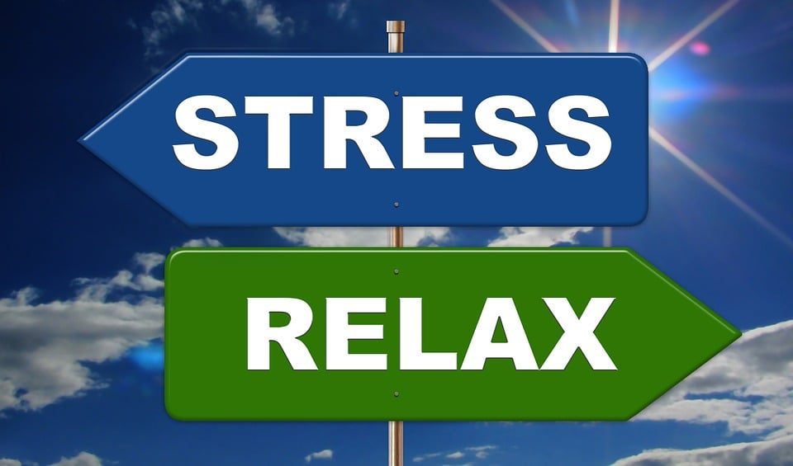
Objective of this course
Learners will:
Recognize procrastination and apply relevant techniques to achieve goals
Identify the basic principles of stress management
Recognize stress triggers and identify ways to manage them effectively

Slide 3

Procrastination
Stress

Slide 4

Time and Stress
Management
Draw a T chart. T
Consider, What stresses me out?
Left side, list home stressors; right side list work stressors.
*Put a star beside those stressors that you can’t control.

Slide 5
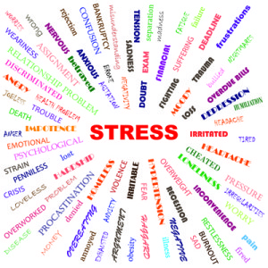
Controllable vs. Uncontrollable Stressors
Fear of failure
Lack of interest
Motivation to keep going
Procrastination
Time management
Planning
Interruptions
Illness
Weather
Lack of support
Poor instructions
Bad internet connection
Traffic

Slide 6
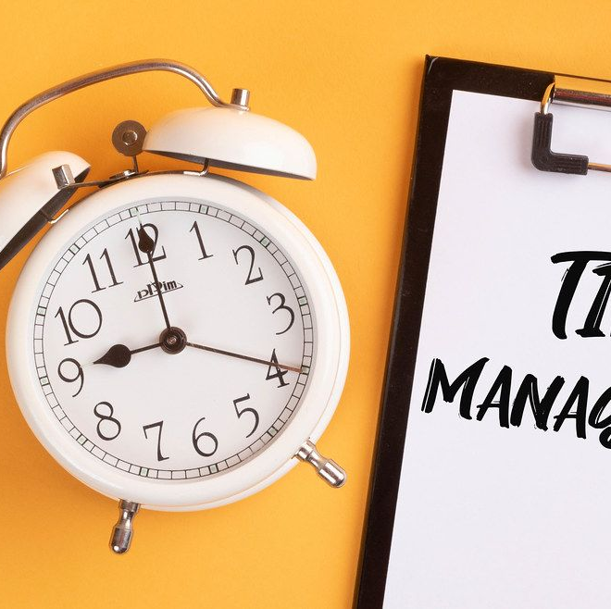
Positive Effects of Time Management on Mental Health
Improves self-discipline which enhances competency and self-esteem
Reduces likelihood of burnout
Boosts productivity (money and time)
Greater job satisfaction which can lead to better self-worth and working relationships with others

Slide 7

Time Saving Tips
Block out distraction
Channel your attention
Don’t get stuck on small details
Focus on priorities
Organize your work station
Label your inbox
Sort your incoming messages
Reduce the amount of repeat work
Eliminate dead time

Slide 8
“Finding Time” – Setting Priorities
https://www.youtube.com/watch?v=n3kNlFMXslo
How to gain control of your free time, Laura Vandercam (11.54)
168 hours per week
Look at the whole of one’s time and seeing where the good stuff can go.
Focus on what matters, we can build the lives we want in the time we’ve got.
Keep a three-category priority list
Career, Relationships, Self
As you view this video, are there connections that you can make with this author?
Please pay particular attention to the concept of setting priorities.
Plan to discuss your thoughts about this video with a partner.

Slide 9
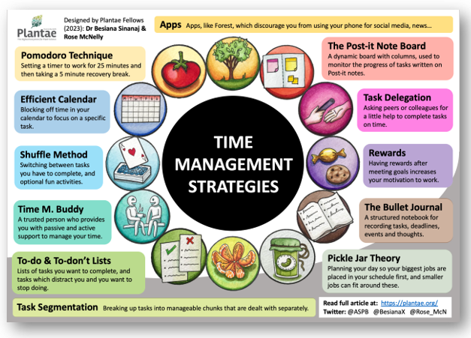
https://plantae.org/12-time-management-strategies-for-researchers/
Read the article that describes 12 time-management strategies.
Note the ones that might work for you.
Be prepared to share with a small group.

Slide 10

Seek and Find
National Institute of Health
https://www.nih.gov/
The American Institute of Stress
https://www.stress.org
With a partner, pick one of the above websites, skim to see the available resources and information related to time management and stress that might help you in your personal and professional lives.

Slide 11
Discussion – Think, Pair, Share
Reflect and write
  What are low-stress and time-efficient techniques you can utilize to reduce tension in your life?
  What are the impacts of stress and poor time management in your
  performance in the workplace?
  What are practical techniques for identifying key time wasters, setting
  boundaries, handling interruptions, and maximizing productivity?
  4. What strategies will you commit to de-stress and manage time?

