Slide 1
Diversity, Equity, and Inclusion
in the Workplace

Slide 2
Overview
This session will act as a micro-sensitivity training on diversity, equity, and inclusion in the workplace.
Participants will gain insight into the intersection of social and professional identities and their impact on workplace spaces.

Slide 3
OBJECTIVES
Participants will…
Describe the impact of intersectionality on stereotypes, insensitive language, and bias behaviors.
Recognize actions, language, and behavior that excludes and/or intimidates others.
Demonstrate skills and competencies that promote and manage a diverse workplace community.

Slide 4
IDENTITY
The collective aspect of a set of characteristics by which a person is recognized or known as an individual or a group member

Slide 5
IDENTITY
Self Reflection
Identities are based on a range of factors, including:
How do you identify yourself?
Race
Sexual orientation
Disability
Ethnicity,
Religion
Gender
Socioeconomic status
Other personal characteristics
On a sheet of paper,
Copy the list to the left.
Answer each about yourself.
Add other personal characteristics that are part of your identity.
List any advantages and disadvantages you’ve personally experienced below each one.

Slide 6
IMPLICIT BIAS
What forms our subconscious implicit biases?
Biases can influence how we interact with, evaluate, or judge others (Deady, 2020).
Reflect on how your identities and implicit biases may impact your interactions.
How does your identity and background influence my thoughts and beliefs about others?
Implicit Bias Video
When we make assumptions about a person, customer, or colleague’s behaviors and their capability for success that are tied to their identities and/or backgrounds.

Slide 7
Example of implicit bias
We remark to someone, “You speak really good English,” or we say, “Where are you from?” based on their appearance or name.
Congratulating a Black student or colleague for being “articulate and well-reasoned.”
Continuing to mispronounce someone's name after having been corrected or using a nickname they have not asked you to use.
Breakout Room Discussion
What other examples can you give that are said or demonstrated nonverbally?
Research shows that these subtle, everyday occurrences have a powerful impact on the psychological well-being of marginalized groups and affect their standard of living by creating inequities in health care, education, and employment.

Slide 8
Consequences of Poor DEI Business Practices
Legal and financial risks
Reputation Damage
Difficulty attracting and retaining talent
Damage to brand image
Reduced employee morale and productivity
High turnover rates
Reduced innovation and creativity
Missed opportunities
Reduced customer base
Hostile work environment
Public backlash
Decreased profits

Slide 9
How can we manage implicit bias?
Become aware of our own biases and how they may impact our interactions with others.
Validate the experience of the incident, communicate their value as a person, affirm their identity, etc.
Use surveys, discussions, and meetings to get to know and colleagues. Surveys can also be used to gain colleague feedback on inclusive practices.
View others through an asset-based mindset. We should view characteristics such as culture, sexuality, language, disability, socioeconomic status, immigration status, gender, etc., as valuable additions to the business and community.
These assumptions can impede a person, customer, or colleague’s growth, loyalty, and willingness to do business with you.
As professionals committed to creating an inclusive and safe environment, reflecting on our identities and how they may affect our interactions with others is helpful.
Use fair evaluation practices, focusing on responsibilities to ensure equity and professional growth.
Design policies that reflect an understanding of the values and staff Develop a caring, empathetic environment that provides colleagues with a sense that they belong.

Slide 10
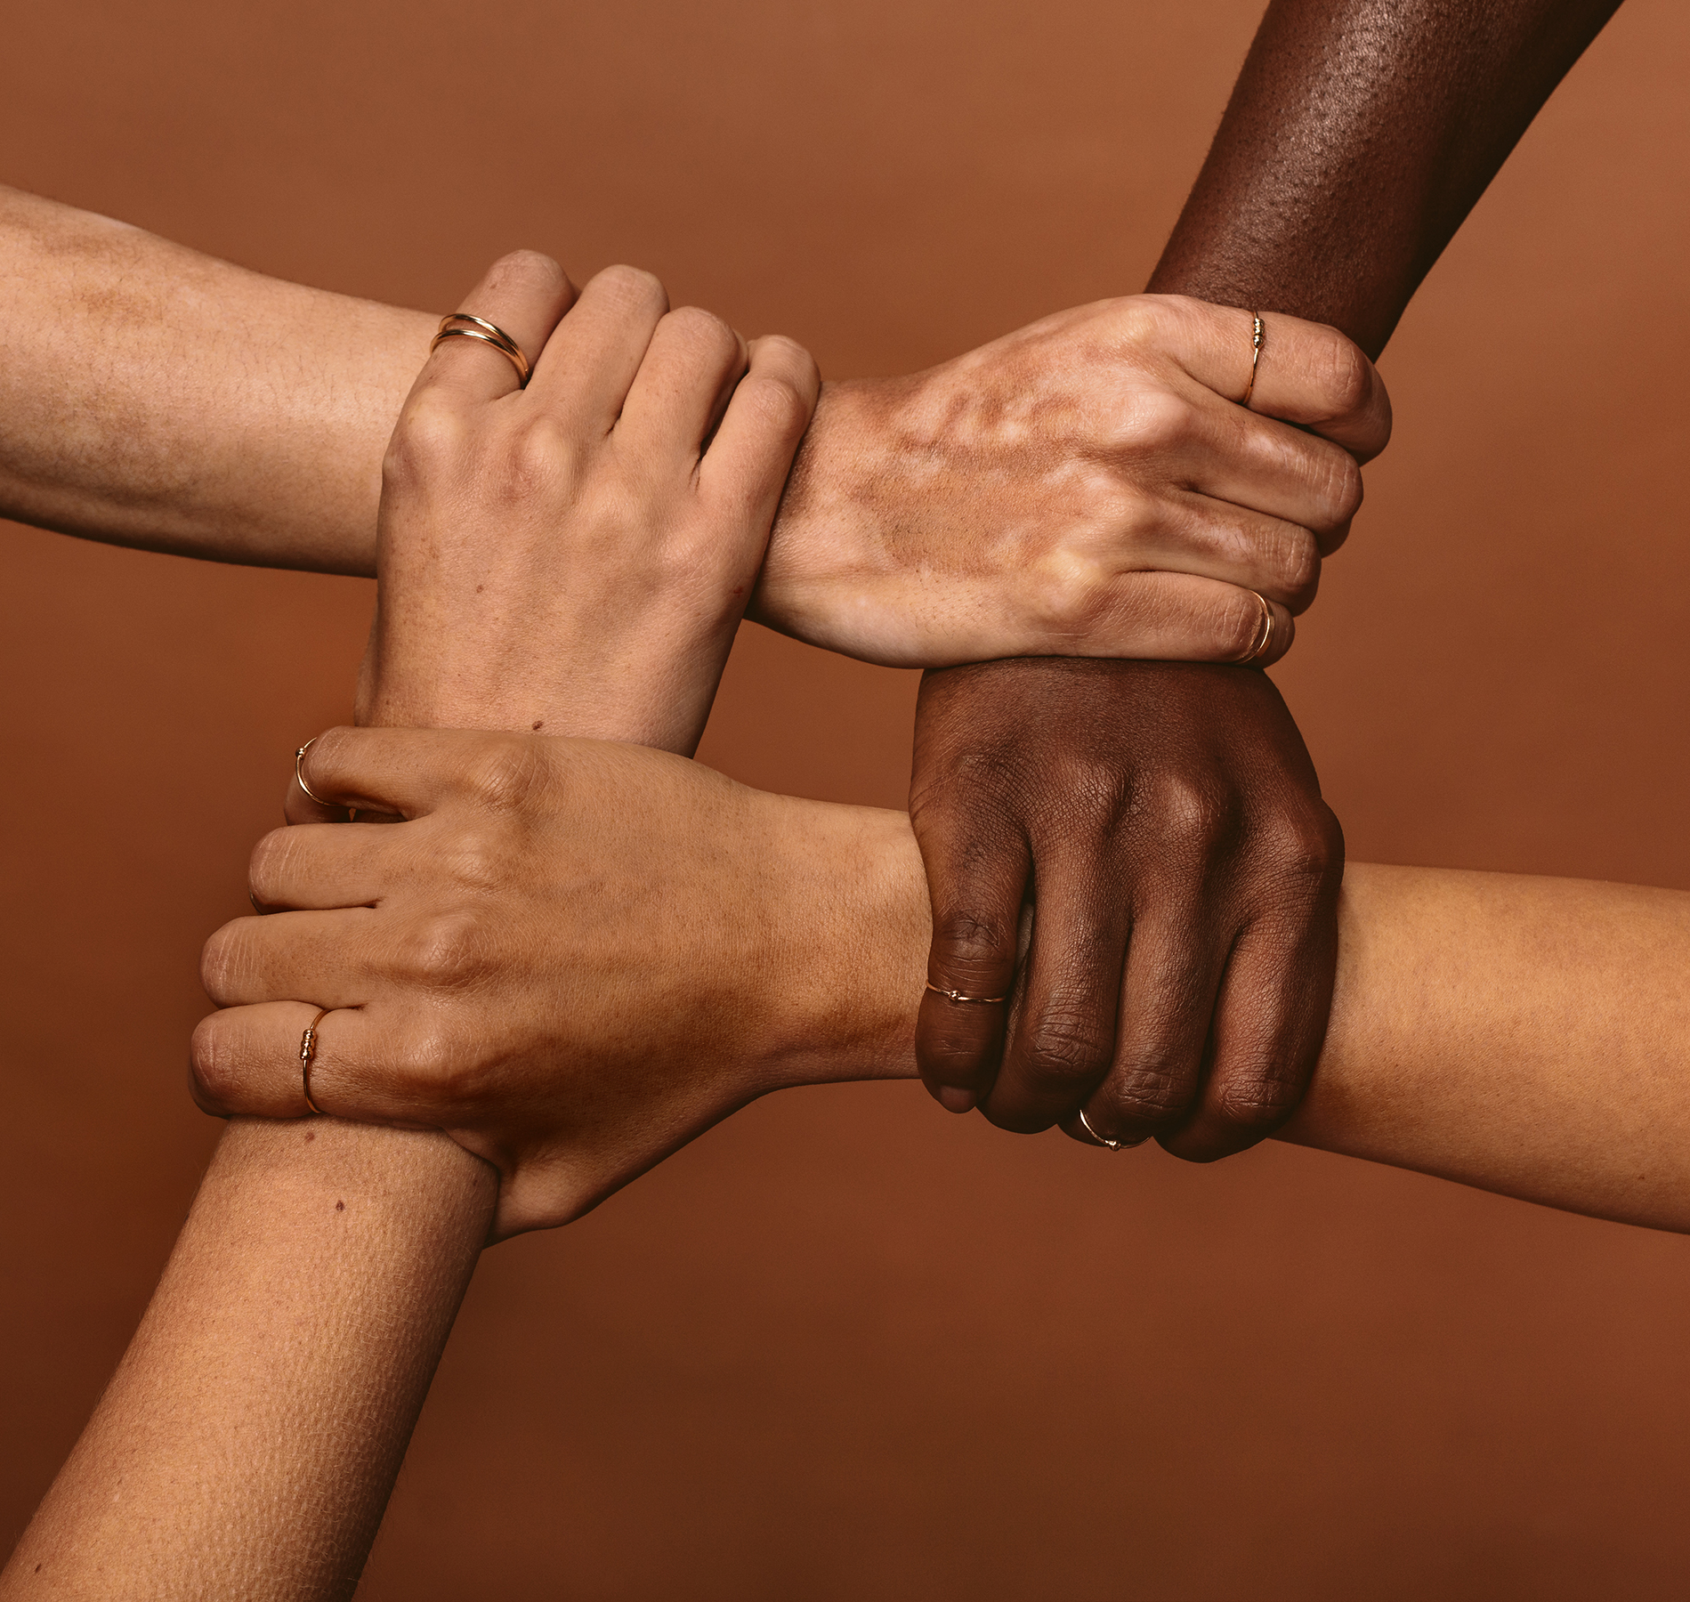
SCENARIOS
DEI Scenario Worksheet
Read through each scenario.
Answer each with: what would you do, what would you say, or how would you handle this?
Why did you choose to approach it the way you did – what was your goal?
What is the potential outcome/consequence because of the way you handled it?
Be prepared to discuss with class.

Slide 11
DEI-Focused Responses to Scenarios
S1: Colleague with a Different Gender Identity
DEI-Focused Response: "I'm sorry if I used the wrong pronoun. I'm happy to use the pronoun that you prefer. How would you like me to address you?“
S2: Customer with a Different Cultural Background
DEI-Focused Response: "I'm happy to help clarify any questions you have. Could you please share what's unclear to you? I'll do my best to explain it in a way that's easy to understand.“
S3: New Employee from a Different Age Group
DEI-Focused Response: "I understand that this process can be confusing. Let's break it down step-by-step, and I'll be glad to answer any questions you have along the way.“
S4: Customer with a Disability Needs Assistance
DEI-Focused Response: "I understand you're having trouble accessing the product information on our website. I can read the details to you over the phone, or we can explore alternative ways to access the product information, such as sending you a PDF with a description.“
S5: A customer calls with a different language, and the agent is not fluent in that language.
DEI-Focused Response: "I'm sorry, I don't speak that language. Can I transfer you to someone who can assist you in your language, or would you prefer to use a translation tool?"

Slide 12
DEI-Focused Responses to Scenarios
S6: A customer expresses concerns about the price of a product or service.
DEI-Focused Response: "I understand your concern. Let's see if we can find a solution that works for you. Are there any alternatives or options we can explore that would fit your budget?"
S7: It was brought to your attention that employees were saying the reason a Hispanic female received a promotion was to show diversity and not because of her skills and work ethic.
DEI-Focused Response: Meet with employees and discuss their concerns, and provide solid examples of her work ethic, training, and knowledge/experience deserving of the promotion.
S8: You are meeting with an interview committee going over resumes submitted for an open position. One person comments on the applicant’s name and suggests we “pass on them.”
DEI-Focused Response: “My understanding is our goal is to bring in the best candidates to interview. I’d like to take a look at the person’s qualifications versus passing them by because of their name. Otherwise, we may be passing by the perfect person for this position.”

Slide 13
IN CONCLUSION…
In the upcoming weeks, what one action will you commit to that promotes diversity, equity, and inclusion?
Thank you!

