Slide 1
Transformational Effective Leadership
Dr. Del Hart
Assistant Professor
Director, Center for Career and Technical Personnel Preparation
Indiana University of Pennsylvania

Slide 2
Introductions
Name.
Position in the organization – leader?
Career objectives – leadership.

Slide 3
Transformational, Effective Leadership
This will be the focus of the course.

Slide 4
Transformational, Effective Leadership
What is a leader?

Slide 5
The Key to Transformational, Effective Leadership
Respect -
- the notion of providing or giving high esteem, value, trust, or credibility to another individual.

Slide 6
The “Audience.”
Who is your audience?
Audience members deserve the leader’s respect.

Slide 7
Respect ≠ Like
Goal of effective educators should be:
Respect
Not: liked or disliked

Slide 8
Respect
The List – Breakout Room, Session 1

Slide 9
Respect
Video: O Captain! My Captain!
https://www.youtube.com/watch?v=3X81np_9QlE

Slide 10
Respect
The List – Breakout Room, Session 2

Slide 11
Respect
The Key to Transformational, Effective Leadership

Slide 12
The Life of a Leader -
“On Stage”
Research –
- High correlation between Leader respect; and, follower achievement, morale, behavior, and effort.

Slide 13
The Life of a Leader -
“On Stage”
Role Model
You may be the only positive role model in the life of a follower on any given day.
(attendance, attitude, image, interpersonal relationships, integrity)

Slide 14
Leaders who never develop into highly respected, and effective transformative leaders are those individuals who do not understand the Eisenhower matrix.

Slide 15
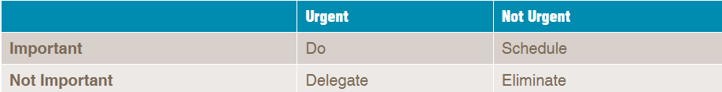
Eisenhower Matrix simplified

Slide 16
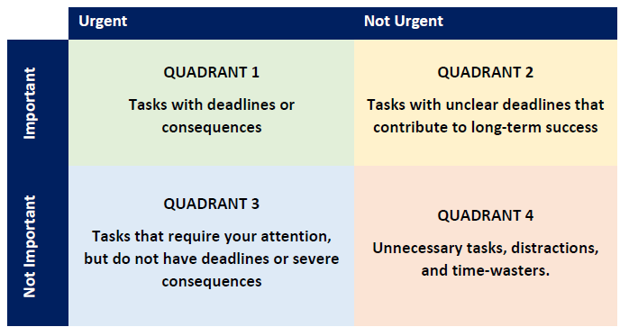
Eisenhower matrix.

Slide 17
Eisenhower Matrix
Quadrant 1: Urgent & Important (Do)
  Tasks or responsibilities that require immediate attention.

Slide 18
Eisenhower Matrix
Quadrant 2: Not Urgent but Important (Decided/Schedule)
  Tasks or responsibilities that you plan for and schedule.

Slide 19
Eisenhower Matrix
Quadrant 3: Urgent but Not Important (Delegate)
  Tasks or responsibilities that may require your attention but can wait.

Slide 20
Eisenhower Matrix
Quadrant 4: Not Urgent & Not Important (Delete)
  Task or responsibilities that waste time and have little value.

Slide 21
Eisenhower Matrix
Breakout Room, Session 3

Slide 22
Eisenhower Matrix
Conclusions
Possible examples of each Quadrant:
Quadrant 1 – tight deadline from supervisor, emergencies
Quadrant 2 – professional development, relationship building
Quadrant 3 – most emails, various meetings
Quadrant 4 – scrolling social media, excessive TV

Slide 23
Developing Transformational, Effective Leadership – The Single Most Important Principle
Interact, or engage, the audience…be visible each day. Keep “in touch” with the audience on a face-to face basis, as much as possible.

Slide 24
Developing Transformational, Effective Leadership – The Single Most Important Principle
“in touch” with the audience on a face-to face basis, as much as possible – MBWA.
https://www.youtube.com/watch?v=Xo1ZWvtX_ZM

Slide 25
Developing Transformational, Effective Leadership – How Well Do You Know Your Audience?
List the single most important organizational gripe of the audience.
2. List two audience members that have expressed an interest in leadership positions.

Slide 26
Developing Transformational, Effective Leadership – How Well Do You Know Your Audience?
List two audience members that are regarded as outstanding mentors by their peers.
2. List a significant life event that has occurred in the lives of two audience members recently.

Slide 27
Developing Transformational, Effective Leadership – The Leader’s Foundation
Always remember your roots and humble beginnings as an entry level employee (what were your gripes).
2. Wisely use your time for the benefit of the audience in the organization (keep in touch with them).

Slide 28
Developing Transformational, Effective Leadership – The Leader’s Checklist
Does the organization excel in its mission?
In the thoughts of the audience/clients/customers, does the organization exemplify excellence?
3. Does the organization inspire its stakeholders to invest in it (trust)?

Slide 29
Developing Transformational, Effective Leadership – The Leader’s Checklist
Do you sincerely seek to develop, motivate, inspire, and encourage your audience members? How?
5. Do you Interact with Your Audience ? Is your door open or shut for the majority of each day? (Urgent! Important!)
6. Have you organized audience advisory teams?

Slide 30
Contact Information
Dr. Del Hart
Assistant Professor
Indiana University of Pennsylvania
dhart@iup.edu
724-762-3660

