Slide 1
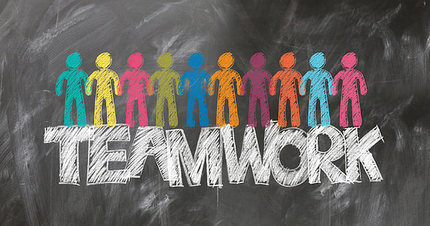
Group and Team Dynamics
This session will review collaboration, teamwork, and group dynamics essential to effective functioning within organizations.

Slide 2
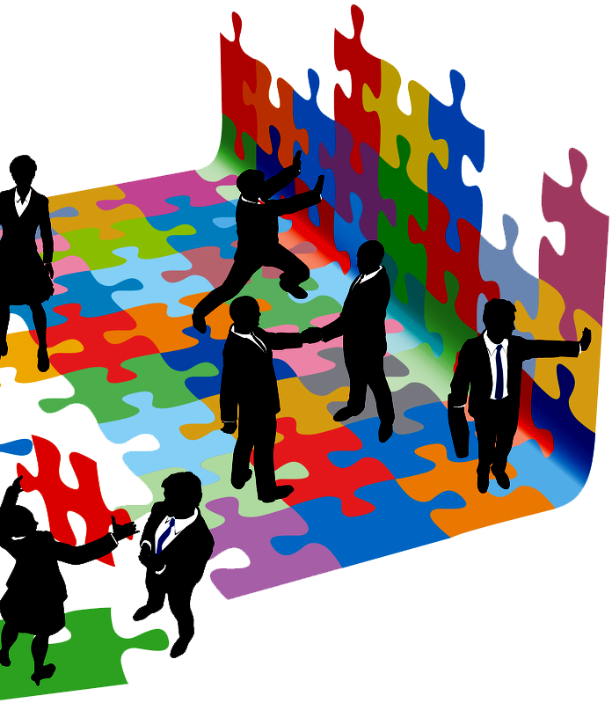
Objective of this course:
Learners will:
Understand team development stages and develop strategies for building high-performance teams
Discuss how team characteristics, strengths/weaknesses, and composition influence team effectiveness

Slide 3
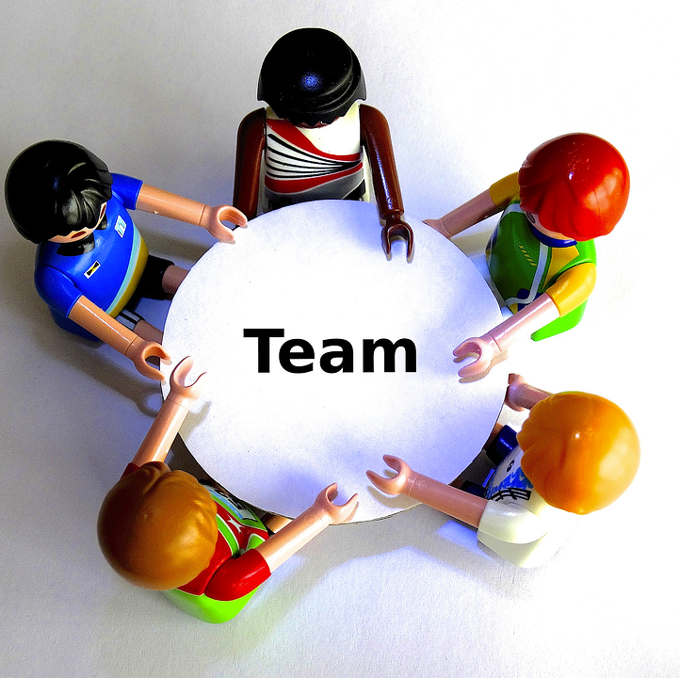
Collaboration, Teamwork, and Group Dynamics
What does collaboration look like to you?
What does teamwork look like to you?
How would you describe group dynamics of a high-performing team?

Slide 5
Five Habits of High-Performing Teams David Burkus (11 min. 3 sec.)
5 Habits Of High-Performing Teams
As you view this video, attend to the five habits of high-performing teams as described by David Burkus. Consider how those five habits fit (or not) in your current workplace and be prepared to discuss with a partner.
Clear, Quick Communication, Conversational Turn-taking,
Respectful debate, Nonwork conversations, Consistent appreciation

Slide 6
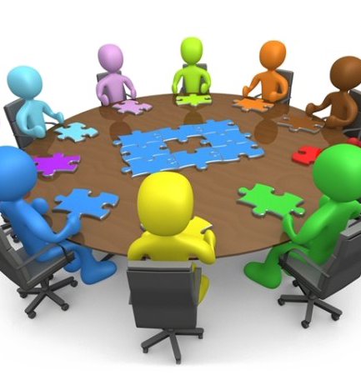
Stages of Group and Team Dynamics
Stage One – Forming
Stage Two – Storming
Stage Three – Norming
Stage Four – Performing
Stage Five – Adjourning
Muscato, Bush, Grenhaw, & Baker (2023)

Slide 7
Transformational Leadership
Read the following article and be
prepared to discuss the relationship
between leadership styles and team
dynamics in high-performance teams.
Kan, J. (2024). Research on the relationship between leadership style and team dynamics in high-performance teams. https://doi.org/10.1051/shsconf/202420002031.

Slide 8
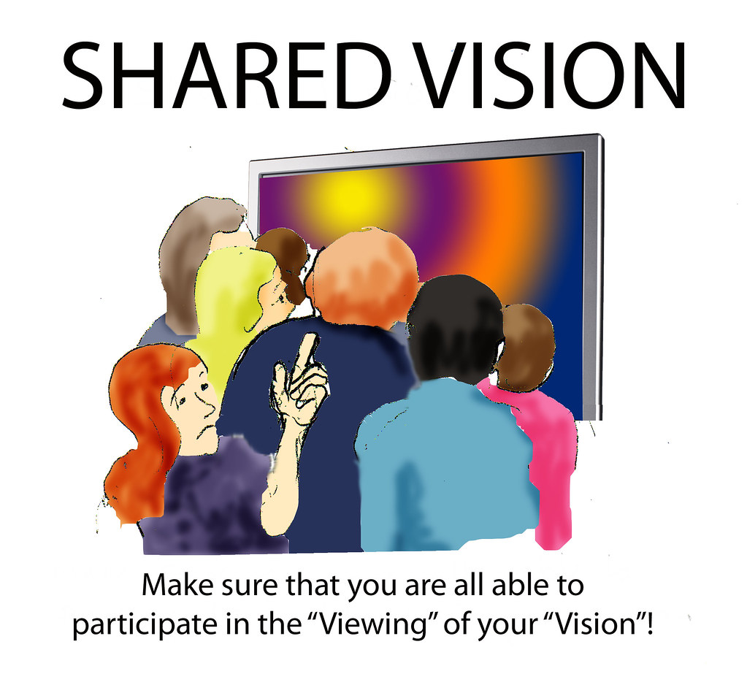
Effect of Team Dynamics on Team Performance, (Kan 2024)
Collaboration
Performance
Communication
Conflict Management
Member Diversity
Team structure
Incentive Mechanisms

Slide 9
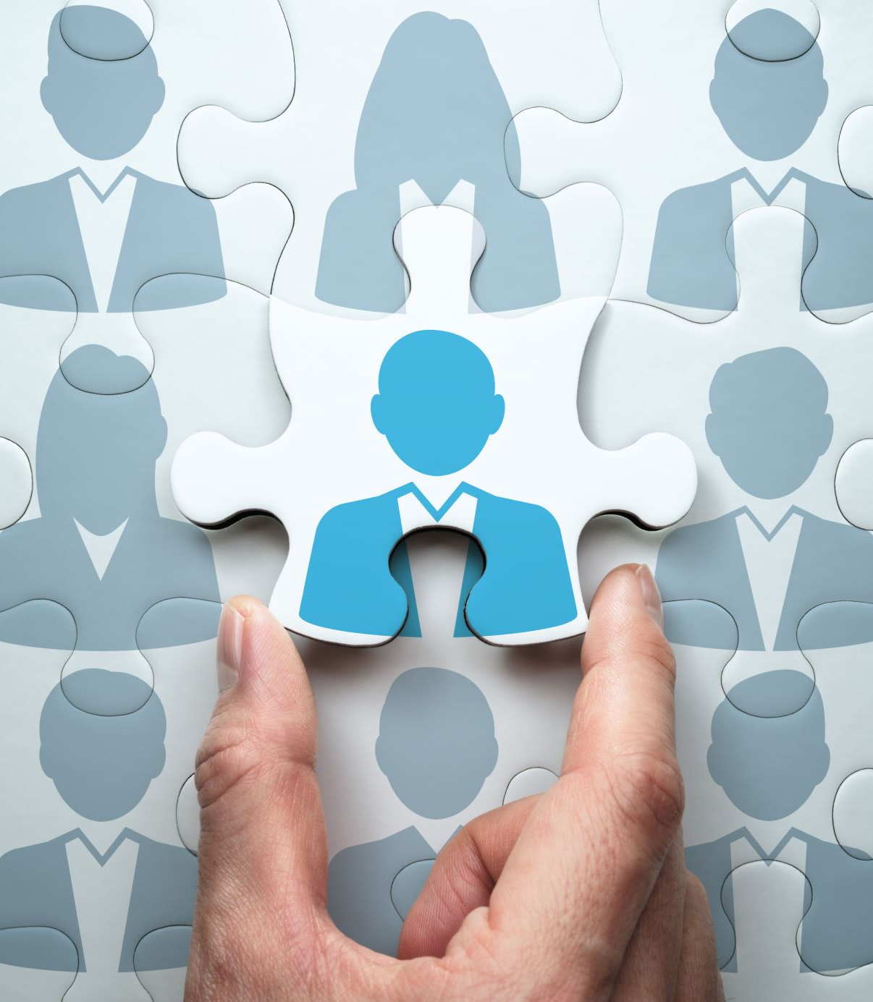
Characteristics of Collaborative Team Members
External characteristics of an individual with strong collaborative/teamwork skills
Leadership
Effective communication
Verbal
Professional language and tone
Clear and concise
Demonstrates active listening through paraphrasing
Non-verbal
Body language
Active listening

Slide 10
Characteristics of Collaborative Team Members
Internal characteristics of an individual with strong collaborative/teamwork skills
Self-aware
Emotionally intelligent
Reflexive
Creative
Desire/Actively seeks growth opportunities
Reliable
Work quality
Deadlines

Slide 11
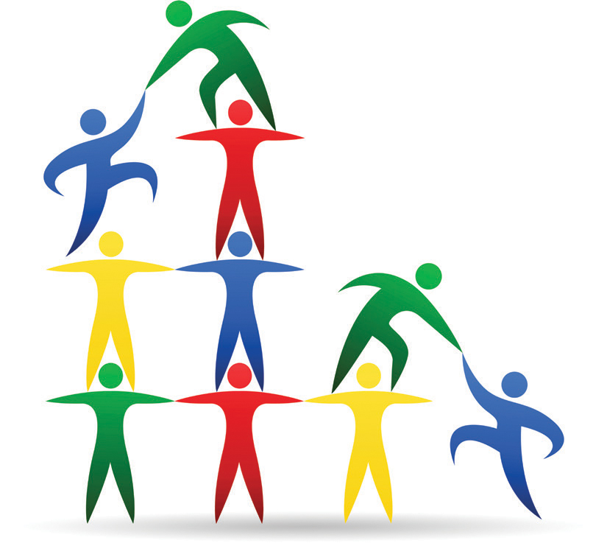
Teambuilding Exercises
What kind of help does your team need to be effective?
What kind of team building exercises would fit that need?

Slide 12
The “Big Five“ a/k/a OCEAN
https://www.youtube.com/watch?v=8Hz0pVx9DfI
This 4.43 min video describes the five different main personality types.
How do these “Big Five” personality traits compare with your group members?

Slide 13
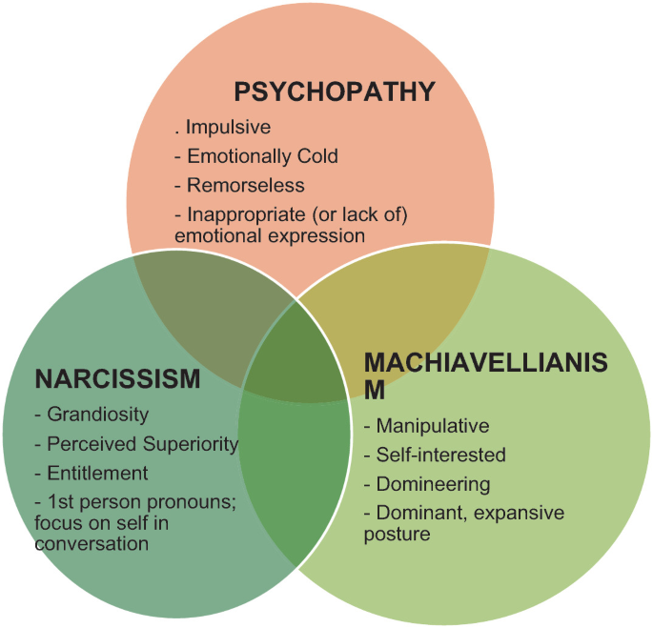
Dark Triad Personality Traits
Personality traits and the degree of their prominence determine various aspects of social interaction.
Dark Triad traits are associated with antisocial behavior, disregard for moral norms, and a tendency to manipulation.
Myznikov, Korotkov, et al. (2024)

Slide 14
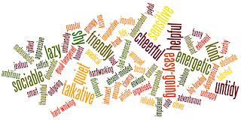
Activity: Personality Styles Worksheet
Complete the Personality Styles Worksheet for yourself and then a person you experienced conflict with at one or more points in your life (professional or personal).
Consider: What motivates your colleagues?

Slide 15
Why do we want to understand motivation?
Job satisfaction and productivity are positively correlated.
Understanding what drives a team member to give 100% every day is crucial for the team leader to understand and support.

Slide 16
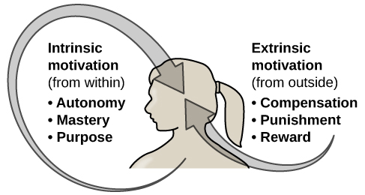
Motivation Types
Intrinsic Motivation (Internal)
Driven internally because the feeling of completing good work is the reward.
Extrinsic Motivation (External)
Driven by external factors because the reward will come in the form of praise from another or compensation (e.g., money, PTO).

Slide 17
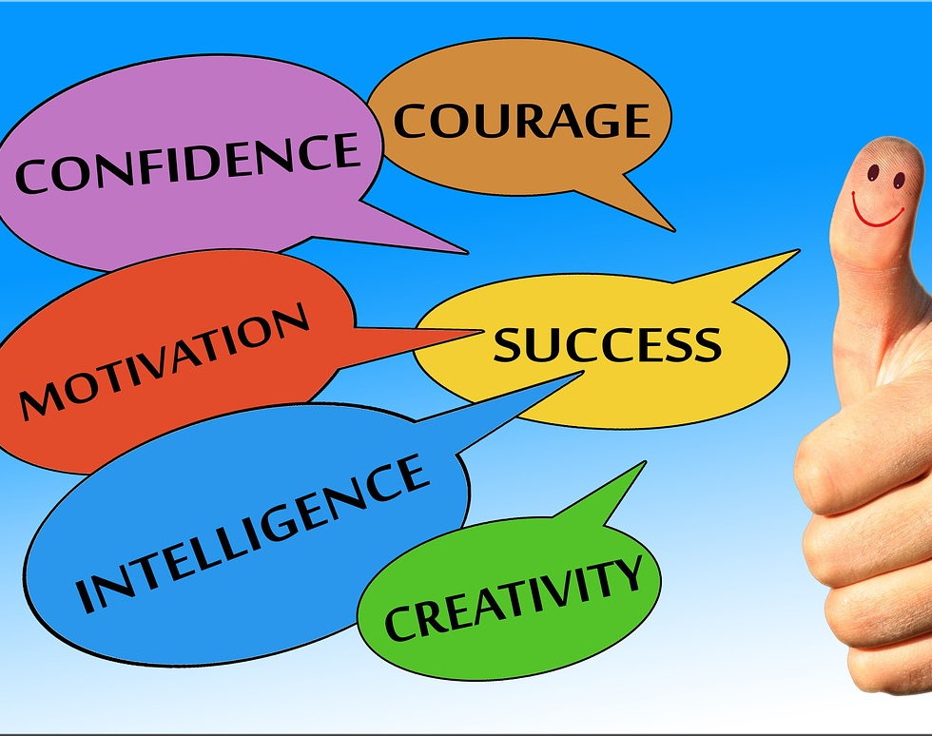
Benefits of Positive Team and Group Dynamics
Creative work, products, and solutions
Motivated employees
Positive organizational culture and better day-to-day operations
High levels of job satisfaction and trust

Slide 18
Discussion
Reflect and write:
1. What are various stages of team dynamics and/or its functionality?
2. What are characteristics of high-performing teams?
3. How can you support teambuilding and grow team cohesion within a group?
4. How would you go about building team camaraderie in your current role?
5. What is one thing you can implement in the coming month?
Share and discuss with the group

