Slide 1
Emotional Intelligence
Individual Differences and Emotions

Slide 2
After this segment you should be able to:
1 Distinguish Individual differences based on their relative stability.
2 Explain how multiple Intelligences affects my performance.
3 Illustrate ways in which personality can affect my performance at work.
4 Justify the impact of core self-evaluations on performance.
5 Summarize the benefits of emotional Intelligence.
6 Explain how understanding emotions makes people more effective.
7 Describe the Implications of Individual differences and emotions for you and managers.

Slide 3
How Does Who I Am Affect My Performance?
We all differ along a vast number of personal attributes.
How we differ has been shown to influence how we approach each of the following:
Work.
Solving problems.
Conflict.
Interactions with co-workers.
Notes:
Individual differences (IDs): the many attributes, such as traits and behaviors, that describe each of us as a person.
As shown in Figure 3.2, individual differences can be arranged on a continuum of their relative stability.
At one extreme are relatively fixed traits (like intelligence) and at the other extreme are more flexible states (like emotions). Relatively fixed differences are stable over time and across situations and are difficult to change. Relatively flexible differences, such as emotions, change over time from situation to situation, and can be altered more easily.

Slide 4
Figure 3.2 Relative Stability of Individual Differences
Which individual differences do you think managers can influence?
Access the alternate text for image.

Slide 5
Test Your OB Knowledge 1
Maria is a manager for Greens and Grits. Maria would like to improve job satisfaction for her employees. She can accomplish this by implementing different policies dealing with
personality.
intelligence.
cognitive ability.
emotions and attitudes.
All of the above.
Notes:
The answer is D. Emotions and attitudes are relatively flexible.

Slide 6
Intelligence: There Is More to the Story Than IQ 1
Gardner’s theory of multiple intelligences (MI).
Linguistic:
Logical-mathematical.
Musical.
Bodily-kinesthetic.
Spatial.
Interpersonal.
Intrapersonal.
Naturalist.
Notes:
Howard Gardner, a professor at Harvard’s Graduate School of Education, investigated this issue for years and summarized his findings in his 1983 book Frames of Mind: The Theory of Multiple Intelligences.
The eight different intelligences he identified include not only mental abilities, but social and physical abilities and skills as well.

Slide 7
Intelligence: There Is More to the Story than IQ 2
We also have practical intelligence.
The ability to solve everyday problems by utilizing knowledge gained from experience in order to purposefully adapt to, shape, and select environments.
We all have strengths and weakness, so knowledge of our intelligences may help in:
Choosing a career or selecting the best candidate.
Development of ourselves or others.
Notes:
Practical intelligence is the ability to solve everyday problems by utilizing knowledge gained from experience in order to purposefully adapt to, shape, and select environments.
It involves changing oneself to suit the environment (adaptation), changing the environment to suit one’s needs or desires, (shaping), or finding a new environment within which to work (selection). One uses these skills to:
Manage oneself.
Manage others.
Manage tasks.

Slide 8
Test Your OB Knowledge 2
George does not score particularly well on standard IQ tests, yet he has a unique ability to deal with complex interpersonal situations. What would explain this phenomenon?
practical intelligence.
multiple intelligences.
reasoning ability.
emotions and attitude.
gender.
Notes:
The answer is B. Multiple intelligences addresses interpersonal and intrapersonal intelligence.

Slide 9
The Big 5 Personality Dimensions
What Is Personality?
The combination of stable physical, behavioral, and mental characteristics that give individuals their unique identities.
Five Dimensions | Characteristics
1. Extroversion | Outgoing, talkative, sociable, assertive
2. Agreeableness | Trusting, good-natured, cooperative, softhearted
3. Conscientiousness | Dependable, responsible, achievement-oriented, persistent
4. Emotional stability | Relaxed, secure, unworried
5. Openness to experience | Intellectual, imaginative, curious, broad-minded
Notes:
Big Five personality dimensions are five basic dimensions that simplify more complex models of personality: extraversion, agreeableness, conscientiousness, emotional stability, and openness to experience.
Table 3-2 describes the Big Five personality dimensions as:
Extraversion: outgoing, talkative, sociable, assertive.
Agreeableness: trusting, good natured, cooperative, softhearted.
Conscientiousness: dependable, responsible, achievement oriented, persistent.
Emotional stability: relaxed, secure, unworried.
Openness to experience: intellectual, imaginative, curious, broad-minded.

Slide 10
What Does It Mean to Have a Proactive Personality?
You’re someone who is relatively unconstrained by situational forces and who affects environmental change.
You’re someone who identifies opportunities and acts on them.
The many benefits:
Increased job performance.
Higher job satisfaction.
Higher affective commitment.
Entrepreneurial.
Notes:
Proactive personality: someone who is relatively unconstrained by situational forces and who affects environmental change.
People with proactive personalities are “hardwired” to change the status quo.
Many argue that today’s hyper-competitive and fast-changing workplace requires employees who take initiative and are adaptable.
The ideal scenario is for both you and your manager to be proactive, as this will increase your level of job performance, job satisfaction, and affective commitment.
Proactivity is a highly valued characteristic in the eyes of employers, and being proactive has direct and indirect benefits for your performance.
Successful entrepreneurs often exemplify the proactive personality.

Slide 11
Personality and Performance 1
The strongest effects result when when both you and your manager have proactive personalities.
Conscientiousness has the strongest and most positive effects on performance across jobs, industries, and levels.
Extroversion is beneficial if the job involves interpersonal interaction and is a stronger predictor of job performance than agreeable-ness.
Those higher on agreeableness are more likely to seek new opportunities.
Notes:
Your personality characteristics are likely to have the greatest influence and effect on performance when you are working in situations that are unstructured and with few rules.
Conscientiousness has the strongest (most positive) effects on job performance and training performance.
Extraversion was associated with success for managers and salespeople, and extraversion was a stronger predictor of job performance than agreeableness, across all professions.
Introverts have been shown to score their extroverted and disagreeable coworkers more harshly than their similarly introverted coworkers.
Agreeable employees are more likely to stay with their jobs.
Openness seems to lead to higher turnover.
Emotional stability, along with conscientiousness and agreeableness, is associated with a greater focus on and practice of workplace safety.

Slide 12
Personality and Performance 2
The problem with workplace personality tests:
Pre- and post-hire personality testing is fairly common.
However, most personality test are not valid predictors of job performance, and here’s why.
Test takers do not describe themselves accurately (faking).
Tests are bought off the shelf and given by untrained employees.
Personality tests are meant to measure personality, not what individual differences are needed to perform a particular job.
Notes:
Despite their widespread use, a panel of industrial-organizational psychologists concluded that the typical personality test is not a valid predictor of job performance.
One reason might be that many test-takers don’t describe themselves accurately but instead try to guess what answers the employer is looking for.
Another reason for the dismal results is that such tests are typically bought off the shelf and often given indiscriminately by people who aren’t trained or qualified.
While rigorous research shows that personality actually is related to performance, the effects are small. Moreover, and more importantly perhaps, the fact is that personality tests are designed to measure personality, not what individual differences are needed to perform at a high level in a particular job.
This means that managers need different and better ways to measure personality if they want to select employees based on performance-conducive personality traits.

Slide 13
Test Your OB Knowledge 3
Martha would like to hire employees who will be strong performers in her organization. Which of the Big Five personality dimensions should she try to make sure the new employees score high on?
extraversion
agreeableness
conscientiousness
emotional stability
openness to experience
Notes:
The answer is C, conscientiousness. Those scoring high on conscientiousness have a strong sense of purpose, obligation, and persistence and generally perform better.

Slide 14
Core Self-Evaluations and Your Performance
Core self-evaluations (CSEs).
A broad personality trait comprised of four narrow and positive individual traits.
Generalized self-efficacy.
Self esteem.
Locus of control.
Emotional stability.
Notes:
A narrow concepts perspective enables you to more precisely describe individuals.
People with high core self-evaluations see themselves as capable and effective.
Core self-evaluations (CSEs) represent a broad personality trait comprised of the following four narrower and positive individual traits:
Generalized self-efficacy.
Self-esteem.
Locus of control.
Emotional stability.
CSEs have desirable effects on outcomes such as increased job performance, job and life satisfaction, motivation, organizational citizenship behaviors, and better adjustment to international assignments.

Slide 15
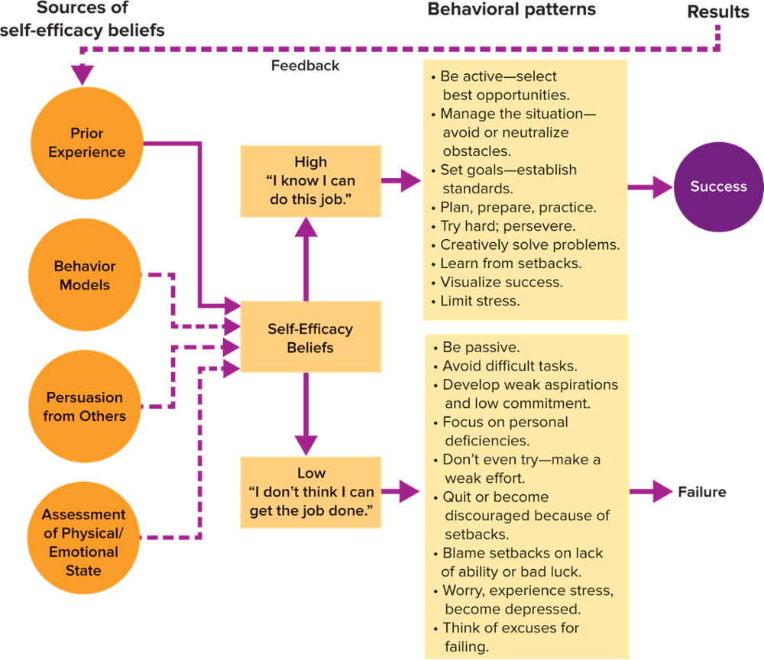
How Self-Efficacy Works
FIGURE 3.4 Self-Efficacy Paves the Way for Success or Failure
Self-efficacy is a belief about your chances of successfully accomplishing a specific task.
SOURCE: Bandura, Albert. “Perceived Self-Efficacy in Cognitive Development and Functioning.” Developmental Psychology 25, no. 5 (1993): 117–148. http://dx.doi.org/10.1037/0012-1649.25.5.729; and Wood, Robert, and Albert Bandura. “Social Cognitive Theory of Organizational Management.” The Academy of Management Review 14, no. 3 (July 1989): 361–384. https://DOI: 10.5465/AMR.1989.4279067.
Access the text alternate for image.
Notes:
Self-efficacy: a person’s belief about his or her chances of successfully accomplishing a specific task.
Figure 3.3 presents the sources of self-efficacy beliefs: prior experience, behavior models, persuasion from others, and assessment of physical/emotional state.
Because prior experience is the most potent source of self-efficacy beliefs, in Figure 3-3 it is listed first and is connected to self-efficacy beliefs with a solid line.
A cognitive evaluation of these four sources of self-efficacy beliefs would lead to a self-efficacy belief which could range from high to low expectations for success.
An individual acts out high or low self-efficacy beliefs through behavior patterns.
Positive or negative results become feedback for one’s base of personal experience and influence future self-efficacy beliefs.
There is a positive correlation between self-efficacy and job performance and job satisfaction.
Job design, training and development, self-management, goal setting, creativity, coaching, and leadership can enhance self-efficacy.

Slide 16
Self-Esteem and Your Performance
Self-esteem is a general belief about your self-worth.
It is relatively stable across your lifetime, but it can be improved.
Best to apply yourself to areas or goals that are important to you.
Why? In those areas your motivation will likely be highest and presumably you’ll work the hardest.
Notes:
Self-esteem is your general belief about your own self-worth.
Personal achievements and praise tend to bolster one’s self-esteem, while prolonged unemployment and destructive feedback tend to erode it.
Self-esteem is measured by having people indicate their agreement or disagreement with both positive and negative statements about themselves.
Those who agree with the positive statements and disagree with the negative statements have high self-esteem. They see themselves as worthwhile, capable, and accepted. People with low self-esteem view themselves in negative terms. They do not feel good about themselves and are hampered by self-doubts.

Slide 17
Locus of Control and My Performance 1
Locus of Control describes how much personal responsibility someone takes for their behavior and its consequences.
External Locus of Control:
Things happen to me.
I blame others for failures.
I can’t control the future.
Internal Locus of Control:
I make things happen.
I can determine my future.
I accept personal responsibility for failures.
Notes:
Locus of control: a relatively stable personality characteristic that describes how much personal responsibility you take for your behavior and its consequences.
People tend to attribute the causes of their behavior primarily to either themselves or environmental factors.
Internal locus of control: possessed by people who believe they control the events and consequences that affect their lives.
A person with an internal locus of control tends to attribute positive outcomes to her or his own abilities and blame negative events on personal shortcomings.
External locus of control: possessed by people who believe their performance is the product of circumstances beyond their immediate control.

Slide 18
Locus of Control and My Performance 2
In the workplace.
Internal Locus of Control:
Higher motivation.
Higher expectations .
Exert more effort when given difficult tasks.
External Locus of Control:
More anxious.
Earn less, receive smaller raises.
Less motivated by incentives.
Notes:
Locus of control is a relatively stable personality characteristic that describes how much personal responsibility you take for your behavior and its consequences.
People tend to attribute the causes of their behavior primarily to either themselves or environmental factors.
A person with an external locus of control tends to attribute outcomes to environmental causes, such as luck or fate.
An internal will display greater work motivation, have stronger expectations that effort leads to performance, exhibit higher performance, and derive more job satisfaction from performance.
Externals demonstrate less motivation for performance when offered valued rewards, earn lower salaries and smaller salary increases, and tend to be more anxious.

Slide 19
Emotional Stability and My Performance
What Is Emotional Stability?
Higher job performance.
More organizational citizenship behaviors.
Few counter-productive work behaviors.
People High in Emotional Stability Tend To Be:
Relaxed.
Secure.
Unworried.
Less likely to experience negative emotions under pressure.
Notes:
Individuals with high levels of emotional stability tend to be relaxed, secure, unworried, and less likely to experience negative emotions under pressure.
In contrast, if you have low levels of emotional stability you are prone to anxiety and tend to view the world negatively.
How is this knowledge useful at work?
Employees with high levels of emotional stability have been found to:
Have higher job performance, perform more organizational citizenship behaviors (OCBs)—going above and beyond one’s job responsibilities.
Exhibit fewer counterproductive work behaviors (CWBs)—undermining your own or others’ work.

Slide 20
Test Your OB Knowledge 4
Joe was terminated from his job and believed the reason was his boss did not like him and his hard work was not appreciated. Joe likely has
high emotional stability.
an internal locus of control.
low self-efficacy.
an external locus of control.
low self-esteem.
Notes:
The answer is D, an external locus of control. Joe is blaming his termination on his boss instead of himself.

Slide 21
The Value of Being Emotionally Intelligent
Emotional intelligence (EI).
The ability to monitor one’s own emotions and those of others, to discriminate among them, and to use this information to guide one’s thinking and actions.
Notes:
Emotional intelligence (EI): the ability to monitor your own emotions and those of others, to discriminate among them, and to use this information to guide your thinking and actions.

Slide 22
Key Components of Emotional Intelligence
Personal Competence.
Self-awareness.
Self-management.
Social Competence.
Social awareness.
Relationship management.
Benefits/Drawbacks of EI:
Better social relationships.
Greater well-being.
Increased satisfaction.
No clear link to improved job performance.
Research remains unclear.
Notes:
Referred to by some as EI (used in this book) and others as EQ, emotional intelligence is a mixture of personality and emotions and has four key components.
1. Self-awareness.
2. Self-management.
3. Social awareness.
4. Relationship management.
The first two constitute personal competence and the second two feed into social competence.
EI has been linked to better social relationships, well-being, and satisfaction across ages and contexts, including work.
Considered together, the results of EI research are mixed. To date, the research just isn’t clear.

Slide 23
Emotions and Performance
What are emotions?
Emotions are complex, relatively brief responses aimed at a particular person, information, experience, or event.
Emotions can change our psychological and physiological states.
There are both positive and negative, or mixed emotions plus past versus future emotions.
Notes:
Emotions are complex, relatively brief responses aimed at a particular target, such as a person, information, experience, event, or nonevent. They also can change psychological and physiological states.
Importantly, researchers draw a distinction between felt and displayed emotions. For example, if your boss screams at you when she’s angry you might feel threatened or fearful (felt emotion). You might keep your feelings to yourself or begin to cry (either response is the displayed emotion). The boss might feel alarmed (felt emotion) by your tears but could react constructively (displayed emotion) by asking if you’d like to talk about the situation when you feel calmer.
Emotions also motivate your behavior and are an important means for communicating with others.

Slide 24
Managing Emotions at Work
Anger.
People are angry about what happened or did not happen in the past.
Anger is a “backward-looking” or retrospective emotion.
Fear.
People are afraid of things that might happen in the future.
Fear is a “forward-looking” or prospective emotion.
Knowing this, managers can guide their own actions as to how they communicate with employees knowing their reactions to events.
But, organizations have emotion display norms, or rules that dictate which types of emotions are expected and appropriate for their members to show.
Notes:
Anger is a “backward looking” or retrospective emotion, while fear is a “forward-looking” or prospective emotion.

Slide 25
Test Your OB Knowledge 5
Liu has a goal to work hard and eventually apply for a promotion at the Great Grain Company. Liu is most likely to exhibit positive emotions if
the emotions are congruent with his goal.
he has emotional intelligence.
the emotions are incongruent with his goal.
he feels inadequate.
he had a bad experience being promoted at his former company.
Notes:
The answer is A. The emotions are positive if they are congruent (or consistent) with his goal.

Slide 26
Test Your OB Knowledge 6
Jessica would like to be a best-selling author. She studied OB and knows this will take at least 10,000 hours of deliberate practice. Jessica should do all of the following EXCEPT:
identify aspects of performance that need improvement.
get a coach to receive feedback.
study other writers and their works.
take breaks to maintain concentration.
only practice as long as it remains fun.
Notes:
The answer is E. Only practice as long as it remains fun. Deliberate practice requires us to focus on things we are not good at doing. It would be more fun to repeat behaviors or activities at which we excel.

Slide 27
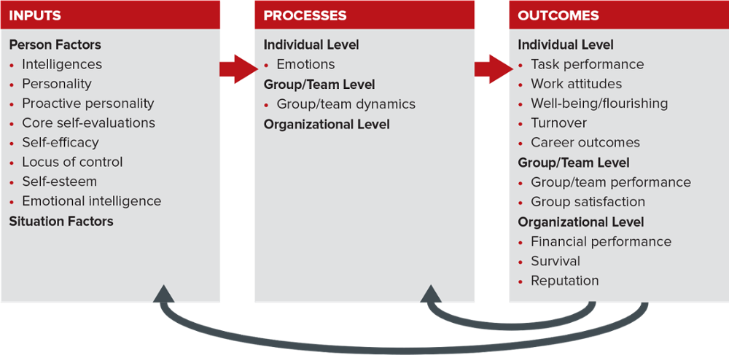
Individual Differences: Putting It All in Context
Figure 3.6 Organizing Framework for Understanding and Applying OB
© 2021 Angelo Kinicki and Mel Fugate. All rights reserved. Reproduction prohibited without permission of the authors.
Access the text alternate for image.

