Slide 1
ARE YOU CAREER READY?
B U I L D I N G Y O U R B R A N D

Slide 2
SESSION OBJECTIVES
Demonstrate career readiness skills needed to compete professionally in an ever-changing world of work.
Describe the key lessons you have learned through the internship.
Identify elements of leadership to practice or develop prior starting in your career field.
Formulate your approach to leadership going forward.

Slide 3
INTRODUCTION TO BUILDING YOUR BRAND
Career and Self-Development is proactively developing oneself and one’s career through continual personal and professional learning, awareness of one’s strengths and weaknesses, navigation of career opportunities, and networking to build relationships within and without one’s organization.
Definition of Branding
Branding is the process where a business makes itself known to the public and differentiates itself from competitors. Branding typically includes a phrase, design, or idea that makes it easily identifiable to the public.
Career Branding
In your own words, define “Career Branding.”
What do you know about it?
What benefits or value come from it?
3

Slide 4
CAREER BRANDING
What it is:
Career branding is about creating a distinct and memorable "mark" around your name or career, highlighting your unique skills, experiences, and values.
Why it's important:
In a competitive job market, a strong career brand helps you stand out, build credibility, and attract opportunities that align with your goals.
How it works:
Define your brand: Reflect on your strengths, values, passions, and skills, and identify what makes you different.
Craft a compelling story: Share your career journey and how you got to where you are today.
Build your online presence: Optimize your LinkedIn profile, personal website, and social media accounts to showcase your brand.
Network strategically: Connect with people in your field and share your story.
Be consistent: Maintain a consistent message and image across all platforms.
Benefits:
Increased visibility: A strong career brand can help you get noticed by recruiters and hiring managers.
Attract better opportunities: You're more likely to be considered for roles that match your skills and values.
Career advancement: A well-defined brand can accelerate your career growth and lead to promotions.
Job security: A strong brand can make you more resilient in the face of job market changes.
4

Slide 5
CAREER BRANDING BEHAVIORS AND ACTIONS
Show an awareness of your strengths and areas for development.
Identify areas for continual growth while pursuing and applying feedback.
Develop plans and goals for one’s future career.
Professionally advocate for oneself and others.
Display curiosity; seek out opportunities to learn.
Assume duties or positions that will help one progress professionally.
Establish, maintain, and/or leverage relationships with people who can help one professionally.
Seek and embrace development opportunities.
Voluntarily participate in further education, training, or other events to support one’s career.
How to Establish Your Personal Brand While You are Still in College
5

Slide 6
COMPETENCIES FOR A CAREER READY WORKFORCE
Career & Self Development
Proactively develop oneself and one’s career through continual personal and professional learning, awareness of one’s strengths and weaknesses, navigation of career opportunities, and networking to build relationships within and without one’s organization.
Critical Thinking (Problem Solving)
Identify and respond to needs based upon an understanding of situational context and logical analysis of relevant information.
Equity & Inclusion
Demonstrate the awareness, attitude, knowledge, and skills required to equitably engage and include people from different cultures and backgrounds. Engage in anti-oppressive practices that actively challenge the systems, structures, and policies of racism and inequity.
Technology
Understand and leverage technologies ethically to enhance efficiencies, complete tasks, and accomplish goals.
Leadership
Recognize and capitalize on personal and team strengths to achieve organizational goals.
Clearly and effectively exchange information, ideas, facts, and perspectives with persons inside and outside of an organization.
Knowing work environments differ greatly, understand and demonstrate effective work habits, and act in the interest of the larger community and workplace.
Communication
Professionalism
Teamwork
Build and maintain collaborative relationships to work effectively toward common goals while appreciating diverse viewpoints and shared responsibilities.
6

Slide 7
C O M M U N I C AT I O N
Understand the importance of and demonstrate verbal, written, and non-verbal/body language abilities.
Employ active listening, persuasion, and influencing skills.
COomVmEuRnCicaOteMin IaNcleGar and organized manner so that others can effectively understand.
Frame communication with respect to the diversity of learning styles, varied individual communication abilities, and cultural differences.
Ask appropriate questions for specific information from supervisors, specialists, and others.
Clearly and effectively exchange information, ideas, facts, and perspectives with persons inside and outside of an organization.
Promptly inform relevant others when needing guidance with assigned tasks.
7

Slide 8
Critical Thinking
Clearly and effectively exchange information, ideas, facts, and perspectives with persons inside and outside of an organization.
Problem Solving
Make decisions and solve problems using sound, inclusive reasoning and judgment.
Gather and analyze information from a diverse set of sources and individuals to fully understand a problem.
Proactively anticipate needs and prioritize action steps.
Accurately summarize and interpret data with an awareness of personal biases that may impact outcomes.
Effectively communicate actions and rationale, recognizing the diverse perspectives and lived experiences of stakeholders.
Multi-tasks well in a fast-paced environment.
8

Slide 9
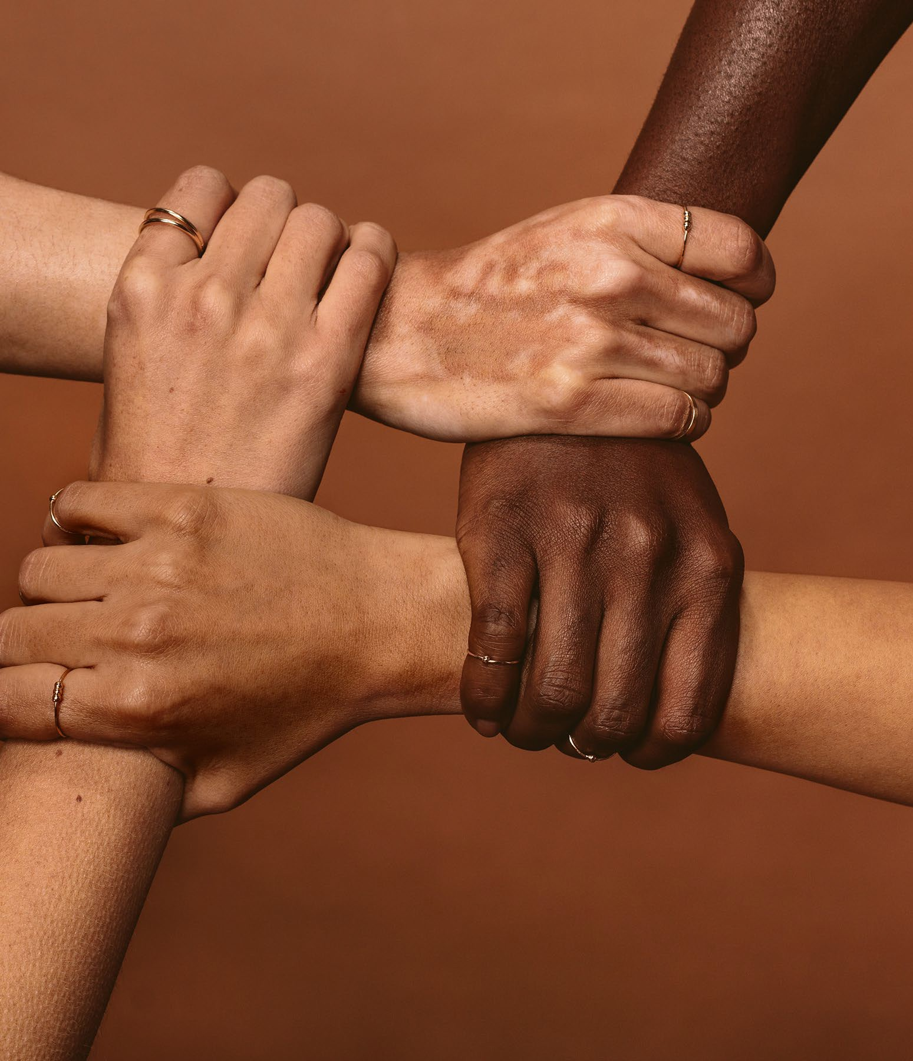
E Q U I T Y &
I N C L U S I O N
Solicit and use feedback from multiple cultural perspectives to make inclusive and equity-minded decisions.
Actively contribute to inclusive and equitable practices that influence individual and systemic change.
Advocate for inclusion, equitable practices, justice, and empowerment for historically marginalized communities.
Seek global cross-cultural interactions and experiences that enhance one’s understanding of people from different demographic groups and that leads to personal growth.
Keep an open mind to diverse ideas and new ways of thinking.
Identify resources and eliminate barriers resulting from individual and systemic racism, inequities, and biases.
Demonstrate flexibility by adapting to diverse environments.
Address systems of privilege that limit opportunities for
Demonstrate the awareness, attitude, knowledge, and skills required to equitably engage and include people from different local and global cultures. Engage in anti-oppressive practices that actively challenge the systems, structures, and policies of racism and inequity.
9

Slide 10
LEADERSHIP
Recognize and capitalize on personal and team strengths to achieve organizational goals.
Inspire, persuade, and motivate self and others under a shared vision.
Seek out and leverage diverse resources and feedback from others to inform direction.
Use innovative thinking to go beyond traditional methods.
Serve as a role model to others by approaching tasks with confidence and a positive attitude.
Motivate and inspire others by encouraging them and by building mutual trust.
Plan, initiate, manage, complete, and evaluate projects.
10

Slide 11
P R O F E S S I O N A L I S M
Act equitably with integrity and accountability to self, others, and the organization.
Maintain a positive personal brand in alignment with the organization and personal career values.
Be present and prepared.
OVERCOM IN G
Demonstrate dependability (e.g., report consistently for work or meetings).
Prioritize and complete tasks to accomplish organizational goals.
Consistently meet or exceed goals and expectations.
Knowing work environments differ greatly, understand and demonstrate effective work habits, and act in the interest of the larger community and workplace.
Have an attention to detail, resulting in few if any errors in their work.
Show a high level of dedication toward doing a good job.
11

Slide 12
Teamwork
Build and maintain collaborative relationships to work effectively toward common goals, while appreciating diverse viewpoints and shared responsibilities.
Listen carefully to others, taking time to understand and ask appropriate questions without interrupting.
Effectively manage conflict, interact with and respect diverse personalities, and meet ambiguity with resilience.
Be accountable for individual and team responsibilities and deliverables.
Employ personal strengths, knowledge, and talents to complement those of others.
Exercise the ability to compromise and be agile.
Collaborate with others to achieve common goals.
Build strong, positive working relationships with supervisor and team members/coworkers.
12

Slide 13
P R O F E S S I O N A L I S M
Act equitably with integrity and accountability to self, others, and the organization.
Maintain a positive personal brand in alignment with the organization and personal career values.
Be present and prepared.
OVERCOM IN G
Demonstrate dependability (e.g., report consistently for work or meetings).
Prioritize and complete tasks to accomplish organizational goals.
Consistently meet or exceed goals and expectations.
Knowing work environments differ greatly, understand and demonstrate effective work habits, and act in the interest of the larger community and workplace.
Have an attention to detail, resulting in few if any errors in their work.
Show a high level of dedication toward doing a good job.
13

Slide 14
BREAKOUT ROOM ACTIVITY
Career & Self Development
Critical Thinking (Problem Solving) Equity & Inclusion
Technology
Leadership
Communication Professionalism Teamwork
Directions:
In the breakout room…
Your team will identify relevant examples (at least 2) of each competency that you experienced as a part of completing the internship.
Be prepared to share during our discussion.
14

Slide 15
Career & Self Development
Proactively develop oneself and one’s career through continual personal and professional learning, awareness of one’s strengths and weaknesses, navigation of career opportunities, and networking to build relationships within and without one’s organization.
SELF-REFLECTION ACTIVITY
Directions: Under each category….
Critical Thinking (Problem Solving)
List 2 strengths you have with a real-life example you have displayed that substantiates each one.
Acknowledge at least one area that challenges you and list ideas/opportunities to improve your “brand.”
You may not use an example previously mentioned in the breakout room activity – this must be individual to you.
Equity & Inclusion
Technology
Leadership
Communication
Professionalism
Teamwork
15

Slide 16
FINAL TIPS & TAKEAWAYS
What can I do to prepare for a successful transition into the workplace?
Seek feedback
In the upcoming weeks, ask 3 adults you respect and admire to…
Reflect on performance
Describe you in 3 adjectives.
What was their first impression of you?
What do they see as your brand?
Explore new techniques
Set personal goals
Iterate and adapt
16

