Slide 1
Traffic Control Exercises B Session 2
Signs, Signals, Markings

Slide 2
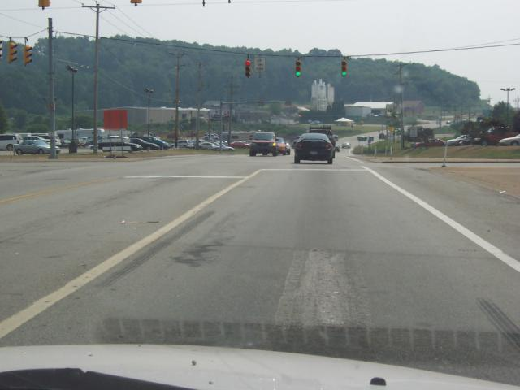
C-1
Notes:
Slides C-1 and C-2 are demonstration slides, and each one will be left on the screen for identification and discussion. Please remember that you are only searching for Traffic Controls. Look at the traffic scene as you would if you were the driver of the vehicle from which the pictures were taken. Remember to use the searching habits that were introduced in Session One, e.g., search from side to side in relation to your projected path of travel and work out as far as you can see.
Before putting C-1 on the screen, tell the students "You are searching for Traffic Controls."
After the slide is on the screen, select individual students to identify a traffic control, its meaning and/or required action, e.g.
You are on a two-way roadway.
The intersection is controlled by a traffic light. .
Sight distance should be as far as environment allows.

Slide 3
C-1 Questions
A B C
The traffic light ahead is red? T/F
The traffic light for the left turn lane only is green? T/F
There are white stop lines on the pavement ahead? T/F
Notes:
Once all of the controls are identified and discussed, ask the following questions
Drivers are permitted to make a right on red at this intersection? True
The traffic light ahead is green? False
There is a stop line ahead? True

Slide 4
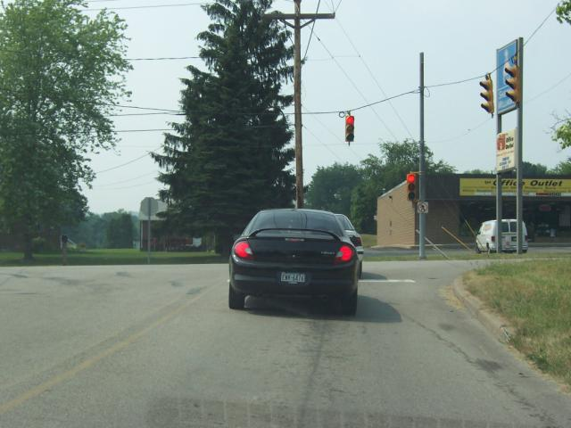
C-2
Notes:
Before putting C-2 on the screen, remind the students "You are searching for Traffic Controls."
After the slide is on the screen select individual students to identify a traffic control, it’s meaning and/or required action, e.g.
You are on a two lane two-way roadway.
The type of traffic control device is at this intersection.

Slide 5
C-2 Questions
A B C
You are permitted to make a right on red at this intersection? T/F
The traffic light ahead is green? T/F
There is a stop line ahead? T/F
Notes:
Once all of the above is identified and discussed, ask the following questions:
You are permitted to make a right on red at this intersection? True
The traffic light ahead is green? False
There is a STO line ahead? True

Slide 6
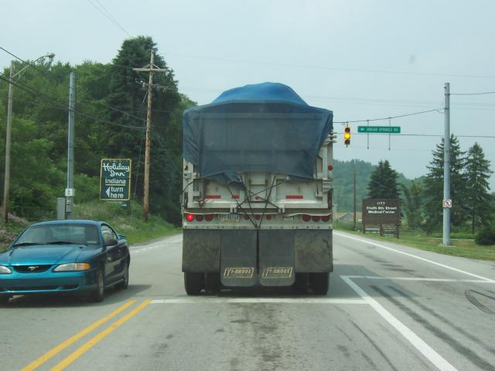
C-3
Notes:
You are now ready to do three practice test slides. Remember that before you put the slide on the screen, remind them that they are searching for traffic controls and if they need to identify a route number, remind them ahead of time. You will put the slide on the screen for a long five seconds, go to the blank slide and ask three questions. The students should respond with a True or False. Once the questions are asked, the practice test slide should be put back on the screen to score and discuss.

Slide 7
C-3 Questions
The traffic light is turning to red? T/F
Passing is permitted? T/F
There is a stop line ahead? T/F
Notes:
Search for Traffic Controls…Ready?
The traffic light is turning to red? True
Passing is permitted? False
There is a stop line ahead? True
Put C-3 back on the screen for scoring and discussion. If you have it wrong, put an "X" over the response.
True, it is yellow and will be turning to red.
False, this is a no passing zone and passing is not permitted at intersections.
True, there is a white stop line ahead.

Slide 8
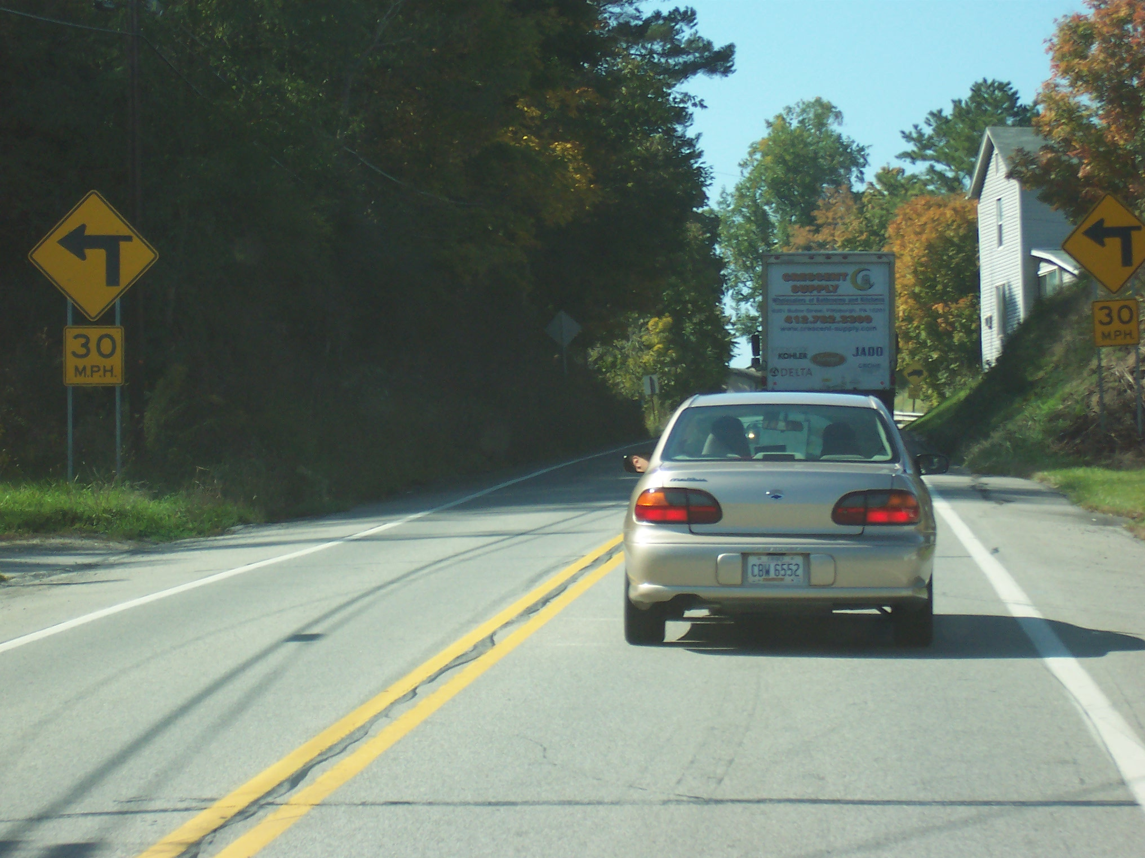
C-4
Notes:
C-4 Search for Traffic Controls... Ready?

Slide 9
Questions C-4
You’re approaching a sharp left turn? T/F
There is a traffic control signal ahead? T/F
Recommended speed is 30mph? T/F
Notes:
You are approaching a sharp left turn True
There is a traffic control signal ahead? False
Recommended speed is 30mph? True
Put C-4 back on the screen for scoring and discussion.
True, the warning sign gives you direction of curve and speed recommendation.
False, there is no traffic control device ahead.
True, the warning sign has a recommended speed limit.

Slide 10
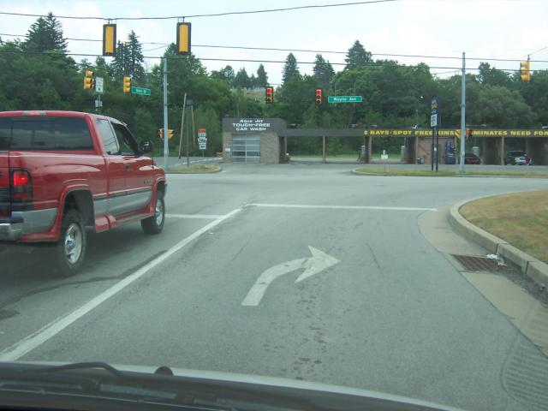
C-5
Notes:
Search for Traffic Controls... Ready?

Slide 11
Questions C-5
There is a stop line at the intersection? T/F
You can make a right turn on red? T/F
The traffic light is green? T/F
Notes:
There is a stop line at the intersections? True
You can make a right turn on red? True
The traffic light is green? False
Put C-5 back on the screen for scoring and discussion
True, there are two stop lines. This is called a staggered stop.
True, there are no regulatory signs posted for no turns on red.
False, the traffic light is red.

Slide 12
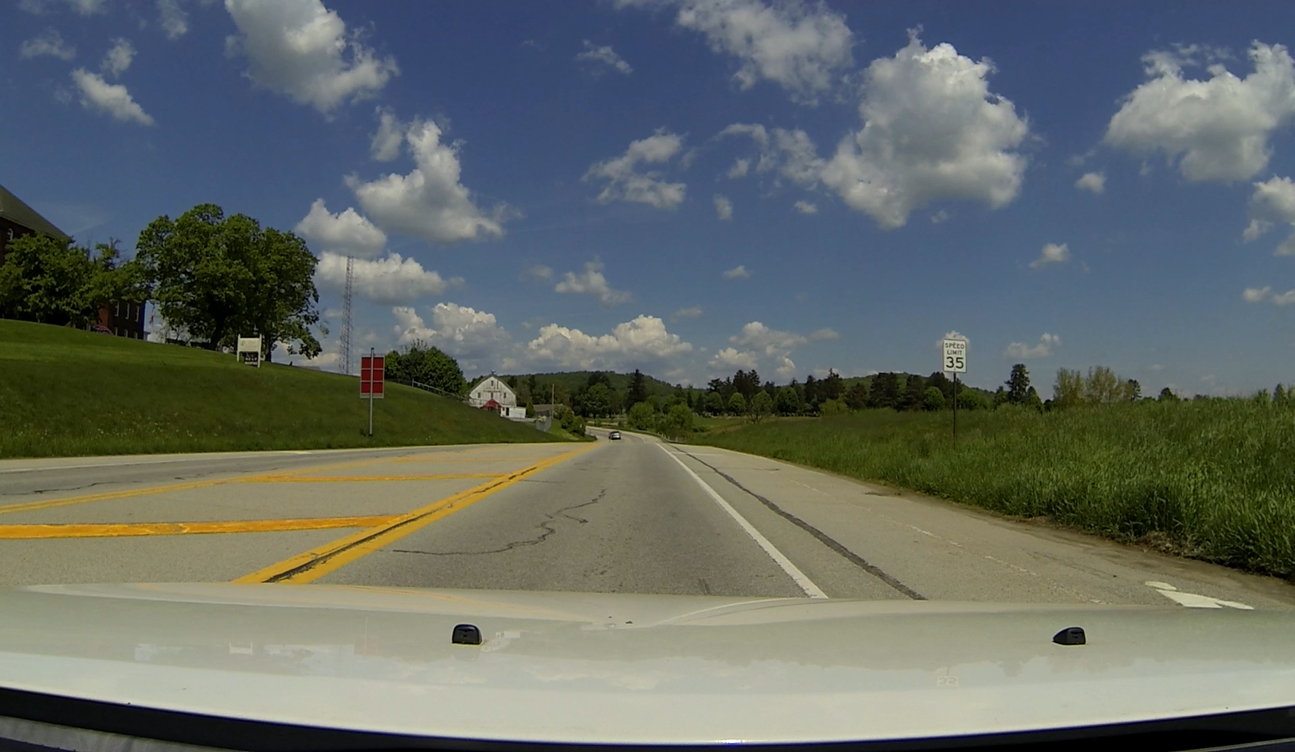
C-6
Video
CLICK FOR VIDEO C-6
Notes:
Video
C-6
Search for Traffic Controls…Ready?

Slide 13
Questions C-6
The road ahead is dividing? T/F
The speed limit is 35 mph T/F
You are in a passing zone? T/F
Notes:
The road ahead is dividing. False
The speed limit is 35 mph. True
You are in passing zone? False
Put C-6 back on the screen for scoring and discussion
False, you will continue in two lane , two-way traffic.
True, there is a regulatory sign ahead telling you the speed limit is 35 mph.
False, there are double yellow lines

Slide 14
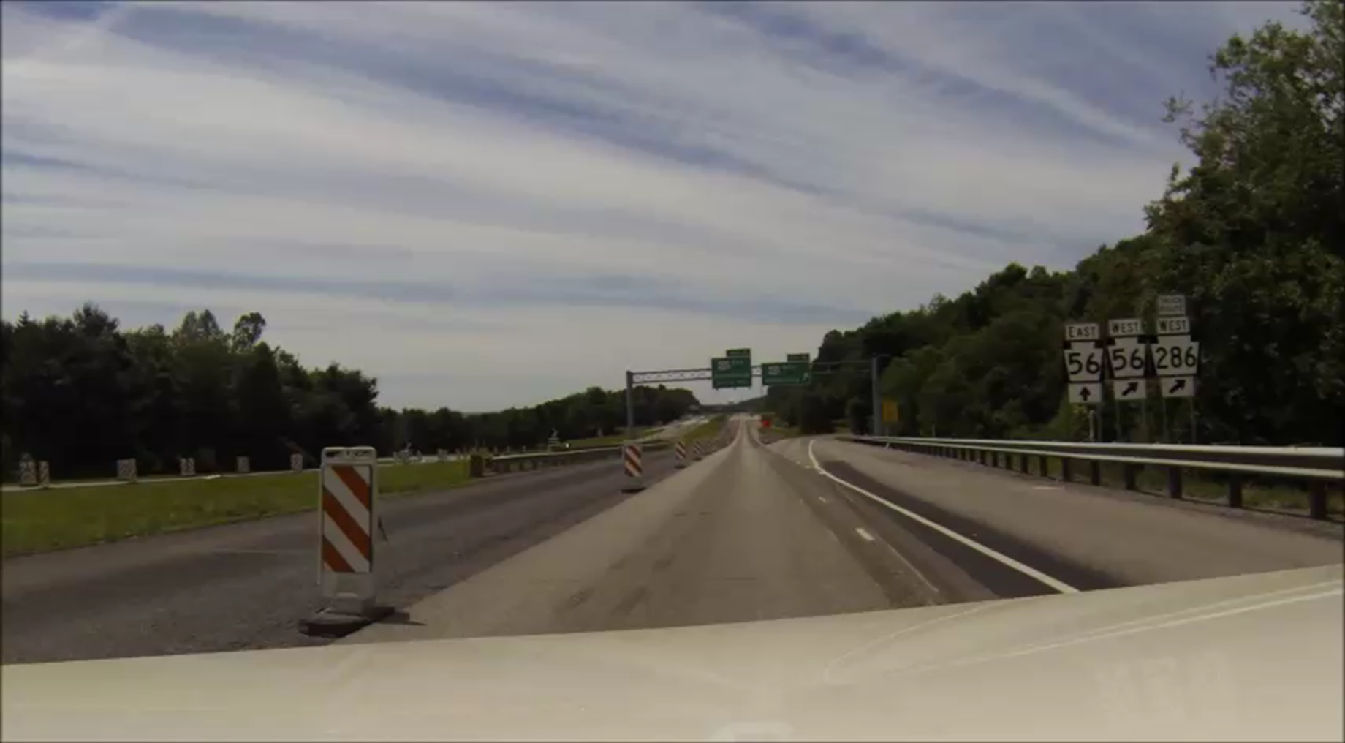
C-7
Video
CLICK FOR VIDEO C-7
Notes:
Video
Search for Traffic Controls…Ready?

Slide 15
Questions C-7
The exit speed is posted 40mph T/F
Passing is permitted T/F
The exit is Exit B Kittanning T/F
Notes:
You are taking exit is Exit B Kittanning?
The exit advisory speed is posted 40 mph?
Passing is permitted?
Put C- 7 back on the screen for scoring and discussion
True, the guide sign shows destination and exit.
False, the exit speed advisory is posted 30mph.
False, this is a construction zone, placards mark hazard to the left.

Slide 16
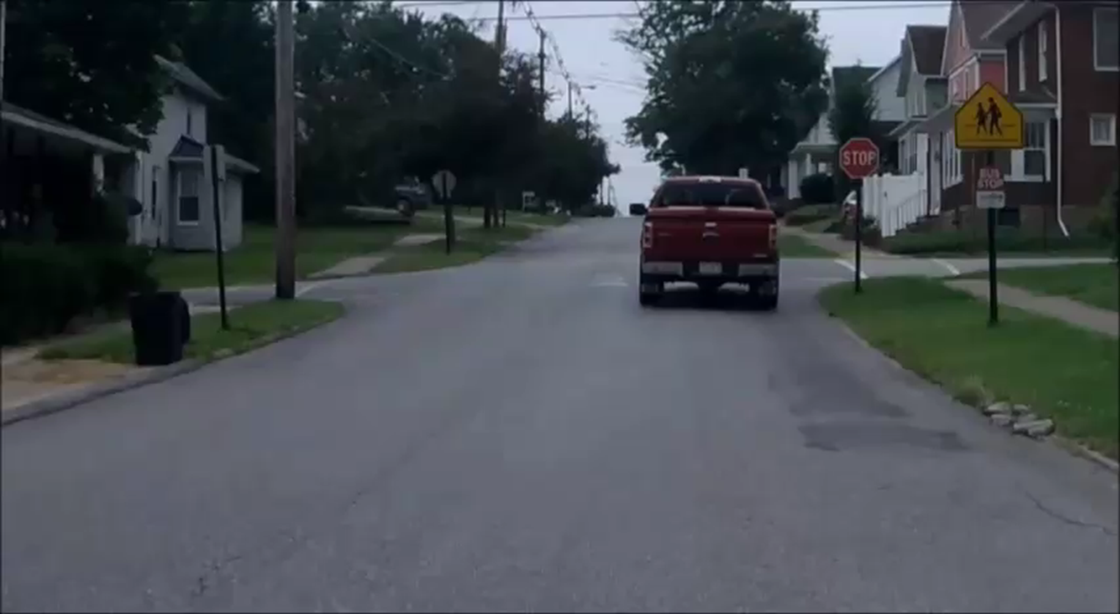
C-8
Video
CLICK FOR VIDEO C-8,9,10
Notes:
Video
C-8 Search for Traffic Controls...Ready?

Slide 17
Questions C-8
The first intersection was not a 4-way STOP T/F
The first warning sign was a school zone sign T/F
The posted speed was 20 mph T/F
Notes:
The first warning sign was a school zone sign?
The posted speed was 20 mph?
No intersection was a 4- way STOP.
Put C-8 back on the screen for scoring and discussion.
False, a school crossing sign. The cross walk lines on the sign designate it as a crossing area.
False, posted speed wa25 mph.
False, All were 4 –Way STOP. The first intersection was missing the advisory sign.

Slide 18
Questions C-9
The last intersection was a 4-way STOP T/F
There is a Bus Stop before the first intersection. T/F
There are no crosswalks at any intersections T/F
Notes:
There is a Bus Stop before the first intersection.
There are no crosswalks at any intersections.
The last intersection was a 4-way STOP
Put C-8 back on the screen for scoring and discussion.
True, under the school crossing sign.
False, there are crosswalk lines at several intersection.
True, All were 4 –Way STOP.

Slide 19
Questions C-10
There are no yellow painted curbs on this route. T/F
There is a Construction Zone Warning barrier past the second intersection. T/F
There is a double yellow center line on this route. T/F
Notes:
There is a Construction Zone Warning barrier past the second intersection.
There is a double yellow center line on this route.
There are no yellow painted curbs on this route.
.
Put C-8 back on the screen for scoring and discussion.
True, If you continue straight ahead, the is a warning barrier and flashing warning light.
False, There is no center line marking.
False, There is curb painting at several intersections and driveways.

Slide 20
End B-Session 2
Next: Session
C-Session 3 A
Identifying Highway Conditions

