Slide 1
Julia Grove
Amy Klemm
Alexi Lykissas
Summer Semester Workshop Series 2014

Slide 2
Graduate Student Grant Workshop
Overview of Presentation
Types of Grant Seekers
Review of Internal Funding Opportunities at IUP
Demonstration of two grant seeker databases
SPINplus
Graduate Research Center
Useful Websites
Foundation Center
Grant Maker Aggregators

Slide 3
Funding Awarded by Foundations in 2012
Student-Related Funding | Total Dollars | Number of Grants
Student Aid Funds | 774,786 | 5,901
Awards/prizes/competitions | 92,876 | 672
Scholarship funds | 371,839 | 3,205
Internship funds | 23,633 | 295
Student aid | 37,676 | 482
Fellowships | 248,761 | 1,247
Source: The Foundation Center, Foundation Giving Trends, 2011. Figures based on a sample of over 1,000 larger foundations. Dollar figures in thousands; grant may occasionally be for multiple types of support and would therefore be counted more than once.

Slide 4
Graduate Student Grant Workshop
What are the types of funding frequently seen in academia?
Institutional Grants
Funding awarded at the organizational level (college, department, program)
Faculty Grants
Funding awarded to faculty members
Student Grants
Grants, Fellowships, Scholarships
Undergraduate and Graduate funding

Slide 5
What’s Right in Your “Backyard”

Slide 6
Internal Graduate Research Funding
Graduate Student Research Grant
Maximum amount of funding per year is $1000
Applications for support must reflect excellent academic scholarship
Students must be enrolled at IUP during the term of the award
Two grant competitions are held annually
The first Monday in November
The first Monday in February
See Graduate Student Research Guidelines for more information

Slide 7
Internal Graduate Research Funding
Graduate Student Outstanding Research Award
SGSR recognizes graduate students who have completed what their academic departments believe to be outstanding research projects during the academic year.
Three to five $100 awards are made, on a competitive basis, to graduate students each Spring Semester.
See Outstanding Research Award Submission Instructions for more information.

Slide 8
Other Internal Graduate Funding
Graduate Student Travel Funds
Supports graduate students currently enrolled in a doctoral or master’s program who are presenting papers at professional meetings.
Doctoral and master’s students may apply for up to $750 in funding for the fiscal year.
See the Application and instructions for doctoral students or the Application and instructions for master’s students for more information.

Slide 9
Other Internal Graduate Funding
Graduate Student Professional Development Fund
Graduate students can apply for up to $300 to support their participation in scholarly and creative activities that add to professional development in a significant way.
Examples of eligible activities include:
Serving as a moderator, discussant, or session chair at a disciplinary conference.
Presenting research methodology for feedback at a roundtable discussion at a conference.
Simply attending a conference is not eligible for support.
See Graduate Student Professional Development Fund application and instructions for more information.

Slide 10
What’s Available “Out There in the Great Beyond”

Slide 11
External Research Funding Tools
Databases
SPIN Plus
Genius
Daily SMARTS E-mails
Grant Resource Center (GRC)
Publications

Slide 12
External Research Funding Tools
Websites
Foundation Center
Philanthropy News Digest
Online Grant Request Tutorials
Federal Student Aid
CareerOneStop
Scholarship & Grants
Research Funding / Fellowships
International Students
Grant Maker Aggregators

Slide 13
Important Grant Maker Information
Contact Information
Website
Assets
Number of grants given
Grant Recipients
Application Guidelines
Restrictions
Deadlines!

Slide 14
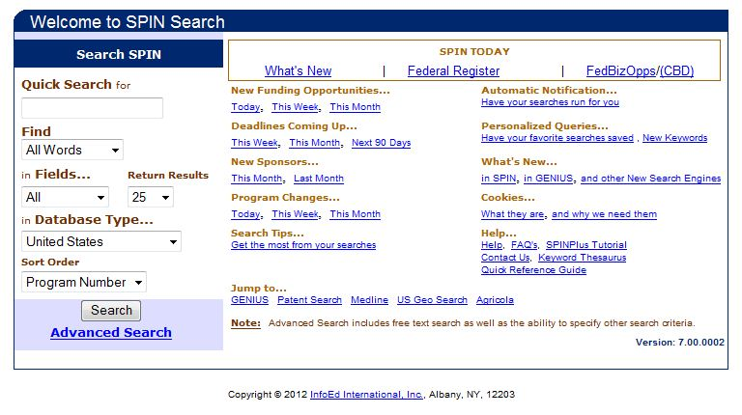
SPIN Plus – A Global Resource
Sponsored Programs Information Network (SPIN)
Contains funding program information from over 6000 government, non-profit, and private funding sources around the world
Let’s take a look

Slide 15
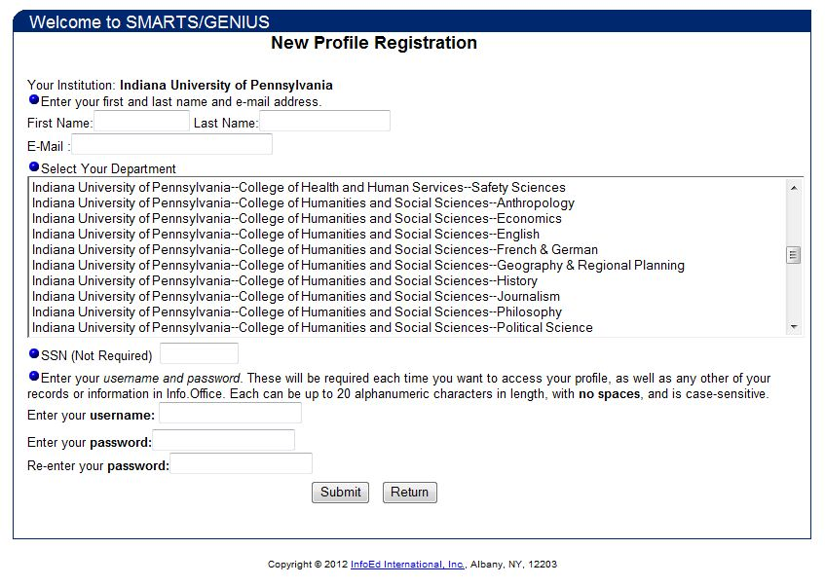
SPIN Plus – A Global Resource
Genius
Create a personal profile used to match you with grant opportunities based on your research interests

Slide 16
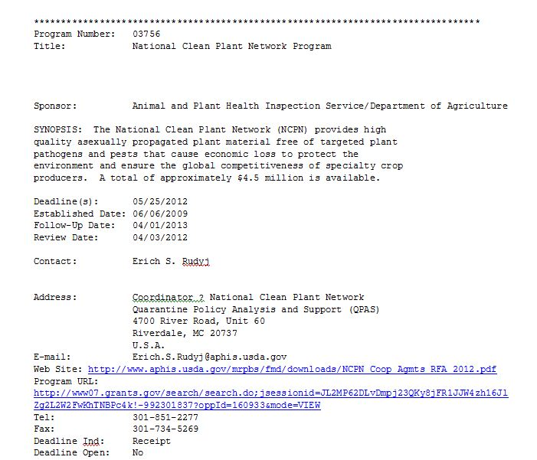
SPIN Plus – A Global Resource
SMARTS
Daily e-mail updates of new funding opportunities matching your profile in Genius

Slide 17
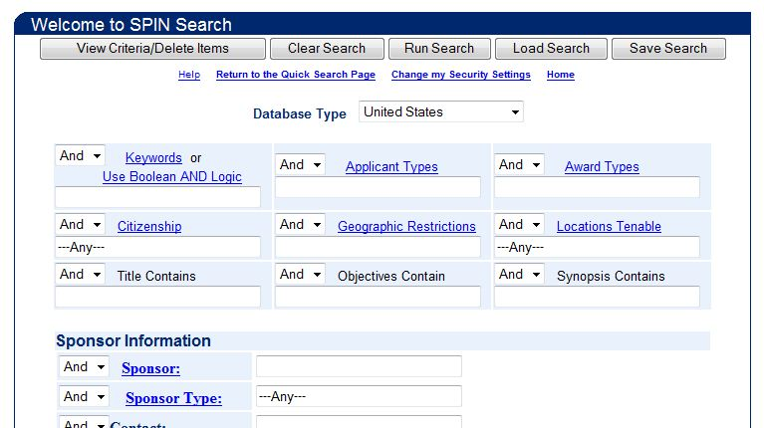
SPIN Plus – A Global Resource
Search by keywords and categories

Slide 18
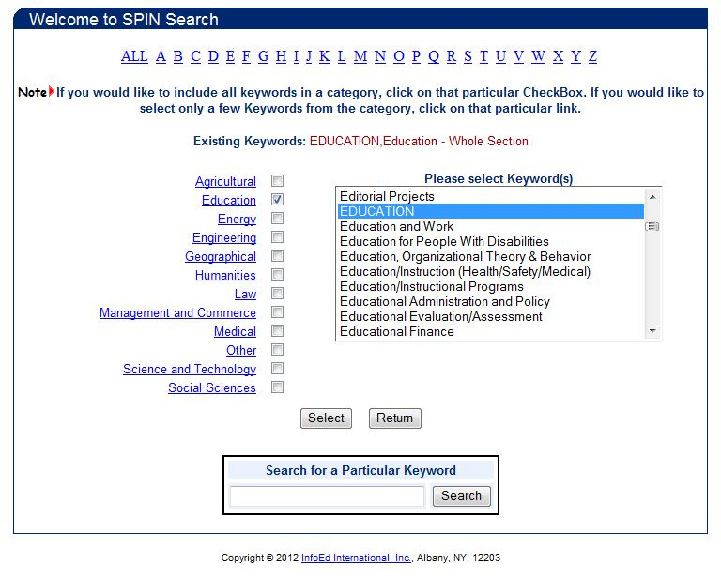
SPIN Plus – A Global Resource
Choose individual keywords from the dialog box or use the check box to select all the keywords in the category

Slide 19
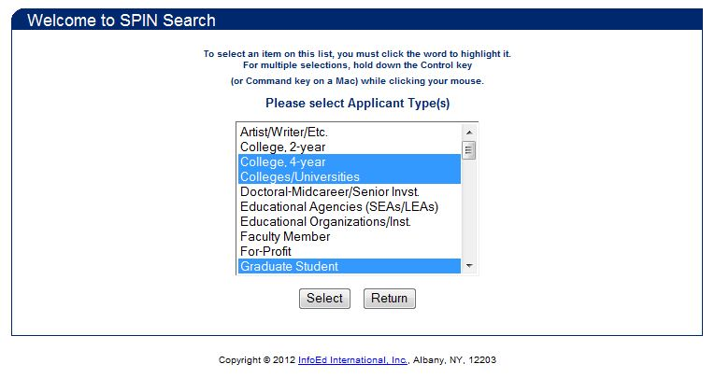
SPIN Plus – A Global Resource
Choose the applicant type, either individual or organizational

Slide 20
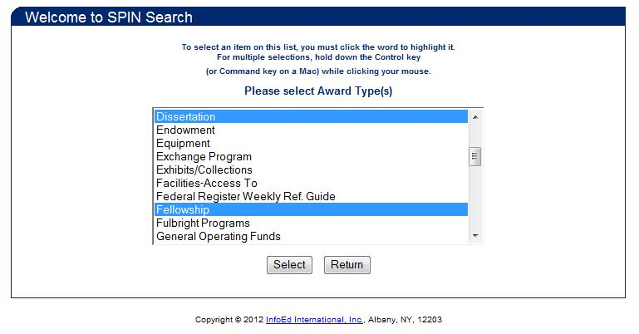
SPIN Plus – A Global Resource
Select the award type that matches your search interest

Slide 21
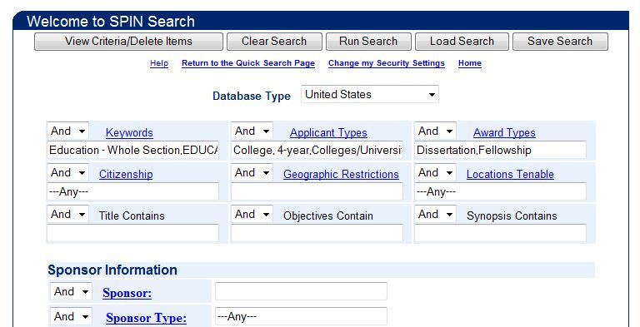
SPIN Plus – A Global Resource
After selecting the keywords, applicant types and award types, click Run Search
You can further narrow the search with the other dialog boxes

Slide 22
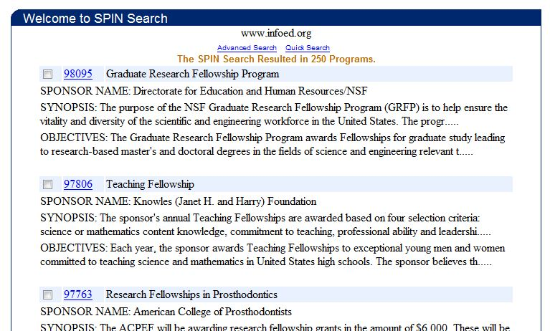
SPIN Plus – A Global Resource
The search results are returned

Slide 23
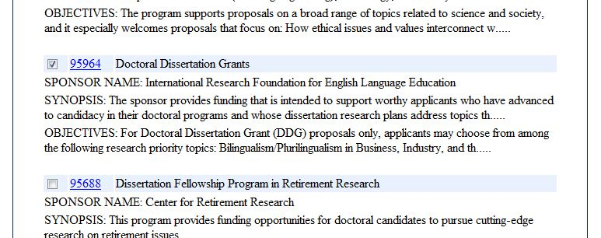
SPIN Plus – A Global Resource
Click on one to view detailed information on the grant

Slide 24
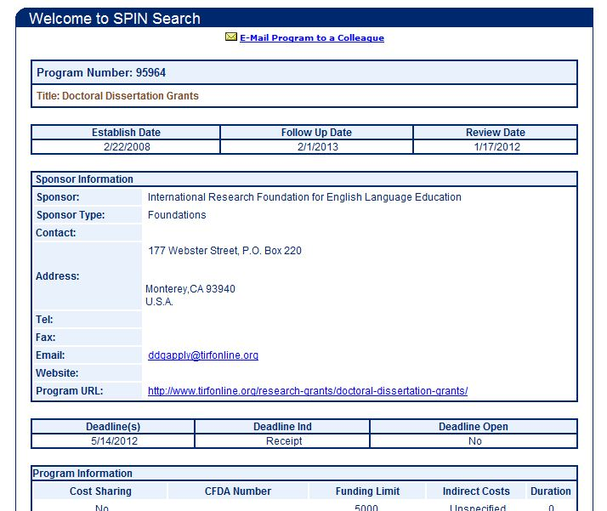
SPIN Plus – A Global Resource
Detailed grantor information is displayed including contact information, deadlines, and funding limits

Slide 25
GRC – A National Resource
A database of over 2000 national and region funding sources
Maintained by the American Association of State Colleges and Universities
Publishes three informational resources
GrantWeek (every Monday) is an electronic magazine containing in-depth articles on pending legislation, new grant programs, proposed changes to agency rules, and the federal budget.
Bulletin (twice weekly, Tuesdays and Fridays) synopsizes hundreds of funding alerts from Grants.gov, the Federal Register, and FedBizOpps.
Deadlines (once a month) announces programs with competitions closing in the next three months.
Let’s take a look

Slide 26
GRC – A National Resource
On the GRC homepage, click on the GrantSearch link to start a search

Slide 27
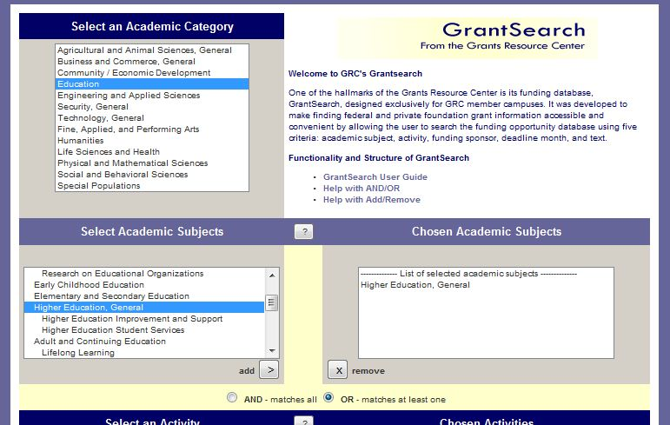
GRC – A National Resource
Use the dialog boxes to narrow the search criteria first by academic category, then academic subject

Slide 28
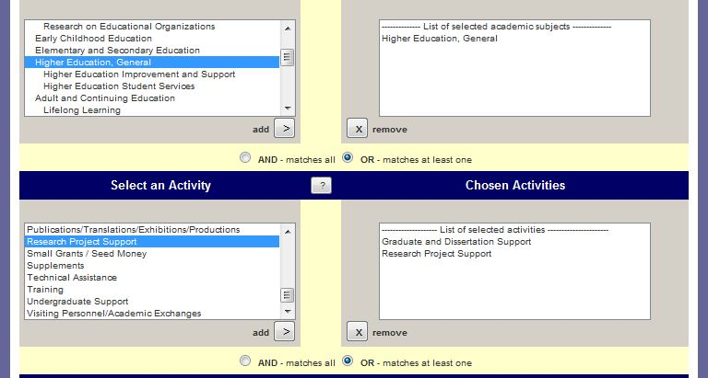
GRC – A National Resource
Then select the activities for which you are searching funding

Slide 29
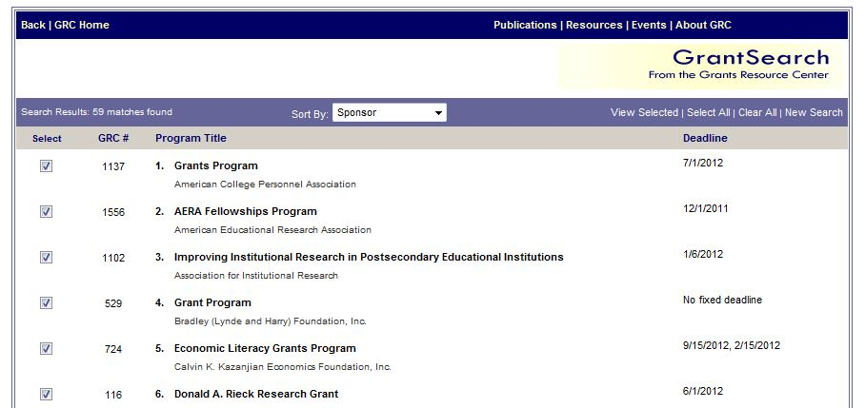
GRC – A National Resource
The results are displayed including basic information such as the grantor name and submission deadline.

Slide 30
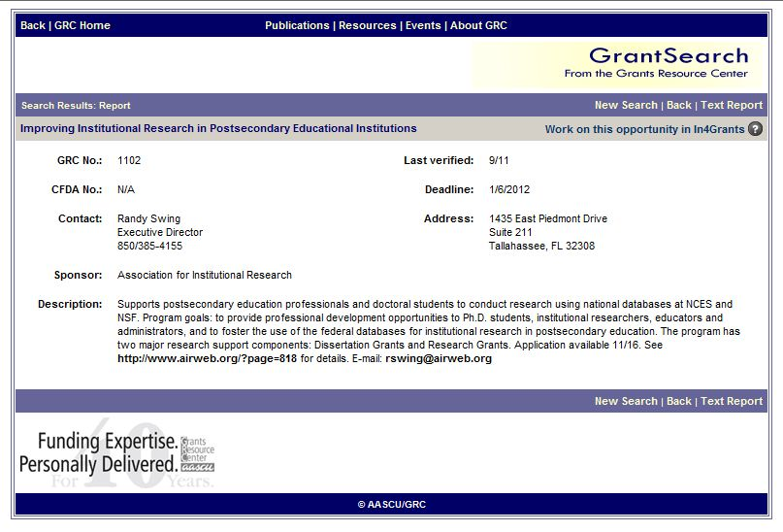
GRC – A National Resource
Detailed grantor information is displayed including contact information, deadlines, and funding limits

Slide 31
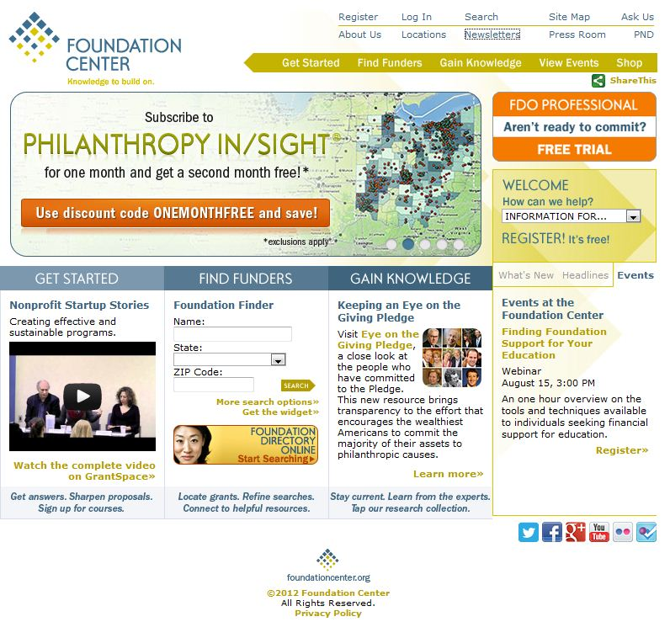
Foundation Center
Maintains database of information on the nearly 100,000 foundations, corporate donors, and grant making public charities in the U.S. and 2.1 million of their recent grants.
Provides a variety of free search tools, blogs, tutorials, downloadable reports
Subscription required for advanced searches
Let's take a look

Slide 32
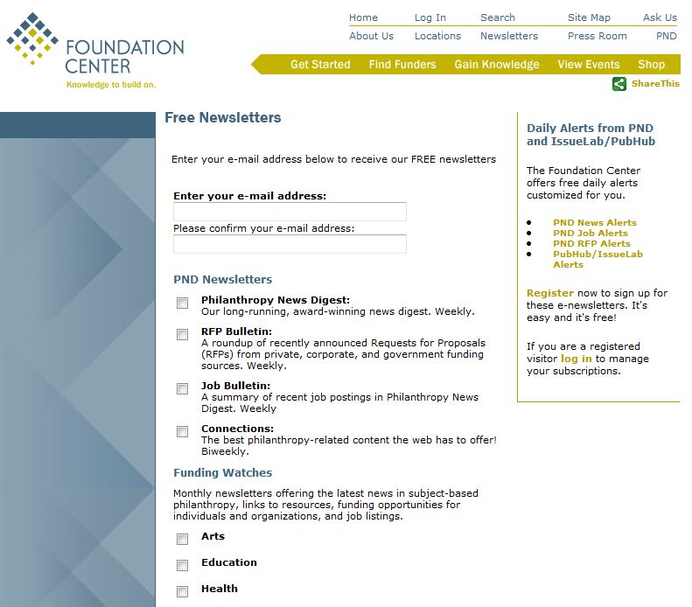
Foundation Center
Free Newsletters
Philanthropy News Digest (PND)
Request for Proposals Alerts (RFPs)
Arts Funding Watch
Education Funding Watch

Slide 33
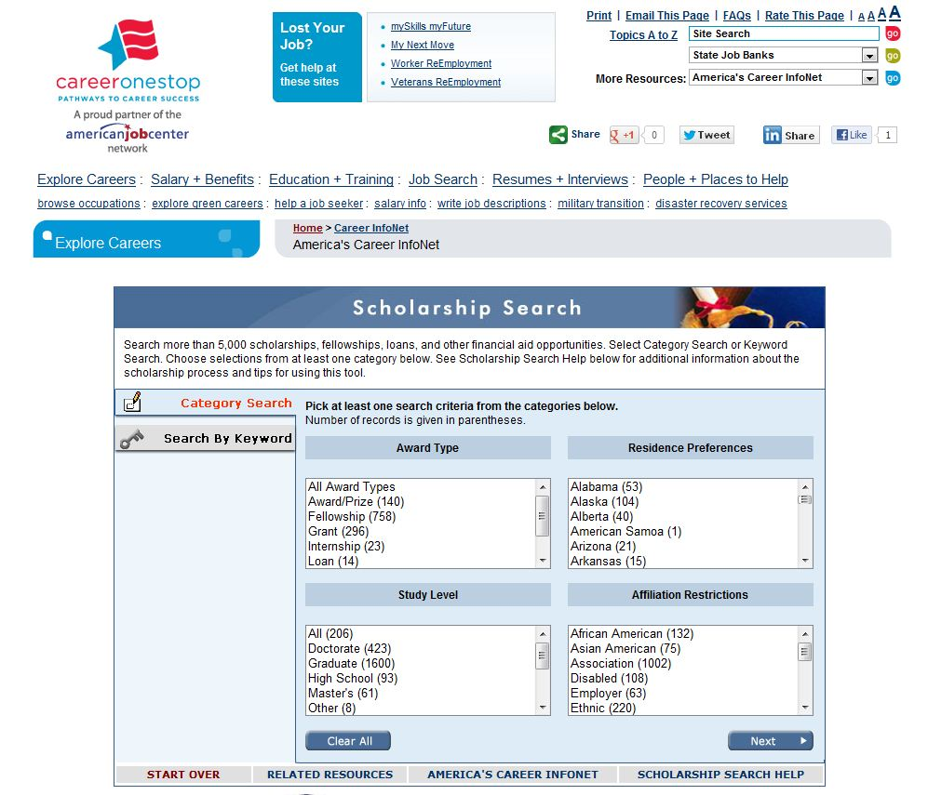
CareerOneStop
Sponsored by the U.S. Department of Labor
Highlights:
Scholarships & Grants
Research Funding / Fellowships
International Students
Let's take a look

Slide 34
Grant Maker Aggregators
Grant maker aggregators are organizations that match grant seekers with grant makers.
They offer a common grant application that is accepted by the grant makers participating in the service.
Primarily focus on institutions and organizations rather than individuals.
Two examples are:
Common Grant Application
Delaware Valley Grantmakers

Slide 35
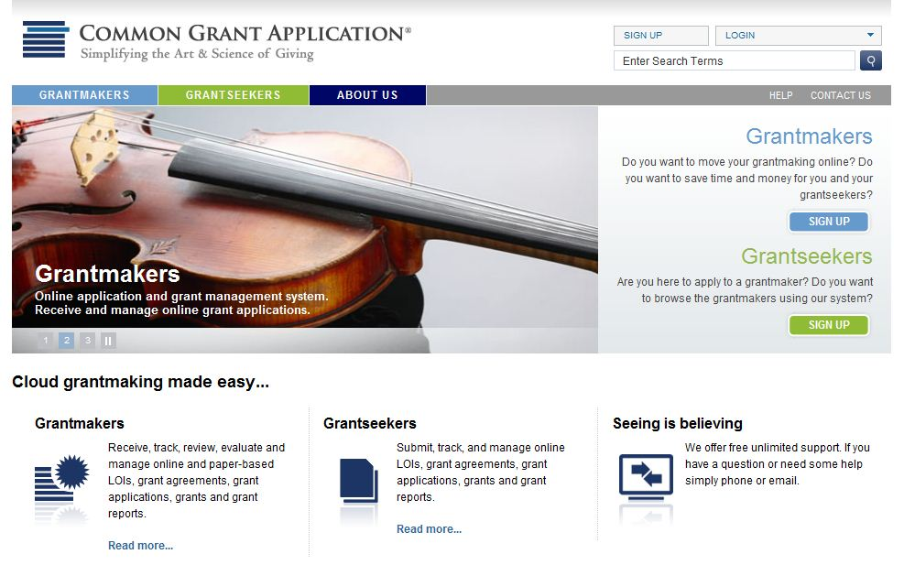
Common Grant Application
Based in California, services nationwide.
Charges a small fee for submissions.

Slide 36
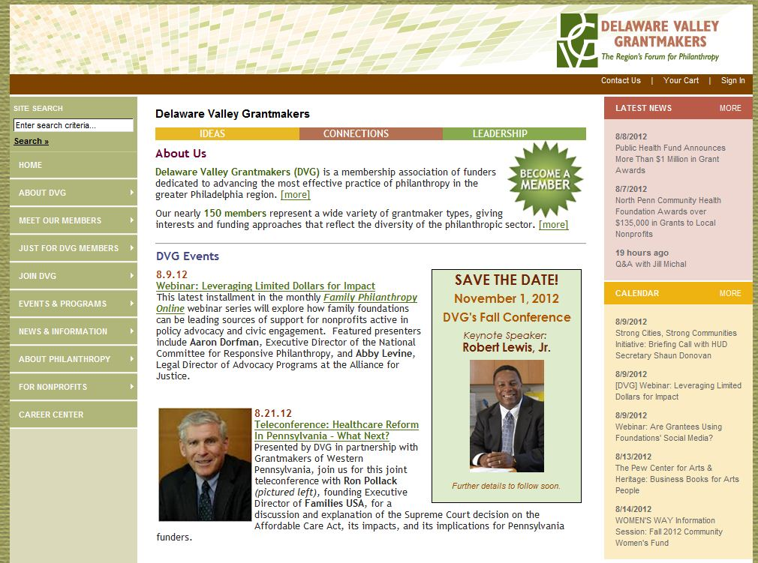
Delaware Valley Grantmakers
Based in Philadelphia, focuses on Eastern PA & NJ organizations.
Submit all applications to grant makers directly.
150 member organizations contributing more than $1 billion annually.

Slide 37
After Finding a Possible Grant Maker
Unsure if the grantor is a good match?
Not enough information?
Grantor’s philanthropic focus and interests?
Application process?
Deadlines?

Slide 38
After Finding a Possible Grant Maker
Contact via phone or e-mail
Try to avoid wasting your time (and the grant maker’s) with a letter of inquiry
Don’t expect to talk to the director or trustee
Take a few minutes to explain why you’re calling and the purpose of your call
Ask if you’re a good match for the grant maker’s program
Try to make a “connection” with the person

Slide 39
After Finding a Possible Grant Maker
Try to focus on grant makers that work with individuals (students).
If the grant maker doesn’t accept applications from individuals:
Contact the Assistant Dean for Research, Dr. Hilliary Creely.
She will work with you to determine the best way to proceed.
It may be possible to route it through your department or a campus institute.

Slide 40
Wrap-Up
Remember that grant seeking is a laborious and time-consuming process
Almost as much work as doing educational research!
Don’t be discouraged if your proposals are not funded
“You have to sow a lot of seeds…”

