Slide 1
Welcome Respiratory Hazards in Cannabis Production Webinar will begin at 10:30am Presented by: Danielle Dougherty Pennsylvania OSHA Consultation Office Phone: 724-357-4095 Website: www.iup.edu/pa-oshaconsultation
Notes:
Thank you for attending today’s webinar on the Respiratory Hazards in Cannabis Production, hosted by the Indiana University of Pennsylvania’s OSHA Consultation Program. My name is Danielle Dougherty. I am a graduate student in the IUP Safety Sciences program.

Slide 2
Respiratory Hazards in Cannabis Production
Webinar General Info PowerPoint Presentation Q&A Questions Chat is open to submit questions. We will be answering questions through this chat feature. If due to the technical nature of the question a more thorough response is required, we will post the answer on our website within seven days of the webinar.
www.iup.edu/pa-oshaconsultation
Notes:
This presentation is pre-recorded, but you will have an opportunity to provide ask questions and provide feedback in the live chat and at the conclusion.

Slide 3
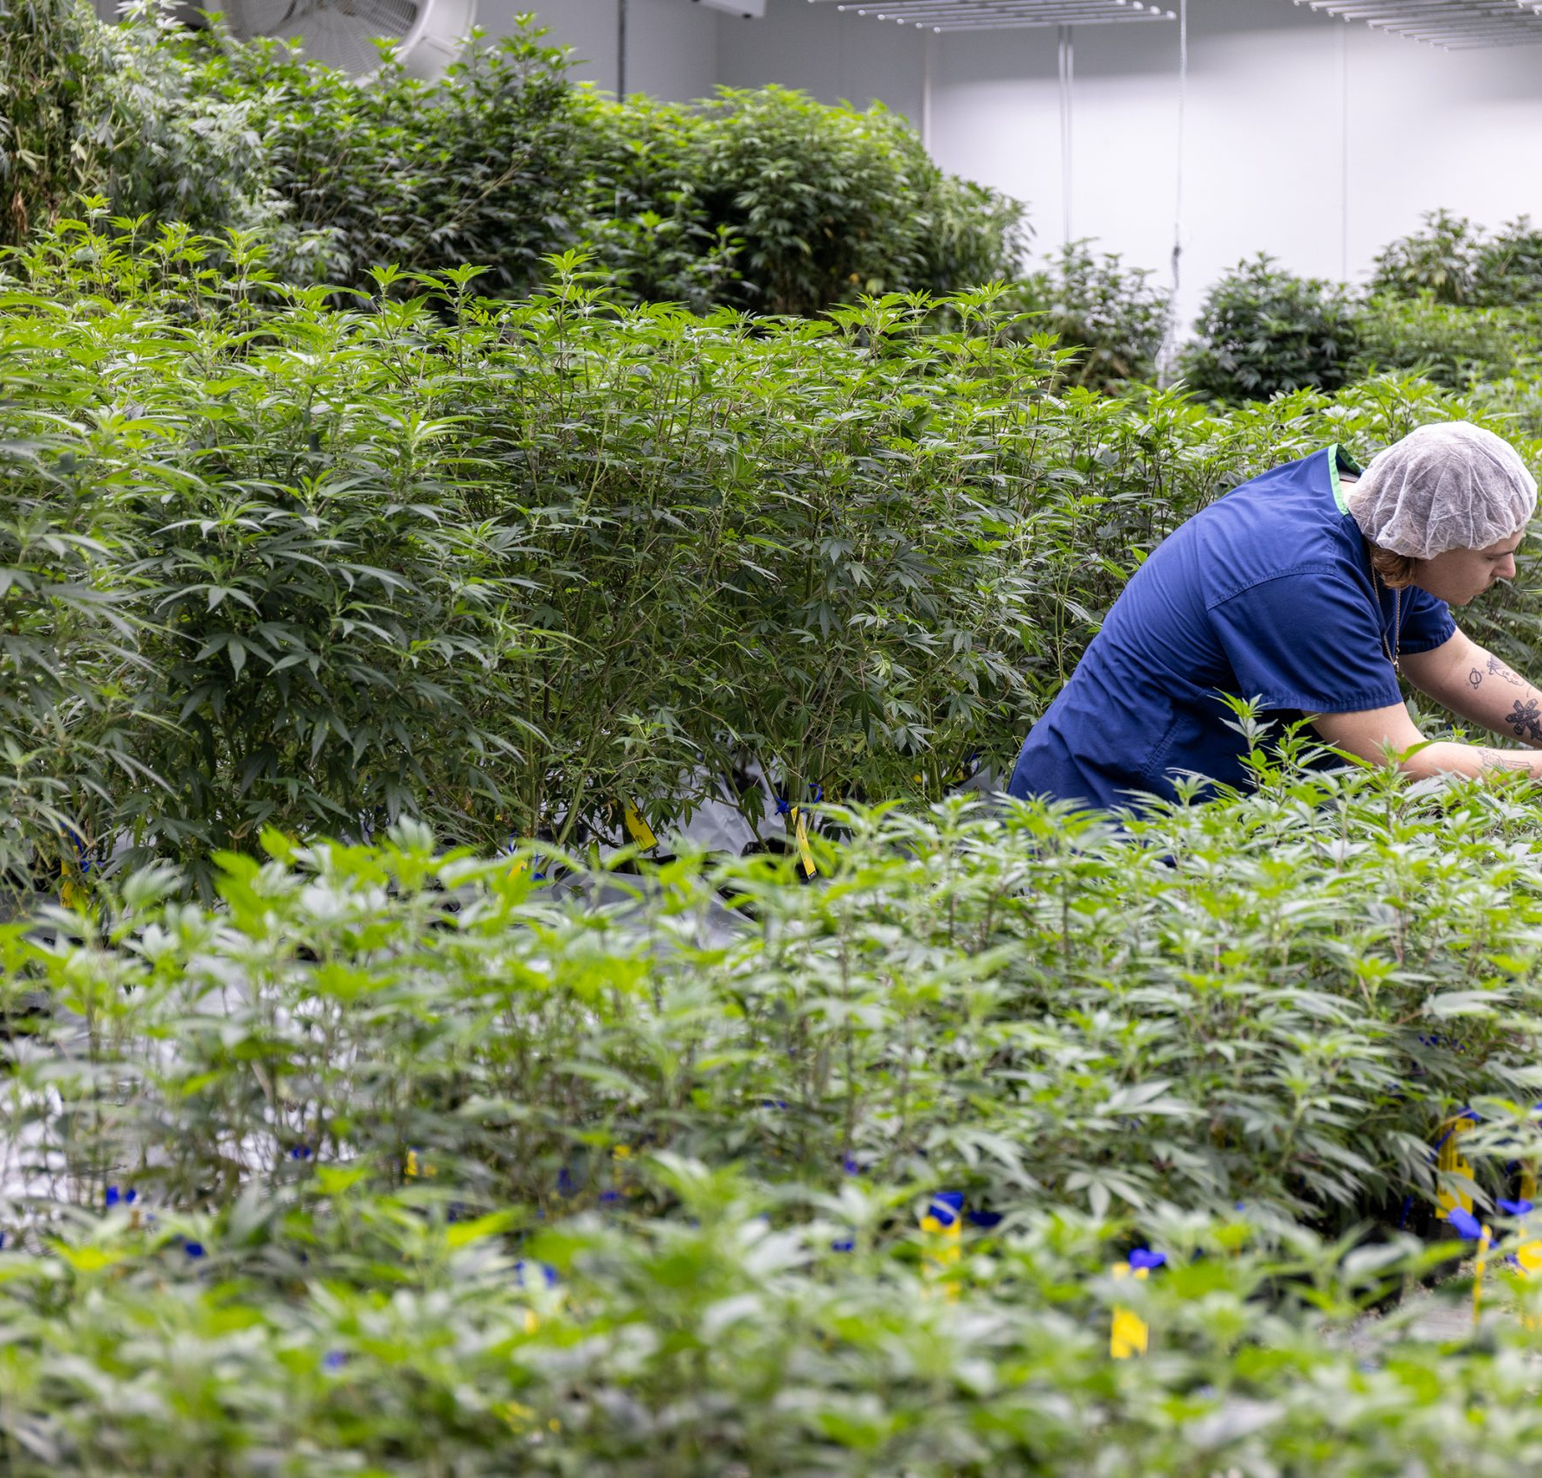
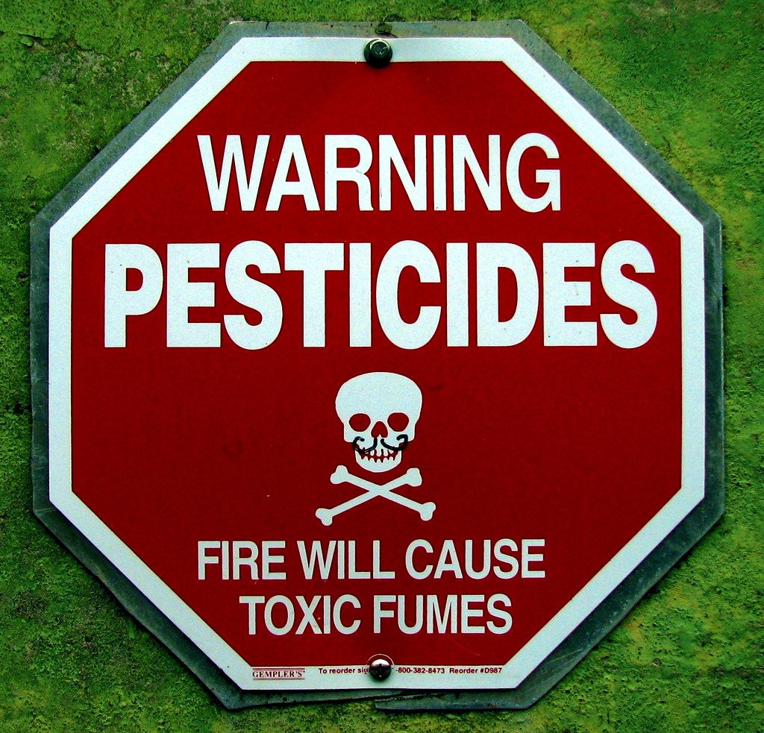
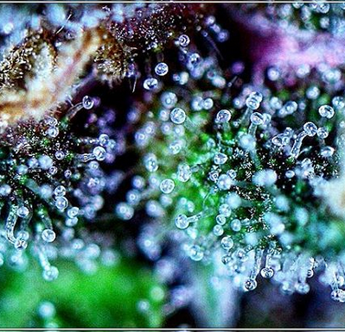
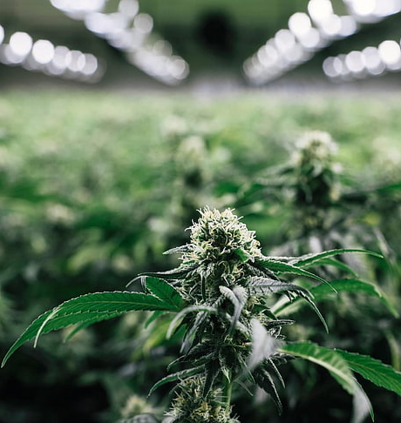
Goal
Reduce Risk of Health Outcomes due to Respiratory Exposures in Cannabis Production Facilities
www.iup.edu/pa-oshaconsultation
This Photo by Unknown Author is licensed under CC BY-SA
Notes:
Today, the goal is to provide knowledge that can help reduce the risk of health outcomes due to respiratory exposures in cannabis production facilities.

Slide 4
Objectives
Explain how safety commitment positively impacts businesses
Recognize cannabis respiratory hazards & their associated health outcomes
Use the Hierarchy of Controls to minimize hazard exposures
POSITIVE SAFETY CULTURE
www.iup.edu/pa-oshaconsultation
Notes:
We will do this by showing how safety commitment can impact a business,
Identifying common cannabis industry respiratory hazards and their health outcomes,
And applying the hierarchy of controls to minimize hazard exposure.

Slide 5
Why does Safety matter?
Human Impact
Business Impact
Financial Impact
Legal Impact
www.iup.edu/pa-oshaconsultation
Notes:
Safety impacts everyone in an organization. Everyone plays a role in an effective safety program, including the cannabis industry.
However, Safety advocates are often put in a position of justifying the cost or need for safety support.
Let’s look at an example that demonstrates how much it costs when safety falls short.

Slide 6
How can Safety impact a cannabis grow? Massachusetts 2022
27-year-old cannabis worker died after 8 months on the job
New asthma symptoms after 4 months on the job.
Worsening symptoms
Fatal allergic reaction at work after 8 months working at the cannabis grow CDC Nov. 2023.
Human Impact
www.iup.edu/pa-oshaconsultation
Notes:
January 2022 is the first documented case of a cannabis worker fatality directly linked to exposure at work.
A worker at a cannabis grow began experiencing new and worsening respiratory symptoms that included runny nose, cough, wheezing, and dypsnea.
Within 4 months of employment, she required medication to treat her breathing problems.
Shortly after that, the worker had such difficulty breathing, EMS responded at the grow.
Not long after, At just 8 months on the job, the worker suffered a fatal allergic reaction that resulted in a heart attack and brain death resulting from lack of oxygen.

Slide 7
How can Safety impact a cannabis grow? Massachusetts 2022
Closure of the Grow
Closure of the company’s 3 Massachusetts dispensaries in 2023
Business Impact
www.iup.edu/pa-oshaconsultation
Notes:
The grow was shut down and today
Just 2 years later, the company has also closed its 3 dispensaries
Resulting in this business’ complete exit from the market in that state

Slide 8
How can Safety impact a cannabis grow? Massachusetts 2022
$14,502 OSHA fines
$500,000 potential state fines
Financial Impact
www.iup.edu/pa-oshaconsultation
Notes:
The company was assessed over $14,000 in fines for safety violations from OSHA.
This number was originally $35,000.
It was reported that the Massachusetts Cannabis Control Commission fined the company over half a million dollars last year.

Slide 9
How can Safety impact a cannabis grow? Massachusetts 2022
Lawsuits against the company, EHS manager, & HVAC contractor
Resignation of MA Cannabis Control Commission Director in 2023
Legal Impact
www.iup.edu/pa-oshaconsultation
Notes:
By the end of 2023, the victim’s family filed lawsuits against the company, the EHS manager, and an HVAC contractor.
The Massachusetts Cannabis Control Commission Director also resigned last year.

Slide 10
Why does Safety matter?
Human Impact
Business Impact
Financial Impact
Legal Impact
www.iup.edu/pa-oshaconsultation
Notes:
It can be difficult for safety advocates to justify measures they are requesting to prevent the possibility of an outcome or reduce risk for something that hasn’t happened yet.
But this worker died.
The risk is not hypothetical.
This death touched on everyone involved in a cannabis operation.
It affected employees and their families, managers, contractors, and regulators.
This is a There is a reason for each one to be aware of and advocate for safety.

Slide 11
Low Safety Priority = Negative Impacts
Fatality
Illness
Injury
Lost time
Turnover
Low Morale
Workers Comp
Insurance Costs
Closures and Delays
Violations
Fines
Licensure impacts
Lawsuits
Human Impact
Business Impact
Financial Impact
Legal Impact
www.iup.edu/pa-oshaconsultation
Notes:
There is research out there demonstrating that low management support and lack of safety priorities not only result in poor health outcomes for the workers, but can also drastically impact morale and productivity, leading to less efficiency and higher turnover.
These types of organizations are more likely to have violations and fines for non-compliance.

Slide 12
Strong Safety Priority = Positive Impacts
Maintenance
Of
Physical Health
Mental Health
Trust
Communication
Employee Committment
Increased Productivity
Workforce knowledge & experience
Compliance in competitive market
Documentation backed by action = protection
Human Impact
Business Impact
Financial Impact
Legal Impact
www.iup.edu/pa-oshaconsultation
Notes:
On the flip side
Strong safety culture and supportive management keep employees healthy.
Healthy employees are likely to be happier, more committed, less stressed, which all lead to less turnover, better productivity, more communication and trust.
Many of the “best places to work” worker engagement surveys, which you can just google, measure these basic aspects of company culture relative to business success.
Also remember – strong safety is a protection for both employers and employees because it is documentation backed by action.

Slide 13
Safety is the law.
OSHA General Duty Clause:
Each employer shall furnish to each of his employees employment and a place of employment which are free from recognized hazards that are causing or are likely to cause death or serious physical harm to his employees…
Each employee shall comply with occupational safety and health standards and all rules, regulations, and orders issued pursuant to this Act which are applicable to his own actions and conduct.
www.iup.edu/pa-oshaconsultation
Notes:
Misconception that because cannabis is not federally regulated, it is exempt from federal regulation.
This isn’t true.
Federal safety regulations do apply to cannabis businesses.
OSHA’s general duty clause requires employers to furnish a place of employment free from recognized hazards
It also places responsibilities on employees to follow standards.

Slide 14
Safety is the law.
OSHA Respiratory Protection Requirements: 29 CFR Part 1910.134
EPA Agricultural Pesticide Application Requirements: 40 CFR Part 170 Worker Protection Standard
State specific regulations
www.iup.edu/pa-oshaconsultation
Notes:
In addition to the General Duty Clause, OSHA also has a specific Respiratory Protection Standard.
If you want specifics on that standard, please check out the IUP OSHA Webinar by Bryan Brougher that goes into detail on the Respiratory Protection Standard. We are just doing an overview here.
Another federal regulation is EPA’s Worker Protection Standard for agricultural pesticide application.
Individual states may have oversight and additional regulations.

Slide 15
What are Potential health outcomes from respiratory exposures in Cannabis Production Facilities?
Acute
Single episode or exposure
Mild or severe
Resolves after exposure removed
Chronic
Repeated exposure
Progressive
Often irreversible
Permanent damage / disease
www.iup.edu/pa-oshaconsultation
Notes:
What are the potential health effects of respiratory exposures?
Symptoms can range from acute to chronic.
Meaning a single exposure could result in an acute episode. Chronic symptoms can result from continued exposure over time.
Mild symptoms may self-resolve. Severe illness can result in permanent respiratory damage, or disease, including cancer and progressive disease like COPD, Chronic Obstructive Pulmonary Disease.

Slide 16
Allergies
1 in 3 American adults reported some kind of allergy – National Center for Health Statistics 2021
Repeated exposure can increase allergic reaction severity
Anaphylactic shock
www.iup.edu/pa-oshaconsultation
Notes:
Allergies are a primary exposure concern.
Allergies in general are an area where there is still a lot to learn about why and how some people develop allergic reactions and others do not.
CDC data showed 1 in 3 American adults have some kind of allergy, and the numbers are growing.
The reasons for this are not known.
While there may be unknown factors influencing people’s sensitivities, it is well known that repeated exposures to any allergen can increase chances of a reaction and severity of reactions.
This is called sensitization. Bakers lung and Popcorn lung are examples of conditions that workers in other industries developed as a result of repeated exposures.

Slide 17
Allergies & Long Term Exposure
Sensitization – Immune system produces antibodies in response to exposure to a substance.
Immune system response causes allergic reactions.
Bakers Lung – repeated exposure to flour
Popcorn Lung – exposure to diacetyl in microwave popcorn. *Some vapes contain diacetyl.
www.iup.edu/pa-oshaconsultation
Notes:
This is called sensitization. Bakers lung and Popcorn lung are examples of conditions that workers in other industries developed as a result of repeated exposures to particles or gases.

Slide 18
Allergies
Allergy symptoms may be prevalent in cannabis workers
Berkeley Center for Occupational & Environmental Health 2020
Annals of Work Exposures and Health, August 2020
Health Hazard Evaluation Program, CDC & NIOSH, Feb. 2022
Journal of Allergy & Clinical Immunology, Nov. 2021
History of Hemp Cultivation in U.S. and Worldwide
www.iup.edu/pa-oshaconsultation
Notes:
Specific to the cannabis plant, there is research and historical evidence showing that workers who harvest and process cannabis can be more at risk for developing certain respiratory illnesses.
At the turn of century, when hemp was a primary source of textile fiber, workers who harvested and worked in the processing areas developed various respiratory diseases, including something called byssinosis.
Back then, a process called carding involved breaking down the hemp plants to reduce it to the usable fibers.
This caused a lot of airborne dust, plant material particles, pieces of soil, bacteria and molds that were on the plant at harvest or that grew after harvest.
A quick google search will turn up a lot of historical literature on byssinosis and hemp.
These are all similar to potential exposures for workers that are harvesting and processing cannabis indoors today.
More recently, current research shows cannabis workers in the modern industry are at risk.
What kind of health outcomes are we talking about

Slide 19
Byssinosis
Caused by exposure to raw textile fibers sourced from plants (hemp, cotton, flax, jute)
Bacteria on plant material dies, endotoxin released
Mild effects – “Monday Fever”
Flulike symptoms
Wheezing, coughing, tightness of chest,
After initial exposure, symptoms may improve
Chronic effects – cotton lung, brown lung, fibrosis
www.iup.edu/pa-oshaconsultation

Slide 20
Chronic Obstructive Pulmonary Disease
Textile Workers – Cotton Workers & OSHA Standard
Inflammatory lung disease caused by repeated exposure to irritating gas or particulates
Restricts airflow from the lungs
Chronic cough, sputum, shortness of breath, wheezing
Irreversible
www.iup.edu/pa-oshaconsultation

Slide 21
Health Effects – Respiratory Tract
Dypsnea / Shortness of Breath
Asthma
Rhinitis
Pneumonitis / Pneumoconiosis
Coughing
Wheezing
COPD
Emphysema
www.iup.edu/pa-oshaconsultation
Notes:
Respiratory exposures most commonly affect the respiratory tract, which is the nose, throat, and lungs.
Symptoms can be as simple as what typically comes to mind with mild allergies like:
Runny nose, coughing, wheezing, shortness of breath
which has the medical diagnosis of Dypsnea.
Beyond the eyes, nose, throat, and lungs – symptoms can affect the eyes and skin.
Irritated, red, itchy or watery eyes and swelling of skin around the eyes and mucous membranes is called angioedema
Urticaria is hives and swelling of the skin..
It is important for employees and employers to recognize diagnosis
And how they may be related to or indicate work exposures
Some of the less common medical terms include
Byssinosis which we talked about with hemp workers causes.
It causes asthma like symptoms that go away with continued exposure..meaning workers would feel the worst on the first day back, which also gave it the nickname “Monday Fever”.
The specific cause is unknown, but it is suspected to be endotoxin related.
We will talk more about endotoxins in a bit.
Farmers Lung is similar to byssinosis, but has been linked to moldy hay, straw, and woodchips that farmers may be exposed to.
Because mold is a potential exposure for cannabis workers, it is included here.
Symptoms of Farmers Lung includes respiratory symptoms,
but can also include fever and flu-like symptoms.
Aspergillosis is specifically caused by inhalation of aspergillus mold spores. Many cannabis workers and users may already recognize the term aspergillus because it commonly has specific product testing requirements, due to its potential to cause illness especially in immunocompromised people.
While aspergillus is a naturally common fungus in the environment, and most people are exposed without issue, it can result in invasive infections that spread through the body.
Its important to remember that allergic and respiratory reactions are not the only outcome to respiratory exposure.
Breathing in chemicals, pesticides, and low oxygen environments can result in asphyxiation, cancer, seizures, and cardiac or respiratory arrest.

Slide 22
Health Effects – Eyes & Skin
Conjunctivitis
Urticaria (Hives)
Angioedema (swelling)
www.iup.edu/pa-oshaconsultation
Notes:
Beyond the eyes, nose, throat, and lungs – symptoms can affect the eyes and skin.
Irritated, red, itchy or watery eyes and swelling of skin around the eyes and mucous membranes is called angioedema
Urticaria is hives and swelling of the skin..
It is important for employees and employers to recognize diagnosis
And how they may be related to or indicate work exposures
Some of the less common medical terms include
Byssinosis which we talked about with hemp workers causes.
It causes asthma like symptoms that go away with continued exposure..meaning workers would feel the worst on the first day back, which also gave it the nickname “Monday Fever”.
The specific cause is unknown, but it is suspected to be endotoxin related.
We will talk more about endotoxins in a bit.
Farmers Lung is similar to byssinosis, but has been linked to moldy hay, straw, and woodchips that farmers may be exposed to.
Because mold is a potential exposure for cannabis workers, it is included here.
Symptoms of Farmers Lung includes respiratory symptoms,
but can also include fever and flu-like symptoms.
Aspergillosis is specifically caused by inhalation of aspergillus mold spores. Many cannabis workers and users may already recognize the term aspergillus because it commonly has specific product testing requirements, due to its potential to cause illness especially in immunocompromised people.
While aspergillus is a naturally common fungus in the environment, and most people are exposed without issue, it can result in invasive infections that spread through the body.
Its important to remember that allergic and respiratory reactions are not the only outcome to respiratory exposure.
Breathing in chemicals, pesticides, and low oxygen environments can result in asphyxiation, cancer, seizures, and cardiac or respiratory arrest.

Slide 23
Health Effects – Systemic
Byssinosis
COPD Farmer’s Lung
Organic Toxic Dust Syndrome
Asphyxiation
Headaches, Dizziness, Nausea
Unexpected Weight Loss, Fatigue
Aspergillosis
Cancer
www.iup.edu/pa-oshaconsultation
Notes:
What are the potential health effects of respiratory exposures?
Symptoms can range from acute to chronic.
Meaning a single exposure could result in an acute episode. Chronic symptoms can result from continued exposure over time.
Mild symptoms may self-resolve. Severe illness can result in permanent respiratory damage, or disease, including cancer and progressive disease like COPD, Chronic Obstructive Pulmonary Disease.
Respiratory exposures most commonly affect the respiratory tract, which is the nose, throat, and lungs.
Symptoms can be as simple as what typically comes to mind with mild allergies like:
Runny nose, coughing, wheezing, shortness of breath
which has the medical diagnosis of Dypsnea.
Beyond the eyes, nose, throat, and lungs – symptoms can affect the eyes and skin.
Irritated, red, itchy or watery eyes and swelling of skin around the eyes and mucous membranes is called angioedema
Urticaria is hives and swelling of the skin..
It is important for employees and employers to recognize diagnosis
And how they may be related to or indicate work exposures
Some of the less common medical terms include
Byssinosis which we talked about with hemp workers causes.
It causes asthma like symptoms that go away with continued exposure..meaning workers would feel the worst on the first day back, which also gave it the nickname “Monday Fever”.
The specific cause is unknown, but it is suspected to be endotoxin related.
We will talk more about endotoxins in a bit.
Farmers Lung is similar to byssinosis, but has been linked to moldy hay, straw, and woodchips that farmers may be exposed to.
Because mold is a potential exposure for cannabis workers, it is included here.
Symptoms of Farmers Lung includes respiratory symptoms,
but can also include fever and flu-like symptoms.
Aspergillosis is specifically caused by inhalation of aspergillus mold spores. Many cannabis workers and users may already recognize the term aspergillus because it commonly has specific product testing requirements, due to its potential to cause illness especially in immunocompromised people.
While aspergillus is a naturally common fungus in the environment, and most people are exposed without issue, it can result in invasive infections that spread through the body.
Its important to remember that allergic and respiratory reactions are not the only outcome to respiratory exposure.
Breathing in chemicals, pesticides, and low oxygen environments can result in asphyxiation, cancer, seizures, and cardiac or respiratory arrest.

Slide 24
What next?
Conduct a Hazard Analysis
www.iup.edu/pa-oshaconsultation
Notes:
The next step is to conduct a Hazard Analysis
This link goes to an OSHA publication to help guide employers through doing a job hazard analysis that will go into the fine details of this process.

Slide 25
Hazard Analysis : What are the Respiratory Hazards in Cannabis Production
Biological
Chemical
Physical
www.iup.edu/pa-oshaconsultation
Notes:
This is an overview of common hazards that may be present, but it is not all inclusive and it is up to each site to do a specific hazard analysis based on your specific operation
Each cannabis grow operation is unique.
Different climates, growing styles, substrates, strains, and levels of automation will affect environmental conditions in the facility.
In general, all facilities have 3 types of respiratory hazards : Biological, Chemical, Physical.

Slide 26
Biological Respiratory Hazards
Fungus
Mold, Mildew, Yeast
Bacteria
Gram negative Bacteria
Plant Matter
Mycotoxins
Spores
Aspergillus
Aflatoxin
Endotoxins
Aerobic Bacteria
Examples
Black Mold - Stachybotrys chartarum
E.Coli, legionella,
Anecdotal evidence that certain Strains may cause more reactions
Some people may have sensitivity to certain strains and not others
**Not covering communicable disease/COVID here
Allergens – Proteins, Terpenes, other natural substances
www.iup.edu/pa-oshaconsultation
Notes:
Many of these biologicals are also included in state regulatory sampling requirements for legal cannabis sales.
The reason for this is due to potential to cause illness when consumed.
As these may be present on finished product, they may be present throughout the grow cycle.
There are levels that are naturally occurring and unavoidable.
Conditions of a grow can lead to concentrations or exposure that exceed these levels.
Fungus and molds also produce spores and chemical mycotoxins.
Molds also produce spores, which are essentially ‘seeds’, which can become activated and begin growing in right conditions.
Aspergillus and its spores can be Problematic for immunocompromised people.
Is also produces Aflatoxin that can cause liver damage in high amounts.
Bacteria can cause illness, and like mold, some produce endotoxins.
Bacteria are responsible for many different sicknesses, ingested or inhaled.
Communicable diseases like COVID will not be covered here, it is best to refer to current guidance as it is subject to change.
Plants are included here due to the amount of anecdotal evidence that certain strains may have more tendency to cause allergic reactions than others.
Terpenes are volatile organic chemicals produced by plants, and are responsible for the characteristic smells from cannabis, to pine trees and lemon. More research is needed, but it may be some of the terpenes
Or combinations of the terpenes that contribute to increased sensitivity for some people.

Slide 27
Hazard Analysis : Endotoxin & Mycotoxin
LIVING CELL
Endotoxin
-part of living cell wall or membrane – released when bacteria dies
Exotoxin / Mycotoxin – produced by living cell
www.iup.edu/pa-oshaconsultation
Notes:
RERECORD

Slide 28
Chemical Respiratory Hazards
Pesticides
Legal
Solvents
Products for Cleaning, Disinfection, Plant Growth
Hydrocarbons
CO2
Illegal
Application
Residual pesticide
Butane, propane, hexane
Ethanol
Cleaners
Isopropyl Alcohol
Bleach / Acid NEVER MIX =
Nutrients
chloroform & chlorine gas
VOC
Ozone
www.iup.edu/pa-oshaconsultation
Notes:
Pesticides can be applied to soil, to plant, and in the air.
Pesticides can expose the applicator and anyone entering the space or contacting the treated material.
Solvents used in Cannabis Processing break down the plant material to release the various plant compounds that are being used, or removed.
CO2 can be pumped into grow rooms using portable tanks or permanent systems.
Iso is used heavily for cleaning purposes, because it leaves no residual.
Bleach and acid based cleaners each have their own specific respiratory hazards, but should never be mixed.
In 2019 a young restaurant manager was killed when he tried to clean up a spill that resulted in 2 products mixing, which resulted in deadly gases mixing.

Slide 29
Physical Respiratory Hazards
Low Oxygen Atmospheres
CO2
Dust & Particles
Toxic Atmosphere
Fire – plastic smoke releases hydrogen cyanide
Kief
CO (generator or idling vehicles)
Plant Dust
Filtration Media – diatomaceous earth, activated charcoal
Sulfur Burners
Shredded Waste
Ozone
VOC
Ingredients & packaging
Sulfur dioxide/sulfuric acid on contact with water
www.iup.edu/pa-oshaconsultation
Notes:
Its possible to have low oxygen atmospheres These are all a little less common that the biological and chemical hazards
These low oxygen atmospheres likely only in event of a leak or malfunction, but its still important to be aware of the hazard.
Carbon dioxide is common in vegetation rooms, and can be fixed or mobile.
Carbon monoxide is less likely
High Pressure Sodium Lights, Electrical Shorts –a lot of electricity and water in indoor cultivation, and pesticide practices that include sulfur burners all increase chances of fire.
Important to note that burning plastic releases toxic hydrogen cyanide smoke, which can be fatal in a few breaths in high concentrations.
Construction materials, contents of a room, HVAC and fire suppression systems all greatly affect the conditions of a space in the event of fire.
Particulate Matter – Growing media, plant particles, dust - silica diatomaceous earth
Ozone is being used more frequently for disinfection of spaces.

Slide 30
Job Hazard Analysis: Who & Where
Vegetation & Flower
Extraction & Processing
Harvest & Trim
Dry & Cure
Packaging
Less Common
www.iup.edu/pa-oshaconsultation
Notes:
After hazards are identified, the locations and potential affected employees are identified.

Slide 31
Vegetation & Flower
Humidity + Moisture + Organic Matter = Mold
Pesticides
CO2
Toxic Smoke
Strain Specific reactions
Nutrients
Rooms likely designed specifically to meet light and nutrient needs-have techniques or technology changed since the room was built?
www.iup.edu/pa-oshaconsultation
Notes:
Veg and Flower – This is where humidity and moisture, along with growing substrate can lead to Molds & bacteria exposures. Pesticide exposures are most likely here. Following Worker Protection standards for pesticide applicators and handlers & ensuring everyone is trained on re-entry time will reduce exposure risks.
If Mobile or Fixed CO2 is used, rooms should also have CO2 monitoring and alarm systems.
Grow areas often have significant ventilation and filtration in place by design, designed to maintain temperature, humidity, and reduce plant contamination potential.

Slide 32
Harvest & Trim
Mold & Mycotoxins
Bacteria & Endotoxins
Pesticides
Particulate Matter – plants, soil, nutrients
Allergic responses to skin exposures
Grinding
*Was this room designed for the processes and workers in it? *
www.iup.edu/pa-oshaconsultation
Notes:
Harvest & Trim – plants are cut and trimmed. A lot of hands on exposure and physical movement of plants
Results in skin exposures and increased particulate matter, airborne mold, bacteria, and associated toxins
Grinding. These spaces may or may not have been designed for the job function that is happening there. Equipment may be in place, but the actual room may not have been designed.

Slide 33
Dry & Cure
Mold & Mycotoxins
Bacteria & Endotoxins
Particulate Matter
Ozone
Irradiation * Inactivates microbiological growth, but does not eliminate toxins.
www.iup.edu/pa-oshaconsultation
Notes:
Dry & Cure – plants are hung to dry for a few weeks to a few months. yeast and molds can be an issue. Environmental controls designed to maintain plant quality may mitigate human exposure. Ozone and Irradiation Use should be clearly identified

Slide 34
Extraction & Processing
Solvents
Hydrocarbons – butane, propane
Ethanol
CO2
Loading / unloading plant material
Off-gassing
*Spaces likely designed to meet regulatory fire code regulations
www.iup.edu/pa-oshaconsultation
Notes:
Extraction and Processing – hydrocarbon extraction done in C1D1/C1D2 rooms rated for explosivity hazards, that include significant ventilation to reduce explosion risk, so that engineering feature really controls your respiratory exposure. Excluding malfunctions, Volatile Organic Compounds released from the plant material when opening and closing extraction vessels are the likely exposures.

Slide 35
Packaging
Dust & Particulate Matter
PNOR – particulates not otherwise regulated
Other ingredients – sucrose, glycerin, starch
Grinding – plant material, pre-rolls, kief, waste
Cleaning and Disinfecting Chemicals
Isopropyl Alcohol
Ethanol
*Was this space designed for the processes and workers in it? *
www.iup.edu/pa-oshaconsultation
Notes:
Packaging – different products have different risks. The fatality reviewed at the beginning involved pre-rolls production, and included grinding of dried plant material. Kief is another very fine dust that is a collection of the trichomes that fall or break off the flowers. Because it is fine powder, even if the work environment may be within the OSHA permissible exposure levels for particulate matter, again there isn’t data to definitively show what is happening, but it may be one or more of a combination of the terpenes, other biologicals, or even residual pesticides that can trigger severe reactions. Extracts used in other products are typically off-gased during the decarboxylation phase in the lab areas, not in packaging and production.

Slide 36
Other Exposures
Toxic Smoke
Accidental Fires – burning plastic releases toxic Hydrogen Cyanide
Sulfur Burners – sulfur dioxide which reacts with water to create sulfuric acid
Carbon Monoxide
Generators
Idling vehicles
Leaks in CO2 or Extraction systems
Storage areas for cleaners, nutrients, solvents, waste
www.iup.edu/pa-oshaconsultation
Notes:
Cannabis facility have many fire hazards. Water, electricity, high pressure sodium lamps, sulfur burners, flammable solvents are all elements that can quickly contribute to fire situations. Hydrogen cyanide is released from burning plastic and can be fatal in just a couple breaths.
Sulfur Burners release sulfur dioxide that reacts with water of mucous membranes to create sulfuric acid, burning the respiratory tract.
Carbon monoxide from generators and idling vehicles,
Malfunctions or leaks in CO2 or extraction systems, may also create unanticipated exposures.

Slide 37
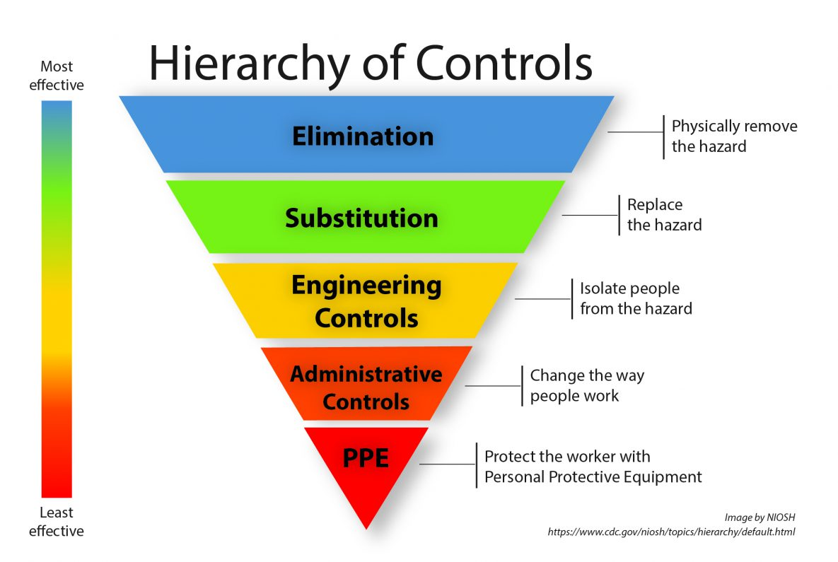
Hazard Control: How
Vegetation
Pesticides – WPS Pesticide Act
Substrates – repotting
Mold / Mildew
Nutrients
CO2
www.iup.edu/pa-oshaconsultation
Notes:
Once hazards are identified and located,
The Hierarchy of Controls are the optimal steps taken to control a hazard.
Beginning with elimination.

Slide 38
Hazard Control: How
Environmental assessment – is the hazard present in the facility?
Is the chemical necessary?
Is the process necessary?
Prevention through Design – build rooms with adequate ventilation, drainage, and irrigation to limit excess moisture and standing water .
Look beyond regulatory limits – this doesn’t guarantee the hazard is not present.
Use non-porous, cleanable, wipeable materials that can be properly sanitized
Vegetation
Pesticides – WPS Pesticide Act
Substrates – repotting
Mold / Mildew
Nutrients
CO2
www.iup.edu/pa-oshaconsultation
Notes:
The first and most sure method to control a hazard is to eliminate it.
specific building design, growing methods, extraction processes, and final products will vary.
If you are in the steps of building or renovating a new facility.
Taking the extra time here to design a facility to accommodate production flow and hazards is well worth it if prevents extra costs and production delays caused by retrofits and workarounds in the future.
A lot of thought is put into plant needs, including ventilation, contamination controls, and HEPA systems. The same amount of thought into planning the engineering needs of the employee occupied spaces, such as trim and packaging areas, could potentially eliminate a lot of problems in the future.
Be aware of geography and climate.
A facility that operates a humid eastern state requires different controls than building controls used in the arid west.
IS each room in the facility designed for the process that is currently happening there. A lot of growth and production changes, often room purposes change. HEPA HVAC. Ventilation and particulate filtration in well designed vegetation and flower rooms are in place for healthy plants, but can result in better air quality for workers also . Trim, Grinding, Packaging rooms with well designed HEPA and HVAC systems will. Beware of portable HEPA units as a bandaid where permanent solutions are needed.

Slide 39
Hazard Control: How
Can the chemical be replaced?
Can the process be changed to replace the hazard
Vegetation
Pesticides – WPS Pesticide Act
Substrates – repotting
Mold / Mildew
Nutrients
CO2
www.iup.edu/pa-oshaconsultation
Notes:
Substitution - again because many of the hazards are related to the plant itself, options for substitution are more limited. In the case of the Chlorine and Acid interation, substituting one of the products with something that is non-reactive eliminates the potential hazard of an employee accidentally mixing substances that could result in chlorine gas or chloroform. This actually happened a couple years ago at a Buffalo Wild Wings. There was an accidental spill in the kitchen , but it resulted in a fatality of the young manager there who tried to clean it up. Be aware of what chemicals are in your facility. The other substitution I can think of is for those facilities using Diatomaceous Earth for filtration media. While OSHA has published several letters of interpretation regarding diatomaceous earth and silica requirements, you can avoid the question all together by buying pre-loaded filters, instead of handling loose D.E. in your facility. If anyone has any other suggestions here, I’d be happy to hear about them via email or the contacts at the end of the webinar.

Slide 40
Hazard Control: How
Vegetation
Pesticides – WPS Pesticide Act
Substrates – repotting
Mold / Mildew
Nutrients
CO2
Facility HVAC – for temperature & humidity controls
HEPA filters & job specific ventilation placement, exhaust hoods
Audio and Visual alarms for Permissible Exposure Limits, CO2
Installation and routine maintenance of fire system, plumbing, HVAC
Mechanization and containment – trim, grind, packaging, shredding
When Purpose of a room changes, re-engineer it to the new process
www.iup.edu/pa-oshaconsultation
Notes:
The 3rd Control in the hierarchy is engineering control. When the hazard can’t be eliminated, use engineering to minimize it. For respiratory hazards in cannabis , HVAC systems and air filtration systems will play a big role here.
Also, automatic air sensors, audio and visual alarms, other mechanisms that trigger alerts so that safety isn’t reliant on a human decision or observation.
This is where appropriate plumbing and fire systems are important. Water leaks are significant contributors to mold growth.
Something to consider also, is what the best fire needs are for your facility. High Pressure Sodium Bulbs, Sulfur Burners, and Electrical shorts can all cause fires in Grow rooms. However, due to the height of the ceiling., heat-activated sprinkler may not be initiated for quite a while if a fire breaks out. This can significantly affect the amount of smoke produced before any kind of fire control is initiated. Photoelectric activated sprinklers may not be ideal in these rooms though, due to the use of misting water systems or pesticide fogs and sprays that might activate them. Having a discussion with the fire safety engineer about the type of sprinkler heads, as well as what features are initiated by the HVAC in the event of a fire, are essential when creating your emergency action and fire protection plans and training your employees what to do in the case of a fire. The last thing anyone wants is for someone to walk into a room to put out a fire with a portable extinguisher and be overcome by smoke.
Another area where engineering can make significant differences is in the processing of the plant.

Slide 41
Hazard Control: How
Vegetation
Pesticides – WPS Pesticide Act
Substrates – repotting
Mold / Mildew
Nutrients
CO2
Train Workers
Reduce Access
Conduct Exposure Monitoring
Good Housekeeping
Accidents Happen – use an Emergency Action Plan
Signage for exposure areas
Health Policies for at-risk employees
Communicate
www.iup.edu/pa-oshaconsultation
Notes:
Next – Administrative Controls are designed to reduce hazard exposure by changing the way people work. The limitation is that it relies on human behavior, and errors will happen.
However, good administrative controls will create multiple hurdles so that a single error won’t necessarily result in a catastrophic failure. For example, training is a big part of this. Knowledge is power.
Well-trained management and staff exhibit better communication.
Reduce access to high hazard areas. Key card entry and locks on areas where pesticides and other chemicals are stored and applied, only trained employees have access to areas where there are plant exposures. Have an emergency action plan and follow it. While confined space entry is not a common cannabis feature, many growers do have large nutrient tanks. In other industries, confined space entry is a high-risk hazard that results in multiple fatalities when procedures aren’t followed. Usually one worker enters the space, loses consciousness, and the next person attempts to enter and save them and also succumbs. Ensure policies around monitoring for respiratory exposure symptoms are in place and followed. Practice good housekeeping, to eliminate moisture.

Slide 42
Hazard Control: How
Vegetation
Pesticides – WPS Pesticide Act
Substrates – repotting
Mold / Mildew
Nutrients
CO2
www.iup.edu/pa-oshaconsultation
Notes:
Lastly, PPE is the last line of protection in the hierarchy of controls

Slide 43
When is PPE is required? Pesticide Applications that fall under WPS
Federal Worker Protection Standards
Pesticide Applicators – training & certification
Train other workers on Re-entry Interval requirements
Labels - “Agricultural Use Requirement”
Pesticide use and protections vary by product
Directions for mandatory PPE and use
www.iup.edu/pa-oshaconsultation
Notes:
The use of any pesticides that require respiratory PPE triggers Worker Protection Standards

Slide 44
When is PPE Required by OSHA?
OSHA Respiratory Protection Standard 29 CFR 1910.134
“When effective engineering controls are not feasible, or while they are being instituted, appropriate respirators shall be used...”
“A respirator shall be provided to each employee when such equipment is necessary to protect the health of such employee.”
www.iup.edu/pa-oshaconsultation
Notes:
Cannabis grows that use pesticides automatically trigger Worker Protection Standards and associated respiratory protection requirements that come with respirator use. The OSHA Standard requires an employer to provide a respirator when it is necessary to protect the health of the employee. This is where there may be gray area.

Slide 45
What hazard exposures trigger PPE?
PEL - Permissible Exposure Limits
OSHA Regulated legal limit
Based on continuous exposure over 8 hours
REL – Recommended Exposure Limits
Not mandatory, but best practice
Recommended limits set by
NIOSH – National Institute for Occupational Safety & Health (CDC)
ACGIH – American Conference of Governmental Industrial Hygienists
www.iup.edu/pa-oshaconsultation
Notes:
THE Permissible Exposure Limit is a specific exposure limit for certain chemicals and substances. This means when environmental sampling of the air reveals limits above a certain amount, usually measured in milligrams per cubic meter, with a time weighted exposure limit – meaning the exposure must happen for 8 hours.
This is also an enforceable number
Recommended Exposure Limits are only recommendations, but are best practice standards that provide risk reduction above and beyond regulatory limits.
This still leaves gray area.

Slide 46
OSHA Permissible E xposure Limits
From PEL Annotated Tables | OSHA PEL Ppm - approximate | OSHA PEL Mg/m3 – Exact | NIOSH REL – Recommended Exposure Limit STEL – Short Term Exposure Limit / 15 min C - Ceiling – should never be exceeded | NIOSH IDLH - Immediately Dangerous to Life or Health LEL - Lower Explosive Limit From Table of NIOSH Table of IDLH values
Butane |  |  |  | IDLH 1,600 ppm LEL 16,000 ppm
CO2 | 5,000 ppm | 9,000 mg/m3 | REL 5,000 ppm STEL 30,000 ppm | IDLH 40,000 ppm
Cotton Dust 1910.1043 |  | 1 mg/m3 | REL <.2 mg/m3
Hydrogen Cyanide |  |  |  | IDLH 50 ppm
Ethanol | 1000 ppm | 1900 mg/m3 | REL 1000 ppm | IDLH 3,300 ppm LEL 33,000 ppm
Isopropyl Alcohol | 400 ppm | 980 mg/m3 | REL 400 ppm STEL 500 ppm | IDLH 2,000 ppm LEL 20,000 ppm
Ozone | .1 ppm | .2 mg/m3 | C .1 ppm | IDLH 5 ppm
PNOR dust |  | mg/m3 5 mg/m3 | * respirable fraction
Propane | 1000 ppm | 1800 mg/m3 | 1000 ppm | IDLH 2,100 ppm LEL 21,000 ppm
Sulfur Dioxide | 5 ppm | 13 mg/m3 | REL 2 ppm STEL 5 ppm | IDLH 100 ppm
www.iup.edu/pa-oshaconsultation

Slide 47
OSHA Permissible Exposure Limits: Cotton Dust versus Particulates Not Otherwise Regulated
Cotton Dust 1910.1043 | 1 mg/m3 | REL <.2 mg/m3
PNOR dust | mg/m3 5 mg/m3
1971 Cotton PEL reduced to 1 mg / 1978 Cotton Dust Standard
Byssinosis in cotton workers reduced from 20% to 1%
Endotoxin primary factor in cotton dust exposure
www.iup.edu/pa-oshaconsultation
Notes:
** NOT discussed on webinar – the difference between total PEL and the respirable fraction is the smaller number refers to smaller sized particles that can be inhaled/respired into the deep parts of the lung and respiratory tract.

Slide 48
1971 – 2024
Technology, Science, Medical advances
Is the 1971 Regulatory PEL the only way to determine a hazard exists in the workplace?
Should a hazard only be controlled if it exceeds the PEL?
OSHA General Duty Clause:
Each employer shall furnish to each of his employees employment and a place of employment which are free from recognized hazards
www.iup.edu/pa-oshaconsultation
Notes:
THE Permissible Exposure Limit is a specific exposure limit for certain chemicals and substances. This means when environmental sampling of the air reveals limits above a certain amount, usually measured in milligrams per cubic meter, with a time weighted exposure limit – meaning the exposure must happen for 8 hours.
This is also an enforceable number
Recommended Exposure Limits are only recommendations, but are best practice standards that provide risk reduction above and beyond regulatory limits.
This still leaves gray area.

Slide 49
PPE – What is required
Written Respiratory Protection Program
Qualified program administrator to oversee RPP
Must provide at no cost to employee:
Medical Evaluation & Fit Testing
Respirators
Training & Procedures on hazards, PPE use, cleaning, storing, maintenance
Procedures to evaluate program effectiveness
Record Keeping
www.iup.edu/pa-oshaconsultation
Notes:
It is likely most cannabis facilities will have to have a written respiratory protection program. The use of any pesticides that require respiratory PPE triggers Worker Protection Standards. Any company policies that mandate employees to wear respirators, including N-95, for certain jobs, must have a written RPP policy. Employers that have staff that voluntarily wear PPE must also have a written respiratory protection plan.
This requires at a minimum 1) a medical evaluation 2) fit testing (be aware of impaired smell and taste) 3) Training and procedures on hazards and proper PPE use, cleaning ,storing, and maintenance, and 4) Procedures to evaluate program effectiveness

Slide 50
PPE – limit skin exposure
Not just face masks and N-95
“Sensitizers” - Repetitive exposure can contribute to allergic reactions
Skin contact can contribute to allergic reactions & anaphylaxis
Long sleeves, Long pants, gloves, head coverings, glasses, goggles
www.iup.edu/pa-oshaconsultation
Notes:
Be aware – exposure is not limited to inhalation. Dermal exposure and skin contact can trigger allergies. The more frequent the exposure, changes of allergic responses increase. Bakers Asthma is a condition coined for bakers and repeated exposure to wheat flour. Popcorn Lung was coined for respiratory problems developed by popcorn factory workers exposures to diacetyl. While this is slightly different than the allergic reactions we are talking about in some of the biological exposures, diacetyl is also an ingredient in some vapes. While some states may have banned the use of diacetyl, there is no federal ban on the use of diacetyl, be aware of what is in your facility.

Slide 51
Medical Evaluations & Monitoring
Baseline Medical Evaluations
Pulmonary Function Tests
Spirometry
Chest X-Ray
Ongoing Medical Screening & Surveillance
Identify new symptoms
Identify worsening symptoms
Identify high risk workers or jobs – rotate/reassign
Identify trends that indicate exposure - analyze hazards
www.iup.edu/pa-oshaconsultation
Notes:
Medical Evaluations are required as part of a written PPE program.
Pulmonary Function Tests may be required in certain instances.
They are a great tool for measuring baseline lung function, and can include methods like spirometry, that measures lung volume and output, and chest-xrays which can reveal fibrosis and other conditions.
Ongoing screening and surveillance identifies new symptoms,
Worsening symptoms, and identify high risk workers, jobs, or trends in the facility.

Slide 52
Ongoing Respiratory Hazard Controls for Cannabis Production
Prioritize Safety
Hazard Analysis & Control
Reduce Exposure Outcomes
Identify new or worsening symptoms
Identify at-risk employees
Track Injury and Illness Rates
Baseline Health Assessments
Management Committment
Employee participation
Training
Communication & Trust
Healthy Workplace Culture
Use Hierarchy of Controls
Revisit at least Annually & when processes or products change
Keep up with changing technology and science
Environmental Assessments
www.iup.edu/pa-oshaconsultation

Slide 53
www.iup.edu/pa-oshaconsultation
www.iup.edu/pa-oshaconsultation
Notes:
A lot of research, growth and change are happening in cannabis. The more we learn and share, that will help contribute to improving the industry.
If you have questions pop them in the chat and we will try to answer them, send me an email, or contact the IUP OSHA consultation office.
I appreciate your time and attention. That concludes today’s webinar.

Slide 54
Please consider subscribing to our youtube channel to be notified of new webinars: https://www.youtube.com/@paoshaconsultationpaosha2922
www.iup.edu/pa-oshaconsultation

Slide 55
Contact us
Danielle Dougherty
Graduate Student, M.S. Safety Sciences
znrdc@iup.edu
Pennsylvania OSHA Consultation Office
Phone: 724-357-4095
Website: www.iup.edu/pa-oshaconsultation/
Facebook: https://www.facebook.com/Pennsylvania-OSHA-Consultation-Program-548810235234647/
Twitter: https://twitter.com/search?q=PA%20OSHA%20Consultation&src=savs
www.iup.edu/pa-oshaconsultation

Slide 56
Thank You
Please look for upcoming webinars on our website.
Pennsylvania OSHA Consultation Office
Phone: 724-357-4095
Website: www.iup.edu/pa-oshaconsultation
www.iup.edu/pa-oshaconsultation

