Slide 1
Welcome
Heat Stress
“Don’t Just Survive – THRIVE”
Will begin at 10:30am
Presented by:
Joseph Sanna, Jr., CSP, MS, ARM
Sr. Risk Control Specialist- PMA Companies
Pennsylvania OSHA Consultation Office
Phone: 800-382-1241 or 724-357-4095
Website: www.iup.edu/pa-oshaconsultation

Slide 2
Heat Stress
“Don’t Just Survive – THRIVE”
Webinar General Info
PowerPoint Presentation
Q&A
Questions
Chat is open to submit questions.
We will be answering questions through this chat feature. If due to the technical nature of the question a more thorough response is required, we will post the answer on our website within seven days of the webinar.
www.iup.edu/pa-oshaconsultation

Slide 3
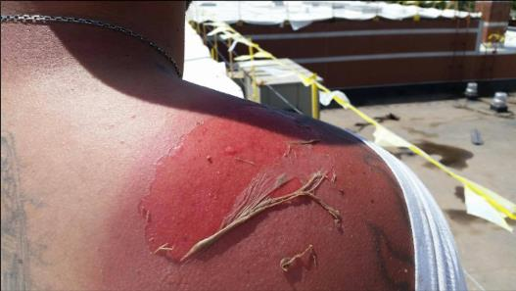
Agenda
The Problem
Exposures
Symptoms
Prevention

Slide 4
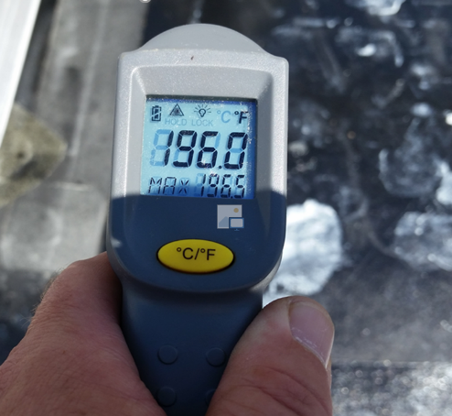
The Problem
Notes:
I started this safety stuff in 1992. Heat stress was talked about for people in a steel mill.
I imagine you are all here because you have the same concern about heat stress as I do. I work with several construction companies and no doubt – there are a lot of hazards to be cautious about. For the last few years I’ve been very passionate about fall protection – working with several companies like roofers and general contractors where falls are an exposure every day. Heck, even a few years ago, OSHA updated the General industry walking/working surfaces standard using a lot of the construction regulations for personal fall arrest to make it even more important (not that I didn’t have my worries about that previously!)
Unfortunately, something was sneaking up on me…heat stress! Maybe it was just me…but heat stress is now one of my biggest concerns for a few months out of the year (at least in Central Pennsylvania).
So here we are … seeing increased heat stress related deaths, illnesses – lost productivity and other issues we’ll talk about briefly.
When workers are in a hot environment doing hard work it is bad enough. Now stand on a griddle! This is the temperature on a roof. Anybody ever smoked meats? That’s usually about 170 degrees to 200. Now work in it all day – and use a torch or spread 500 degree tar! A human can only take so much.

Slide 5
OSHA Focus:
When is it a concern?
Sources of heat-related illnesses, such as working in direct sunlight, a hot vehicle, or areas with hot air or near a gas engine, a furnace, a boiler, or steam lines;
WetBulb Globe Temperature (WBGT) calculations, a formula used by the National Weather Service to measure the heat stress in direct sunlight, using temperature, humidity, wind speed, sun angle, and cloud cover (solar radiation); other temperature measurements; and any weather service heat advisories, warnings, or alerts;
https://www.osha.gov/laws-regs/standardinterpretations/2021-09-01

Slide 6
OSHA Focus:
When is it a concern?
The use of heavy or bulky clothing or equipment;
The types of activities performed by the employees and whether those activities can be categorized as moderate, heavy, or very heavy work, as well as the length of time a worker is continuously or repeatedly performing moderate to strenuous activities;
Heat-related illnesses among new workers, as well as any recent vacation time or breaks in employment before complaints of heat-related symptoms; and
The availability of rest breaks, shade, and water on-site.
https://www.osha.gov/laws-regs/standardinterpretations/2021-09-01

Slide 7
Back to our regularly scheduled program….
How well do you work when hot?
How well do you work when physically active?
…after three days?
…after three weeks?
What if?
…acclimatized?
…rested?
…hydrated?

Slide 8
Roofer Falls From Roof
Worker complained of extreme heat minutes before fall
Published 3:14 pm Wednesday, August 3, 2016
At 11:20 a.m. Tuesday, about 90 minutes before he fell from the roof of the Vicksburg Convention Center, James Michael Pace wrote the following post on his Facebook page: “Please say some prayers for me and my co-workers y’all; this heat has never gotten to me like this and I now see how serious it is.” About 29 minutes later, Pace, 28, of Pelahatchie, an employee of E. Cornell Malone Corp. of Jackson, wrote another post. “I took a BC for a headache which always works; it worked for 25 minutes and 13 seconds, and I had sweated all of it out and was back to my migraine. … Now I may be super delirious right now on my lunch or I just exposed an epidemic no one even knew was occurring?”
Pace died after falling from the roof about 12:55 p.m. At the time, according to the National Weather Service observation site at the Vicksburg Tallulah Regional Airport, the temperature was 95 degrees and the heat index was 110. He was on the roof alone at the time. “A coworker had gone down to their truck to get something and stopped to get a drink of water. When he returned, he didn’t see him and went looking for him,” deputy Vicksburg police chief Bobby Stewart said. “When he went to the spot where he was working, he looked down and saw Mr. Pace and immediately called 911.” Vicksburg police Lt. Troy Kimble said police were told Pace was working on the roof’s flashing when he fell. He was part of a crew for Malone, which has the contract to replace the convention center roof. Convention center executive director Annette Kirklin said the workers were in the process of fixing minor problems on the roof that were discussed at a project meeting last week. Pace was declared dead at the scene by deputy Warren County coroner Ronald C. Regan. His body was sent to the Mississippi State Crime Lab for autopsy. The fall remains under investigation.
http://www.vicksburgpost.com/2016/08/03/worker-complained-of-extreme-heat-minutes-before-fall/
Notes:
A terrible story – I have done a full presentation on heat stress using this story and how it went down.

Slide 9
Heat stress impact
Nearly 3 out of 4 fatalities from heat illness happened during the first week of work.
According to the National Bureau of Economic Research, productivity declines roughly 14% during weekdays above 86°F and can cost an average of $20 per person.
Between 1992 and 2017, heat stress injuries killed 815 U.S. workers and seriously injured more than 70,000, according to the Occupational Safety and Health Administration.
Way under-reported
Notes:
Using statistics to prioritize your focus
The worst heat related illness I ever had with a contractor with whom I worked was a new worker who was hospitalized for 3 days after 3 days of work. He insisted he was fine all that last day but the crew foreman still didn’t know enough about this worker’s personality, pace, conditioning, etc. and didn’t figure it out.
That never made it into a “statistic” – We’re all here because we have seen the impact or we have concerns about it.
Do we need to wait for a trend of terrible statistics? I don’t have a lot of “studies” or statistics and I don’t need them to help me focus. We just know they are there – and we need to do something about it.
https://portacool.com/the-cost-of-heat-stress-and-heat-related-injuries/

Slide 10
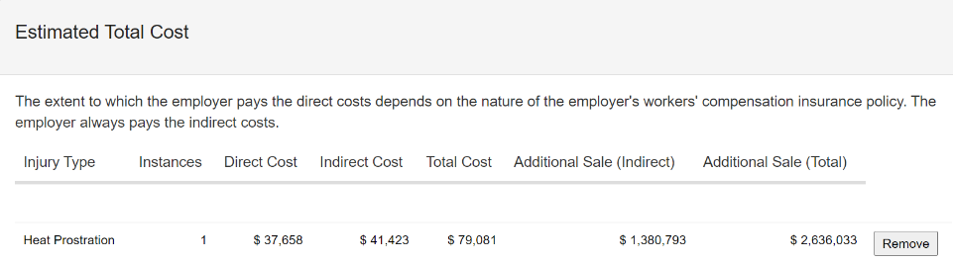
Heat stress impact
https://www.osha.gov/safetypays/estimator
Notes:
https://www.osha.gov/safetypays/estimator

Slide 11
Lost productivity
Start Monday morning…push too hard…what good are they later in the week?
How productive are heat stressed workers?
Are workers more productive in a week of mild weather or a week of brutal heat? Or by the end of a hot period?
Can you schedule intense work early and other work later in the day?

Slide 12
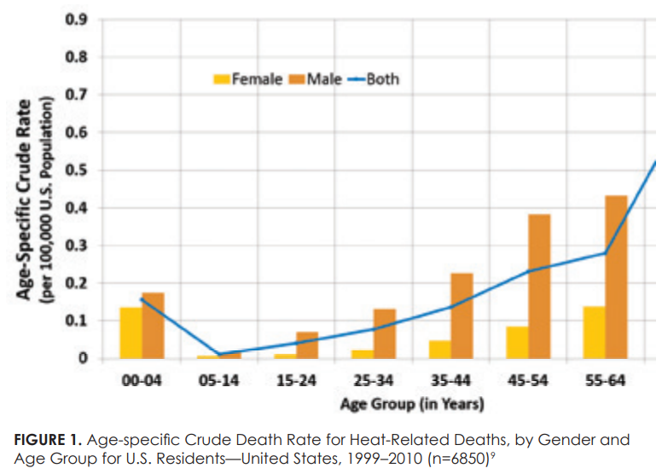
Heat Stress Impact
Notes:
Plus we’ve got an aging workforce. I do see that many of them have learned tips and tricks to deal with the heat. But at some point, it catches up with us if we aren’t doing the right things.
https://www.cdc.gov/pictureofamerica/pdfs/picture_of_america_heat-related_illness.pdf
Note – this is for all U.S. residents – not just workplace.

Slide 13
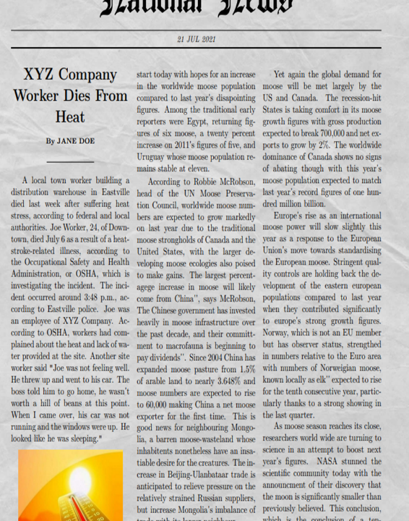
Other issues
OSHA Fines
Employee turnover
Bad public relations and image
Others?
Notes:
What if this was the news about your company – not XYZ Company donates work project to needy family.
https://www.homemade-gifts-made-easy.com/newspaper-generator.html

Slide 14
Exposures
Heat
Weather
Work
Workers
Whole picture
Notes:
The problem for employers and workers presents itself when working in cold environments – indoor or outdoor.
But it could also mean working in wet environments.
https://www.bing.com/images/search?view=detailV2&ccid=Sql5sRaZ&id=1BD07568EC0B6CEB5AA00C89650C1FC0433C3E32&thid=OIP.Sql5sRaZiCKHS_TuqxtucgHaE8&mediaurl=https%3a%2f%2f62e528761d0685343e1c-f3d1b99a743ffa4142d9d7f1978d9686.ssl.cf2.rackcdn.com%2ffiles%2f70500%2fwidth668%2fimage-20150129-22325-2ut9lo.jpg&cdnurl=https%3a%2f%2fth.bing.com%2fth%2fid%2fR.4aa979b116998822874bf4eeab1b6e72%3frik%3dMj48Q8AfDGWJDA%26pid%3dImgRaw%26r%3d0&exph=446&expw=668&q=shovel+snow&simid=608054592021212770&FORM=IRPRST&ck=E6E627B09332DC1ADC7CF793F68B2B4B&selectedIndex=3&qft=+filterui%3alicense-L2_L3_L4&ajaxhist=0&ajaxserp=0
10/18/2021 @6:18 a.m. free to share and use commercially.

Slide 15
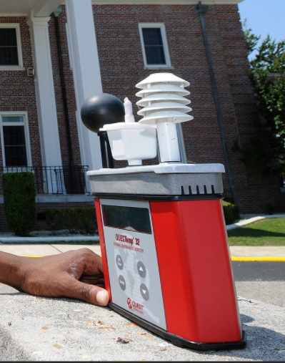
Disclaimer
Wet Bulb Globe Thermometer
What is “too hot”?
Notes:
This would be destroyed on a construction site. Sure it would be great if
We need to discuss how you determine “what is hot?” or what levels of “hot” are workers exposed to? How many here have a wet bulb globe thermometer?
Maybe I’m a fraud – but I’m using the OSHA Heat Index. A respected colleague (she is a C.I.H.) of mine was discussing this with me and said you really need to use WBGT to determine heat stress levels. I said I haven’t seen a WBGT since 1991. I wish my world had me carrying around one of these – but I’m putting all my faith in site leadership to say – hey, it’s only 87 degrees, but it is 85% humidity with no breeze – we’re starting at 5:00 a.m. and quitting at noon.
Basically, what I’m saying is you need to use the tools you have – but set a level, a trigger, for when your heat stress controls kick into action.
In most situations environmental heat exposures should be assessed by the Wet Bulb Globe Thermometer (WBGT) method or equivalent techniques, such as Effective Temperature (ET), Corrected Effective Temperature (CET), or Wet Globe Temperature (WGT), which are then converted to estimated WBGT values. When air- and vapor-impermeable protective clothing is worn, the dry bulb temperature (ta) or the adjusted dry bulb temperature (tadb) is a more appropriate measurement than the WBGT, because impermeable clothing does not transfer humid heat loss but only dry heat loss (e.g., radiation, convection, and conduction) [Åstrand et al. 2003]. These temperature readings may be used to determine the degree of heat stress the worker is experiencing in the work environment and allow a qualified safety and health professional to determine how to mitigate that heat stress to prevent heat injury.
Picture from bing images free to use and share commercially on 7/21/21 @5:44 a.m.
https://www.bing.com/images/search?view=detailV2&ccid=xaLahogD&id=8916028F7C35C2E95DDF2921FAEBFE146E515012&thid=OIP.xaLahogDhMJDcbiRSJsfSwHaEy&mediaurl=https%3a%2f%2fupload.wikimedia.org%2fwikipedia%2fcommons%2fthumb%2f0%2f03%2fUS_Navy_100524-N-5328N-671_Cryptologic_Technician_%2528Technical%2529_Seaman_Antron_Johnson-Gray_checks_the_wet_bulb_globe_temperature_meter.jpg%2f1920px-US_Navy_100524-N-5328N-671_Cryptologic_Technician_%2528Technical%2529_Seaman_Antron_Johnson-Gray_checks_the_wet_bulb_globe_temperature_meter.jpg&cdnurl=https%3a%2f%2fth.bing.com%2fth%2fid%2fR.c5a2da86880384c24371b891489b1f4b%3frik%3dElBRbhT%252b6%252fohKQ%26pid%3dImgRaw&exph=1240&expw=1920&q=wet+bulb+globe+thermometer&simid=608039220299979052&FORM=IRPRST&ck=31078B016D2B8C81CCC4B9570542D7BB&selectedIndex=1&qft=+filterui%3alicense-L2_L3_L4&ajaxhist=0&ajaxserp=0

Slide 16
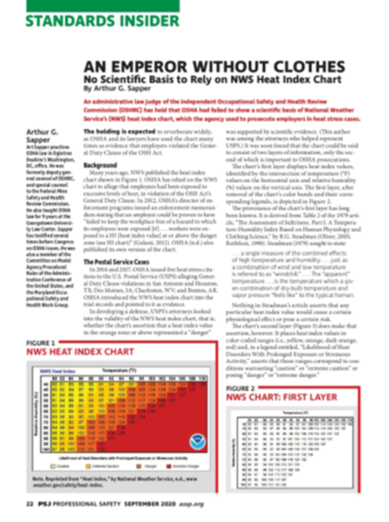
Disclaimer
Heat Index Chart
What is “too hot”?
Notes:
Recent information has been communicated that says the heat stress index may not really reflect the true level of heat stress on workers. One of my colleagues who is a highly respected C.I.H. has been telling me this for years. She’s said we need to use Wet Bulb Globe Thermometers and other sources to get a true determination of the heat stress levels. What say you? What do we do? Hot is hot. Humid is humid. Sunny is sunny. And “stale air” is “stale air”. So whatever you use has to work. I’ve never worked with a construction company that had a wet bulb globe thermometer. Do we really need one? I have to work with what I have, so I’m using the OSHA heat stress app and weather applications that tell you how it really feels – based on breezes, lack of clouds, etc. I’m finding that well trained company and site leadership already have this figured out. They communicate and use their experience. And they are seeing how this is all playing out.

Slide 17
Weather
Increased temperatures
Humidity
Airflow
Direct sun
Environment – asphalt, dark surfaces, structures, etc.
Notes:
Real feel/real temp/real impact
The RealFeel Temperature is an index that describes what the temperature really feels like. It is a unique composite of the effects of temperature, wind, humidity, sunshine intensity, cloudiness, precipitation and elevation on the human body--everything that affects how warm or cold a person feels.

Slide 18
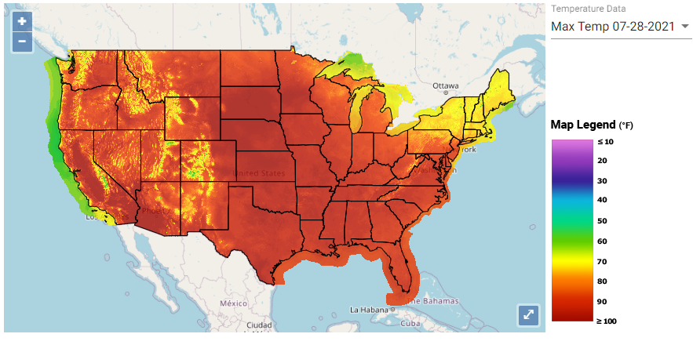
https://ephtracking.cdc.gov/Applications/heatTracker/
Notes:
Here’s where the science behind all this comes from…

Slide 19
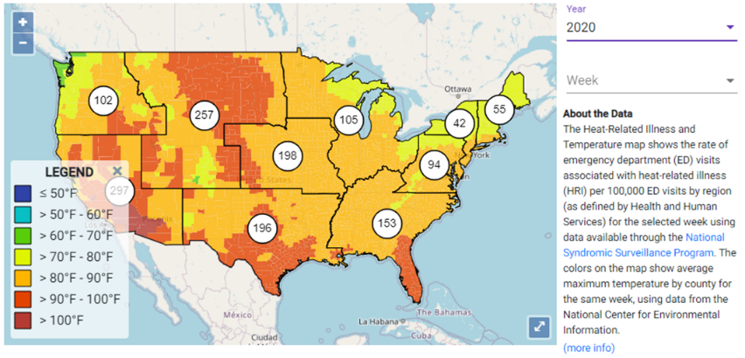
https://ephtracking.cdc.gov/Applications/heatTracker/
Historical data - # of incidents week of July 28, 2020

Slide 20
Work
What are you doing?
Indoor
foundries, brick-firing and ceramic plants
glass production facilities
rubber products factories
electrical utilities (particularly boiler rooms)
bakeries, confectioneries, commercial kitchens, food canneries
laundries
warehouses without adequate climate control
chemical plants
smelters
Outdoor
agriculture
landscaping
construction operations
refining gas/oil and well operations
asbestos and lead removal
waste collection activities
package and mail delivery
any other activities that require moderate to high physical exertions or the wearing of heavy or /bulky clothing or equipment on a hot day
Notes:
We talked about weather…now lets talk about work.
OSHA has specifically called out these industries/tasks for focus for heat stress.
https://www.osha.gov/laws-regs/standardinterpretations/2021-09-01
Things you need to consider include the work pace – how fast are they working, how “pressured” – and this can change – like when a storm is coming and you are trying to get work done. Or you’d like to have the job finished by the end of the day.
How strenuous is the work? Shoveling hard packed clay is different than shoveling sand. Using a gravel buggy is different than using a wheel barrow.
I guess these both of these relate to the stress it places on the body.
And the environment relates to – well, the locality or surroundings – hot asphalt, no shade, things like that –
And then put it all together = tearing off shingles on a 7:12 pitch roof while wearing a personal fall arrest system. Now that is WORK!
Real feel/real temp/real impact

Slide 21
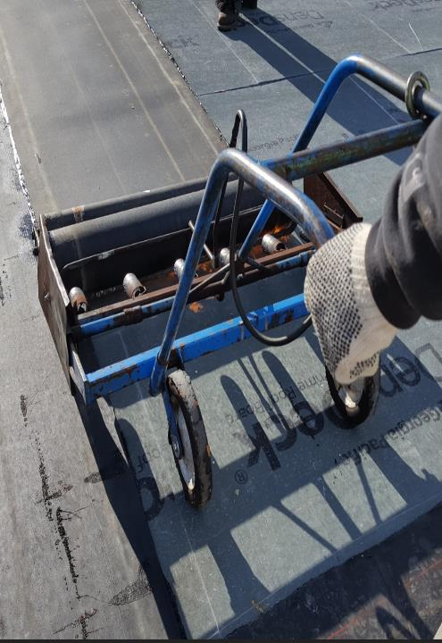
Work
Heat
What are you doing?
Pace: moderate, heavy, or very heavy work Low, moderate and high
Hot work
Strenuousness
Environment
Notes:
Things you need to consider include the work pace – how fast are they working, how “pressured” – and this can change – like when a storm is coming and you are trying to get work done. Or you’d like to have the job finished by the end of the day.
How strenuous is the work? Shoveling hard packed clay is different than shoveling sand. Using a gravel buggy is different than using a wheel barrow.
I guess these both of these relate to the stress it places on the body.
And the environment relates to – well, the locality or surroundings – hot asphalt, no shade, things like that –
And then put it all together = tearing off shingles on a 7:12 pitch roof while wearing a personal fall arrest system. Now that is WORK!
Real feel/real temp/real impact

Slide 22
Workers
Heat
Workers
Pre-disposition/The BODY
Acclimatization
Diet and Energy drinks
Leadership?
Notes:
What about the workers? They are part of this picture.
Energy drinks: Soft drinks, heat and exertion may be a recipe for kidney disease, study finds - https://www.safetyandhealthmagazine.com/articles/print/18118-soft-drinks-heat-and-exertion-may-be-a-recipe-for-kidney-disease-study-finds
Pre-disposition – I don’t have facts on this, but in my experience workers who have experienced work related heat stress in the past will likely experience it again.

Slide 23
Workers
Worker predisposition – A little about the body
Age
Weight
Adjusting to the hot environment
Physical Fitness
Other Health Conditions
Notes:
There is some data on it…but in my personal experience – workers who are pre-disposed to heat stress are risky. They deal with it every hot day. I’ve been around new workers who experienced heat stress once and said, “Oh, I’ll be fine…” and then the second time they still try to fool themselves. But on the third time, they know they need to do things differently or find a different occupation.
We can try to defy the aging process…but I haven’t found a way.
I can also try to fool myself about weight – hey, I’m carrying around two 20 pound kettlebells worth of extra weight every day – think about the exercise I’m getting just by being overweight! But being overweight plays a big role in how your body can tolerate stresses.
How well do you acclimatize? We’ll talk about that in a little while…
Physical fitness. I guess we can’t be fooled to think a construction worker doing hard work all day is in good physical condition.
And pre-existing medical conditions that we may not even know about.
Two workers who had heat stress – were diabetic and never new it until they went to the hospital for heat stress! The doctor set them straight.

Slide 24
Workers
Acclimatization
Improvement in heat tolerance that comes from gradually increasing the intensity or duration of work performed in a hot setting.
The best way to acclimatize is to increase the workload performed in a hot setting by gradually increasing exposure to hot conditions over 7–14 days.
Helping workers acclimate to high temperatures by scheduling new workers for no more than 20% of the usual duration of work in a hot environment on the first day with no more than a 20% increase each day.
Pushing to the point of heat exhaustion will hurt, not help, your heat tolerance.
Be aware – it comes and goes.
Notes:
Would be a good idea to make a toolbox talk on this topic! Refer to the CDC sheet on this.

Slide 25
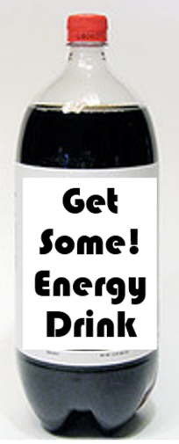
Workers
Diet and Energy Drinks
Encourage healthy diet
Regular meals and snacks
Avoid energy drinks
Notes:
As far as I’m concerned – these should be forbidden. They are the pariah of heat stress.
Energy drinks: Soft drinks, heat and exertion may be a recipe for kidney disease, study finds - https://www.safetyandhealthmagazine.com/articles/print/18118-soft-drinks-heat-and-exertion-may-be-a-recipe-for-kidney-disease-study-finds
Pre-disposition – I don’t have facts on this, but in my experience workers who have experienced work-related heat stress in the past will likely experience it again.
Soda bottle free to share and use commercially from bing:
https://live.staticflickr.com/1081/3172441570_fc7d9b383d_n.jpg on 7/19/21 @ 7:37 a.m.

Slide 26
Workers
Leadership
Good leaders really lead!
Supervisors are responsible for encouraging employees to frequently consume water or other acceptable beverages to ensure hydration.
Communication!
Monitoring
Quick response
Notes:
What about leadership? The leadership personnel I train on heat stress get a different training program than the workers. Why? Because it all comes back to them. They need to be omnipotent.

Slide 27
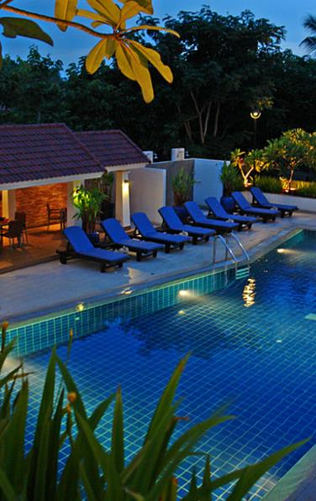
Whole picture
The world we live in
Workers staying out of town
Mental health and stress
Crew relationships
Notes:
I’m not talking about just the workers – I’m talking about general wellness of the whole picture – the workers and the work environment and life.
Life can be hard. I’m blessed with an incredible family and awesome employer and a great support system. Not everybody has that…benefit. Many workers and maybe even some in this room have more stress to deal with and little support. A passion of mine is mental health. Suicide rates are up. I’ve talked with workers who have incredible stress in their life. Workers may work out of town all week, go home and deal with the stress of life. We may not always have the time, but I try to include in my training and discussions about mental wellness. I was talking with a worker who was out of town, missing his son’s baseball games, had to get home and mow his property and the washing machine broke and he said he was probably going to get a divorce. What a burden to carry! Does that impact wellness and how it relates to heat stress?
What if the workers don’t get along? We know there is workplace bullying. We know that we are in a worldly environment that is stressful in itself! I heard one guy being called “Butters” – like Butters, a character from Southpark. Maybe he did look like a little like what Butters would look like if he were 24. I asked pulled him off to the side and if he was ok with that. He said at first, but now they all get along and he likes it! Helps him fit in – I guess everybody has a nickname on that crew – and from all indications, that crew gets along great.
https://www.bing.com/images/search?view=detailV2&ccid=nXA3lJ3j&id=2D077A5B5890D809D3FC4DA8D81770A7176B41D7&thid=OIP.nXA3lJ3jO-HUHh9Zghi_lgHaE8&mediaurl=https%3a%2f%2flive.staticflickr.com%2f6009%2f5917947563_99379f6909_b.jpg&cdnurl=https%3a%2f%2fth.bing.com%2fth%2fid%2fR.9d7037949de33be1d41e1f598218bf96%3frik%3d10FrF6dwF9ioTQ%26pid%3dImgRaw%26r%3d0&exph=683&expw=1024&q=hotel+pool&simid=608018282364174050&FORM=IRPRST&ck=83D631EE3BFEA6E934A291CE6B9FD502&selectedIndex=4&qft=+filterui%3alicense-L2_L3_L4&ajaxhist=0&ajaxserp=0
Free to use and share commercially from bing.com on 10/19/2021 @6:12 a.m.

Slide 28
Symptoms
Plenty of info available.
OSHA NIOSH Heat Stress Application
Best for Leaders/Buddies
Cramps
Sweating (too much/too little)
Malaise
Vomiting
Notes:
There are plenty of tools out there to know about the symptoms of heat stress.
One of my favorite is the OSHA NIOSH heat stress app. Now I think we can all agree this app is flawed – as we’ve already discussed about the heat stress index and the tools we have to identify the REAL temperature and impact of the “weather” and/or environment (the micro climates we all deal with). There is really so much more that is needed. It can be 84 degrees F and still be deadly hot, right? High humidity. No airflow. Full sun. And all the other things we’ve talked about…the work/workers. No app can capture that.
But it does give us an easy reference tool that even the newest worker can use.
And we can rely on the good communication and training of site leaders and our Buddies. These are the very BEST tools to identify symptoms. Because if we don’t see the symptoms it is hard to know they are existing. I don’t know how many times a Buddy approached someone or reported to a foreman that he saw someone limping (leg cramps) or heard vomiting in the porta-john.

Slide 29
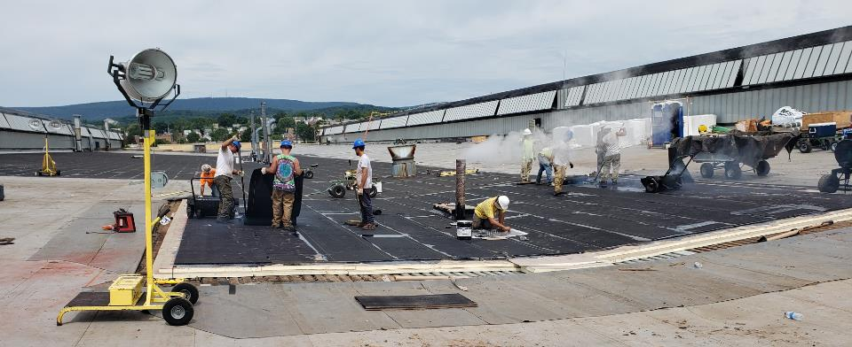
Prevention
What do we do?
Notes:
Hopefully – enough of what we’ve already discussed gives us some ideas - knowing the weather, workers, environment, etc. can help us work with our teams to think about what we have in place already.

Slide 30
OSHA Enforcement: July 2012
The employer failed to keep the workplace free of a hazard to which its employees were exposed:
  Workers were exposed to a HI at or above the Danger zone (see Hi chart); or
  Workers were working outside for most of the day or during the heat of the day when there was a NOAA Heat advisory.
2. The hazard was recognized:
  NOAA issued heat advisory because of a HI at or above Danger zone (see HI chart) and employer was or should have been aware of the advisory;
  Employees made complaints regarding heat;
  Employees showed signs or symptoms of heat exposure;
  Employer indicated that it was aware of the heat hazard (e.g., by providing water but not rest and shade); or
  The employer’s industry has issued guidance or information about heat hazards.
3. The hazard was causing or was likely to cause death or serious physical harm:
  Heat exhaustion;
  Heat stroke; or
  Fatality
4. There was a feasible and useful method to correct the hazard:
  Providing workers with immediate access to water, rest, and shade, and allowing them to use that relief;
  Implementing an acclimatization program for new employees and for those returning from extended time away (e.g., vacation)
  Implementing a work/rest schedule; or
  Providing a climate – controlled area to cool down.
Notes:
If we have one of those terrible incidents – there is no way we all won’t have to answer to someone (maybe even ourselves) if we haven’t tried even the most basic of controls to prevent it.
This is what I used to prepare for an informal conference with OSHA.
Source: July 19, 2012: Richard Fairfax Memo to Regional Administrators – Expedite heat related inspection and issuance of citations
There are no specific standards for Heat Stress. The general duty clause (PL Section 5a1) is used when problems are identified as described below. Only the Hazwoper standard (29 CFR 1910.120) addresses heat stress.
29 CFR 1926.21 Safety Training and Education Standard requires employees to be trained in the recognition and control of unsafe conditions. A key component will be Heat Stress awareness and emergency response
A violation of the general duty clause may exist if workers are working outside and the employer is aware of heat-related dangers but has not taken protective action to provide at minimum : water, rest, and shade.
THE 4 POINTS in the slide are examples only, and there could be other observations as evidence that would satisfy OSHA’s burden of proof.

Slide 31
From the OSHA Heat Stress Initiative (4/8/2022)
Where the information is available and applicable to the inspection, the case file should document factors such as the employer’s knowledge of the hazard, the reading on the OSHA-NIOSH App (use the camera screen shot function to save the image of the reading, when possible), WBGT temperature if possible, wind speed and /direction, radiant heat, cloud cover, length of time the work was performed, and other sources of heat in the workplace. Additionally, document whether any exposed employees were temporary workers, new hires, or employees returning from prolonged leave periods who were not acclimatized.

Slide 32
During heat-related inspections, CSHOs should;
Review OSHA 300 Logs for heat-related illness(es),
Review injury and illness reports/obtain any records of emergency room visits and/or ambulance transport, even if hospitalizations did not occur,
Interview workers for reports of symptoms that may indicate heat-related illnesses,
Review employer’s plan to address heat exposure, including acclimatization procedures (especially for new and returning workers), work-rest schedules, access to shade and water (with electrolytes when needed), and any training records associated with implementing a heat illness prevention program,
Document, where possible, the heat index on the OSHA-NIOSH Heat App, using the screen save feature on a mobile phone or tablet,
Notes:
https://www.osha.gov/laws-regs/standardinterpretations/2021-09-01

Slide 33
During heat-related inspections, CSHOs should;
Identify conditions and activities relevant to heat-related hazards. These can include, but are not limited to:
  Potential sources of heat-related illnesses (e.g., working in direct sunlight, a hot vehicle, or areas with hot air, near a gas engine, furnace, boiler or steam lines),
  WBGT calculations and/or other temperature measurements,
  Heat advisories, warnings or alerts,
  The use of heavy or bulky clothing or equipment,
  The types of activities performed by the employees and whether those activities can be categorized as moderate, heavy or very heavy work,
  The length of time in which a worker is continuously or repeatedly performing moderate to strenuous activities,
  Heat-related illnesses among new workers,
  The presence of any recent vacation time or breaks in employment prior to complaints of heat-related symptoms, and
  The availability of rest breaks, water and shade on site.
Notes:
https://www.osha.gov/laws-regs/standardinterpretations/2021-09-01

Slide 34
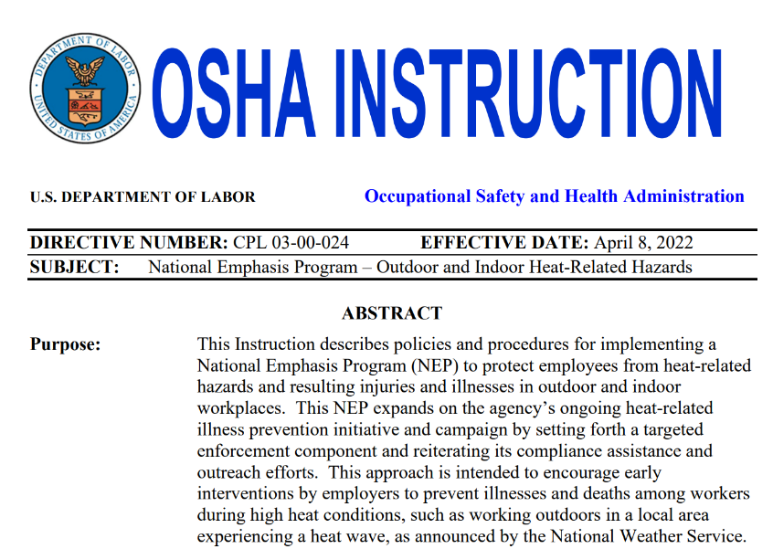
https://www.osha.gov/sites/default/files/enforcement/directives/CPL_03-00-024.pdf
Notes:
https://www.osha.gov/sites/default/files/enforcement/directives/CPL_03-00-024.pdf

Slide 35
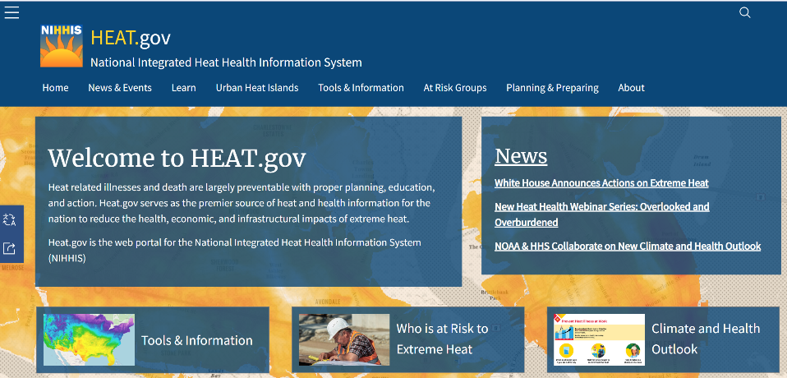

Slide 36
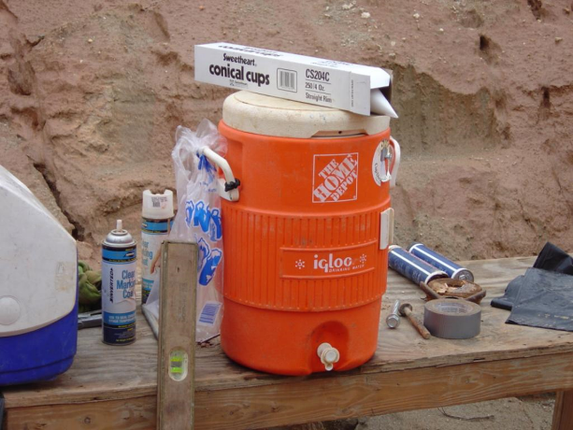
Hydration
Are workers hydrated?
Notes:
I’m going to jump ahead – usually we talk about your plan – policies and procedures drive how we do things.
Let’s discuss hydration. This should be a step in your plan – training, education, leadership personnel
Are your workers hydrated?
This is an OSHA picture (from the Outreach program). We see here the ever so common construction site water cooler.

Slide 37
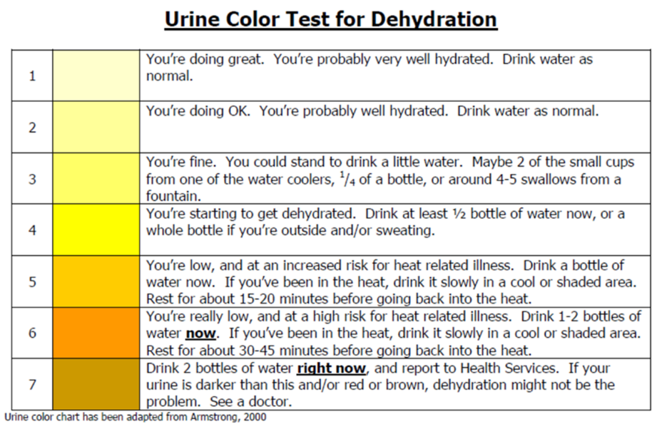
Notes:
It is not like we can have workers urinate into a clear mason jar and hold it up to a chart like we’re checking our pool chlorine. But there are clearly some things that can’t be faked.
This is a tool provided by the military that my first exposure to came from a construction crew working on a military site. They were given this by the site safety personnel. Great tool.

Slide 38
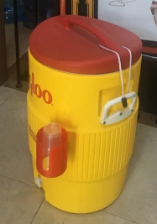
How much cool water?
32 oz. an hour x 8 hours x 10 workers = 20 gallons a day
100 gallons a week
400 gallons a month
Question: How can a supervisor take one of these jugs onto the site and expect it to cover the crew for the day?
There must be a process.
Notes:
How do we keep them hydrated? And hydrated PROPERLY.
I still see these 5-gallon coolers. Yes, you have to keep them clean. You must avoid contamination including Covid-19 now. For the past few years, I’ve added the cleaning of water coolers to the safety training and guidance I’ve provided to clients in construction.

Slide 39
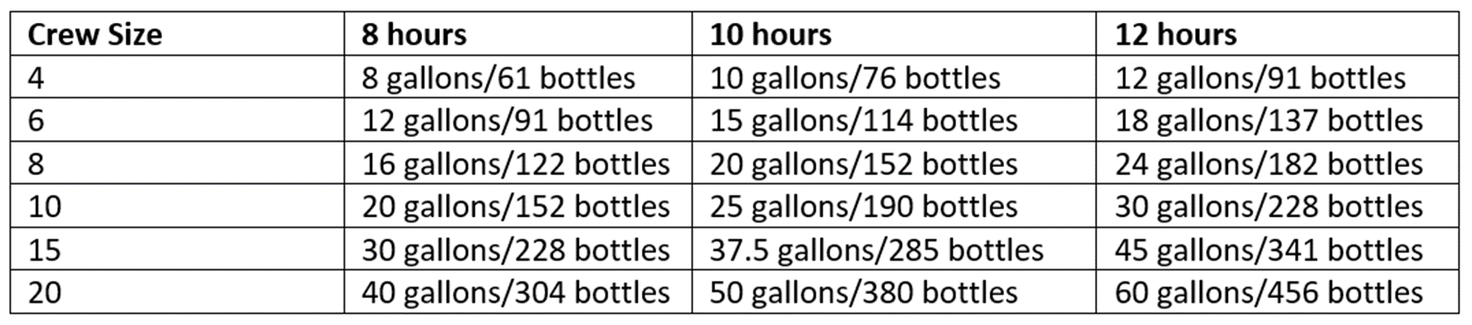
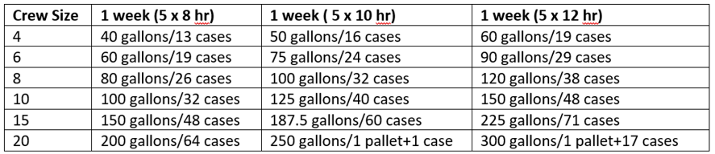
A 10 person crew working 8 hours a day for every day of August 2021 (22 work days) will need 3344 bottles of water or 140 cases, or 1 pallet +62 cases (or just get 2 pallets?)
Notes:
Consider pallets of bottled water…but then you have the issue with plastic bottles and environmental concerns – maybe set up a recycling vs landfill trash – but you need to work. The coolers and cups create other risk management concerns.

Slide 40
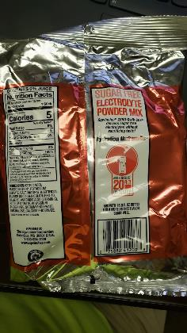
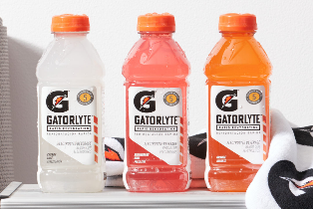
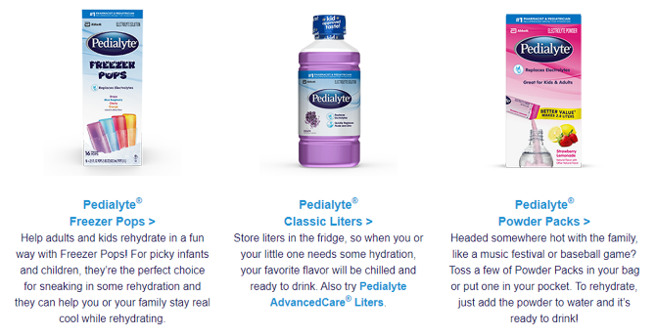
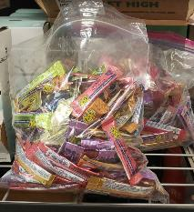
Other drinks
Hydration products
Chocolate milk?
Home remedies?
Notes:
I hear all kinds of things from people – I don’t know what is best. There is only so much time…
There are all kinds of hydration products from packets to dump in water bottles to products for athletes to chocolate milk and pickle juice.

Slide 41
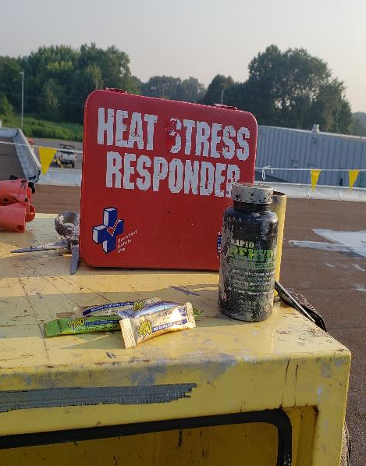
Prevention
Policy/Procedure/Program
Good supervision
Water. Rest. Shade.
Improve as you go
Sharing ideas
Notes:
So this brings us to the meat and potatoes of the way we deal with this deadly exposure.
Don’t be fooled for a second that you won’t need to have all of these controls addressed in some form or another to protect workers.
What do our policies/procedures/programs need to have? Unfortunately, for me – we don’t have a standard to follow. Not one that I can use to get employers to buy into completely. If only we had a standard…that would tell us what we need to do to ensure we are doing the right things. You could use some of the State OSHA program standards (and it is great if that is what you have going on).
Procedures, Tools, Training
Details. Spell it all out. New hires must be acclimatized. The weather must be monitored. The work tasks must be considered. Work/rest regimens must be spelled out. The plan must include every countermeasure possible for the issues we’ve talked about. Water. Shade. Clothing. PPE.

Slide 42
https://www.osha.gov/laws-regs/standardinterpretations/2021-09-01
General Controls:
Training: Hazards; Avoiding heat-related illnesses; Recognizing signs and symptoms; First-aid procedures and Employer's program to address heat-related illnesses.
Personal Protective Clothing and Equipment: Hats; Loosely worn reflective clothing; Cooling vests and water-cooled/dampened garments*; and Wearable Technology.
Administrative Controls: Scheduling; Cool drinking water; Frequent rest and water breaks; Rotation; and Cool rooms/shade.
Health Screening and Acclimatization: New worker plan; Returning worker plan; Awareness of medication and alcohol/drug use impact; and Personal factors/issues.

Slide 43
How do you know?
What is the leader’s approach?
Notes:
Here is one I’ve used with a construction company. We have questions that need to be answered – and these can even be improved based on

Slide 44
How do you know?
What is the leader’s approach?
Notes:
Here is one I’ve used with a construction company. We have questions that need to be answered – and these can even be improved based on

Slide 45
How do you know?
What is the leader’s approach?
Notes:
Here is one I’ve used with a construction company. We have questions that need to be answered – and these can even be improved based on

Slide 46
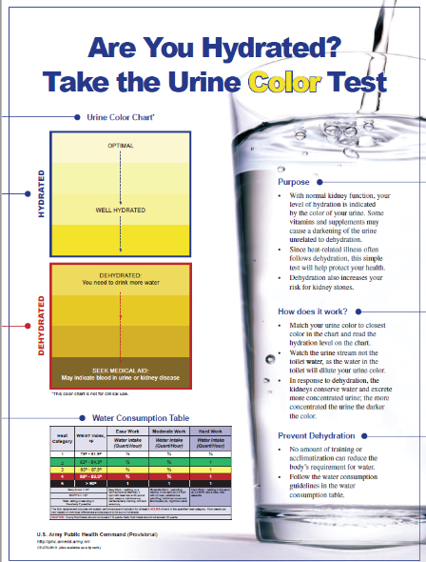
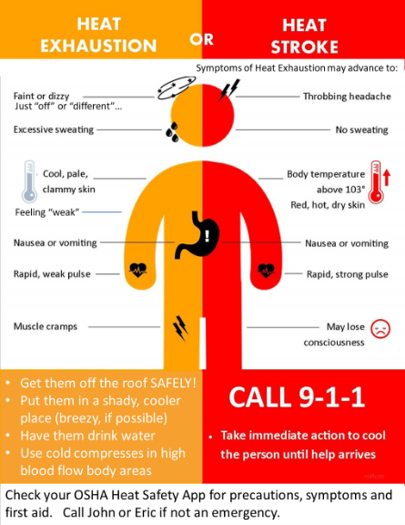
Educate and Remind!
Notes:
https://gacc.nifc.gov/nwcc/content/pdfs/safety/DOD_Urine%20Color%20Test_Poster.pdf
https://www.weather.gov/images/safety/Heat_Illness.jpg

Slide 47
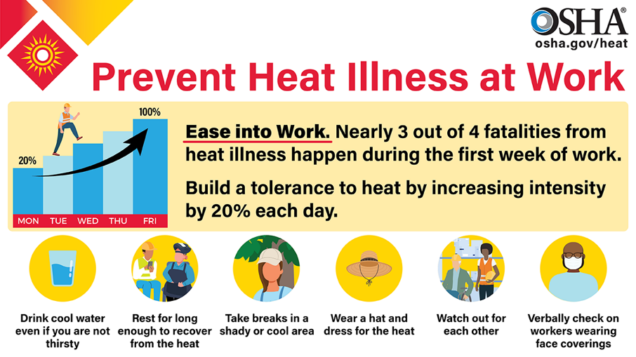
Notes:
Here’s a new New OSHA poster I’ve already used as a Toolbox Talk (and will share).
It addresses some of the things we need to do to reduce the likelihood of heat stress taking a worker.
Let’s talk about each of these

Slide 48

Clothing
What works? What do workers like?
Hats
Shirts and pants
Boots – Insulated?
Monitors/wearables
Cooling devices
Cloths/gaiters
Notes:
Comment on hard hats
Comment on long sleeves for certain work.
Light clothing
Breathable but not wet.
Try it out yourself! I purchased a vest – you soak it in water. It weight 1,000 pounds and did not allow for evaporation. I hated it. I had a hi viz vest with pockets – I stuck ice packs in it while working on outdoors on a very hot day – it was heavenly!

Slide 49
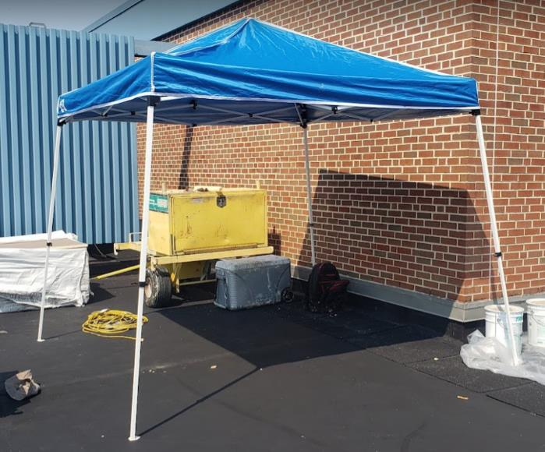
Shade
Notes:
The other benefit of providing shade is that you can cool the area/surface where the rest periods will be taken.

Slide 50
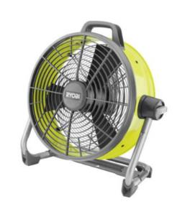
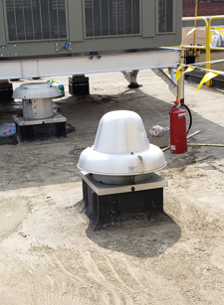
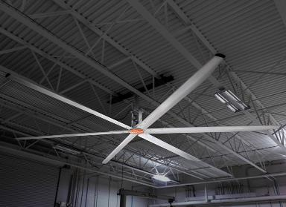
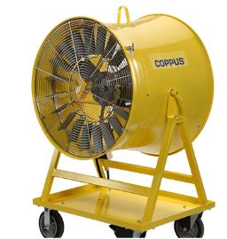
Fans!
HVLS
Coppus
Battery
Misting
Notes:
In order for a fan to be effective, the skin surface must be moist. When the skin surface is moist, moving air removes heat from the skin as the moisture evaporates. Unfortunately, when a person begins to develop heat stroke, they stop sweating. In addition, elderly persons may not sweat due to poor heat regulation messages sent out by their brain centers. If a fan is to be effective, the skin must be moist either with sweat, or with dampened clothing, or with moisture added by rubbing wet cloths over the skin surface.
Although fans are less expensive to operate, they may not be effective as indicated above, and may even be harmful, when temperatures are very high. As the air temperature rises, air flow is increasingly ineffective in cooling the body until finally, at temperatures above about 100° F (the exact number varies with the humidity) increasing air movement actually increases heat stress. More specifically, when the temperature of the air rises to about 100° F, the fan may be delivering overheated air to the skin at a rate that exceeds the capacity of the body to get rid of this heat, even with sweating, and the net effect is to add heat rather than to cool the body. The widespread distribution of fans, often practiced in the past as a heat-relief measure, thus appears unlikely to be particularly effective in preventing major heat-related health effects when temperatures are very high. The better alternative by far when the temperature soars is to use an air conditioner if one is available or to seek shelter in an air-conditioned building.
https://health.mo.gov/living/healthcondiseases/hyperthermia/heatprecautions.php
https://www.google.com/search?q=high+volume+low+speed+fan&rlz=1C1GCEA_enUS902US902&sxsrf=AOaemvIG0n6tvSMbyjzxlRaJ2zixq8A2Dw:1634660324048&source=lnms&tbm=isch&sa=X&ved=2ahUKEwj6p8Wf8NbzAhW-pXIEHdUbCpAQ_AUoAnoECAEQBA&biw=1920&bih=874&dpr=1#imgrc=COdBaMXXg5AOyM
https://intrinsicallysafestore.com/product/intrinsically-safe-ventilator-coppus-double-duty-heat-killer/?attribute_version=24K10DF+115%2F1%2F60

Slide 51
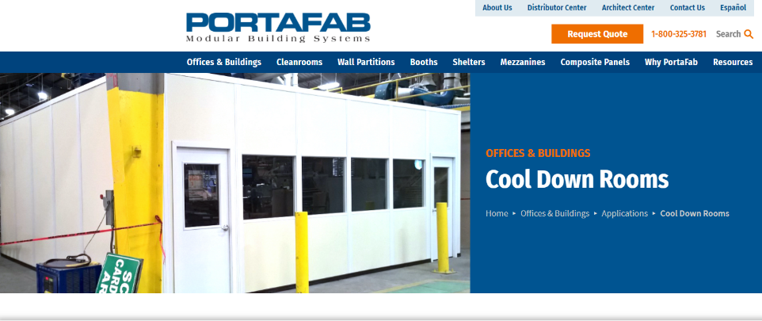
Cooldown Room
Shared idea
Sea Can with air conditioner (easy to move)
Benches – no tables
Cooldown kits
Bags of ice
Has to be monitored – and cell phones? Trash can? Fire extinguisher?
Posters and heat stress info
First aid kits and sked sled
No food – just hydration products/water
Notes:
https://www.portafab.com/cool-down-rooms.html

Slide 52
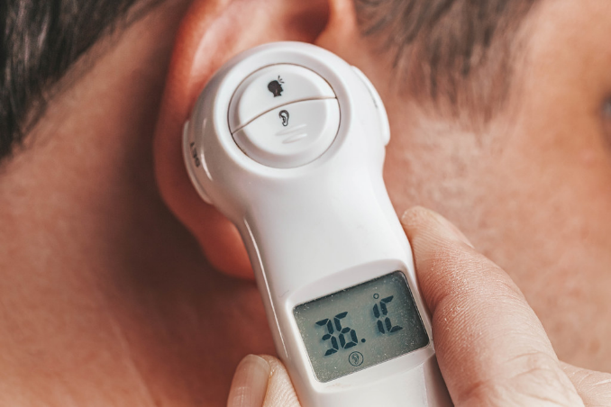
IMO: Absolute best way to know?
You can’t fake temperature!
Notes:
https://www.bing.com/images/search?view=detailV2&ccid=QETIUEE2&id=9EEAAC0C552380F32DAF7CB47B4B1FAA6696E17A&thid=OIP.QETIUEE26eWg74gQEDz7twHaE8&mediaurl=https%3a%2f%2fc1.staticflickr.com%2f1%2f65535%2f49236067786_d903becfc2_b.jpg&cdnurl=https%3a%2f%2fth.bing.com%2fth%2fid%2fR.4044c8504136e9e5a0ef8810103cfbb7%3frik%3deuGWZqofS3u0fA%26pid%3dImgRaw%26r%3d0&exph=683&expw=1024&q=ear+temperature&simid=608040109392035338&FORM=IRPRST&ck=2A147F2DC0FA77DBB3169615413E415F&selectedIndex=6&qft=+filterui%3alicense-L2_L3_L4&ajaxhist=0&ajaxserp=0
Free to use and share commercially – 10/19/2021 @12:26 p.m.

Slide 53
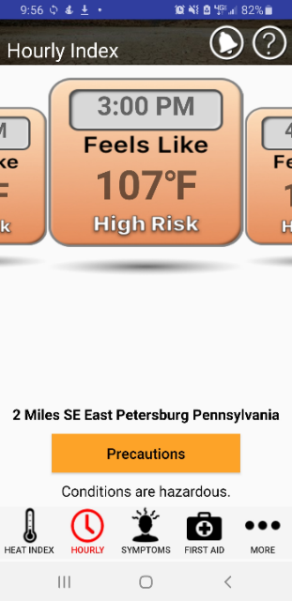
https://www.cdc.gov/niosh/topics/heatstress/heatapp.html

Slide 54
Support Information
Great training and handout tools
https://www.cdc.gov/niosh/topics/heatstress/default.html
https://www.cdc.gov/niosh/mining/UserFiles/works/pdfs/2017-124.pdf
https://www.cdc.gov/niosh/mining/UserFiles/works/pdfs/2017-126.pdf
https://gacc.nifc.gov/nwcc/content/pdfs/safety/DOD_Urine%20Color%20Test_Poster.pdf
https://www.osha.gov/otm/section-3-health-hazards/chapter-4
https://www.cdc.gov/niosh/docs/2016-106/pdfs/2016-106.pdf
https://repository.tcu.edu/bitstream/handle/116099117/4472/James_tcu_0229M_10430.pdf?sequence=1&isAllowed=y
https://www.tdi.texas.gov/pubs/videoresource/stpheatst.pdf

Slide 55
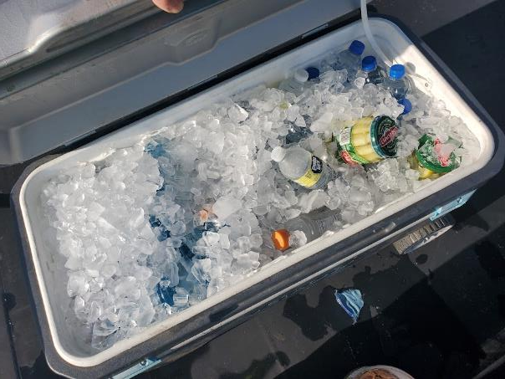
Review
The Problem
Exposures
Symptoms
Prevention

Slide 56
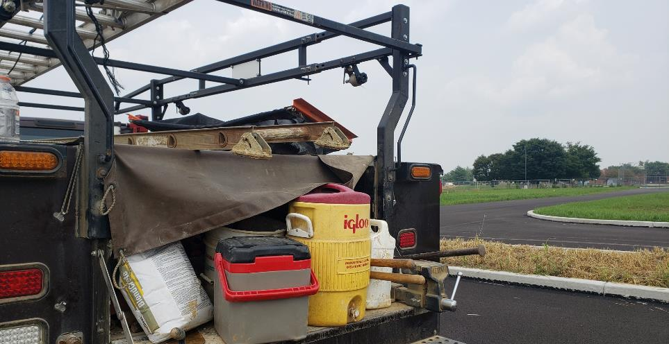
Questions?
Joseph_sanna@pmagroup.com

Slide 57
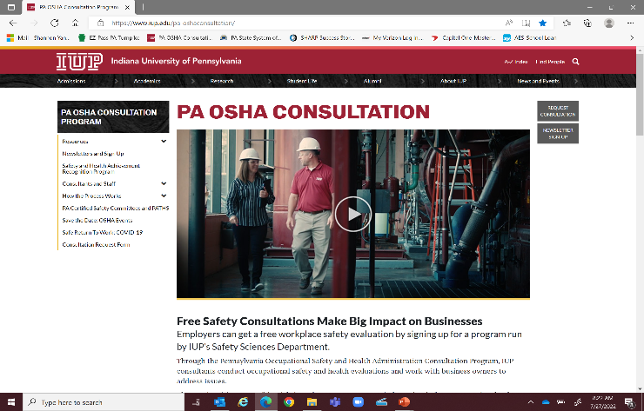
www.iup.edu/pa-oshaconsultation
www.iup.edu/pa-oshaconsultation

Slide 58
Contact
Pennsylvania OSHA Consultation Office
Phone: 800-382-1241
Website: www.iup.edu/pa-oshaconsultation/
Facebook: https://www.facebook.com/Pennsylvania-OSHA-Consultation-Program-548810235234647/
Twitter: https://twitter.com/search?q=PA%20OSHA%20Consultation&src=savs
www.iup.edu/pa-oshaconsultation

Slide 59
Thank You
Upcoming Webinar:
Beryllium & the OSHA Standard
October 5, 2022@ 10:30am
Pennsylvania OSHA Consultation Office
Phone: 800-382-1241 or 724-357-4095
Website: www.iup.edu/pa-oshaconsultation
www.iup.edu/pa-oshaconsultation

